Slide 1
Today – more making models (workbook 011)
Using categorical features (encoding).
Visualizing and exploring categorical data.
Practice with regression. This is really the most important – do the steps make sense?
Next – imputation and pipelines – the tools we need to handle generic problems.
Read – Intro to Machine Learning in Python (PDF on Moodle).
Chapter 1 (intro, some of the details on libraries and stuff you can skip).
Chapter 2 – Intro part (~27), “Linear Models” (~47 – not the classification parts).
Chapter 4 – Categorical and One-Hot Encoding.
The text ‘chunks’ things in a somewhat awkward way – ignore things we haven’t touched.

Slide 2
Categorical Features

Slide 3
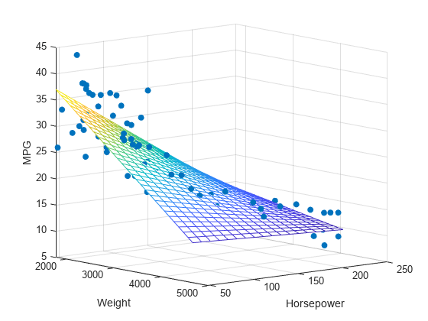
Regression Review
Up until now we’ve been looking at one type of predictive model – linear regression.
Linear regression allows us to predict a value:
We have several inputs, X1, X2, X3….
We have one target – Y.
The algorithm generates a line (plane) to predict Y based on the Xs.
The location of the plane minimizes squared error.
The actual prediction can be calculated out by hand:
Y_pred = X1*m1 + X2 *m2… + b
Where Xs are our features, and the Ms and the b are what the model “learns”.

Slide 4
What if we Have non-Numeric inputs?
The linear regression calculation depends on having numbers.
What if we have a model that predicts the net worth of a person?
Some of the features we use might be ‘job’ or ‘city’.
These can hold a lot of useful value in predicting someone’s worth.
We can’t go net_worth = JOB*m1 + CITY*m2 + b
Using categorical data requires a transformation first.
We must make categorical values into a number, so our models can math them.
This is called encoding our categorical variables.

Slide 5
Encoding Categorical Variables
Encoding just means changing labels into values.
Math doesn’t work with words, so we must remove them.
There are several ways to do this.
How well our representation matches reality will impact performance.
I.e. we need the converted data to mean the same as the original data.

Slide 6
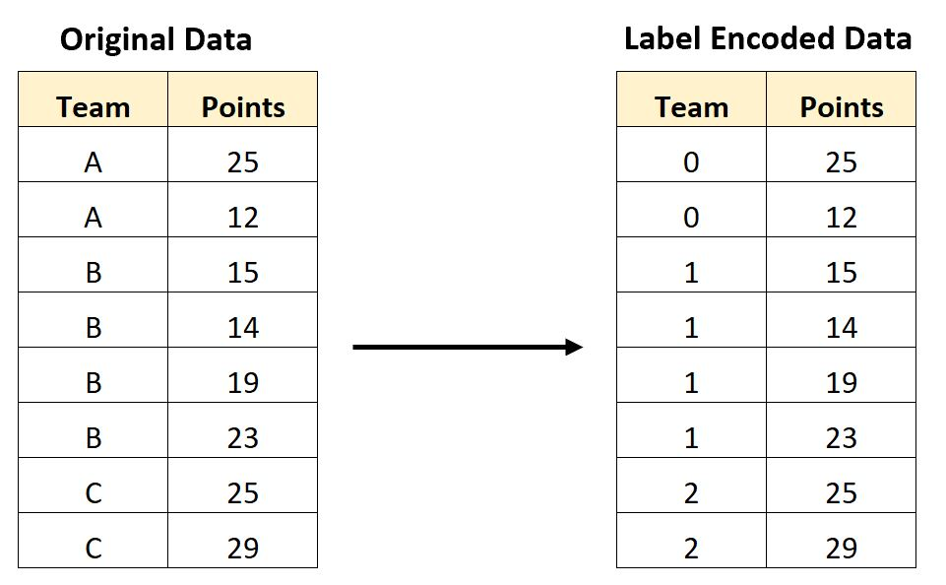
Label Encoding
The simplest way to encode data is label encoding.
Assigns each possible value some number.
E.g. blonde->1, brunette->2, redhead->3
Pros:
This is very easy and basic to understand and do.
It is easy to translate back and forth from real data.
Cons:
Numbers are in order after we assign the labels.
These numbers imply an ordinal relationship in the data.

Slide 7
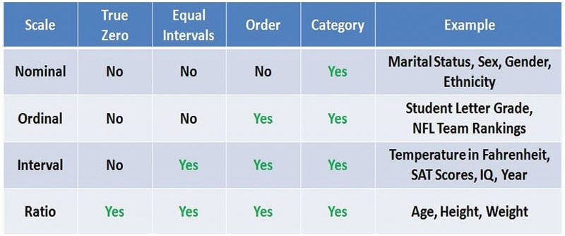
Ordinal Relationships
Way back when we looked at data types there was one split in categorical data we mostly ignored – nominal vs. ordinal.
Ordinal data – denoted by category, but there is an order or ranking.
E.g. a Likert (class satisfaction) scale. Strongly agree, agree, neutral…
Nominal data - denoted by category, but there is no order or ranking.
E.g. hair color, city you live in.

Slide 8
Label Encoding Issues
Using label encoding makes the data that we use ordered, even if not intended.
E.g. for predicting a loan approval:
Numerical data of “years at job” is a value 0 and up.
Label encoded data of “profession” is a value 1, 2, 3…
A linear regression model sees these in the same way – professions are “ranked”.
This can introduce error to our model, especially with lots of categories.

Slide 9
There must be a better Way!

Slide 10
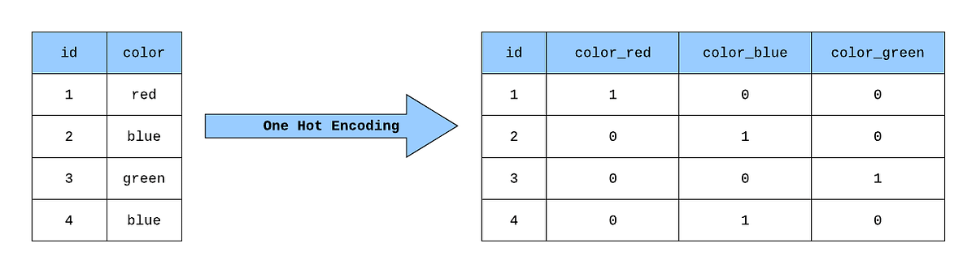
One-hot Encoding
An alternative method is One-Hot Encoding.
One-hot encoding does a more elaborate transformation on the data:
For each categorical column, we create one column per possible value.
The value that was true gets a 1, the rest get a 0.
Does not imply order in the data.
Generally better for ML usage.

Slide 11
Doing Encoding
Using encoding is simple in practice:
Pandas get_dummies will do one-hot encoding.
Sklearn functions can also do it. (We’ll see more of these later).
We normally do this right before putting the data into our ML process.
We don’t want to explore or manipulate data that’s been encoded.
We can convert right as we are creating the datasets for the model.
This is pretty universal for almost all scenarios of machine learning.

Slide 12
One-Hot Drawbacks and Concerns
One-hot encoding can dramatically increase data width.
This can cause ‘overfitting’ – something we’ll explore more soon.
We want many more rows than columns, so that can be an issue.
If any categories are “high dimensional” (have many values), we may need to condense first.
One-hot is the standard way we deal with categorical data.
There may be misidentification of what is categorical from Pandas.
Most likely, a numeric value becomes categorical because pandas sees a text value in it.

Slide 13
Visualizing Categorical Features
With numerical features we look at two main things visually.
Distribution (range, skew, variance) of the data.
Relationships (correlation) between variables.
With categorical features, our visualization is a little different.
Boxplot
Countplot

Slide 14
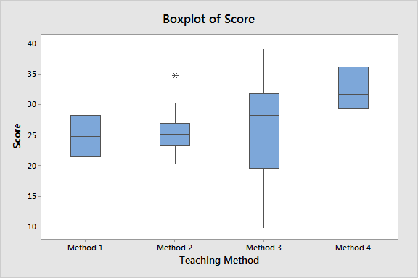
Boxplot
Splits the data by category. Shows the distribution of (usually) target for each.
Good if we want to see if different groups have different results.

Slide 15
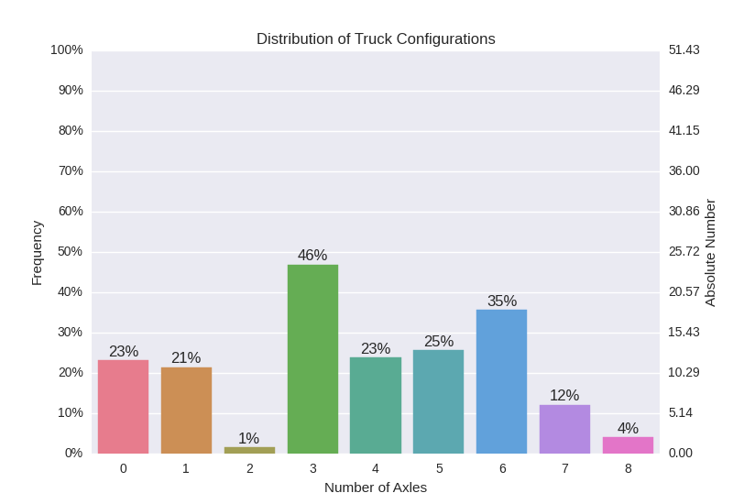
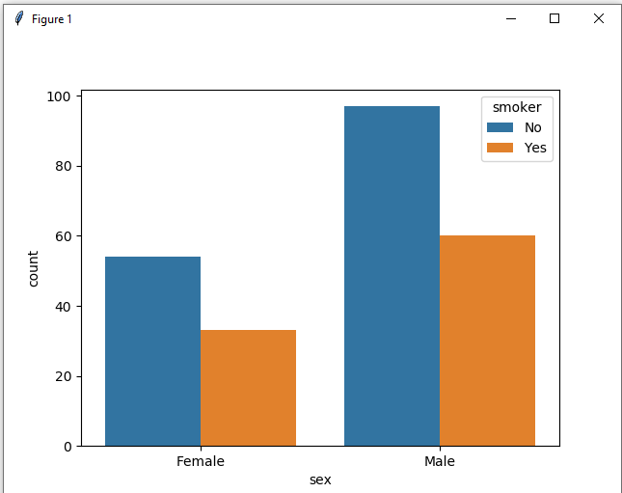
Countplot
Countplots show us how many are in each group.
Can be split by categorical target (in a few classes).

Slide 16
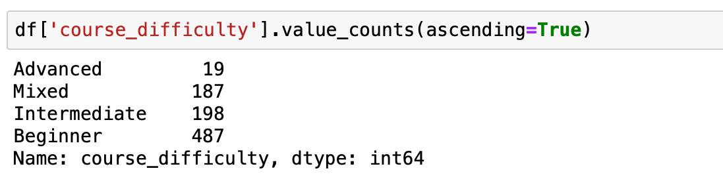
Numerical Exploration
Value_counts will give us the counts in a numeric way.
Describe will tell us the mode and the number of values.

Slide 17
Dealing with Categorical Data (for now)
For cleaning categorical data, there are a few things we can think of now.
A group has very few values in it (from countplot or value counts):
Think about removing them, or grouping into an “other” group.
E.g. When predicting a loan, a “job” column might not have many “trapeze artists”.
If groups don’t indicate variation (from a boxplot):
If the distribution of the target for different groups are all the same, then knowing the group may not be very useful in predicting the target.
Too many groups (from describe, or other):
Consider consolidating, or even dropping the column if it can’t be cleaned.
E.g. a “job” column may have “bank teller”, “teller”, “CSR”, “Cust. Serv. Rep”, etc…

Slide 18
Categorical Features
We use categorical features all the time, as they hold a lot of value.
The processing and prep of these features is different from numerical ones.
We need to encode the categorical data, or make it into numbers.
Label encoding -> best when there is a clear ordinal relationship.
One-hot encoding -> best in every other scenario (do this if unclear).
Failure to properly process categorical data can lead to issues in the model.
Categorical data will not be understood correctly.
Model may become too ‘sparse’ – too many columns of data.

