Slide 1
Housekeeping
Today (015):
Hyperparameters
Grid search and HP tuning basics.
Making models a bit better by changing their configuration options.
Chapter 5 covers this in detail in the text (ignore multiclass parts for now).
Next:
Review exercise on this stuff and/or using this with new model types (tree).
The code changes with new models are minimal, but the way they make their decision is different internally. If you’re ok with the mechanics, then we can proceed. If they are hard and/or confusing, then we can review and fix that.

Slide 2
Grids and Hyperparameters

Slide 3
Quick review – Logistic Regression
Logistic regression is a classification model – predicts True/False.
Internally based on a linear regression that predicts logit – log odds.
Some math converts that logit into a “probability of True”.
The closeness of that prediction feeds the cost, used to find weights in G+T grad. Desc.
We can get errors that are different, and may need error metrics that are different.
False positives vs false negatives – both wrong, but opposite impacts on reality.
Confusion matrix and assorted metrics (f1, prec, recall, etc…) may do better than accuracy.

Slide 4
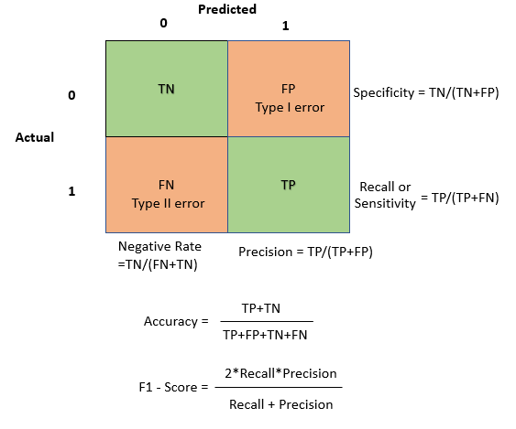

Slide 5
Modelling
We can now make some predictive models for most scenarios:
Including any number of categorical and numerical inputs.
Predicting either a binary class or a raw value.
With an accuracy metric telling us how much we can trust the predictions.
We generally want to make the models as accurate as we can, there are several ways:
Get more or better data - this is the best.
Choose a different model type that “fits” the data better – we’ll do that next week.
Manipulate the hyperparameters – the rules and settings that control the model’s creation.
Today we’ll look at the tool we can use to automate the bottom option.
Guess and test is needed, so we want to make it easy on ourselves.

Slide 6
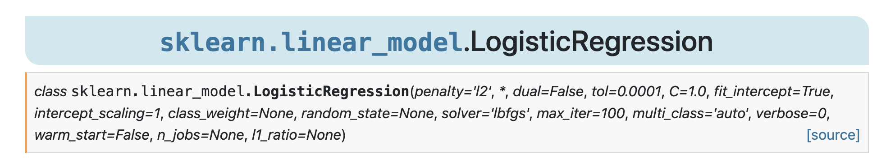
Hyperparameters
We looked briefly at using hyperparameters to make accurate models.
Each algorithm has different hyperparameters and different options.
Hyperparameters are variables set ahead of time that control the training process.
They are basically the “settings” for how the model is created.
We can’t evaluate optimal HP ahead of time, we need to set them and see the results.
Trial and error!
Hyperparameters are what we set, parameters are what the model learns.

Slide 7
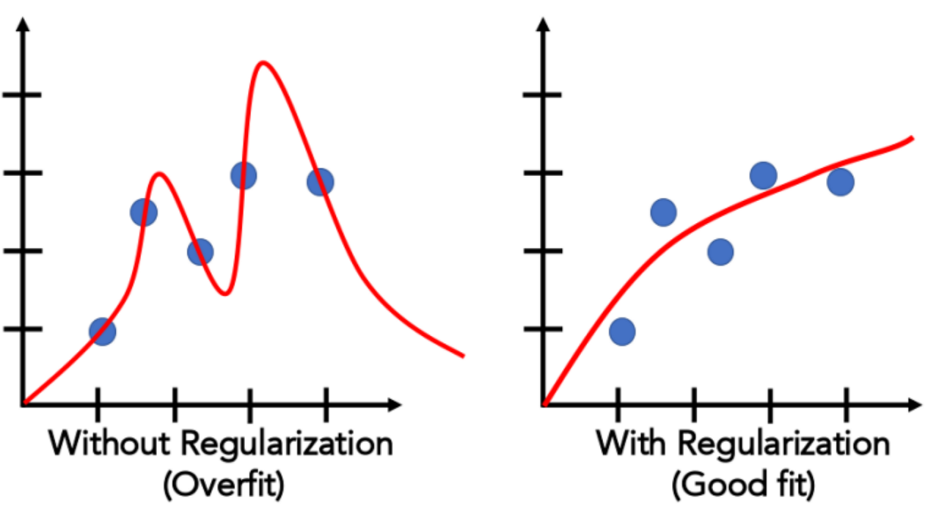
Hyperparameter Impact
Hyperparameters have a major impact on the performance of a model.
Some other model types we’ll see next week are more impacted than regression ones.
Can change the ‘shape’ of data modeled, how many features to use, the complexity, the speed, etc…
One major tool to improve accuracy is to select optimal hyperparameters.
Differences in accuracy can be night and day with different HP combos, but it varies widely.
Hyperparameters also control more general rules:
Limit on iterations, number of threads, how much to print, etc…

Slide 8
Grid Search
We could loop through different combinations of HPs and collect scores.
Complex and clumsy – multiple nested loops.
Sklearn provides a simplification – GridSearchCV.
Grid search takes a list of HP values we want to try, checks every combination, and returns the best model.
Same result of looping through each value.
Also a randomized version – for when we have no idea what HP values may work.
CV = cross validation….

Slide 9
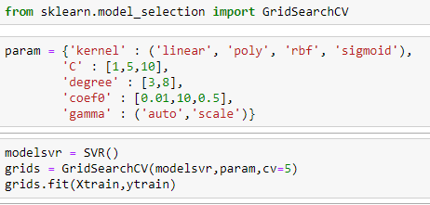
Hyperparameters
The grid search takes in a list of values to try for each parameter you want to change.
A model is made for each combination of parameters that you provide.
Can become a time issue with large sets.
Every model has different possible HP choices.
The GSCV object works just like a pipe in code.
Results in the best performing model of those tried.
We can specify a scoring metric, or take default.

Slide 10
Grid Usage
The grid search will automate the trials that we’d have to do manually.
We get the best model of all possibilities.
We are still limited by providing a non-massive good set of options, which isn’t always clear.
There are other approaches to this automated testing process that can be smarter.
Some things have large numbers of possible options, or wide ranges for numerical HPs.
We generally don’t know exactly what a good set of things to try is.
For numerical values, dialing into an exact value is even more challenging.
Randomized search will try random values – good if we have no real idea.
Halving grid search in sklearn uses a smarter approach to find good combinations.
We can get information out of the GSCV after training by grabbing its attributes.

Slide 11
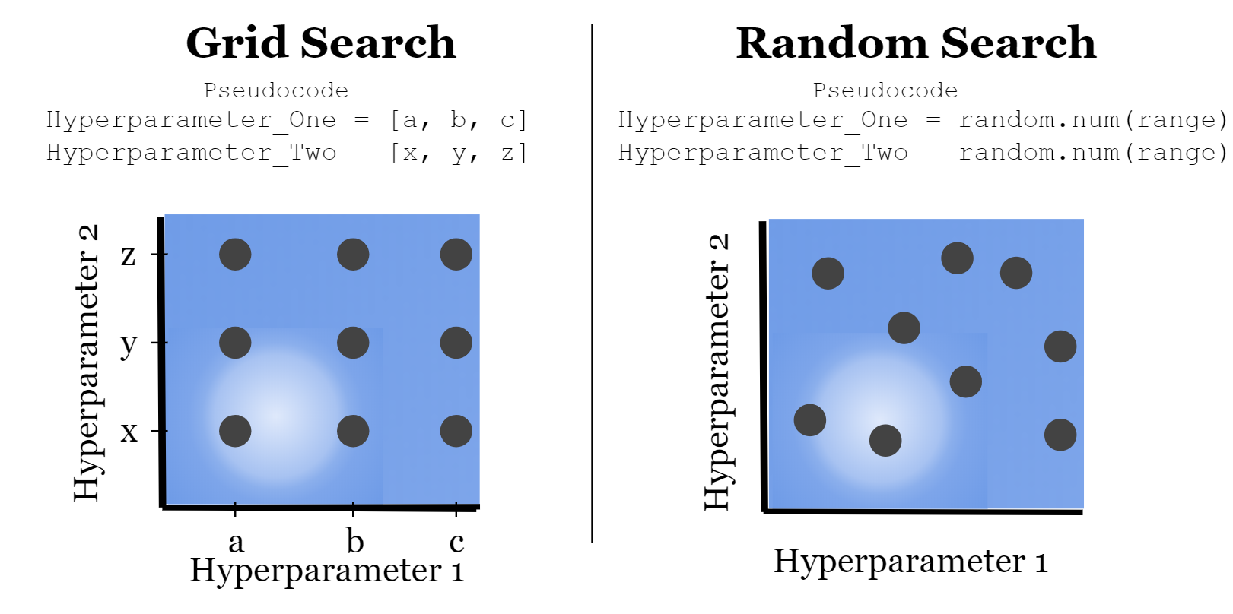

Slide 12
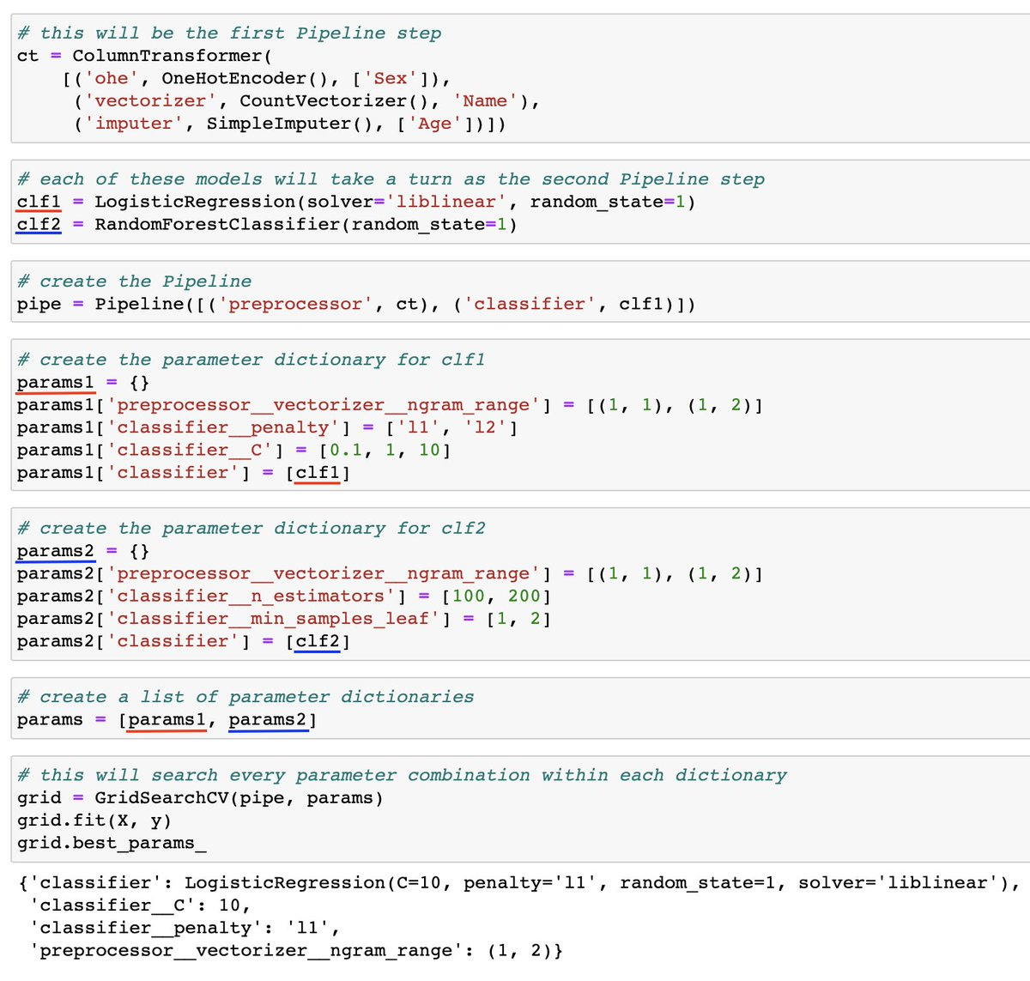
Grids and Pipes
This example is a (too) complex one.
Important:
We can refer to items by name.
Each ‘layer’ is separated by a double underscore.
We can access any hyperparameter this way.
This can be any # of layers deep, each layer just adds a double underscore.
We can also tell the grid search to use different error metrics – f1, recall, etc…

Slide 13
Running Tests
The grid search will run many trials, and calculate the error for each.
We are used to splitting data when building models:
Training data (~70%) used to create the predictive model.
Testing data (~30%) used to evaluate the accuracy of the model.
This split allows us to accurately assess the accuracy on “new” data, and compare models.
What if a split disproportionately benefits or hurts one specific HP combo?
A small difference in results may foist a non-optimal model on us.

Slide 14
Train-Test Split
We are used to splitting data when building models:
Training data (~70%) used to create the predictive model.
Testing data (~30%) used to evaluate the accuracy of the model.
This split allows us to accurately assess the accuracy on “new” data.
Problem – random splits in the data can lead to variance in results:
Think of drastically different trees we get when data is split differently.

Slide 15
Cross Validation
Cross validation addresses this problem by repeating the split-test concept repeatedly.
K-fold Cross Validation:
Randomly split the data into K subsets.
Use k-1 set for training data.
Use the other set for testing data.
Repeat for all K subsets.
Average results together.
Mitigates variation from data randomly in one set or the other.
K of 5 to 10 is typical.

Slide 16
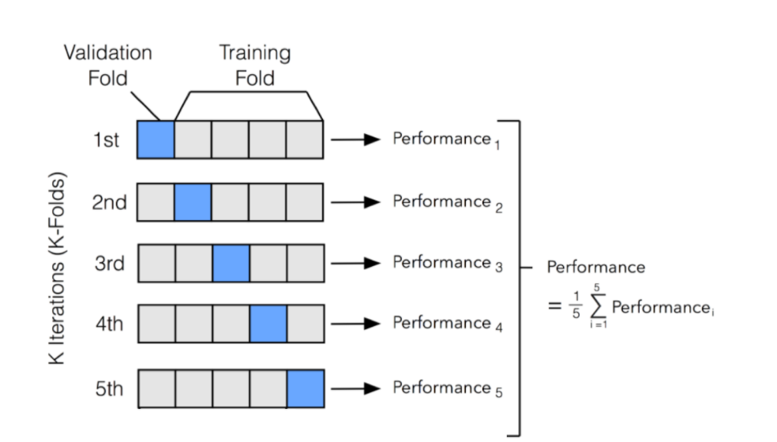

Slide 17
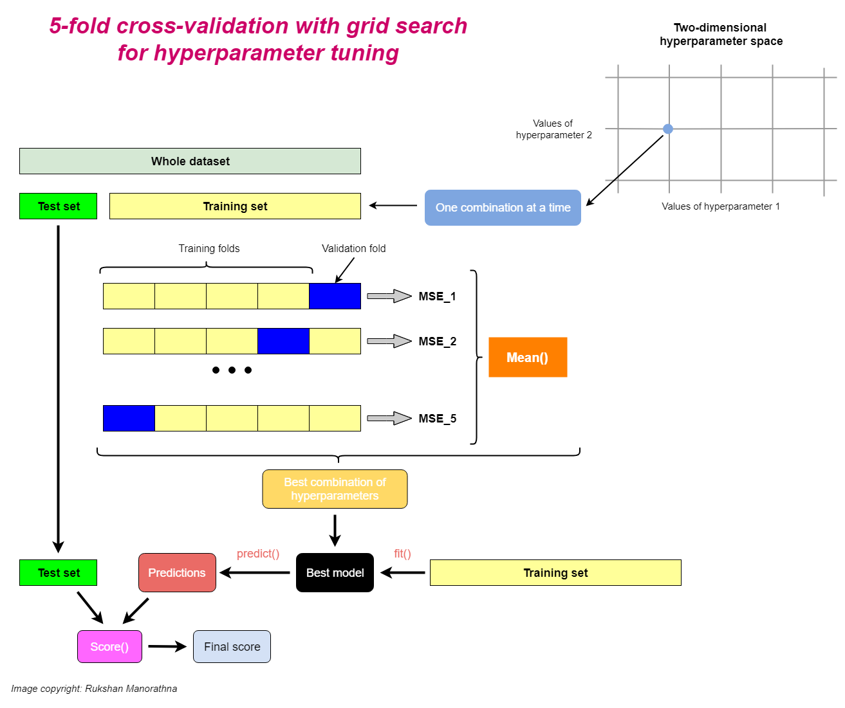

Slide 18
Cross Validation Scoring
We can use the cross validation in place of the score function to do CV scoring.
Results will generally be more stable and consistent, at a cost of time.

Slide 19
Grid Search CV
Grid Search CV combines these two into one simple call.
Test every HP combination.
Use cross validation to calculate scores.
Identify best model.
In place of one “normal” score we get the cross-validated score, and best HP combo.
Time of grid search cv can explode:
Every combo of parameters gets a model.
Each model gets made K times.
If either of these gets large, or if the data is large, the time can grow. Sampling may be needed.

Slide 20
Conclusion
We use grid searching all the time when we need to select hyperparameters.
If we care about performance, this is kind of an assumed step.
Guessing and checking is a major way to create accurate models:
Grid searching, or its alternatives, allows us to find HP combinations automatically.
Cross validation helps us get reliable scores, combating random variation.
Other technologies like neural networks have similar tools available.

