Slide 1
Housekeeping
Today – regression review exercises.
Practice of both linear and logistic regression.
Exploration and data cleanup – with extra bonus stats!!!!
Using pipelines and column transformers to make the data prep easier.
Next week – using different models for classification/regression:
Other models work differently, have different strengths, and give different results.
Most of the code stays exactly the same (exploration, most prep and pipelines, results).
HP tuning and making our models better will become more important – we want to pick the best.
We’ve covered the basics of making (reg/clas) predictive models – you can solve most problems!!!
Book (ItMLwP) – done chapters 1,2,4,5,6 (except diff models)

Slide 2
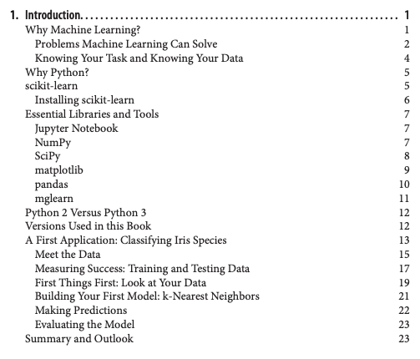
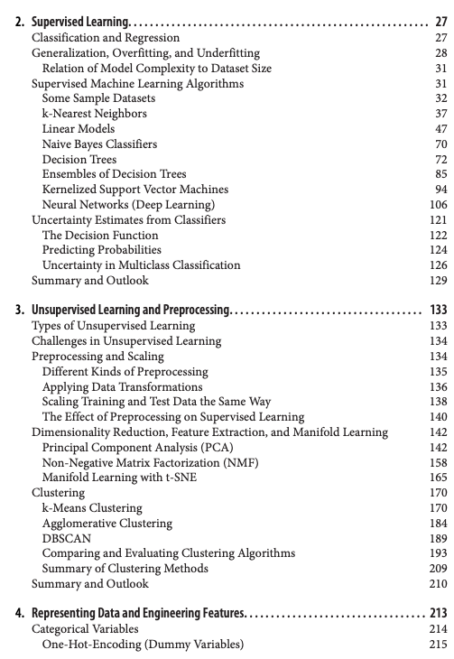
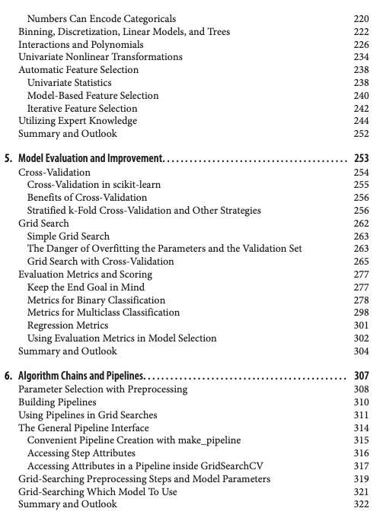
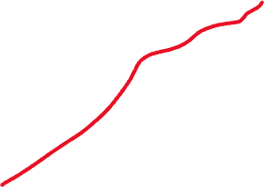
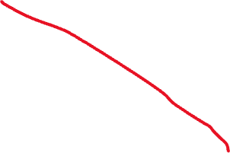

Slide 3
Regression Review – With bonus Stats

Slide 4
Data Exploration
We always do at least some exploration of data prior to making models.
Numeric exploration via info, describe, etc…
Visual exploration via pairplots, countplots, boxplots, etc...

Slide 5
Preparing Data With Stats
We can use what we see in our data to help us think of changes we can make to prep it for modelling.
We can use our knowledge of what may have predictive value to make some judgments.
None of these things are definitive improvements, we need to check.
There is random variation, especially with small data.
Other model types of hyperparameter combos may perform differently.

Slide 6
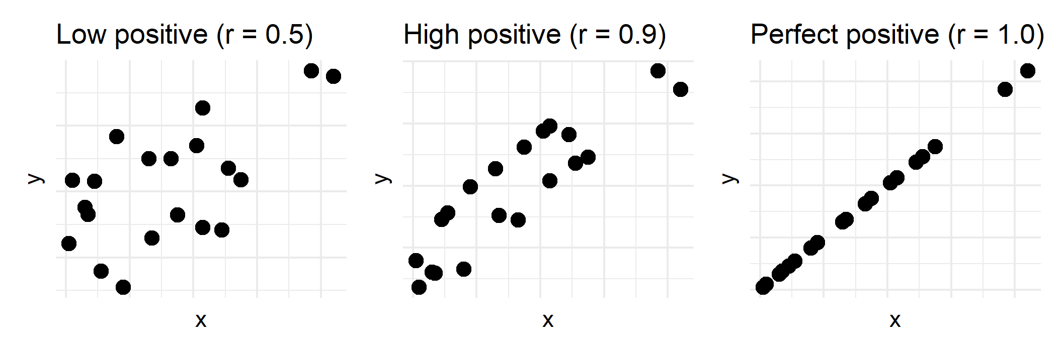
Predictive Value
We want to have features that have predictive value.
I.e. knowing the feature helps us predict the target.
This is most simply seen in correlation – categorical have chi2 which is ~equivalent.
Features that have some ‘correlation’ with the target are good, those that don’t aren’t.*
Think – “if I know what this feature value is, does that tell me about the target?”
We can see this correlation in our exploration, to a degree.

Slide 7
But…
Features being correlated with the target is good, but a simplification.
The magic of ML is the models can capture more complex, invisible, relationships.
E.g. a combination of 397 features can be highly correlated with the target.
Our inspection in 1-3 dimensions can help, but isn’t everything.
We won’t find a deterministic set of actions to take that will give the best model.
Our brains’ “r-squared” in this scenario can be pretty low.
We can get rid of things that are useless, and take attempts at improvements, but we need to test and check the results to know if changes are actually good.
We can do a pass here to help, but we aren’t calculating the answer.

Slide 8
Nothing is Real
When we are trying things like this, it is weird and often not intuitive.
The goal is to create a dataset that represents some real-world thing, in a way that allows a ML model to predict the target accurately.
This is not the same as doing manipulations of our original data.
The representation is not a defined, real thing, we are creating it from our data.
Our dataset isn’t reality, it is one snapshot of some metrics, from reality.
Changing the data to make it “more legible” to the model, is ok. Like phonetic spelling.
Simple things here are required, the more elaborate things are more of an art.

Slide 9
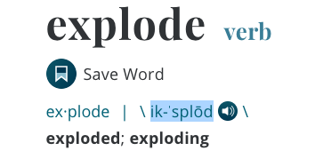
Hooked on data
When kids learn how to read, they may be ‘trained’ on phonetical data.
This alternate representation of actual language allows the model (a kid) to learn better.
The real text is transformed into the pheonetical representations.
Our models are similar – we want to be able to predict accurately.
If some alternate version of the data we have allows them to learn better, that’s good.
We can do whatever we need to (encode, scale, transform) as long as it helps the model.

Slide 10
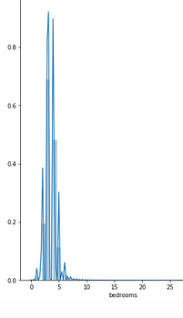
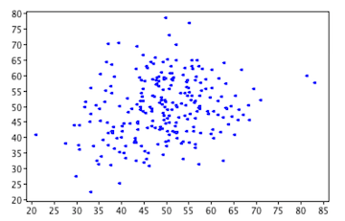
Some things that may not be useful…
Some patterns indicate that variables may not be that helpful:
Little to no correlation with the target.
Little variance (i.e. almost everything has the same value).
Seeming randomness with no correlation to anything. (I.e. ‘sum of phone number digits’ as a feature – the value has no connection with anything meaningful).
Huge number of classes with very small numbers in each/most.
Fully or mostly redundant features. I.e. ‘Province’=‘Alberta’ and ‘Province_short’=‘AB’.*
Having multiple features that all have the same information is called multicollinearity.

Slide 11
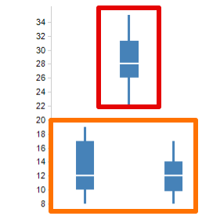
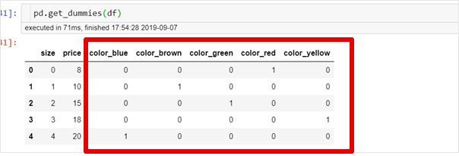
Some Categorical Things that May Be Changed…
If one class is very different from the others, maybe this could be grouped into T/F.
If there are small classes with similar distributions, they may be better grouped as “other” (or something).

Slide 12
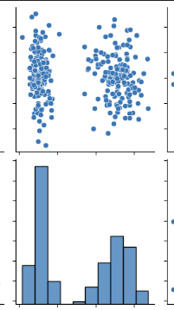
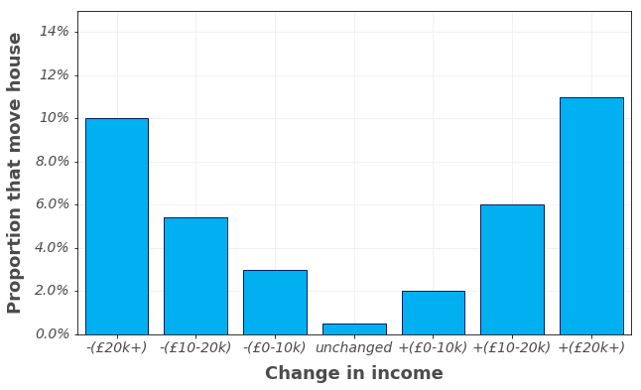
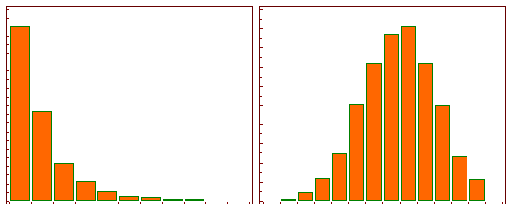
Some Numerical Things that Could be Changed…
If there are clear groups in the distribution with a separation between them, maybe that would be better as a categorical.
If there is a value that could be converted to a normal distribution (i.e. using a log() function on a log-normal distribution), it may yield better results after.
Many models (including regression) will usually give better results if inputs are normal-ish.
Other transformations to make things normal are common in stats work.
If there are lots of rows with one value, is that plausible? Is it a placeholder, default, actually a missing value, or something?

Slide 13
Process
During data exploration, we note if anything looks like it may need to be changed.
If something is clear, we can just do it right off the top.
If something is more of a maybe, then we can hang on to the ideas.
Create a model as you would normally and check the performance.
In particular, check if there is wide variance on the cross-validation results from the grid.
Create a copy of the data, make the changes you want to try, and model again.
If the results are the same or better, then your data changes are definitely good.*
If the results are a bit worse, then its still debatable. Make some tweaks, then make a judgment depending on the real scenario.

Slide 14
Goals
Removing features from a model will usually not result in a climb in raw accuracy.
The worse the feature was, and the worse the model was, the more likely an increase is.
We may get less variability – we will get a model that is more stable.
A smaller model is usually a better model.
Easier to explain and understand, faster to make and use, cheaper to gather/store data for.
If we can get similar performance with a smaller model, that’s usually better.
We need to use judgement to evaluate a reasonable balance.

