Slide 1
Housekeeping
Today:
More trees – practice with larger and more realistic exercise.
Regularization – fight overfitting (semi-)automatically.
Marks and such:
I’ll hopefully finish marking the regression assignment tomorrow or Saturday.
I’ll finalize the next ML assignment, on classification, this weekend. Like the last, a bit more complex.
In a week we’ll open the final project as well – in groups, a larger version of these two assignments.
We’ve covered most of the core concepts – just more practice and variations on tools/techniques.
The stuff we’ve done lets you predict almost anything, now add depth of understanding, improve performance, expand toolkit of preparation steps, etc…

Slide 2
Classification Trees Part 2 and Intro to Regularization

Slide 3
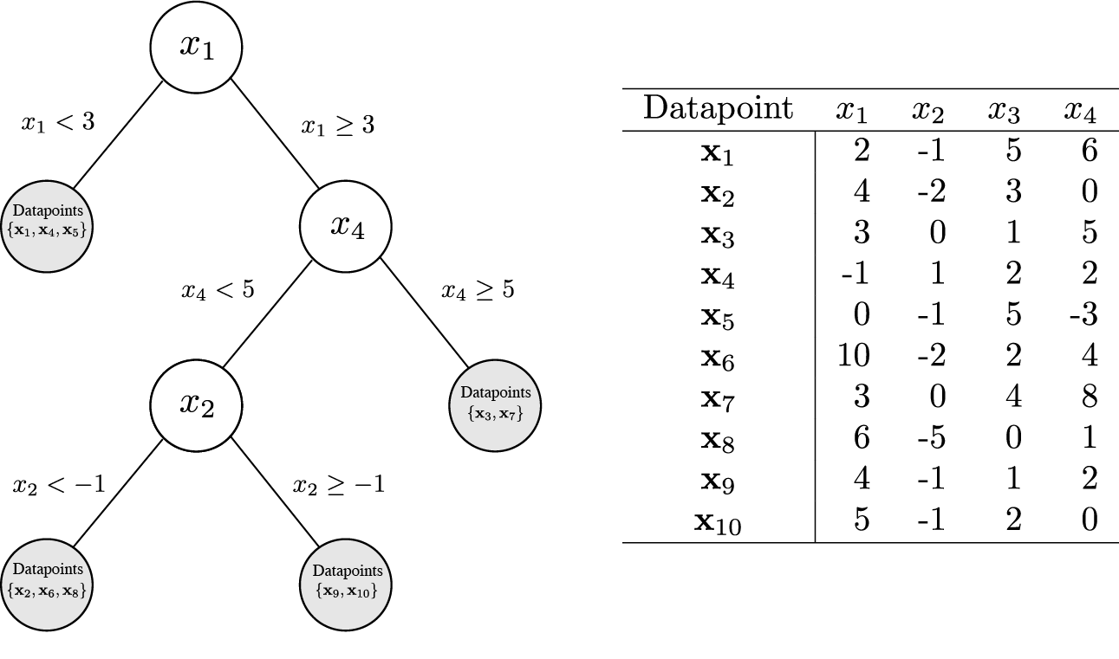
Trees – Remember Them
Last time we looked at a new type of model – a decision tree!
These models do the same things (class. and reg.) as LinReg/LogReg, but they use totally different math to create a totally different model that predicts.
Regression models translate X to y by figuring out weights and doing a linear combination (y = mx + b).
Tree models translate X to y by figuring out which split (on an X) will lead to the best result (most pure).

Slide 4
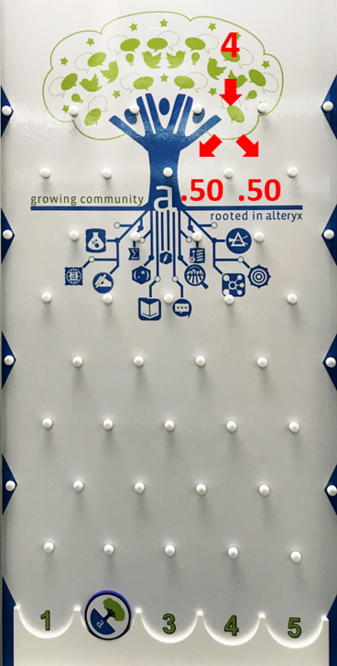
Keep ‘Em Separated
The model in a tree is basically plinko – data goes in the top, and follows a path based on the decisions.
Trees decide on what to split on by calculating the maximum increase in purity.
This is calculated by either the similar Gini or Entropy metrics.
0 means that a node is all 1s or all 0s, 1 means that it is a 50/50 mix.
These splits keep happening until we hit a limit, or all nodes are pure.
Leaf nodes are at the end, that is the prediction for that group.

Slide 5
Why the Trees?
Trees have different strengths and weaknesses compared to regression models.
Trees are far more flexible (reactive); they can learn more complex relationships in data.
This can be seen when looking at decisions, a tree can decide on any value, anywhere.
This makes trees more likely to be good when dealing with ‘natural’ things.
They can also overfit, or become too tailored to the specific training data to be useful.
Regression models have a “line” for a model that is an average, so this overfitting is unlikely.
Trees are more tuning-intensive for us to use, and are unlikely to be great OOB.
Hyperparameter tuning to limit the growth in different ways.
Regularization – changing the cost calculation to limit growth.

Slide 6
Going Bonsai
A major way to create a good tree is to use hyperparameter tuning.
Trees have many hyperparameters that are very impactful.
Depth limits.
Limits on splitting a node – minimum numbers, minimum improvement, etc…
Some combination will give the best result, so a grid is very useful.
Grid searches will do multiple splits and calculate average test scores.
We can get an idea of what to try by looking at the training and testing scores.
If training is far higher, we probably what to limit the tree size. (Less complex model)
If not, we probably want to try allowing the tree size to grow. (More complex model)

Slide 7
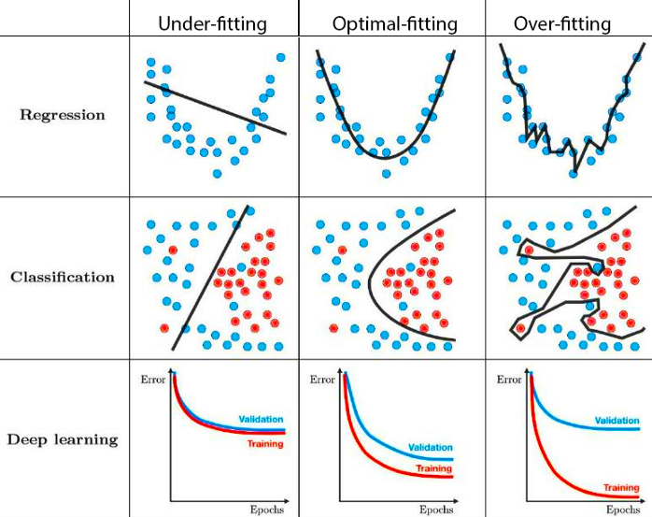
Fitting
We want a model to ‘fit’ the data:
Underfit models are not tailored enough – they need to learn more from the data.
Overfit models are too tailored – they need to be more generic to do well on new data.
More complex models can do more complex things, but need more data to not overfit.
Trees are prone to overfitting – they will get to 100% accuracy on test data without limits.

Slide 8
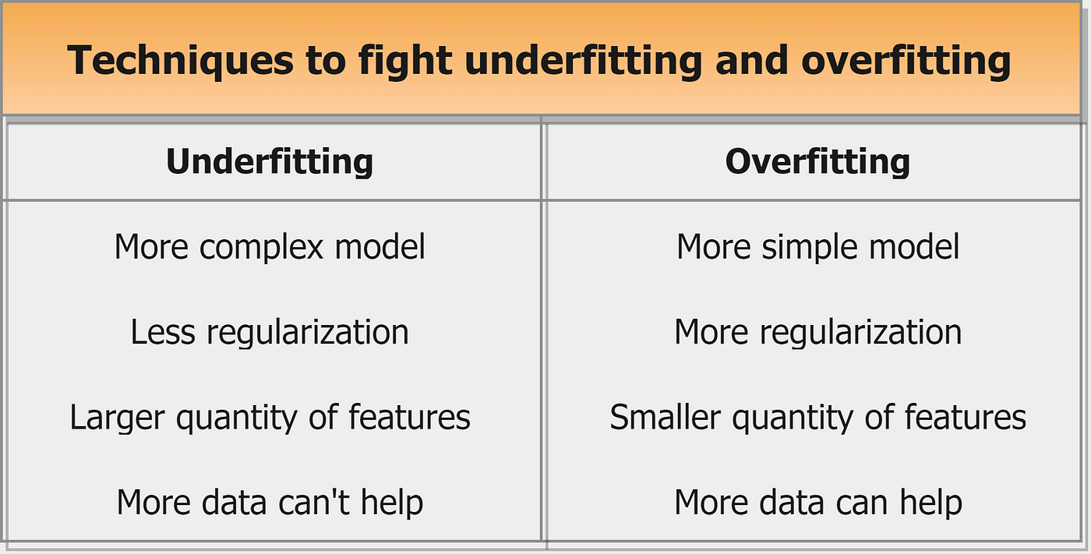
Work on that Fit
Balancing overfitting and underfitting is often the major concern of making models.

Slide 9
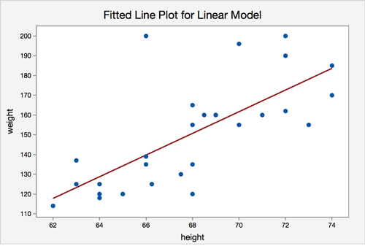
Complexity
This concept of complexity exists across machine learning.
The more complex the model, the more complicated things it can predict.
This has to do both with the type of model and the number of “weights”.
In a regression the weights are the slopes and the bias. X + 1 of them exist.
In a tree the “weights” are the decision points. 2^layers of them, max, exist.
Imagine a model predicting weight from height – one X value.
No matter what, the only thing the model can change is the slope and b (up/down)
E.g. you see a billion people of different shapes and sizes, but you can’t use any of it to help predict.
More features allow more stuff to make a prediction on. The size of a tree controls what we use.

Slide 10
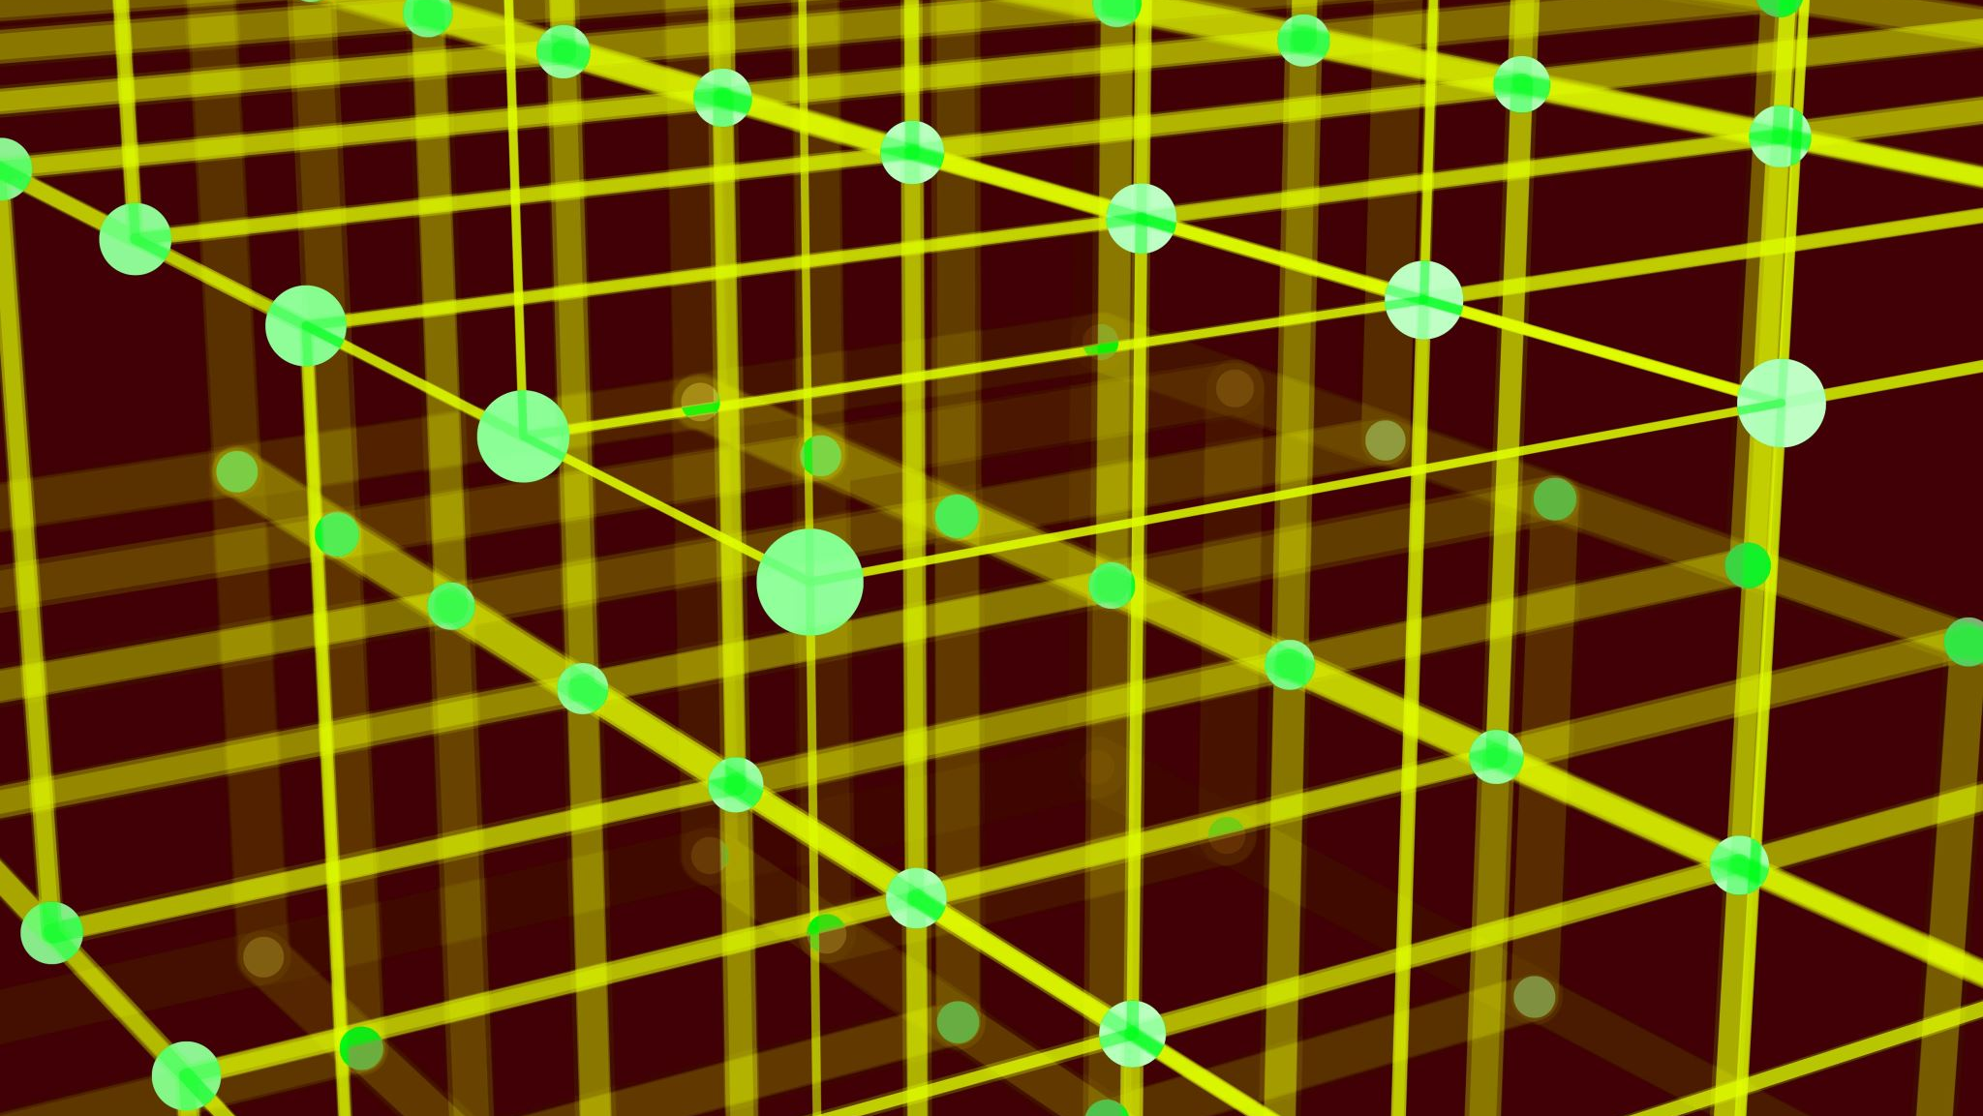
Regularization

Slide 11
What is regularization?
Regularization is another technique to limit overfitting of a model.
The concept can be applied in any cost-based model.
For trees the cost that is minimized is the purity (gini/entropy).
For regression the cost that is minimized is the MSE, for logistic it is log-loss.
Regularization is simple – a penalty is added to the cost calculation for growth.
The original goal of the algorithm is to minimize the cost – the amount of error.
Now it is to minimize the total of (cost + penalty).
This acts to force the model to balance growth and accuracy – i.e. less overfitting.
There is a hyperparameter that controls the balance of cost/penalty.

Slide 12
Regularization is Common
Regularization is one of the more common things used to limit overfitting.
The details differ, but the core concept is universal.
Strengths:
Easy to implement and not too slow to run.
Requires little manual input into the details.
Does not require any extra steps, it is built into the training process.
If the model makes errors, that’s bad. If the model grows, that’s also bad. The strength of regularization balances how much each matters in making the model.

Slide 13
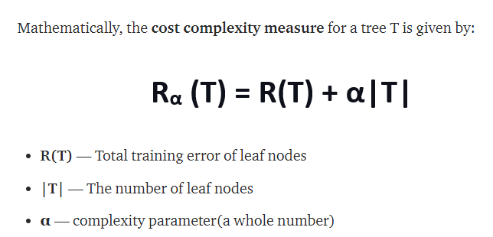
Cost Complexity Pruning
This the the cost complexity formula.
The first term is the cost – the error.
The second term is the penalty of growth.
The alpha scales the importance.
If alpha is 0, this is the regular process.
Effect – if the tree is going to split, that split needs to “overcome” the penalty to be allowed.
Only “bigger” improvements make it.

Slide 14
Cost Complexity Pruning
Cost complexity pruning is a way to reduce the complexity of a tree after it is made.
CCP finds the leaves that are least beneficial.
The complexity parameter is used to define the cost-complexity measure, Rα(T) of a given tree (or branch of a tree) T:
Rα(T)=R(T)+α|T|
Where |T| is the number of terminal nodes in T and
R(T) is traditionally defined as the total misclassification rate of the terminal nodes.
Parts of the tree that were least helpful are pruned.
Acts to limit tree size like hyperparameter limits, but dynamically based on the tree.

Slide 15

Be More Alpha
In the CCP equation Rα(T)=R(T)+α|T| the alpha-t is a penalty.
The larger the number of terminal nodes gets, the larger the penalty.
The larger alpha gets, the larger the penalty.
Effectively removes things that have many terminal leaves.
Larger trees will generate larger penalties in branches.
Tends to limit overfitting, as it stops large branches from being developed.
Adding a penalty to “size” is a common strategy.
If a split is going to happen, it needs to “overcome” the penalty incurred by increasing the number of terminal nodes ( |T| increases ).
R(T) needs to decrease, or more accuracy, to overcome alpha-T increase.

Slide 16
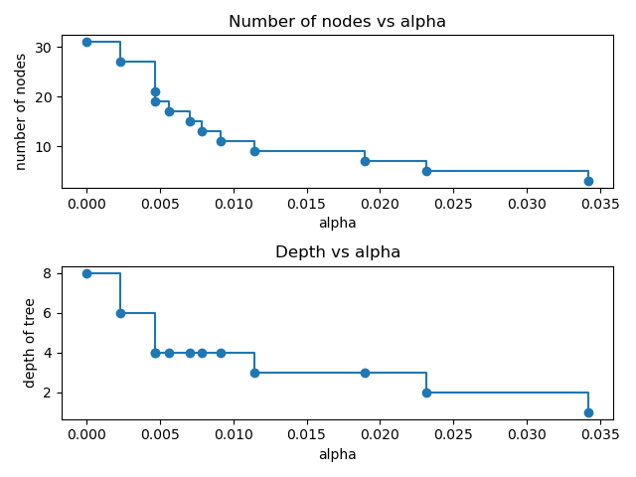
CCP in SKL
In sklearn we can apply regularization via the ccp_alpha hyperparameter.
The higher it is, the more the growth part of the cost will matter.
This will limit tree size.
Regularization is dynamic.
It will react to the data it sees and limit growth on its own, unlike a set of grid search limits.

Slide 17
Conclusion
Trees are more dependent on good tuning to be accurate.
We have to pay attention to overfitting – accuracy may not be a good thing in all cases.
Hyperparameter tuning is a way that we can limit overfitting.
Regularization is another way.
Adds a penalty to the cost that penalizes a larger, more complex, model.
Dynamically limits growth by forcing a split to “overcome” the penalty of a bigger model.
This idea exists in lot of models – as long as there is a cost that is being optimized we can do it.

