Slide 1
DevOps
Garth Fort
garth.fort@contoso.com

Slide 2
Agenda
DevOps with the Microsoft cloud
Enabling the DevOps pipeline

Slide 3
Why DevOps?
Isn’t DevOps another phrase for Agile?
Who is responsible for deploying code?
When deployments fail, who gets blamed?
How many production deployments do you perform per year? Month? Day? Hour?
What is stopping you from deploying faster?

Slide 4


Traditional Development + Operations
DEV
OPS

Slide 5

What is DevOps?
“It’s a job title”
“It’s automation”
“It’s Development and Operations collaboration”
“It means faster and smaller releases”

Slide 6






The DevOps conversation
DEV
OPS
1
People
2
Process
3
Products
Notes:
People = Culture
Fundamental attributes of successful cultures:
Shared mission and incentives: infrastructure as code, apps as services, DevOps/all as teams
You need to consider your hardware as a commodity, (don't give your servers names) , servers are like farm animals, it is just harder if you let theids name them
Build deep instrumentation into services, push complexity up the stack
Rally around agile, shared metrics, CI, service owners on call, etc.
Changing the culture: any change takes time, changing culture is no exception and you can't do it alone, exploit compelling events to change culture: downtimes, cloud adoption, devops buzz
PROCESS Definition and design, compliance, and continuous improvement
PEOPLE Responsibilities, management, skills development, and discipline
Products Tools and infrastructure

Slide 7
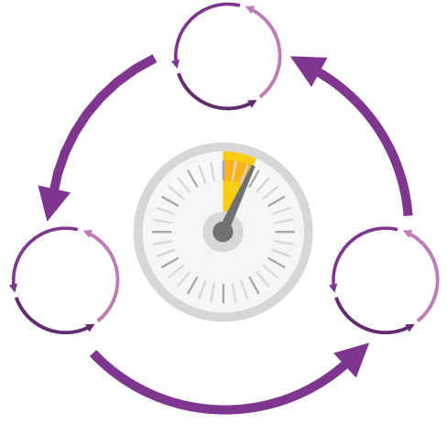
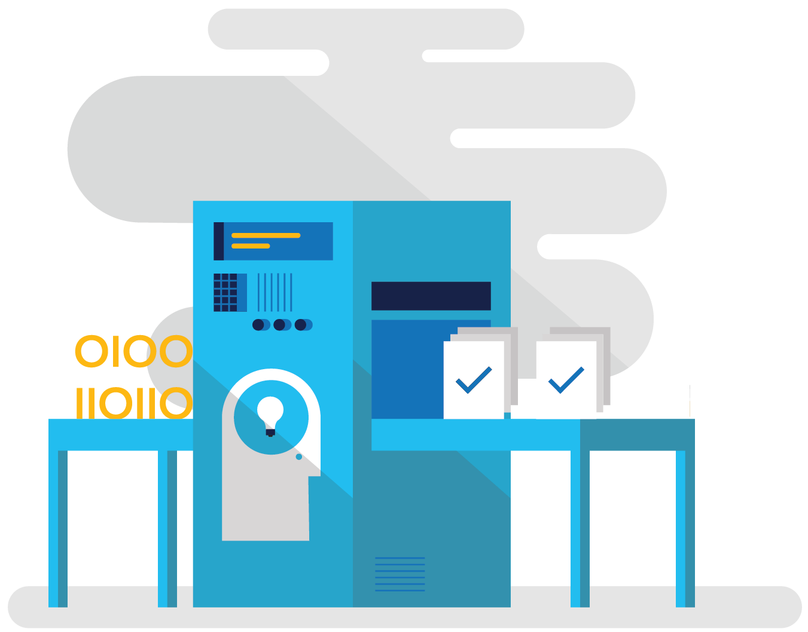
How DevOps can help
Shorten Cycle Times
Optimize Resources
Improve Quality and Availablilty
Speed up and increase traceability of each release by empowering your development and operations teams with advanced collaboration and automation tools.
Efficiently manage environments using technologies that support self-service provisioning in a secure way, in line with your IT governance standards.
Capture rich telemetry on application performance and usage so that you can make better decisions on future investments and anticipate issues in production before they impact your service.

Slide 8
DevOps habits and practices
PRACTICES
Application Performance Management
Infrastructure as Code
Continuous Deployment
Release Management
Configuration Management
Automated Recovery
PRACTICES
Automated Testing
Continuous Integration
Continuous Deployment
Release Management
PRACTICES
Usage Monitoring
Telemetry Collection Testing in Production
Stakeholder Feedback
PRACTICES
Code Reviews
Automated Testing
Continuous Measurement
FLOW OF CUSTOMER VALUE
TEAM AUTONOMY & ENTERPRISE ALIGNMENT
BACKLOG refined with LEARNING
EVIDENCE gathered in PRODUCTION
MANAGED TECHNICAL DEBT
PRODUCTION FIRST MINDSET
INFRASTRUCTURE is a FLEXIBLE RESOURCE
PRACTICES
Testing in Production
Usage Monitoring
User Telemetry
Stakeholder feedback
Feature flags
PRACTICES
Application Performance Management
Infrastructure as Code
Continuous Delivery
Release Management
Configuration Management
Automated Recovery
PRACTICES
Enterprise Agile
Continuous Integration
Continuous Deployment
Release Management

Slide 9
Four focus areas
1
4
Plan
Monitor + Learn
Development
Production
2
3
Develop + Test
Release

Slide 10
Enabling the DevOps pipeline

Slide 11
Plan
Project starts
Manage work
Develop + Test
1
Track progress
Plan

Slide 12
Kanban, Git+TFVC, Content about planning

Slide 13
Develop + Test
2
Write Code
Unit Testing
Version Control
Build
Build Verification
Release

Slide 14



Continuous Integration
Source
Build
Value
Accelerate Delivery
Repeatability
Optimized Resources
Test
Measure
Deployment Lead Time
MTTR
MTTD
DEV
OPS

Slide 15
Continuous Testing
Testing Software
Value
Accelerate Delivery
Repeatability
Optimized Resources
X
Measure
Deployment Lead Time
MTTR
MTTD
DEV
OPS

Slide 16
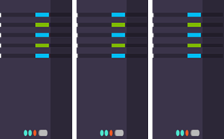
Release
Cloud Load Testing
Integration testing
environment
Staging
environment
3
Monitor + Learn
Automated functional testing environment
Pre-production environment

Slide 17

Continuous Delivery
SOURCE & BUILD
QA ENVIRONMENT
Value
Optimized Resources
Accelerate Delivery
Measure
Deployment Frequency
MTTR
Availability
DEV
OPS

Slide 18
Release Management
SOURCE REPO
DEV
Value
Optimized Resources
Accelerate Delivery
STAGE
Measure
Deployment Frequency
MTTR
Availability
PRODUCTION
DEV
OPS

Slide 19
Infrastructure as Code
DEV
Value
Optimized Resources
Accelerate Delivery
STAGE
Measure
Deployment Rate
MTTR
OPS
PRODUCTION
DEV
OPS

Slide 20
Monitor + Learn
Plan the next iteration
Feedback
Monitor
4

