Slide 1
DevOps
Garth Fort
garth.fort@contoso.com

Slide 2
Agenda
DevOps with the Microsoft cloud
Building a continuous deployment pipeline

Slide 3
Why DevOps?
Isn’t DevOps another phrase for Agile?
Who is responsible for deploying code?
When deployments fail, who gets blamed?
How many production deployments do you perform per year? Month? Day? Hour?
What is stopping you from deploying faster?

Slide 4
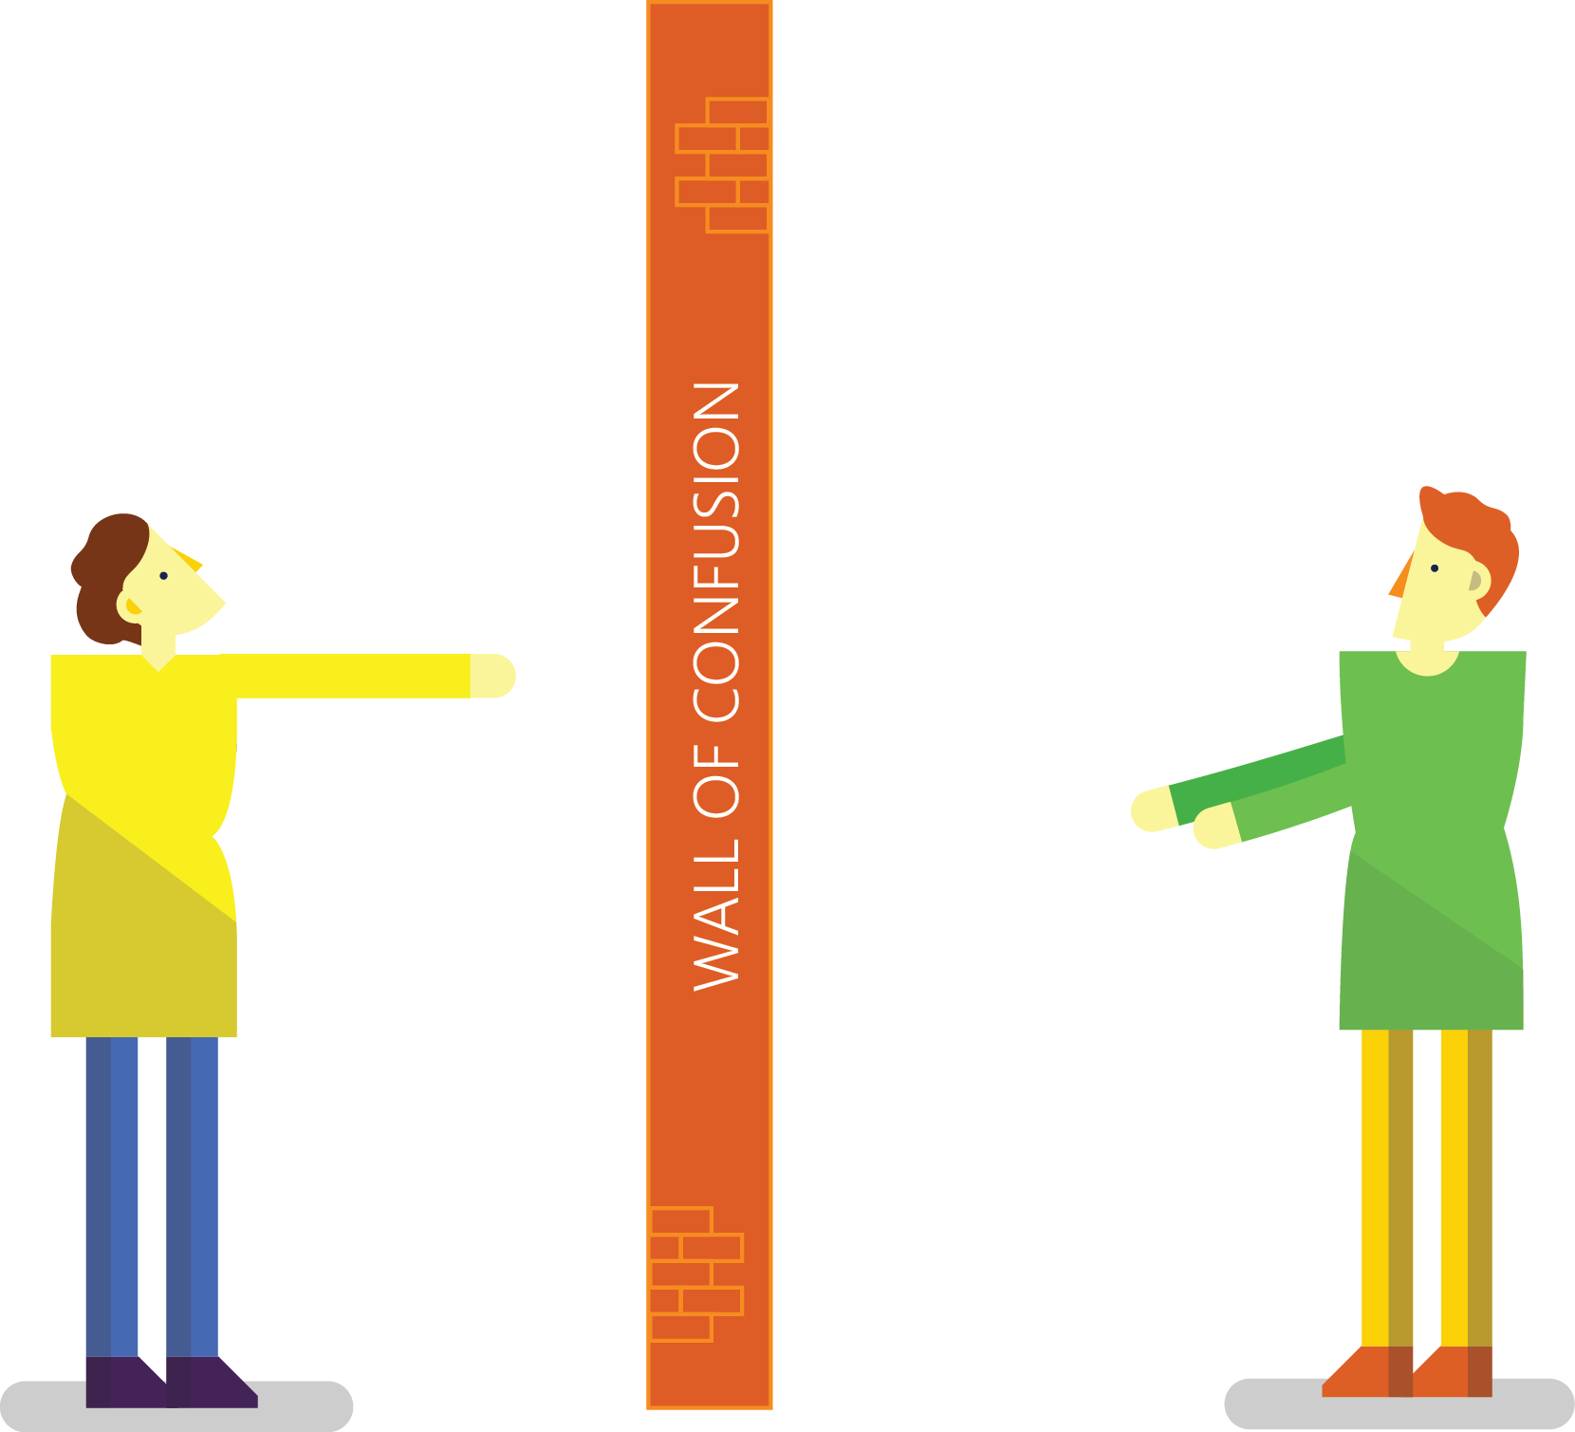

Traditional Development + Operations
DEV
OPS

Slide 5

What is DevOps?
“It’s a job title”
“It’s automation”
“It’s Development and Operations collaboration”
“It means faster and smaller releases”

Slide 6
The converged DevOps lifecycle
Plan + Track
Release
Development
Production
Develop + Test
Monitor + Learn

Slide 7


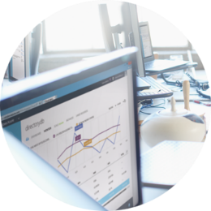
The DevOps conversation
Collaborate more
Share common goals
Focus on improvement
BRINGING PEOPLE TOGETHER
PEOPLE
Eliminate waste
Increase efficiency
Streamline feedback
DELIVERING VALUE FASTER
PROCESS
Enhance productivity
Enable collaboration
Facilitate experimentation
EXECUTING A DEVOPS STRATEGY
TOOLS

Slide 8
DevOps habits and practices
PRACTICES
Application Performance Management
Infrastructure as Code
Continuous Deployment
Release Management
Configuration Management
Automated Recovery
PRACTICES
Automated Testing
Continuous Integration
Continuous Deployment
Release Management
PRACTICES
Usage Monitoring
Telemetry Collection Testing in Production
Stakeholder Feedback
PRACTICES
Code Reviews
Automated Testing
Continuous Measurement
FLOW OF CUSTOMER VALUE
TEAM AUTONOMY & ENTERPRISE ALIGNMENT
BACKLOG refined with LEARNING
EVIDENCE gathered in PRODUCTION
MANAGED TECHNICAL DEBT
PRODUCTION FIRST MINDSET
INFRASTRUCTURE is a FLEXIBLE RESOURCE
PRACTICES
Testing in Production
Usage Monitoring
User Telemetry
Stakeholder feedback
Feature flags
PRACTICES
Application Performance Management
Infrastructure as Code
Continuous Delivery
Release Management
Configuration Management
Automated Recovery
PRACTICES
Enterprise Agile
Continuous Integration
Continuous Deployment
Release Management

