Slide 1
Hands on Labs

Slide 2
Agenda
HOL 1 - Tools and Developer Environment Setup
HOL2 - Modern Cloud Apps
HOL 3 - Identity and Office365 APIs
HOL 4 - DevOps Continuous integration
HOL 5 - Infrastructure as code
HOL 6 - Monitoring

Slide 3
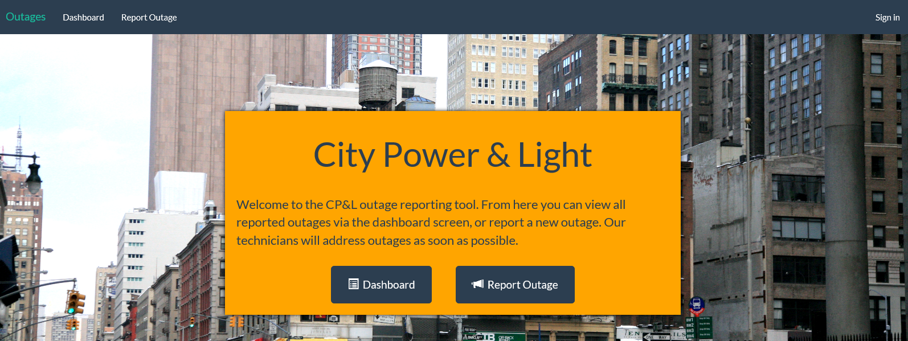
City Power & Light Outage Incident Tracker

Slide 4
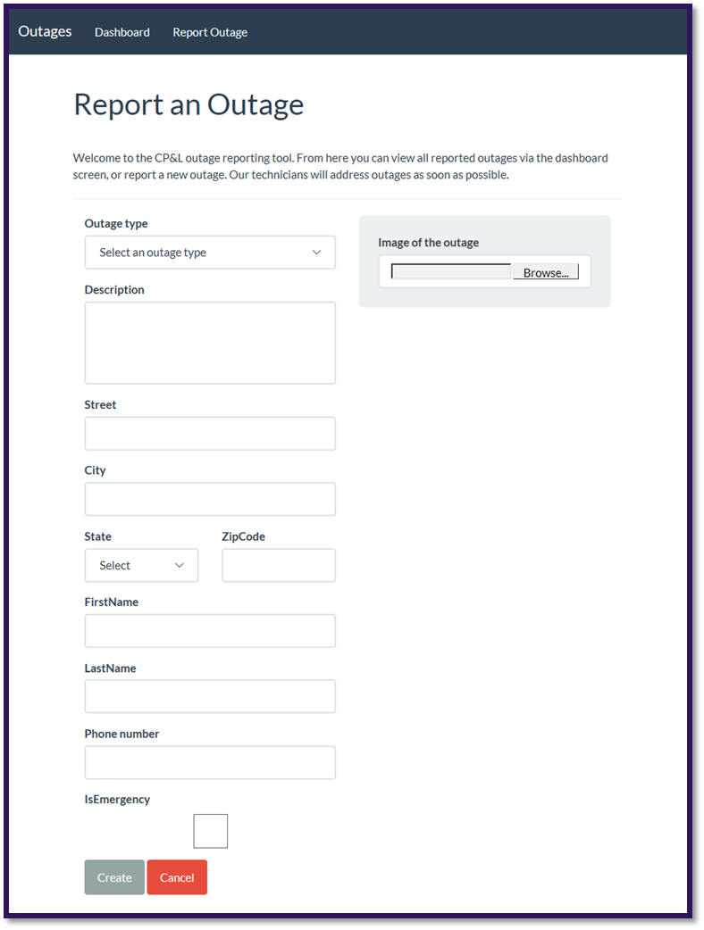
City Power & Light is looking to use cloud capabilities
Would to allow field workers the ability capture incidents
Would like to provide photo upload capability
Would like to consume PaaS services on Azure

Slide 5




City Power & Light App Architecture
START
3
AZURE QUEUE
1
WEB SITE
3
AZURE BLOB STORAGE
Outage Tracker
VSTS
AZURE AD
3
AZURE CACHE
3
3

Slide 6
HOL 1: Setting up your developer environment
Connect Azure subscription (Pass or Trial)
Create O365 Developer Tenant
Create Visual Studio online account
Take prepared image, walk through the tools that are available
Run ARM Template to scaffold out resources

Slide 7
HOL 2: Building modern cloud apps
Starting with provisioned resource group
Select front end app (Node.js /.NET/ Java)
Connect to deployed API
Add blob storage
Add queueing
Add Redis cache
Stretch: Image resizing with Function

Slide 8
HOL 3: Identity with Azure AD and Office 365 APIs
Find AD
Create AD Application
Add authentication to app
Authenticate
Add profile page
Add graph API call to get user data for profile page
Populate first & last name of the new incident form with first name & last name from Graph/token
Send Email via Graph on new incident creation
Stretch: Add calendar event on new incident creation

Slide 9
HOL 4: DevOps with Azure and VSTS
Create VSTS Tenant
Create Git repository
Clone git repo locally
Push code into VSTS
Create CI pipeline to build
Ends with published artifacts

Slide 10
HOL 5: Infrastructure as code with (ARM)
Create ARM template for web app in VS
Deploy using VSTS
Create 3 environments
Configure CD

Slide 11
HOL 6: Monitoring applications with App Insights
Add App Insights resource to Azure
Add App Insights to application
Add server side SDK
Add client side libraries
Create custom events
Create custom metric
Create availability test
View the dashboard

