Slide 1

MICROSOFT MOVIE DATA ANALYSIS PRESENTATION
Presentation by:
AKELLE WAGUMA
MEDIA AND COMMUNICATION SPECIALIST Email: akellewaguma@gmail.com

Slide 2
INTRODUCTION
Microsoft is interested in venturing into the world of original movie content and has recently set up a new movie studio. However, as they don't have any prior experience in this field, they require guidance in selecting the right types of films to produce.
To address this issue, I will analyze data on the current box office trends and interpret the insights to advise Microsoft on the types of movies that are performing well and why. This will enable them to make informed decisions on what movies to create in their new studio.

Slide 3

OBJECTIVE
To identify the types of films that are currently performing best at the box office and provide actionable insights for Microsoft to make informed decisions about the types of films they should create.

Slide 4
STEPS UNDERTAKEN
Loaded all relevant data sets.
Examined the data to ensure it has been loaded correctly, checking the size, data types, and any missing values.
Cleaned the data by removing irrelevant columns or rows, renaming columns, handling missing values, and correcting any errors.
Merged the relevant data sets to create a master data set.
Used data analysis to explore the data, looking for trends, patterns, and relationships between variables.
Used data visualization to present the data in a clear and meaningful way.
Drew up conclusions from the analysis and provided recommendations based on findings.
Communicate the findings and recommendations to the Microsoft team.

Slide 5
OUTLINE
Business Problem
Data
Methods
Results
Conclusions
Recommendations

Slide 6
Business Problem
Genres of movies to be made
Budget Allocation
Time for Movie release

Slide 7
DATA
IMDb containing movie ratings and genre including ratings and number of votes per movie
The Box Office Mojo that tells us the domestic and foreign gross

Slide 8
METHOD
Python imports several libraries used for data analysis and visualization:
pandas (imported as pd): a library for data manipulation and analysis.
numpy (imported as np): a library for mathematical operations and array manipulation.
seaborn (imported as sns): a library for data visualization based on matplotlib.
sqlite3: a library for working with SQLite databases.
matplotlib.pyplot (imported as plt): a plotting library for creating visualizations.
%matplotlib inline: a magic command used in Jupyter notebooks to display plots inline.
warnings: a library for handling warnings used to ignore warning messages that may appear during the execution of the code.

Slide 9
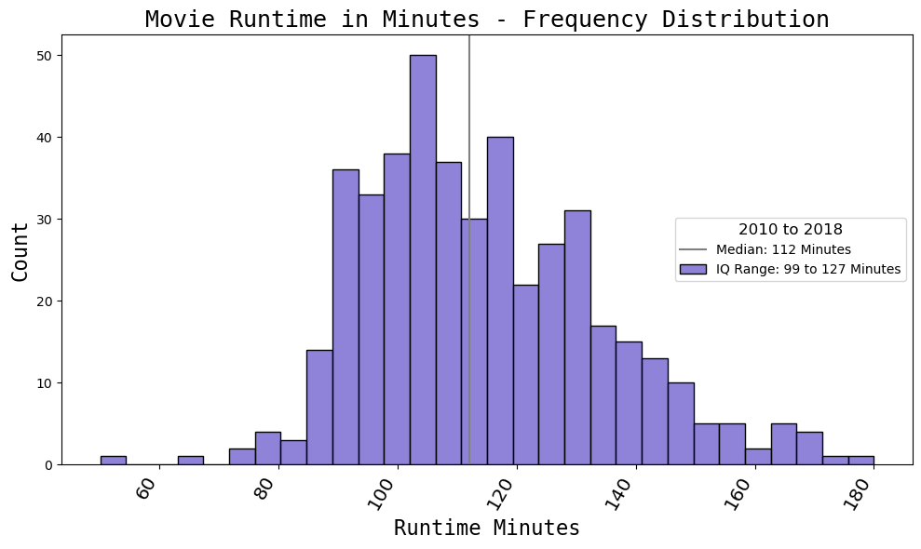
MOVIE RUNTIME

Slide 10
RESULTS
The most popular months for releasing a top 50 film are November, December, June, and July.
The median runtime for these films is 114 minutes with a maximum runtime of 180 minutes.
Action, adventure, and western films are common in the top 50. There is not much difference in ratings between top 50 films and the overall dataset.

Slide 11
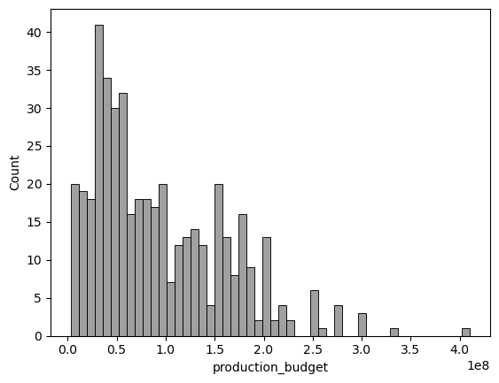
PRODUCTION BUDGET

Slide 12
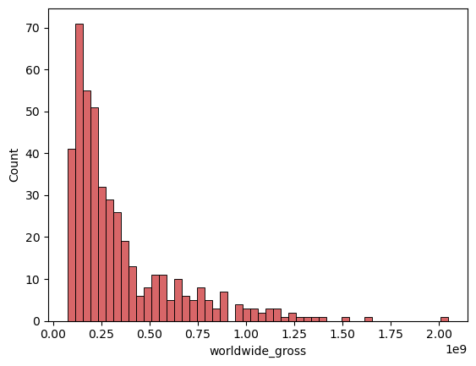
WORLDWIDE GROSS

Slide 13
RESULTS
The new dataframe, which includes the top 50 films of each year, shows that the median cost for these films is USD 75 million, which is significantly higher than the original dataframe's median cost of USD 35 million.
Additionally, the worldwide revenue median for the top 50 films is USD 240 million compared to all films at under USD 90 million. The median payment for a top 50 film is 26% of gross revenue, but the range can be as high as 17-39%.

Slide 14
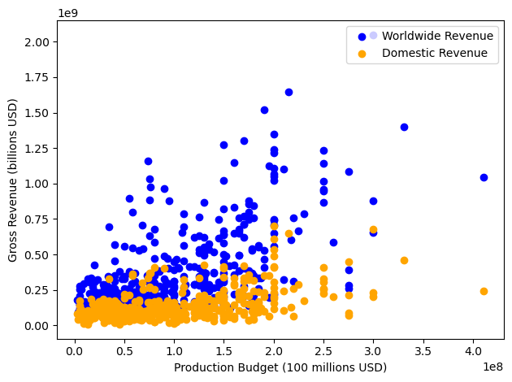
GROSS REVENUE

Slide 15
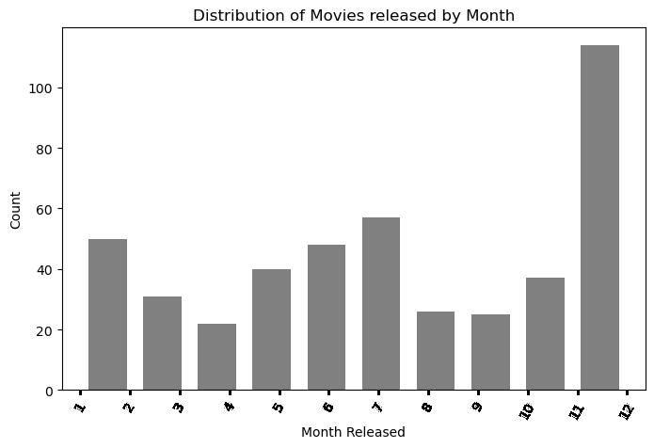
DISTRIBUTION OF MOVIES

Slide 16
RECOMMENDATIONS
The majority of top 50 films range between 99-127 minutes and are often action and adventure films. The cost of a film does not necessarily affect the ratings.
However, the dataset only considered films from 2010 to 2018 and does not account for any changes experienced in the movie industry.
Therefore, future analyses may need to consider a more comprehensive understanding of movie attributes and revenue.

Slide 17

THANK YOU
Email: akellewaguma@gmail.com
LinkedIn: AkelleWaguma

