Slide 1
具体实现
Input: (C_{in}+ 1) x H x W
Conv (allows merging)
Final Conv
Orig. Conv
C_{in}
Duplicate channels on C_{in} (Merge)
Search for channels to split for current outputs
C_{out}
通过复制卷积权重的方式，实现
1）上一层被分裂的频道的合并，
2）当前层输出的频道分裂

Slide 2
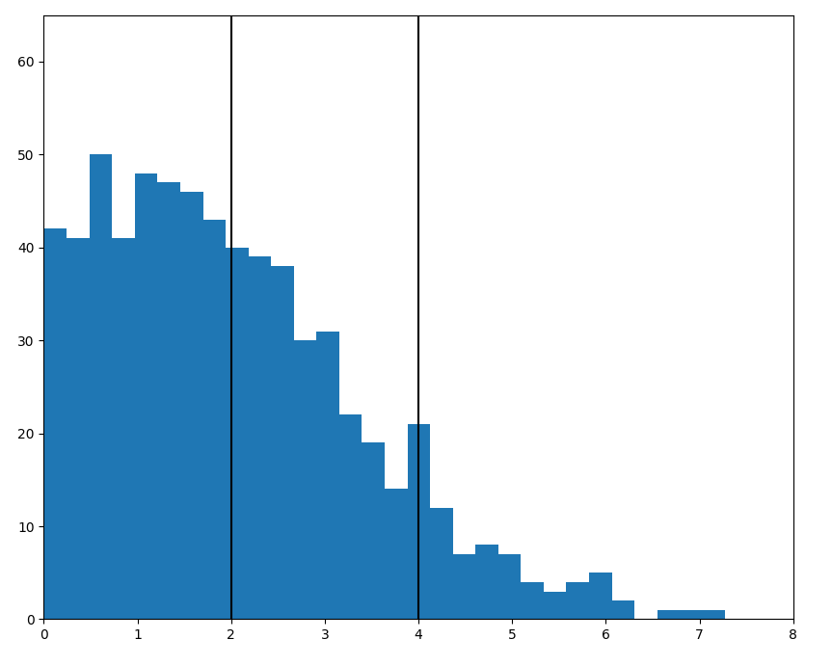
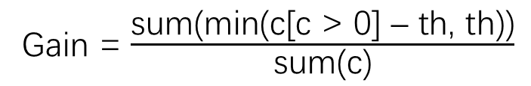
分裂筛选标准
th
2th
gain = 0
gain = c-th
gain = th
Gain = $\frac{\text{sum}\text{(}\text{min}\text{(}\text{c}\text{[}\text{c}\text{ > 0] – }\text{th}\text{, }\text{th}\text{))}}{\text{sum}\text{(}\text{c}\text{)}}$

Slide 3
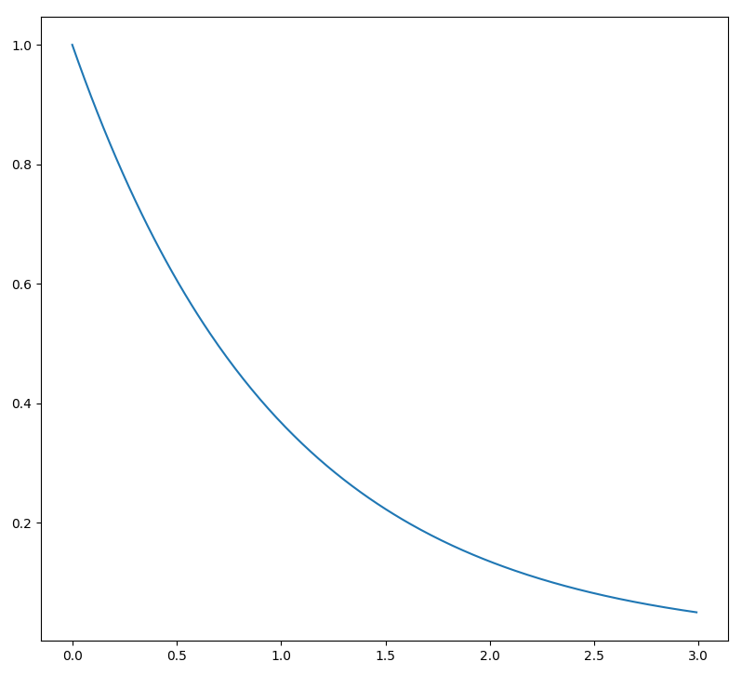
Clip和量化步长的取值
范围小，分桶精度高
范围大，分桶精度低
n_bits = 3,
Clip = 0.75
n_bits = 3,
Clip = 1.5

