Slide 1
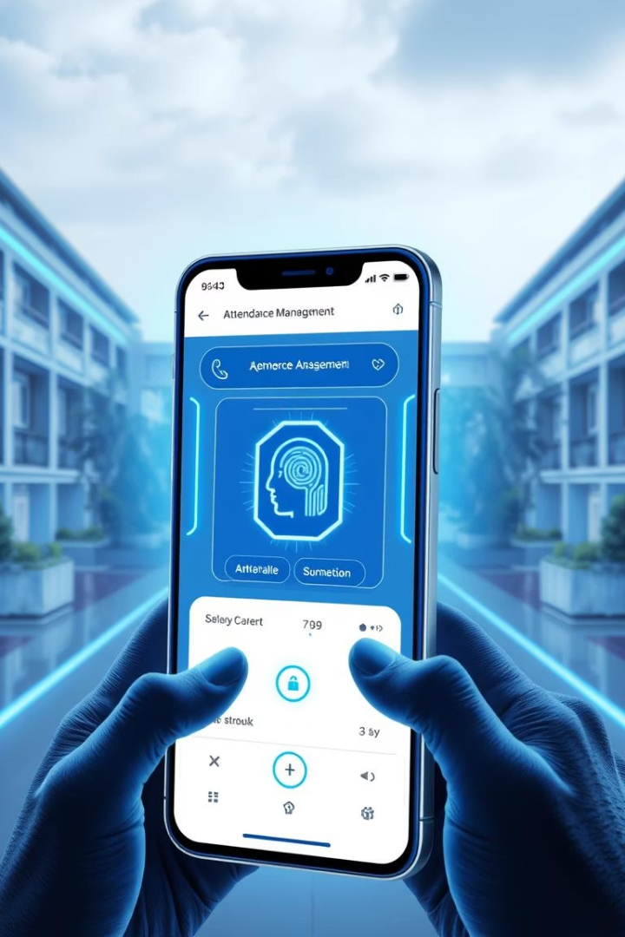
GeoFace – UI & Front-End Implementation
Mobile Attendance Management System
Group 17 | CEF 440 | Dr. Nkemeni Valery – May 2025

Slide 2

App Identity – Naming & Brand
App Name
Positioning
GeoFace (Geo = Location, Face = Biometrics)
Secure, modern, academic-focused

Slide 3



Visual Identity – Logo, Colors & Typography
Logo
Colors
Font
Checkmark + academic silhouette within a circular badge.
Blue (trust), Green (success), Orange (alerts), Red (errors).
Poppins – clean, accessible, screen-optimized.

Slide 4




Visual Design – UX Principles
Simplicity
Transparency
Feedback
Accessibility
Progressive disclosure of data.
Clear biometric usage info.
Real-time response to actions.
Inclusive and adaptive design.

Slide 5
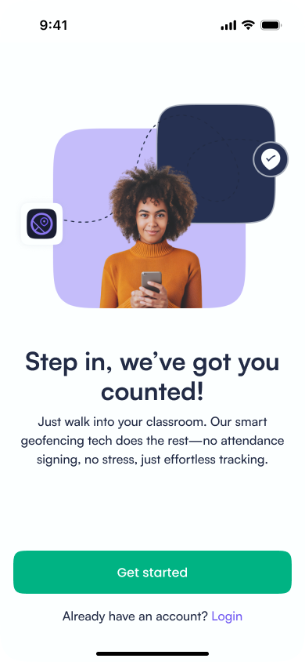
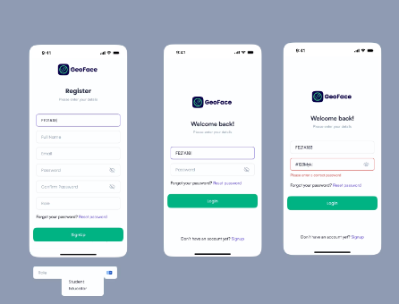
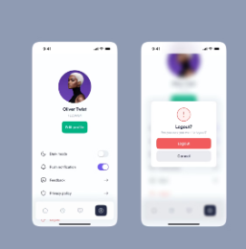



Authentication & Onboarding
Secure Login
Role-based (Firebase).
Onboarding Flow
Welcome → Setup → Permissions.
User Feedback
Clear progress and navigation.

Slide 6
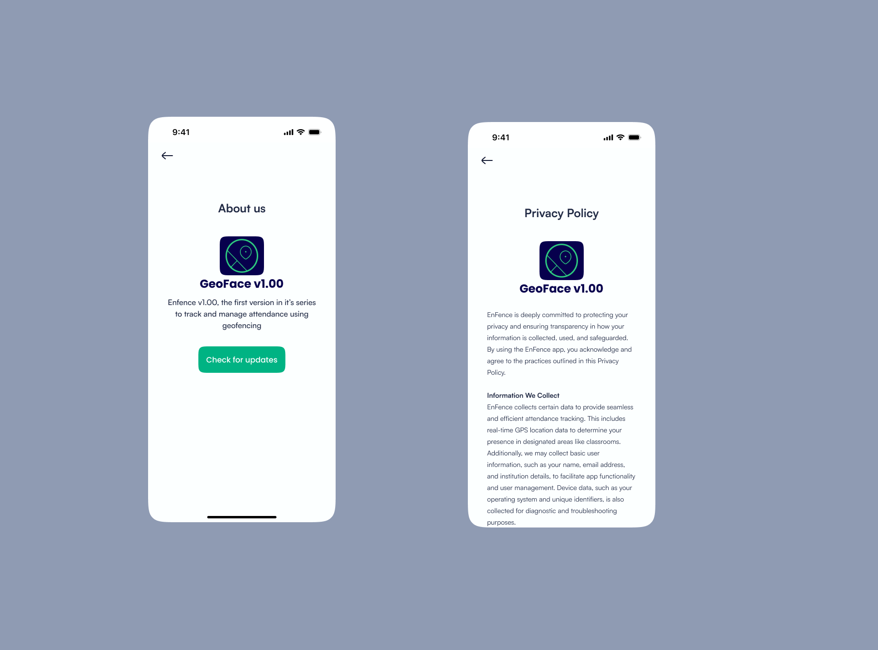
About Geoface

Slide 7
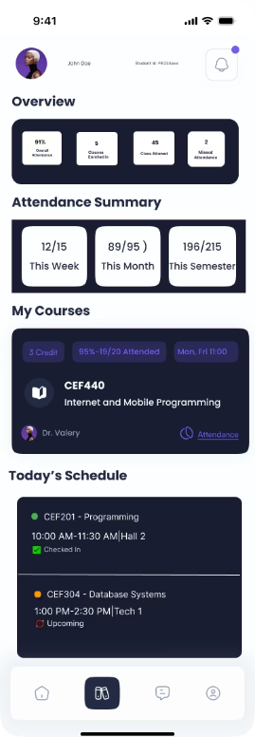



Dashboards Overview
Admin
Assign lecturers, manage courses.
Lecturer
Live attendance grid, alerts, manual override.
Student
Class info, streaks, check-in.

Slide 8
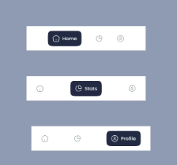
Navigation
Students
Lecturers/Admins
Primary Navigation
Bottom tab bar (role-adaptive).
Home, Attendance, Profile.
Live Grid, Reports, Exports.

Slide 9
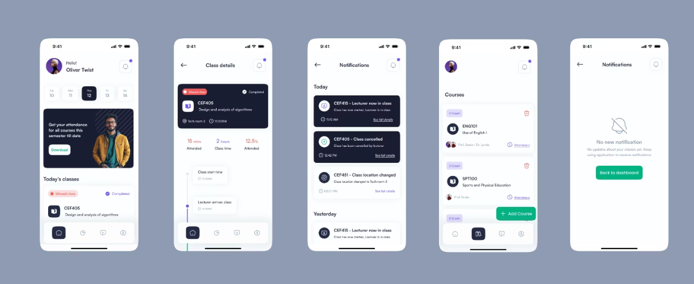
Student's Section
1
Dashboard
Personalized course overview.
2
Check-in
One-tap attendance with facial recognition.
3
Attendance History
Detailed records of past classes.
4
Profile
Manage personal and biometric data.

Slide 10
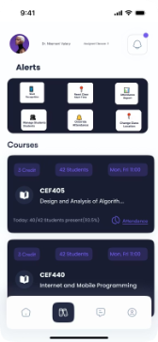
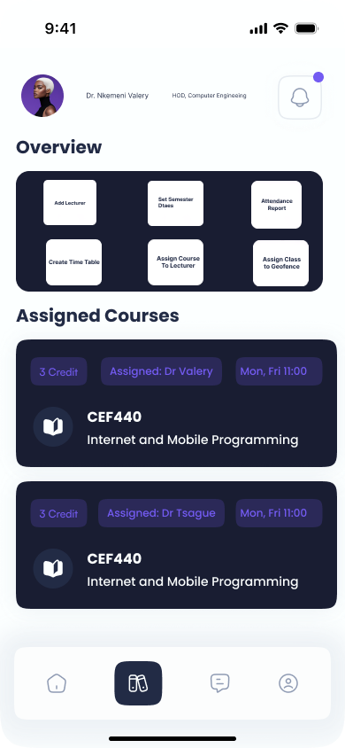
Admin Dashboard
Lecturer Dashboard
Admin Section
User Management
Course Administration
Add/remove lecturers and students.
Create and assign courses.
System Settings
Configure geofence boundaries.

Slide 11
Frontend Tech Stack & Architecture
Framework: Flutter for cross-platform UI
Technology stack decision

Slide 12
UI Implementation (Core Functionality)
Core UI: Auth, Check-In, Dashboard, Profile, Notifications
Responsive design with role-based UI logic
Visual consistency and task focus per screen

Slide 13
Core Functionality Continuation
FR2/3/10: Face Recognition
FR4/12: Geofencing – Google Maps
FR5/6/11: Auto Attendance Logging & Sync
FR9: Analytics – Exportable Charts

Slide 14
Conclusion
Task 5 successfully delivered a secure and intuitive front-end for the GeoFace attendance system by integrating facial recognition and geofencing. The app identity, visual design, and UI implementation were thoughtfully crafted to ensure usability, accessibility, and performance. As we move forward, we will focus on enhancing the user interface further and begin the implementation of the backend to support full system functionality. This marks a strong foundation for a complete and scalable attendance management solution.

