Slide 1
Image Classification with Convolutional Neural Networks
Kenyon Leblanc
Mentored by Dr. Girard

Slide 2
Problem Description
How can one classify images of animals based on the animal type?
Notes:
The problem I addressed

Slide 3
Machine Learning
Support Vector Machine
Supervised learning algorithm that finds the optimal hyperplane between different classes
Random Forest
Constructs decision trees during training
Neural Network
Inspired by the structure and function of the human brain
Notes:
Machine learning techniques

Slide 4
Convolutional Neural Networks
End-to-end learning
Raw input to desired input
Hierarchical feature learning
Early layers learn edges and texture
Later layers learn complex shapes and patterns
Translation Invariance
Pattern recognition regardless of position
Notes:
End-to-end
model is trained to perform the task directly from raw input
done w/o relying on intermediate handcrafted features or processing stages

Slide 5
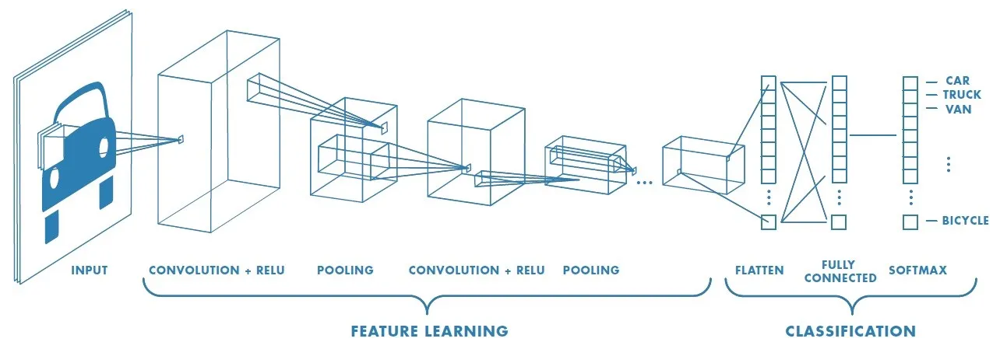
CNN Background
[1]
Figure 1

Slide 6
CNN Background
[1]
Figure 1

Slide 7
CNN Background
[1]
Figure 1
Notes:
data smaller and smaller

Slide 8
CNN Background
[1]
Figure 1

Slide 9
CNN Background
[1]
Figure 1

Slide 10
CNN Background
[1]
Figure 1

Slide 11
CNN Background
[1]
Figure 1

Slide 12
CNN Background
[1]
Figure 1

Slide 13
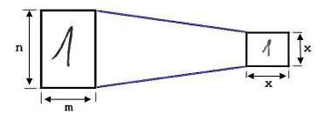
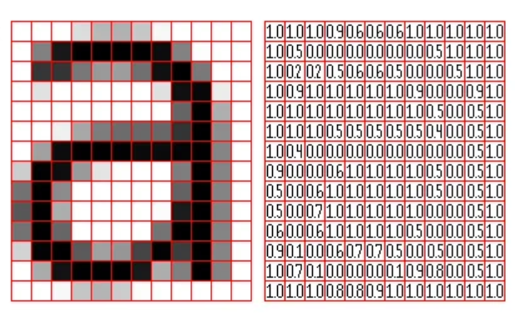
Preprocessing
Image Interpolation
Resize image, preserving essential information
Color Conversion
Black&White
Grayscale
Normalization
Scaling pixels
Transforming
Flipping
Rotating
Cropping
[1]
Figure 1
[2]
Figure 2
[1]
Figure 3
Notes:
Before input
data must have a standard to follow to minimize as many variables as possible
Transforming (random)
not only introduce diversity
enhance robustness of model
exposing it to real world scenarios

Slide 14
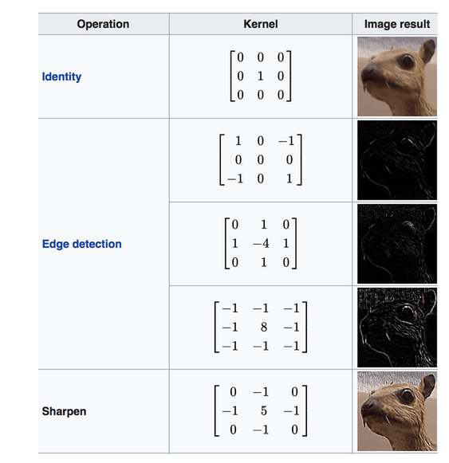
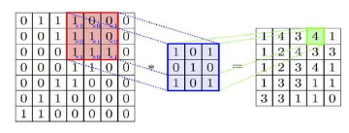
Feature Learning
Convolutional Layer
Filter/Kernel
Identity
Detecting edges
Sharpening
Weights
Bias
ReLU Activation
f(z) = max⁡(0,z)
[1]
Figure 1
[3]
[4]
Figure 3
Figure 2
Notes:
START Feature detection
apply filters otherwise known as kernels
detect features such as edges, texture, patterns
each specializes in detecting specific feature
Weights
strength of connections
Bias
randomly initialized values to help model remain flexible
0 always 0 w/o bias
helps prevent the model from solely relying on input
ReLU
introduces the property of nonlinearity
Hierarchical Feature Learning
deeper layers learning more complex and abstract features
by combining low level features

Slide 15
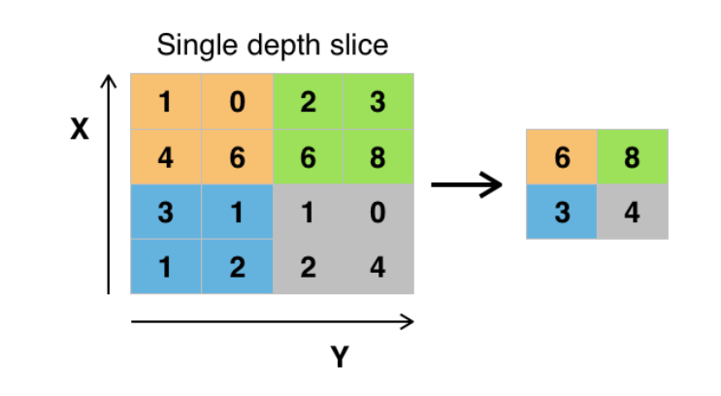
Feature Learning
Pooling Layer
Features captured in regions
Regardless of location
Decreased computational complexity
Max pooling
Preserves most prominent features
Discards the rest
Average pooling
Balanced representation of input data
[1]
Figure 1
[5]
Figure 2
Notes:
2 main pooling methods
results with a feature map reflects

Slide 16
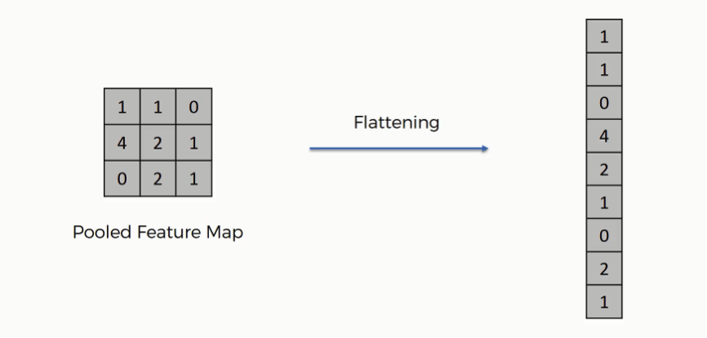
Classification
Flatten Layer
Reshaping data
Compatibility
[1]
Figure 1
[6]
Figure 2
Notes:
input to this layers
3D tensor w/ features learned from network
Compatibility
fully-connected layer requires 1D input
Summarize
Basically aggregating features from Conv and pooling to single vector
This in turn allows learning complex relationships between features.

Slide 17
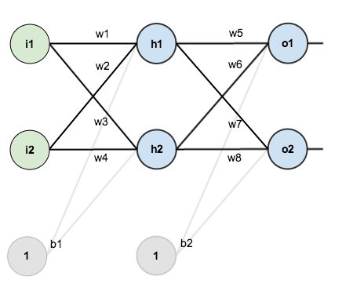
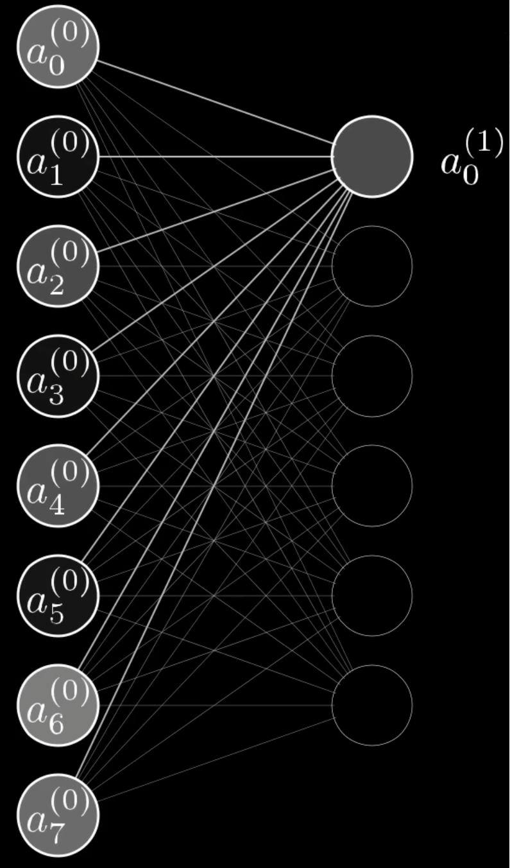
Classification
Fully Connected Layer
Input
Weights
Biases
Net input
[1]
Figure 1
Function for computing raw net input:
net_{in} = ∑_{i} w_{i} * i_{i} + b
[7]
[8]
Figure 2
Figure 3
Notes:
Goal
Correctly map arbitrary inputs to outputs
Get target output for node
Net Input
weighted sum of the inputs and bias

Slide 18
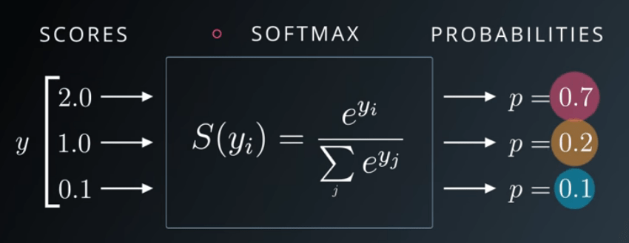
Classification
Softmax
Softmax Activation
[1]
Figure 1
[10]
Figure 2

Slide 19
Backwards Propagation
Training
Minimize the error by adjusting the weights based on the error gradient
Calculated from results from output gained from forward propagation
Goal
Update all weights in network so actual output is closer to target output
[1]
Figure 1

Slide 20
Primary Objective
To assess how activation functions and learning rate impact performance of a convolutional neural network in accurately identifying specific animal species in an image.
Time constraint:
1 Month

Slide 21
Solution Description
Python
NumPy
Matrix multiplication
Data manipulation
Albumentation
Image interpolation, image transformation
CSV
reading/writing data to files
Pickle
Save/load models
Filters
Edge detection filters
Sobel X/Y, Scharr X/Y, Laplacian
Dataset
CIFAR-10
5,000 32x32 RGB training images per class
bird, cat, deer, dog, frog, horse
1,000 32x32 RGB testing images per class
Testing batches of 10
600 test images per test
Note: Classes do not distinguish between types such as types of dogs

Slide 22
Hypothesis
Hypothesis 1:
Null: Activation function will have no effect on performance.
The ReLU activation function will outperform TanH and Sigmoid.
The Tanh activation function will perform the worst.
Hypothesis 2:
Null: Learning rate will have no effect on performance.
A learning rate of 1e-05 will outperform 1e-03 and 1e-04.
The learning rate 1e-03 will perform the worst.

Slide 23
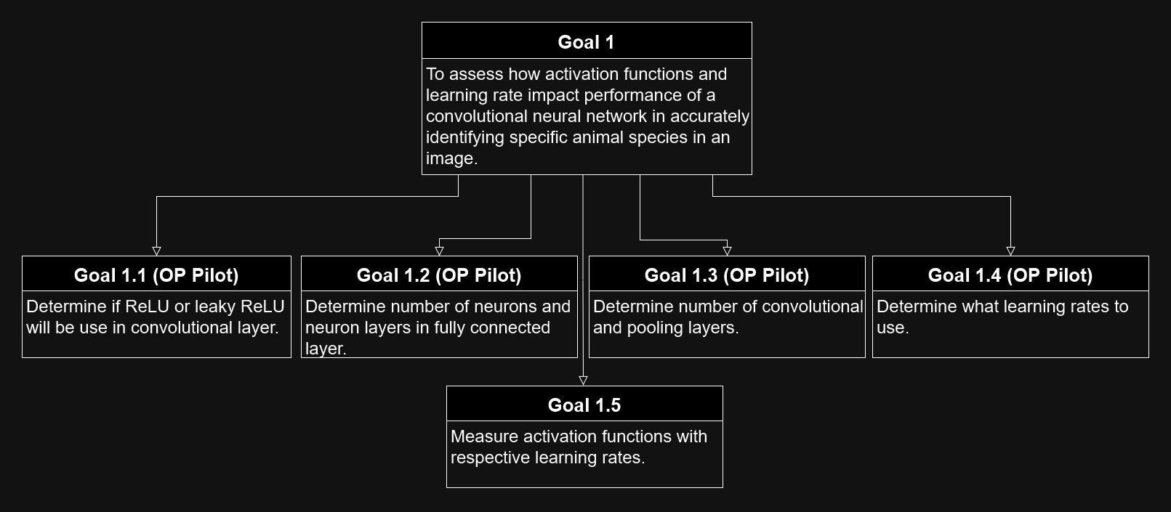
Goal Tree

Slide 24
Experiment Design
Factors | Values
Activation Function | {ReLU, Tanh, Sigmoid}
Learning Rate | {1e-03, 1e-04, 1e-05}
Training Time: With a training set of 30,000 rgb images at 32x32 pixels, 1 convolutional + pooling layer, 1 neuron layer in the fully connected layer, and around 1 hour per training, it took approximately 45 hours.
Experiment time: With a testing set of 6,000 rgb images at 32x32 pixels separated into 10 batches of 600 images and classified using a pre-trained model, it took approximately 20 hours.

Slide 25
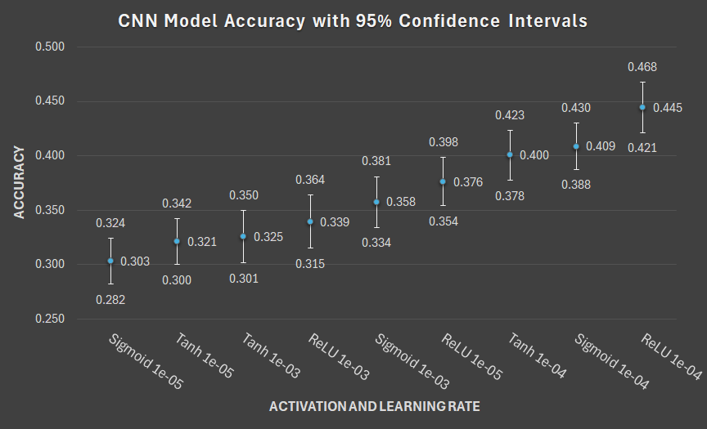
Results

Slide 26
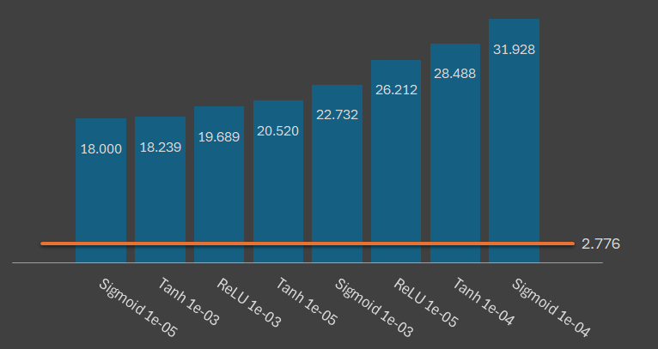
Results
Critical t-value of ± 2.776
DF of 4
Significance level (α) of .05
One Sample T-test Results |  | Learning Rate
 |  | 1e-03 | 1e-04 | 1e-05
Activation Function | ReLU | 19.689 | 33.31 | 26.212
 | Tanh | 18.239 | 28.488 | 20.520
 | Sigmoid | 22.732 | 31.928 | 18.000
Random chance: 0.1667
Notes:
Worth noting values between +/- 2.776 the values are not statistically significant, meaning they are not likely different.
Is, one accuracy is likely better than the other.
The difference in accuracy between all models is statistically significant. All results are more likely to be better than random chance.

Slide 27
Results
Critical t-value of ± 2.776
Paired T-test Results Learning Rate 1e-03
ReLU v Tanh | 1.006
ReLU v Sigmoid | -1.341
Tanh v Sigmoid | -2.374

Slide 28
Results
Critical t-value of ± 2.776
Paired T-test Results Learning Rate 1e-03
ReLU v Tanh | 1.006
ReLU v Sigmoid | -1.341
Tanh v Sigmoid | -2.374
Notes:
The difference in accuracy between ReLU and Tanh is not statistically significant. So neither is likely better.

Slide 29
Results
Critical t-value of ± 2.776
Paired T-test Results Learning Rate 1e-03
ReLU v Tanh | 1.006
ReLU v Sigmoid | -1.341
Tanh v Sigmoid | -2.374
Notes:
The difference in accuracy between ReLU and Sigmoid is not statistically significant. So neither is likely better.

Slide 30
Results
Critical t-value of ± 2.776
Paired T-test Results Learning Rate 1e-03
ReLU v Tanh | 1.006
ReLU v Sigmoid | -1.341
Tanh v Sigmoid | -2.374
Notes:
The difference in accuracy between Tanh and Sigmoid is not statistically significant. So neither is likely better.

Slide 31
Results
Critical t-value of ± 2.776
Paired T-test Results Learning Rate 1e-04
ReLU v Tanh | 3.368
ReLU v Sigmoid | 2.846
Tanh v Sigmoid | -0.656

Slide 32
Results
Critical t-value of ± 2.776
Paired T-test Results Learning Rate 1e-04
ReLU v Tanh | 3.368
ReLU v Sigmoid | 2.846
Tanh v Sigmoid | -0.656
Notes:
The difference in accuracy between ReLU and Tanh is statistically significant. ReLU is likely better than Tanh based on my data.

Slide 33
Results
Critical t-value of ± 2.776
Paired T-test Results Learning Rate 1e-04
ReLU v Tanh | 3.368
ReLU v Sigmoid | 2.846
Tanh v Sigmoid | -0.656
Notes:
The difference in accuracy between ReLU and Sigmoid is statistically significant. ReLU is likely better than Tanh based on my data.

Slide 34
Results
Critical t-value of ± 2.776
Paired T-test Results Learning Rate 1e-04
ReLU v Tanh | 3.368
ReLU v Sigmoid | 2.846
Tanh v Sigmoid | -0.656
Notes:
The difference in accuracy between Tanh and Sigmoid is not statistically significant. Neither is likely better.

Slide 35
Results
Critical t-value of ± 2.776
Paired T-test Results Learning Rate 1e-05
ReLU v Tanh | 4.492
ReLU v Sigmoid | 5.959
Tanh v Sigmoid | 1.525

Slide 36
Results
Critical t-value of ± 2.776
Paired T-test Results Learning Rate 1e-05
ReLU v Tanh | 4.492
ReLU v Sigmoid | 5.959
Tanh v Sigmoid | 1.525
Notes:
The difference in accuracy between ReLU and Tanh is statistically significant. ReLU is likely better than Tanh based on my data.

Slide 37
Results
Critical t-value of ± 2.776
Paired T-test Results Learning Rate 1e-05
ReLU v Tanh | 4.492
ReLU v Sigmoid | 5.959
Tanh v Sigmoid | 1.525
Notes:
The difference in accuracy between ReLU and Tanh is statistically significant. Neither is likely better.

Slide 38
Results
Critical t-value of ± 2.776
Paired T-test Results Learning Rate 1e-05
ReLU v Tanh | 4.492
ReLU v Sigmoid | 5.959
Tanh v Sigmoid | 1.525
Notes:
The difference in accuracy between Tanh and Sigmoid is not statistically significant. Neither is likely better.

Slide 39
Recap
ReLU performed the best
No significant difference between Sigmoid and Tanh
Neither is likely better

Slide 40
Results
Critical t-value of ± 2.776
Paired T-test Results Activation Function ReLU
1e-05 v 1e-04 | -5.293
1e-05 v 1e-03 | 2.776
1e-04 v 1e-03 | 7.773

Slide 41
Results
Critical t-value of ± 2.776
Paired T-test Results Activation Function ReLU
1e-05 v 1e-04 | -5.293
1e-05 v 1e-03 | 2.776
1e-04 v 1e-03 | 7.773
Notes:
The difference in accuracy between 1e-05 and 1e-04 is statistically significant. 1e-04 is likely better than 1e-05 based on my data.

Slide 42
Results
Critical t-value of ± 2.776
Paired T-test Results Activation Function ReLU
1e-05 v 1e-04 | -5.293
1e-05 v 1e-03 | 2.776
1e-04 v 1e-03 | 7.773
Notes:
The difference in accuracy between 1e-05 and 1e-03 is statistically significant. 1e-05 is likely better than 1e-03 based on my data.

Slide 43
Results
Critical t-value of ± 2.776
Paired T-test Results Activation Function ReLU
1e-05 v 1e-04 | -5.293
1e-05 v 1e-03 | 2.776
1e-04 v 1e-03 | 7.773
Notes:
The difference in accuracy between 1e-04 and 1e-03 is statistically significant. 1e-04 is likely better than 1e-03 based on my data.

Slide 44
Results
Critical t-value of ± 2.776
Paired T-test Results Activation Function Tanh
1e-05 v 1e-04 | -6.380
1e-05 v 1e-03 | -0.342
1e-04 v 1e-03 | 5.609

Slide 45
Results
Critical t-value of ± 2.776
Paired T-test Results Activation Function Tanh
1e-05 v 1e-04 | -6.380
1e-05 v 1e-03 | -0.342
1e-04 v 1e-03 | 5.609
Notes:
The difference in accuracy between 1e-05 and 1e-04 is statistically significant. 1e-04 is likely better than 1e-05 based on my data.

Slide 46
Results
Critical t-value of ± 2.776
Paired T-test Results Activation Function Tanh
1e-05 v 1e-04 | -6.380
1e-05 v 1e-03 | -0.342
1e-04 v 1e-03 | 5.609
Notes:
The difference in accuracy between 1e-05 and 1e-03 is not statistically significant. Neither is likely better based on my data.

Slide 47
Results
Critical t-value of ± 2.776
Paired T-test Results Activation Function Tanh
1e-05 v 1e-04 | -6.380
1e-05 v 1e-03 | -0.342
1e-04 v 1e-03 | 5.609
Notes:
The difference in accuracy between 1e-04 and 1e-03 is statistically significant. 1e-04 is likely better than 1e-03 based on my data.

Slide 48
Results
Critical t-value of ± 2.776
Paired T-test Results Activation Function Sigmoid
1e-05 v 1e-04 | -8.838
1e-05 v 1e-03 | -4.328
1e-04 v 1e-03 | 4.043

Slide 49
Results
Critical t-value of ± 2.776
Paired T-test Results Activation Function Sigmoid
1e-05 v 1e-04 | -8.838
1e-05 v 1e-03 | -4.328
1e-04 v 1e-03 | 4.043
Notes:
The difference in accuracy between 1e-05 and 1e-04 is statistically significant. 1e-04 is likely better than 1e-05 based on my data.

Slide 50
Results
Critical t-value of ± 2.776
Paired T-test Results Activation Function Sigmoid
1e-05 v 1e-04 | -8.838
1e-05 v 1e-03 | -4.328
1e-04 v 1e-03 | 4.043
Notes:
The difference in accuracy between 1e-05 and 1e-03 is statistically significant. 1e-03 is likely better than 1e-05 based on my data.

Slide 51
Results
Critical t-value of ± 2.776
Paired T-test Results Activation Function Sigmoid
1e-05 v 1e-04 | -8.838
1e-05 v 1e-03 | -4.328
1e-04 v 1e-03 | 4.043
Notes:
The difference in accuracy between 1e-04 and 1e-03 is statistically significant. 1e-04 is likely better than 1e-03 based on my data.

Slide 52
Recap
1e-04 performed the best
Not enough difference between 1e-05 and 1e-03
ReLU 1e-05 v ReLU 1e-03: 2.776
Sigmoid 1e-03 > Sigmoid 1e-05
Notes:
The result is considered statistically significant, but it represents the weakest possible evidence for rejecting the null hypothesis.
The difference in accuracy between Sigmoid 1e-03 and Sigmoid 1e-05 is statistically significant. 1e-03 is likely better than 1e-05 based from the data.

Slide 53
Conclusion
Models produced results better than random
ReLU performed the best
No significant difference between Sigmoid and Tanh
1e-04 performed the best
Not enough difference between 1e-05 and 1e-03

Slide 54
Future Work
Test edge detection kernels with other kernel types
Implement self learning kernels

Slide 55
Work Cited
[1]
https://towardsdatascience.com/a-comprehensive-guide-to-convolutional-neural-networks-the-eli5-way-3bd2b1164a53
[2]
https://doi.org/10.1145/3432867.3432896
[3]
https://doi.org/10.34257/GJCSTDVOL19IS2PG13
[4]
www.guru99.com/convnet-tensorflow-image-classification.html
[5]
www.kaggle.com/code/androbomb/using-cnn-to-classify-images-w-pytorch
[6]
https://www.superdatascience.com/blogs/convolutional-neural-networks-cnn-step-3-flattening
[7]
https://mattmazur.com/2015/03/17/a-step-by-step-backpropagation-example/
[8]
https://www.youtube.com/watch?v=aircAruvnKk
[9]
https://www.v7labs.com/blog/neural-networks-activation-functions
[10]
https://sefiks.com/2017/11/08/softmax-as-a-neural-networks-activation-function/

Slide 56

Schedule

Slide 57
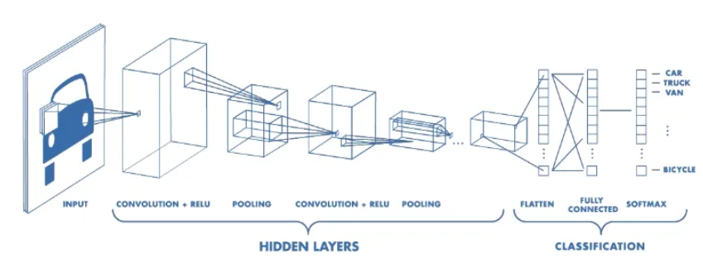
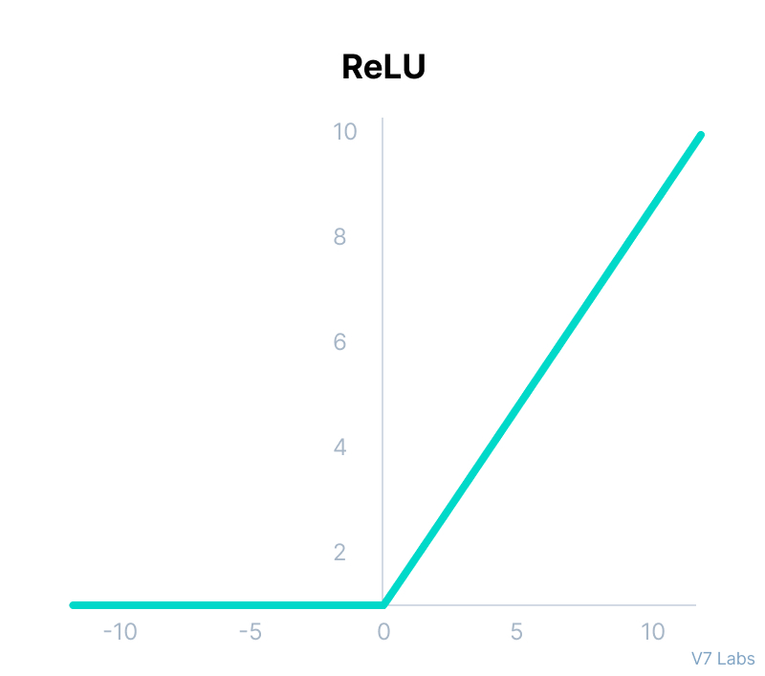
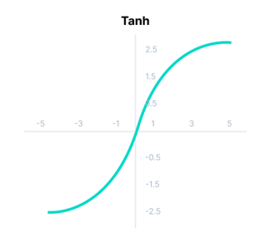
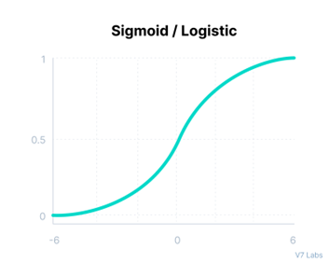
Classification
Fully Connected Layer
Activation Functions
ReLU: f(z) = max⁡(0,z)
TanH: f(z) = (e^{x}-e^{-x}) / (e^{x}+e^{-x})
Sigmoid: f(z) = 1 / (1+e^{-x})
[1]
Figure 1
Function for computing activation vector:
a_{out} = f(net_{in})
[9]
[9]
[9]
Figure 2
Figure 3
Figure 4
Notes:
Goal
Add non-linearity to network
e
base of the natural logarithm

Slide 58
Classification
Softmax
Softmax Activation
[1]
Figure 1
[10]
Figure 2

Slide 59
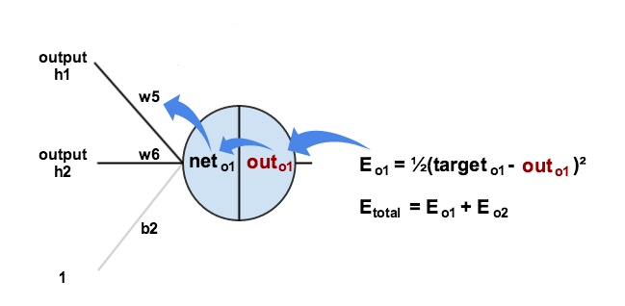
Backwards Propagation
Training
minimize the error of the neural network by adjusting the weights based on the error gradient calculated during forward propagation
Learning Rate
Input
Derivative of the Activation Function
Error
[7]
Figure 1
Function for computing updated weight:
w_{new} = w_{old} + 𝛂(input*derivative(AF)*error)
Notes:
Goal
Update all weights in network so actual output is closer to target output
minimizing error out output neurons
a
helps ensure stability by preventing too rapid of change (oscillation)
higher rate may overshoot optimal solution
Input
output of the neuron (h1)
Derivative(AF)
represents rate of change of the AF with respect to the weighted sum of inputs
Error
represents the error in the output relative to target value
essential for computing how much to adjust weight to minimize error
How much does total error change with respect to AF output

Slide 60
Results
Accuracy Averages |  | Learning Rate
 |  | 1e-03 | 1e-04 | 1e-05
Activation Function | ReLU | 0.3394 | 0.4446 | 0.3762
 |  | 0.0196 | 0.0187 | 0.0179
 | Tanh | 0.3255 | 0.4005 | 0.3211
 |  | 0.0195 | 0.0184 | 0.0168
 | Sigmoid | 0.3576 | 0.4087 | 0.3029
 |  | 0.0188 | 0.0170 | 0.0169
Accuracy
Standard Deviation
Random chance: 0.1667
Notes:
helps understand the variability of the accuracy results for each combination
lower standard deviation means the accuracy is more stable across tests
higher standard deviation suggests more fluctuation

Slide 61
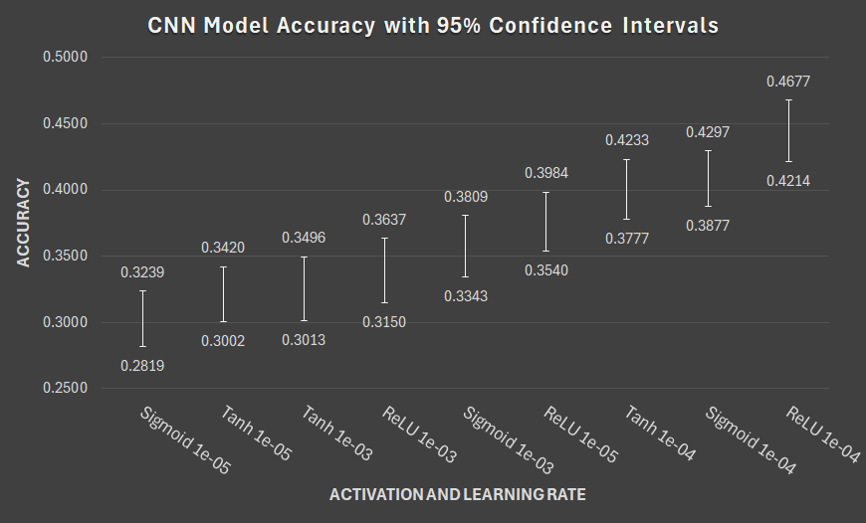
Best Performing Model

Slide 62
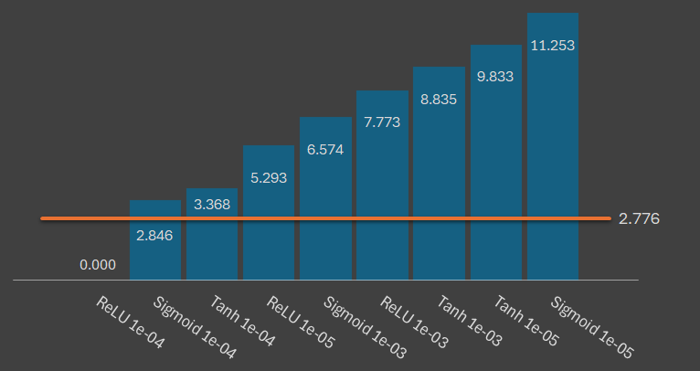
Results
Critical t-value of 2.776
DF of 4
Significance level (α) of .05
Paired T-test Results |  | Learning Rate
 |  | 1e-03 | 1e-04 | 1e-05
Activation Function | ReLU | 7.773 | 0.000 | 5.293
 | Tanh | 8.835 | 3.368 | 9.833
 | Sigmoid | 6.574 | 2.846 | 11.253

