Slide 1
Kernelized Ridge Regression
-eric page
-Neeraj Ankam
-Srujan bandarkar
-Pradeep Bhat

Slide 2
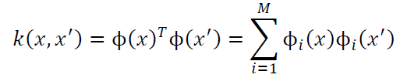
Introduction
Kernel ridge regression combines Ridge Regression (linear least squares with l2-norm regularization) with the kernel trick. It thus learns a linear function in the space induced by the respective kernel and the data.

Slide 3
OUR DATASET
NAME: automobile dataset
13 i/p variables and 1 o/p variable
Description:
Given a set of inputs like the horsepower, peak rpm, highway-miles-per gallon, cetera. We predict the price of automobile
Why?
Cause cost efficiency is a major factor considered by customer while buying a car.

Slide 4
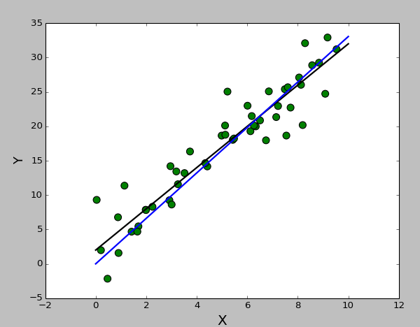
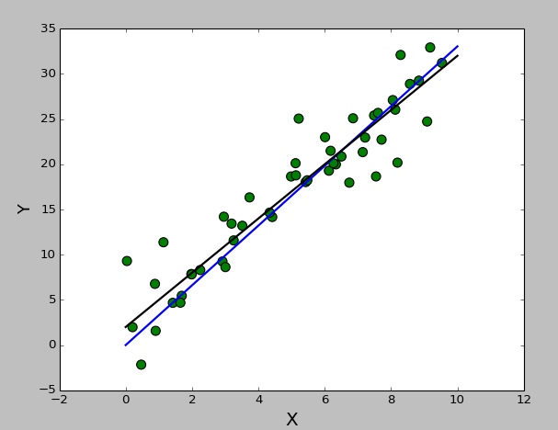
linear kernel implementation (K(x,x’)=x^{T}x’)
Our implementation
Scikit

Slide 5
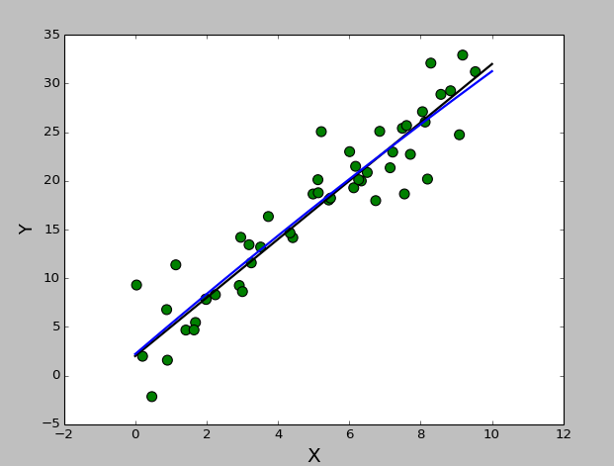
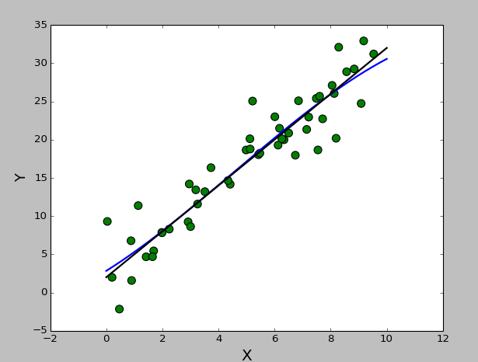
Polynomial kernel implementation (K(x,x’)=(ϒx^{T}x’+r)^{M})
Our implementation
Scikit

Slide 6
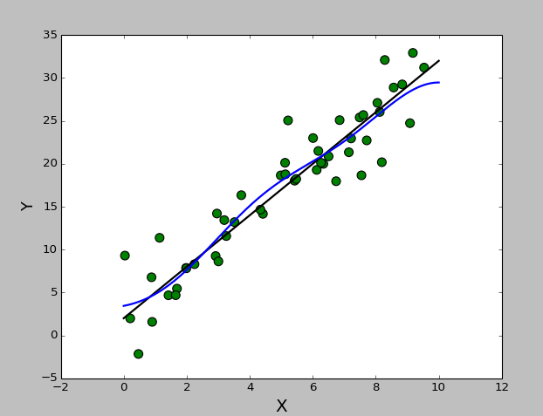
Gaussian kernel implementation K(x,x’)=exp(-( (.5) (x*x’)^{T} ) ∑⁻¹(x-x’))
Our implementation
Scikit

Slide 7
OUR APPROACH
Import dataset(excel file) as a numpy array in python
Separate the data into input and output values.
Separate the datasets into training(149rows) and testing(37 rows) subsets
Use K-fold verification to further divide the training set and test various hyperparameters with each kernel using R-squared as a judge of fitness
Run each kernel regression algorithm with the top hyperparameter candidates

Slide 8
Results
Linear Kernel lambda: 0.01 R2 train: 0.878277214763 R2 test: 0.496575057845 Polynomial Kernel lambda: 5 R2 train: 0.946503895487 R2 test: -3.72236049762 Gaussian Kernel lambda: 0.01 sigma: 5 R2 train: 0.998834900823 R2 test: -10.7984353859

