Slide 1

EE 580 Electrical Machines & Drive Systems Dr. A.Ravindranath
Emulating On-Road Operating Conditions for Electric-Drive Propulsion Systems
0885-8969 © 2015 IEEE
Presented by
Akesh Kotnana
224102102

Slide 2
Outline:
Abstract
Vehicle and Testbench specifications
Force calculations
Vehicle Equivalent Rotational Inertia
Vehicle Dynamics
Controller Design
Simulation Diagram
Results
Conclusion

Slide 3
Abstract:
A new approach for emulating road load conditions for an electric-drive vehicle (EDV) system (a drive motor (DM) connected to a dynamometer). The effect of total vehicle inertia is considered and a control scheme is developed based on vehicle equivalent rotational inertia. This method of EDV emulation not only takes into account all of the stress imposed on the DM due to vehicle inertia effect, but also allows electric vehicle emulation for any standard drive cycle. Simulations are conducted using MATLAB/Simulink.
Introduction:
Emulating an electric-drive vehicle (EDV) by means of an electric motor/dynamometer test bench is a timely research topic that has received increased attention in recent years.
Low cost approach
Possible in academic environments
How can we do?
System simulation
HIL
Real vehicle testing

Slide 4

Vehicle and Testbench specifications:
Vehicle mass 400 kg
Air density ($ρ_{α}$) 1.22 kg/$m^{3}$
Aerodynamic drag coefficient ($C_{d}$) 0.3
Frontal area ($A_{f}$) 1.6${ m}^{2}$
Rolling resistance coefficient ($f_{r}$) 0.01
Wheel radius ($r_{d}$) 0.28 m
Ground slope angle ($α$) 0
Overall gear ratio (G) 2.3
DM inertia ( $J_{DM}$) 0.016 kg.$m^{2}$
Dynamometer motor inertia ( $J_{Dyno}$) 0.019 kg.$m^{2}$
Coupling inertia ( $J_{coupling})$ 0.003 kg.$m^{2}$
Equivalent vehicle rotational inertia (${ J}_{ew}$) 33.029 kg.$m^{2}$
Vehicle drive train overall efficiency ($η$) 90%
DM viscous coefficient ($B_{DM}$) 0.086 N.m/(rad/s)
Dynamometer viscous coefficient ($B_{Dyno}$) 0.0133 N.m/(rad/s)

Slide 5
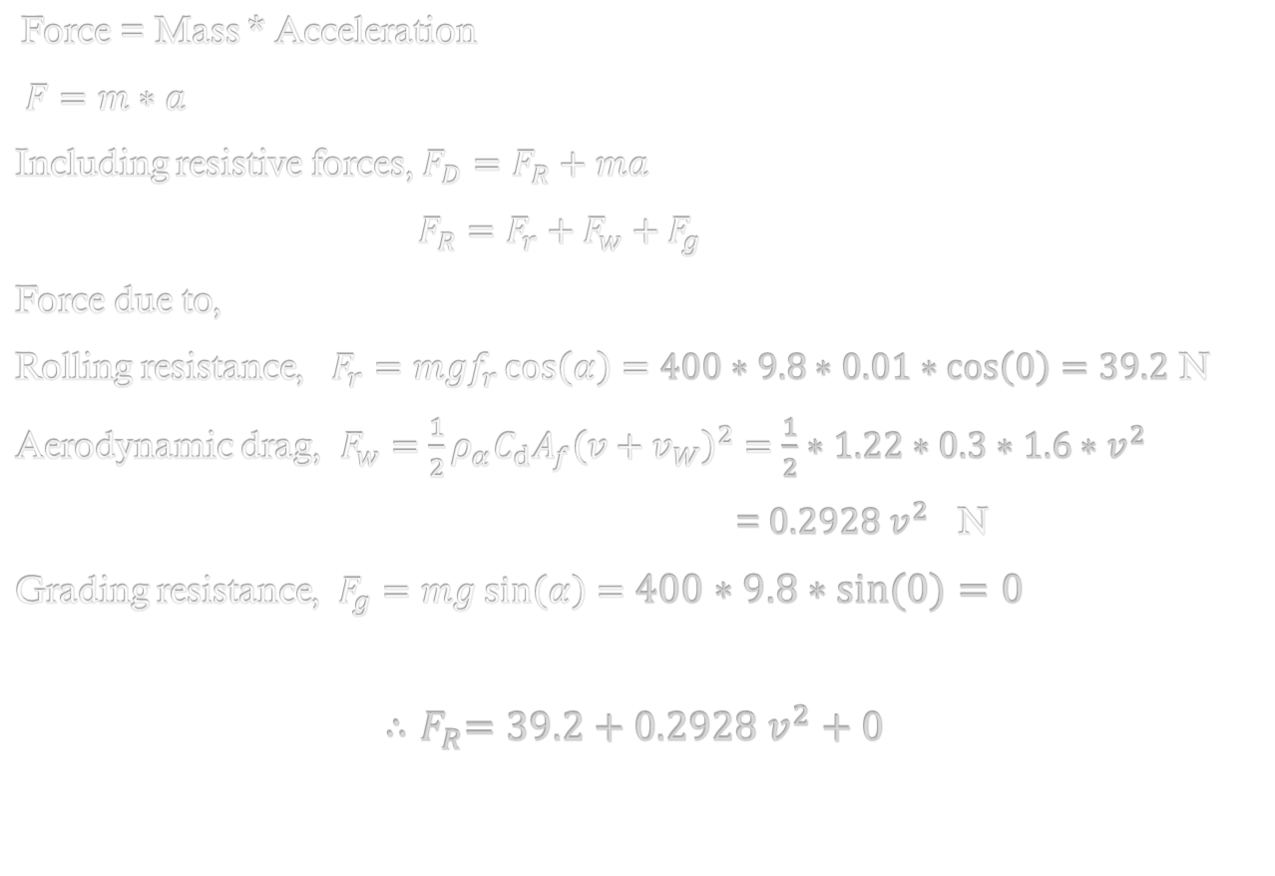
Acting forces on a vehicle:
Force = Mass * Acceleration
$F=m∗a$
Including resistive forces, $F_{D}=F_{R}+ma$
$F_{R}=F_{r}+F_{w}+F_{g}$
Force due to,
Rolling resistance, $F_{r}=mgf_{r}\cos\left(α\right)=400∗9.8∗0.01∗\cos\left(0\right)=39.2$ N
Aerodynamic drag, $F_{w}=\frac{1}{2}ρ_{α}C_{d}A_{f}{\left(v+v_{W}\right)}^{2}=\frac{1}{2}∗1.22∗0.3∗1.6∗v^{2}$
$\text{=} 0.2928 v^{2}$ N
Grading resistance, $F_{g}=mg sin\left(α\right)=400∗9.8∗\sin\left(0\right)=0$
$${∴F}_{R}=39.2+0.2928 v^{2}+0$$

Slide 6

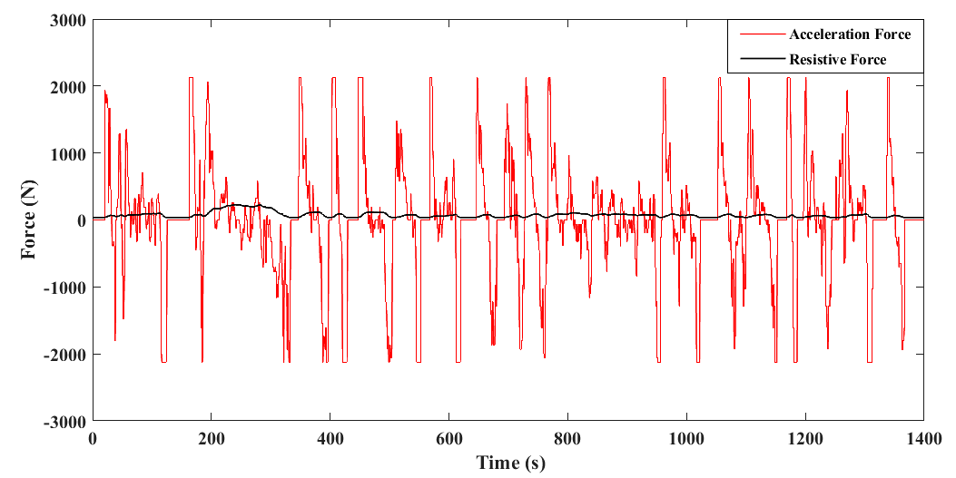
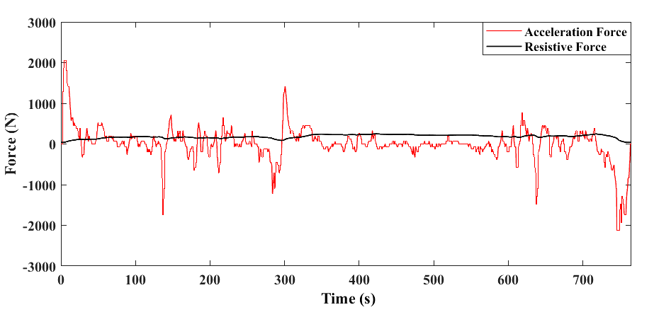
UDDS
HWFET

Slide 7

Vehicle Equivalent Rotational Inertia :
Total kinetic energy stored, $E=\frac{1}{2}mv^{2}+\frac{1}{2}Jw_{w}^{2}$
$\frac{1}{2}m_{e}v^{2}=\frac{1}{2}mv^{2}+\frac{1}{2}Jw_{w}^{2}$ , $v=wr$
$m_{e }=m+J\left(\frac{1}{r_{d}^{2}}\right)$
Alternate approach $m_{e}=δ∗m$
Mass factor, $δ=1+\frac{I_{w}}{mr_{d}^{2}}+\frac{i_{o}^{2}i_{g}^{2}I_{p}}{mr_{d}^{2}}$
$δ=1+δ_{1}+δ_{2}i_{o}^{2}i_{g}^{2}=1+0.04+0.0025 G^{2}$
$$=1+0.04+0.0025∙{2.3}^{2}=1.053225$$
$$∴m_{e}=1.053225×400=421.29 Kg$$
$\frac{1}{2}m_{e}v^{2}=\frac{1}{2}J_{ew}w_{w}^{2}$
$J_{ew}=m_{e}r_{d}^{2}=421.29∗0.28∗0.28=33.029 Kg.m^{2}$

Slide 8

Vehicle Dynamics :
$$T_{w}−T_{R}=J_{ew}\frac{ dw_{w}}{dt}$$
$$T_{w}=T_{R}+J_{ew}\frac{ dw_{w}}{dt}$$
$$T_{DM}=\frac{T_{w}}{nG},w_{m}=w_{w}.G$$
$$T_{DM}−T_{Dyno}−\left(B_{DM}+B_{Dyno}\right)w_{m}=J_{total}∗\frac{dw_{w}}{dt}$$
$=(J_{DM}+J_{Coupling}+J_{Dyno})∗\frac{dw_{w}}{dt}$
$\frac{ J_{ew}\frac{dw_{w}}{dt}+T_{R}}{nG}−T_{Dyno}−$ $\left(B_{DM}+B_{Dyno}\right)w_{m}$= $(J_{DM}+J_{Coupling}+J_{Dyno})\frac{dw_{w}}{dt}$

Slide 9

Controller Design:
$$\frac{J_{ew}}{nG^{2}}∗\frac{dw_{w}}{dt}+\frac{T_{R}}{nG}−T_{Dyno}−\left(B_{DM}+B_{Dyno}\right)w_{m}=(J_{DM}+J_{Coupling}+J_{Dyno})∗\frac{dw_{w}}{dt}$$
$T_{Dyno}=$ $\frac{T_{R}}{nG}−\left(B_{DM}+B_{Dyno}\right)w_{m}$+ $( \frac{J_{ew}}{nG^{2}} − J_{DM}−J_{Coupling}−J_{Dyno})$ * $\frac{dw_{m}}{dt}$ ${=F}_{R}r_{d}∗\frac{1}{0.9∗2.3}−\left(0.0086+0.0133\right)w_{m}+\left[\left(\frac{33.029}{0.9∗{2.3}^{2}}\right)−0.016−0.03−0.019\right]\frac{ dw_{m}}{dt}$
$$T_{Dyno}{=0.13524 F}_{R}−0.0219{ w}_{m}+6.872\frac{ dw_{m}}{dt}$$

Slide 10
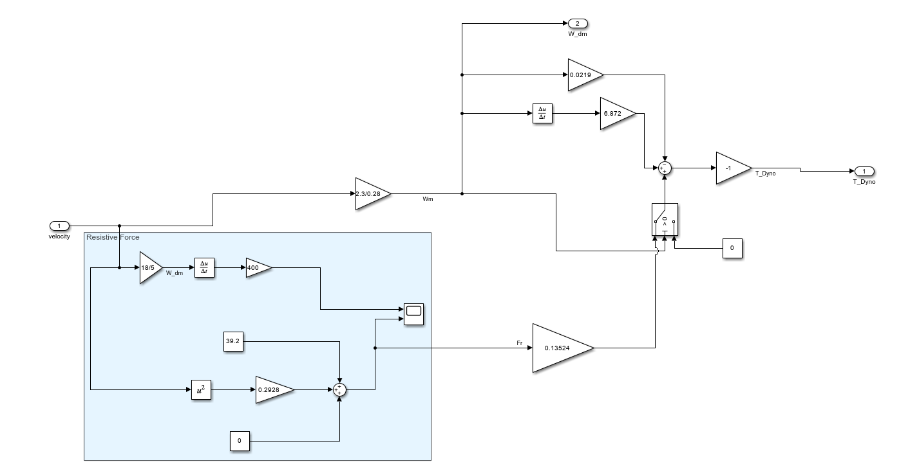
Controller Block:
EE 580 Electrical Machines & Drive Systems
10

Slide 11
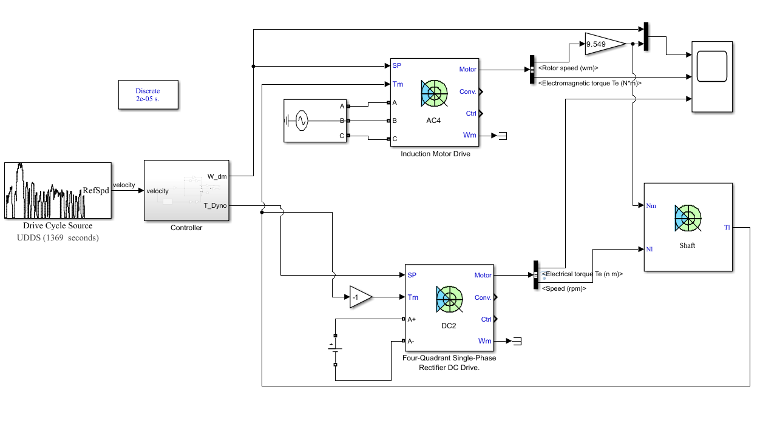
Simulation Model:

Slide 12
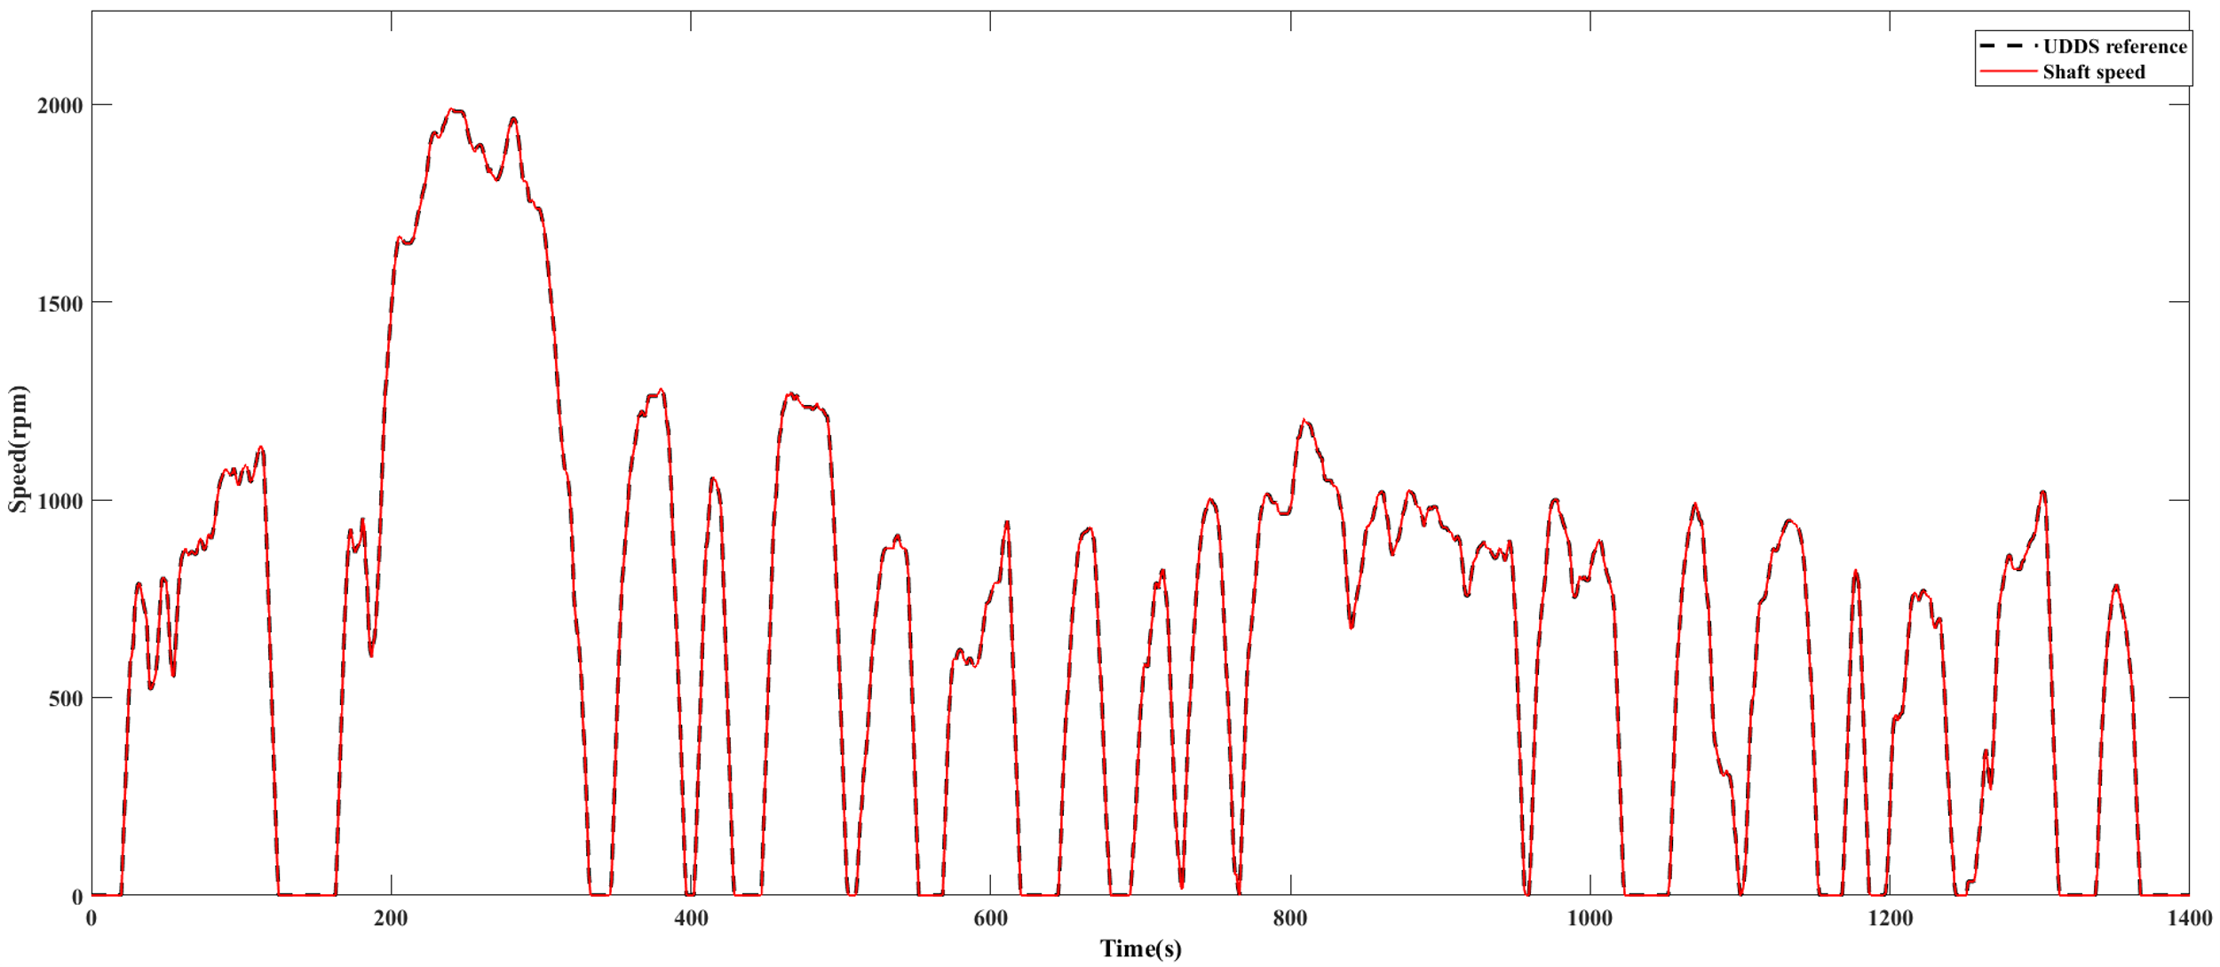
Results:
1) Speed:

Slide 13
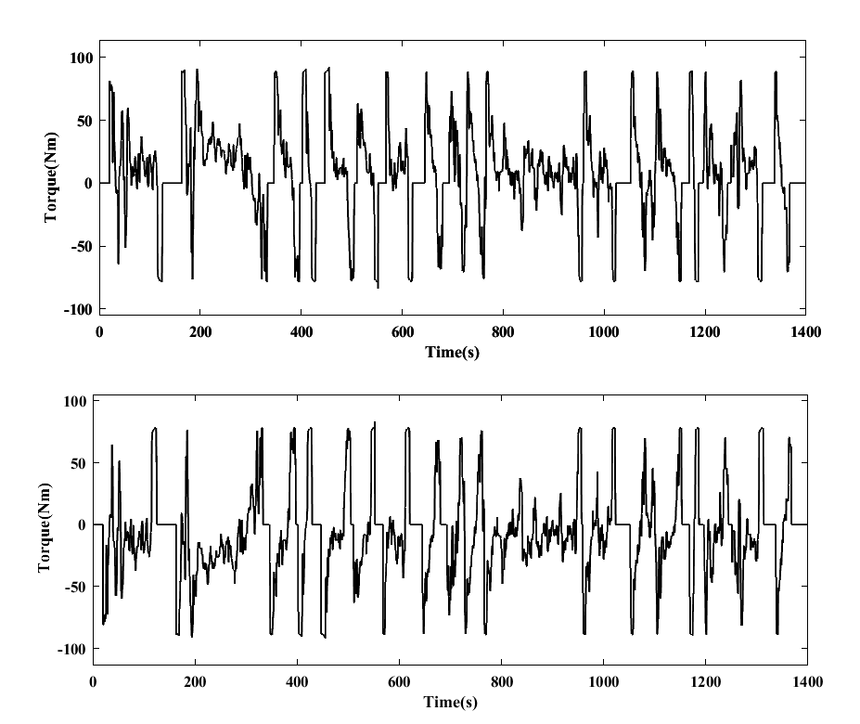
2)Torque:
Fig : a) IM Torque b) DC Motor Torque

Slide 14
Conclusion:
A new approach for emulating the behavior of EDVs was proposed based on vehicle equivalent rotational inertia. The method used to properly map the linear inertia of a vehicle to an equivalent rotational inertia was described in detail, and an expression for the equivalent rotational inertia of a vehicle was derived analytically. Using this expression, control approach was developed and simulated. The maximum torque required to complete this cycle was found to be approximately 92 Nm for this vehicle.

