Slide 1

Retail Apparel Sales Analysis
The business objectives are to clean and analyze the data, calculate key performance indicators (KPIs), and provide actionable insights to improve sales across customer segments, products, and regions.

Slide 2
Introduction
This is about analyzing the sales performance in a retail apparel company.
This dataset contains variables like Invoice Number, Customer ID, Product ID, Total Sales etc.
16898 rows and 12 columns are included in this dataset.
Dataset contains data from January 1st 2021 to January 11th 2021.
KPIs have been calculated such as Average Invoice Value, Rate of Retuned Products, etc.
Data Preprocessing, Data Analysis, Data Visualization parts have been done in this analysis.

Slide 3
Data Preprocessing
The Date Time column has been converted into proper datetime format(Year, Month, Day) for the easiness of date-based operations.
A row with an invalid Date Time was removed from the dataset.
346 null values from the Customer Age Group column have been dropped.
No duplicate values were found in this dataset.
There were misspelled values in the ‘Product Category’ and ‘Sales Channel’ variables and found using the value_counts() method in pandas and renamed to the correct name.

Slide 4
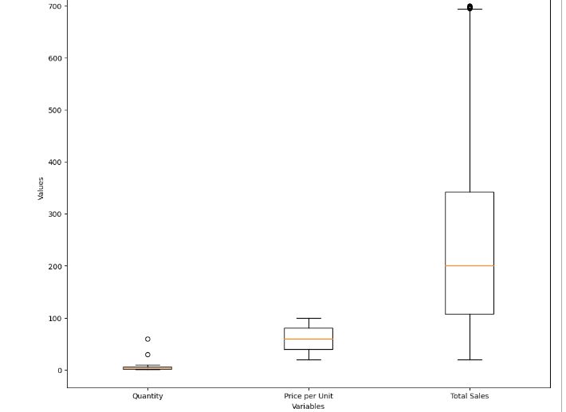
Detecting and removing outliers
Boxplots were used to detect the outliers of numerical variables.
Outliers in the Quantity and Total Sales.
IQR method has been used to detect the outliers.
The numerical dataset without the outliers have been taken.
Renamed the numerical variables with a new name and concatenated to the original dataset.
The old numerical name columns and the null values from the dataset have been removed.
Again, renamed the numerical variables to previous names and reorder it as previous dataset.

Slide 5
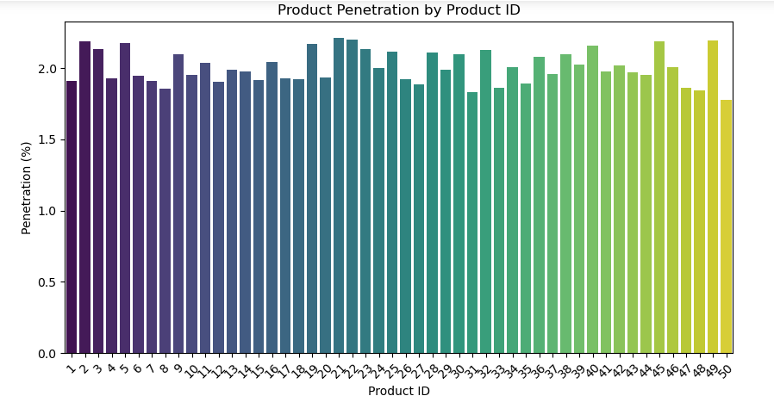
Product Penetration
The products over 2% penetration are most preferred products of customers.
The Product ID 50 has the lowest penetration just above 1.5%
Lower penetration can happen due to lack of awareness.
There is no significant upward or downward trends and products may have similar segments.
.

Slide 6
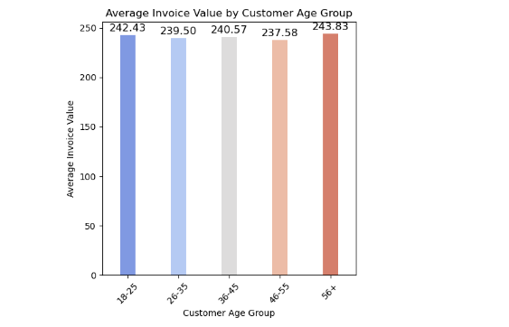
Average Invoice Value by Customer Age Group
Customer Age Group have been divided into 5 categories.
The age group 56+ have the highest average per invoice this suggest older customers make larger purchase.
18-25 age group has the 2nd highest value.
Young customers want to spend significant amount when they make purchases.
46-55 age group has the lowest values indicates less expensive items or smaller transactions.
26-35 and 36-45 age groups are middle aged adults and have a balance of spending power.

Slide 7
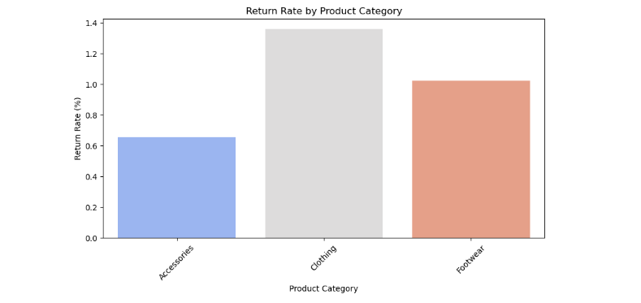
Rate Of Returned Products
Clothing has the highest return rate percentage.
Clothing return rate maybe higher due to sizing issues, fabric damages, style preference.
Accessories have the lowest return rate because they are less likely to have sizing issues.
Customers may feel confident in purchasing accessories.
Footwear returns can happen due to uncomfortable and sizing issues.

Slide 8
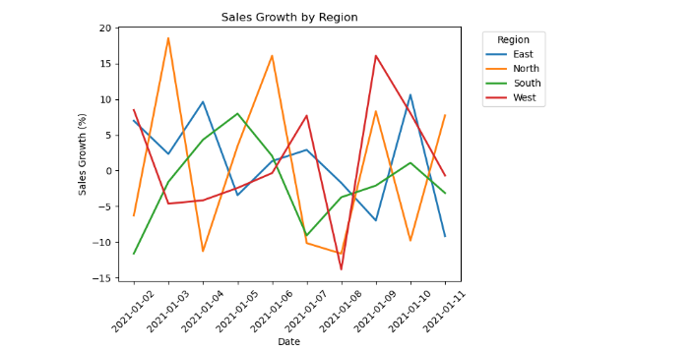
Sales Growth by Region
All four regions have significant fluctuations in sales growth over time.
The North region have the most significant increases and decreases due to demand and supply disruptions.
The South region have more smoother trend compared to other regions due to stable market conditions.
East and West regions have fluctuations less extreme than the North region.
The sharp peaks and drops can happen due to sales trend and promotions.

Slide 9
Insights and Findings
People prefer online shopping over in-store shopping, with 60.4% of sales coming from online purchases and 39.6% from in-store sales.
There is a high positive relationship between the Quantity and Total Sales and moderate positive relationship between Price Per Unit and Total Sales.
Most of the Invoices are for the Footwear and second for the Clothing and third for the Accessories.
There were 1.1% of products have been returned from the sold products.
Most of the sales are from the East region and least are from North region.
Most of the sales are being happened before the 9th hour o the day and after the 9th hour the sales have gone down.
Customers in the 46-55 age group have the highest total sales but the lowest average invoice value, possibly due to purchasing lower-priced items with high turnover.

Slide 10
Thank You

