Slide 1

Trading With ML: Classification and SVM

Slide 2
Multiclass Classification
Mutually exclusive: We can either go ‘long’ or ‘short sell’ or not take any actions. We cannot do these at the same time.
Not mutually exclusive=Multilabel Multiclass Classification

Slide 3
One vs. All Algorithm
Let’s say you have K classes:
C₁, C₂, ..., Cₖ
The One-vs-All strategy trains K binary classifiers, each one focused on one class vs. the rest.
For each class Cᵢ:
Label all examples of class Cᵢ as positive (1)
Label all other examples as negative (0)
Train a binary classifier on this dataset

Slide 4
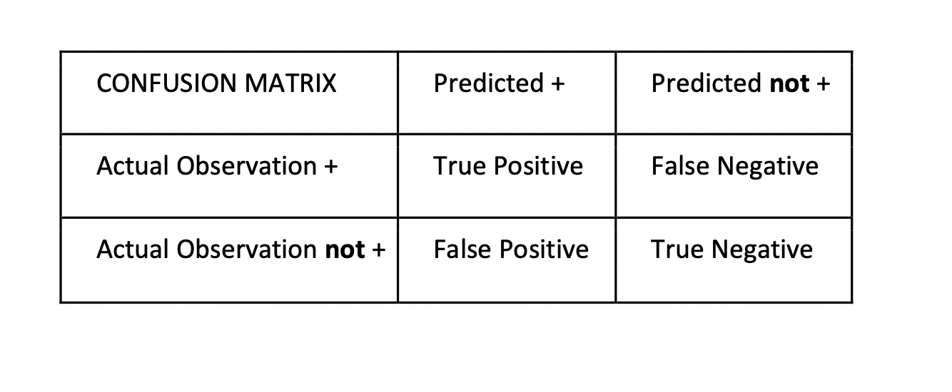
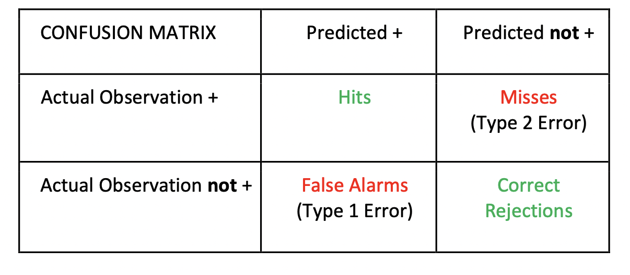
Confusion Matrix

Slide 5
Accuracy
Accuracy is simply a measure of how good a model is in predicting the classes. It is a model’s ability to ‘hit’ or ‘correctly reject’ observations while classifying the observations.
It can be understood by the following formula:
Accuracy = (TP + TN) / (TP + FN + FP + TN)

Slide 6
Precision
Precision is the ratio of correctly predicted positive observations to the total number of positive predictions including those which were in fact negative. It is a measure of how many ‘hits’ predicted by the model were actually ‘hits’ by the observed values.
Precision = TP / (TP + FP)

Slide 7
Recall
Recall also known as ‘sensitivity’ of the model, is the ratio of correctly predicted positiveevents to total number of actual positive observations. It is a measure of how many ‘hits’ were predicted with respect to total hits and misses by the model.
Recall = TP / (TP + FN)

Slide 8
F – measure
F-measure is a measure of test’s accuracy. It considers both precision and recall to compute the score of the test. It is nothing but the harmonic mean of precision and recall.
F1 Score = 2* [(Precision * Recall) / (Precision + Recall)]

Slide 9
1. Encoding Categorical Features
Goal: Convert non-numeric categorical data into numeric format suitable for machine learning models.
Examples:
Numeric: Open, High, Low, Close, Volume
Non-numeric: Sector (e.g. Banking, Tech), Type (Public/Private), Nature (Cyclical/Non-cyclical)
Numeric Encoding: Assigns a number to each category.
Example: [Public=0, Private=1], [Technology=3], etc.

Slide 10
2. One-Hot Encoding
Converts each category into a binary vector.
Each category becomes a separate column with 0s and 1s.
Example:
If there are 25 sectors, each company gets a 25-length vector with only one “1” and the rest “0”.
This allows categorical variables to be used in machine learning models without implying ordinal relationships.

Slide 11
3. Softmax Regression
Softmax Regression (also known as Multinomial Logistic Regression) is a generalization of logistic regression that allows us to perform classification when the target variable has more than two classes.
The output of the softmax function is a probability distribution across all classes.
To sum up, Softmax Regression transforms raw feature vectors into a probability distribution over multiple classes and selects the class with the highest probability, making it ideal for multi-class classification tasks.

Slide 12
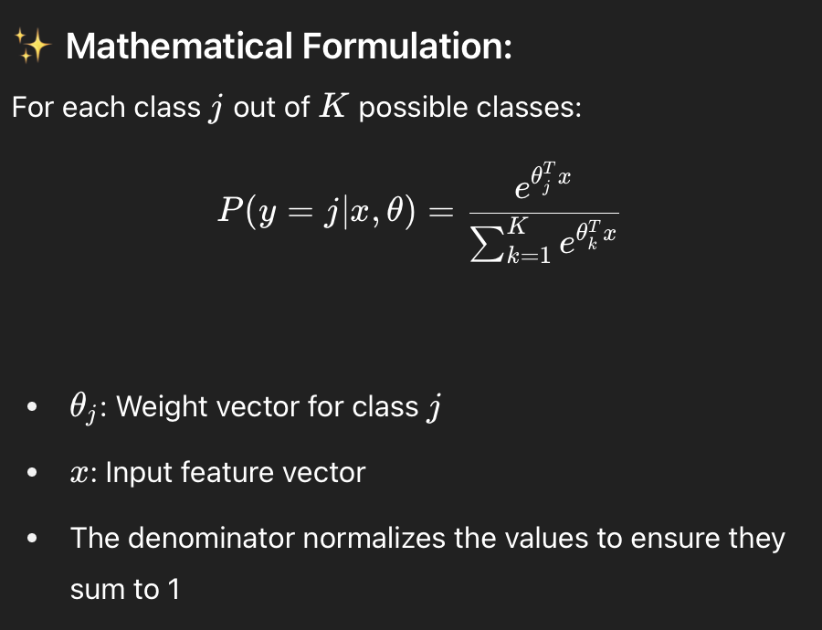
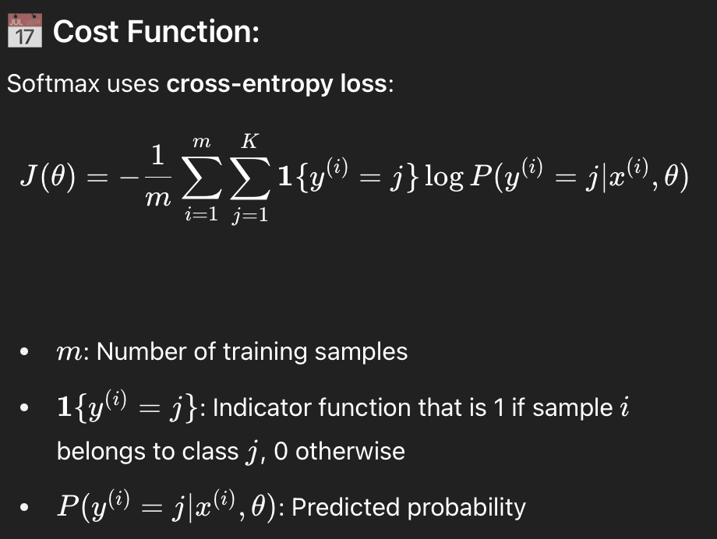
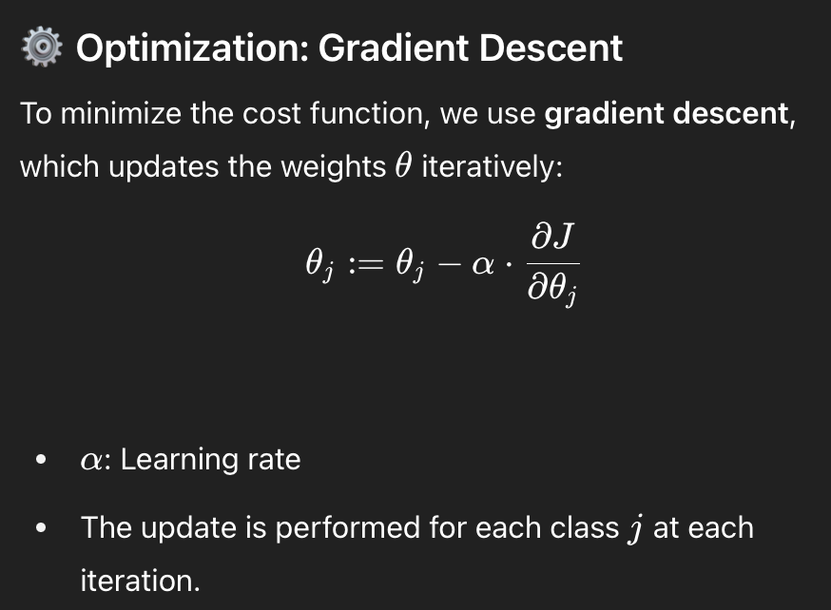
3. Softmax Regression

