Slide 1

Trading With ML: Classification and SVM

Slide 2
Introduction to Classification
Allocation of a data point to a predefined label.
Binary Classification: Categorization into two classes.
Multi Classification: Categorization into more than two classes.

Slide 3
Types of Supervised Classifier Algorithms
Size of training data
Independence of features set
System speed

Slide 4
Types of Supervised Classifier Algorithms
K-nearest Neighbours Algorithm (KNN)
Random Forest Using Decision Trees
Artificial Neural Network (ANN)
Naive Bayes Classification

Slide 5
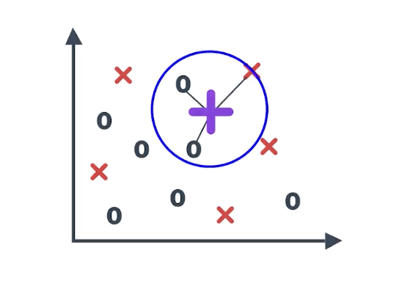
K-nearest Neighbors Algorithm (KNN)
A data point is classified on the basis of the distance between the data point and its neighbor.
The class of + is 0

Slide 6
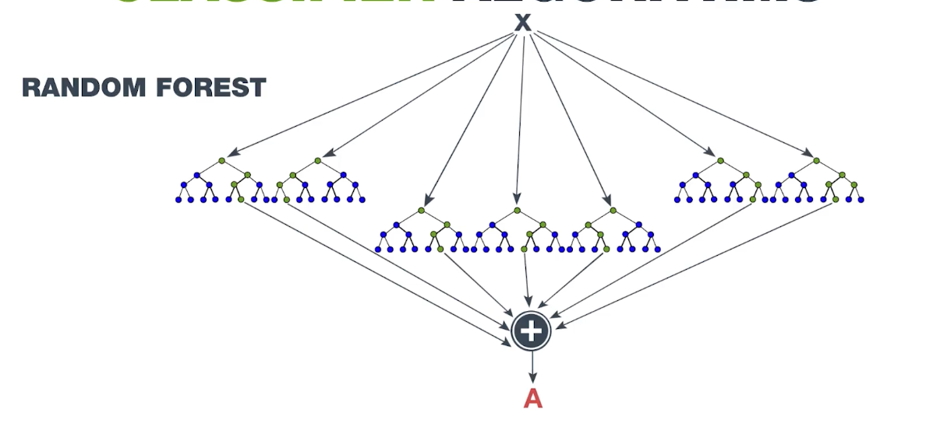
Random Forest Using Decision Trees
Random forest decision trees are developed based on random selection of variables and subsets.

Slide 7
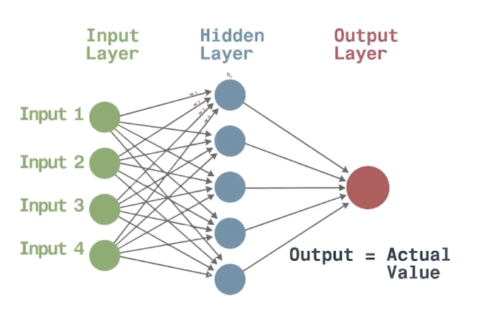
Artificial Neural Network (ANN)
A neural network divided into interconnected processing element called nodes
Back propagation: When actual value is not equal to output

Slide 8
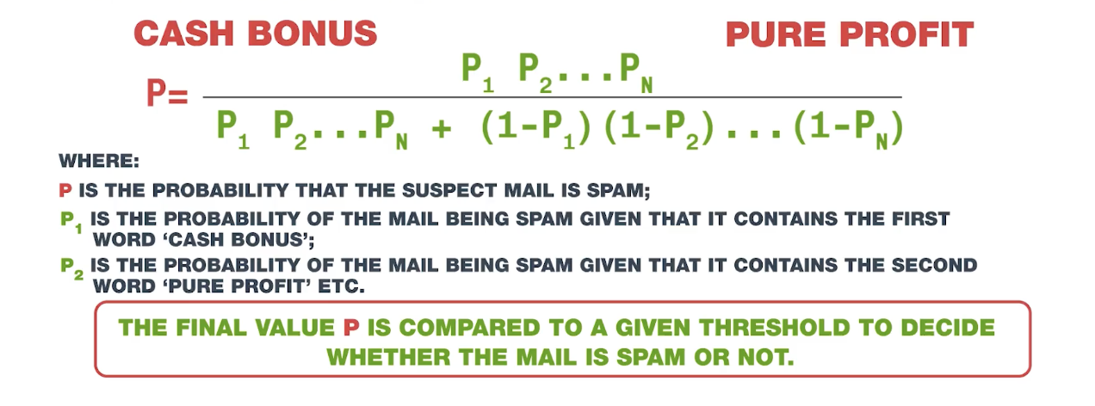

Naive Bayes Classification
Based on Bayes’ Theory of conditional theory

Slide 9
Technıcal ındıcators

Slide 10
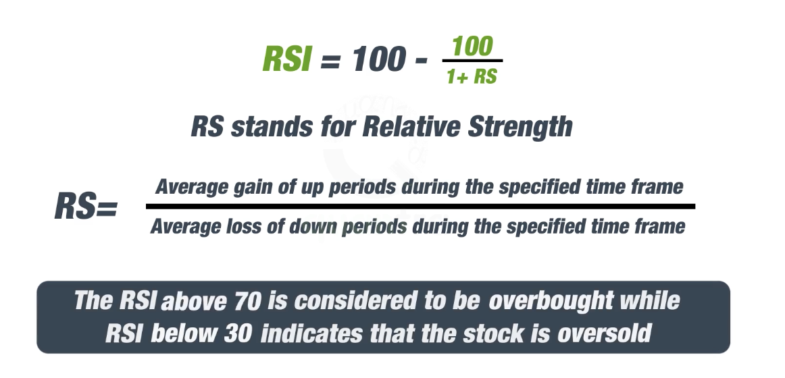
Relative Strenght Index (RSI)
Measures the strenght of the stock
Momentum oscillation
0-100
Typically, a time frame of 14 days is used to measure the indicator

Slide 11
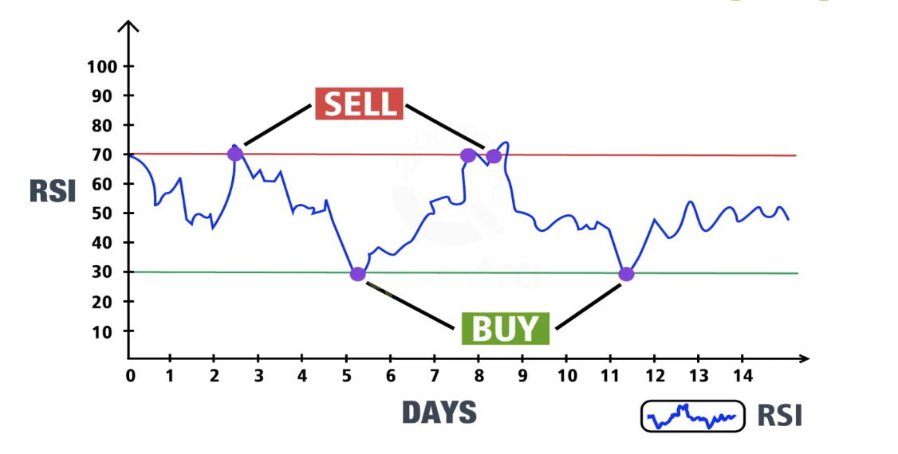
Relative Strenght Index (RSI)

Slide 12
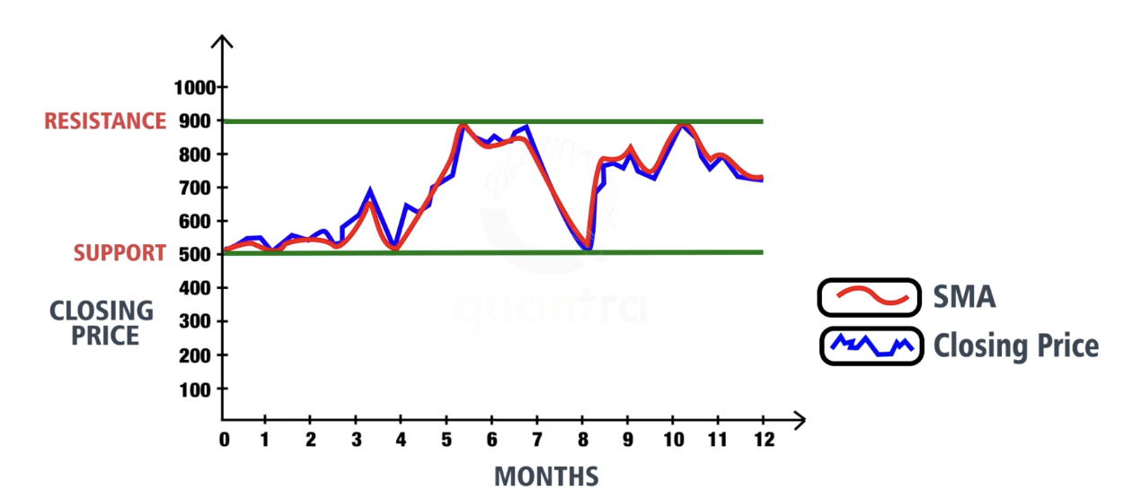
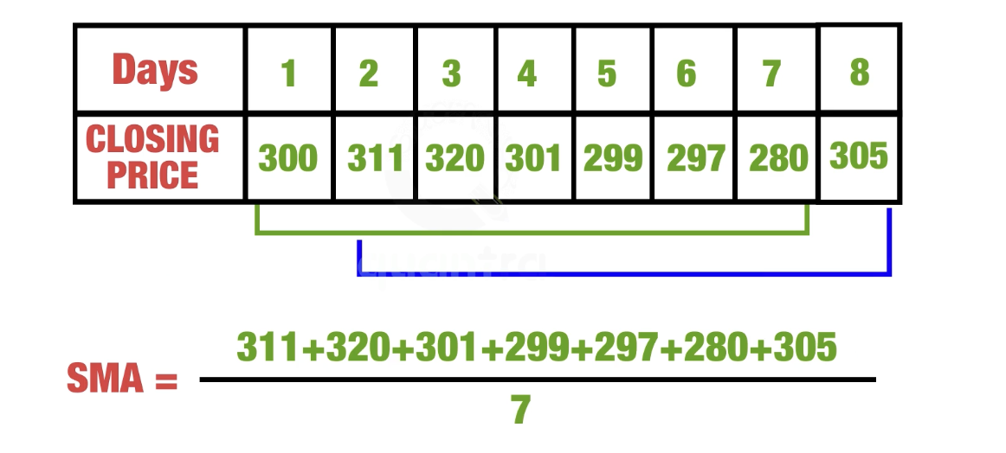
Simple Moving Average
Calculated by adding the average price of a security over a specific period of time
Most moving averages are based on closing price

Slide 13
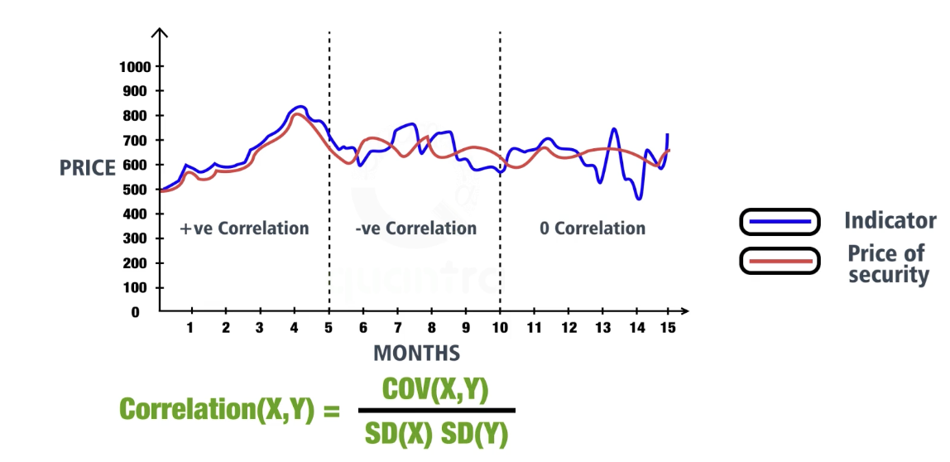
Correlation Coefficient
How closely two securities are related to each other
Between -1 and +1
Relationship between two securities become stronger as correlation move towards extreme of +1 or -1
A correlation of 0 means no relationship between two securities

Slide 14
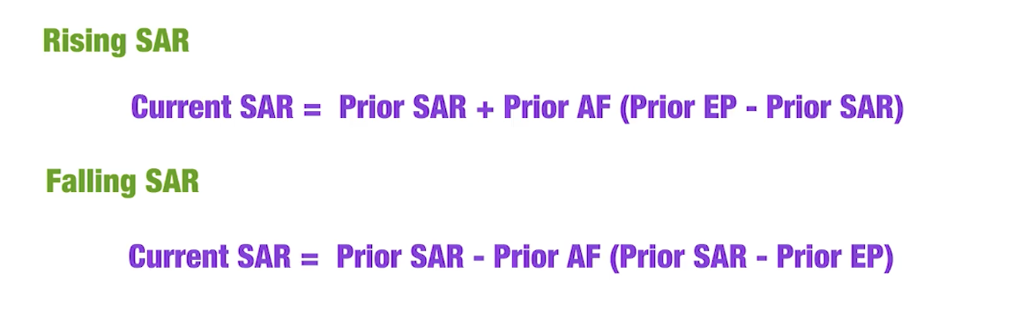
Parabolic SAR
SAR stands for ’’stop and reverse’’
Identify price trends and points of trend reveals
Plotted on a chart of the price of a stock
If prior SAR is not available
in downtrend: previous day’s high price
in uptrend: previous day’s low price
EP: Extreme point
AF: Accelerator factor
Considered as prior SAR

Slide 15
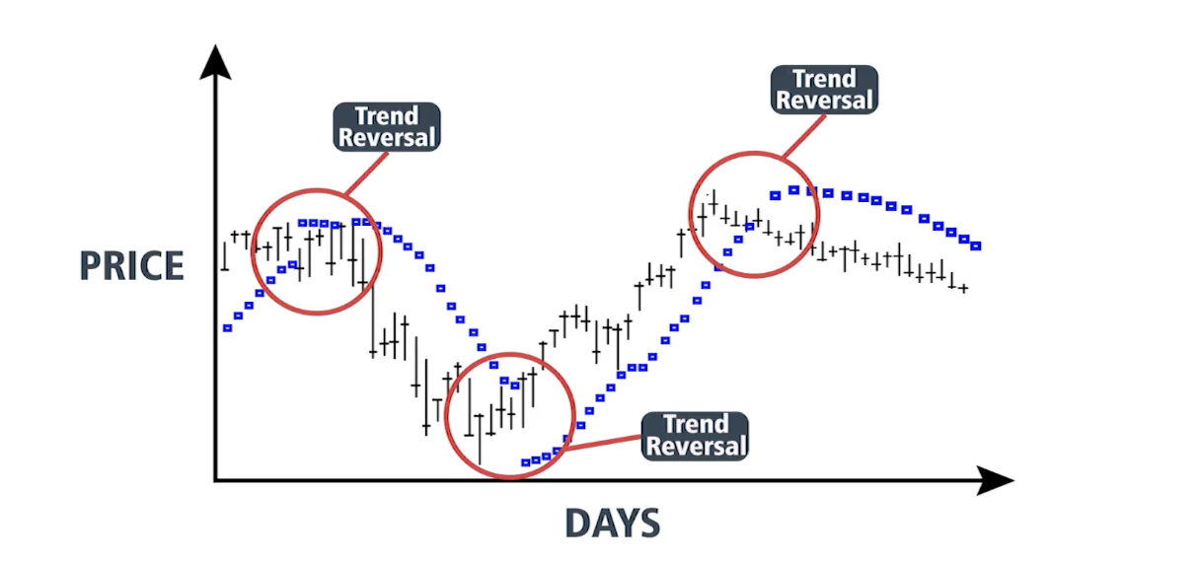
Parabolic SAR

Slide 16
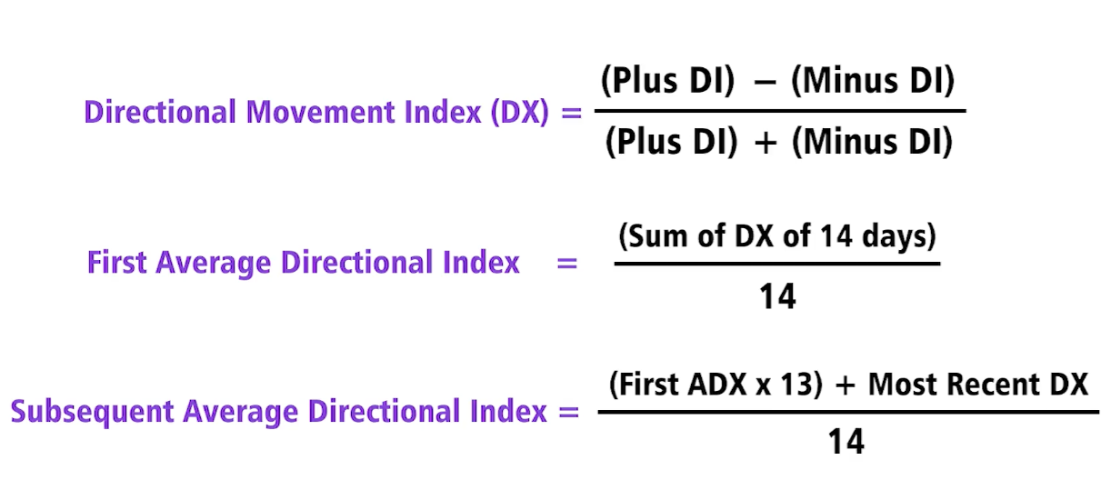
Average Directional Index (ADX)
Provides a value to the strenght of a trend
Non-directional
0-100
Typically, calculated over a period of 14 days
To calculate we need:
True range
Directional movement
Smoothed Plus Directional Indicator (Plus DI)
Smoothed Minus Directional Indicator (Minus DI)

Slide 17
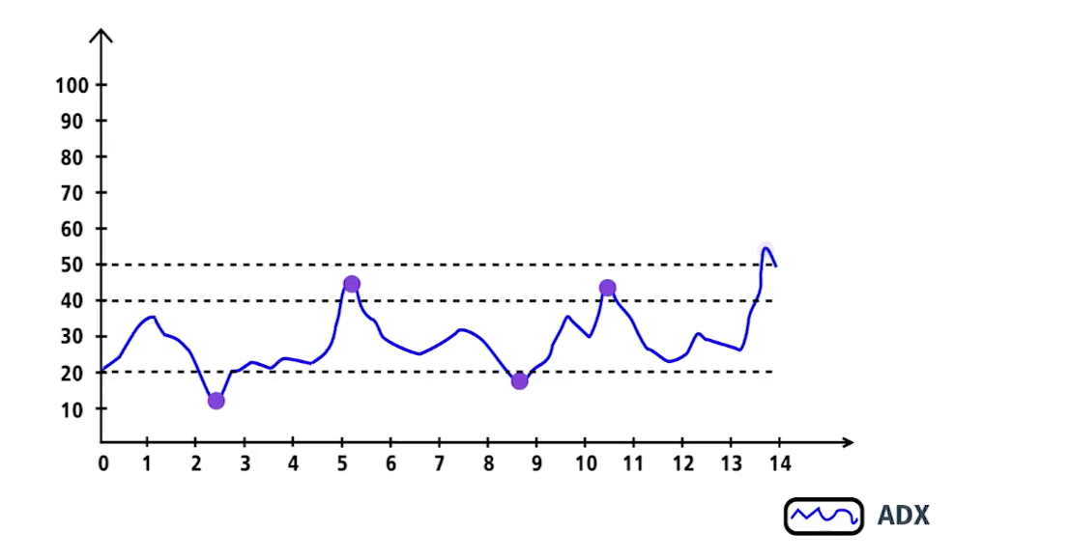
Average Directional Index (ADX)
Extremely strong trend

Slide 18
The Coding Question
https://github.com/Akgnbas/Trading-With-ML-Classification-and-SVM/blob/main/creting_an_indicator.ipynb

