Slide 1
Healthcare Business Intelligence | Revenue Strategy Simulation
Annual Wellness Screening Program
12-Week Pilot Analysis
Deborah Akhabue
Healthcare Data Analyst

Slide 2
Business Goals
The hospital ran a 12-week pilot of the Annual Wellness Screening Program to see if it can work in the long term.
Leadership wants to understand:
Which pathway brings in the most patients
Which pathway generates the most revenue per patient
Whether spending more staff time brings enough financial return
How enrollment and revenue changed over the 12 weeks
These answers will guide decisions about expanding the program.

Slide 3
Executive Summary
A 12-week pilot was conducted to assess whether the wellness program is operationally and financially sustainable.
A total of 12,000 patients enrolled through three different access pathways. Each pathway required a different level of staff involvement.
The goal was to understand how pathway design affects patient volume, revenue performance, and long-term sustainability.

Slide 4
Executive Summary Contd.
This analysis focuses on:
Patient enrollment volume
Total revenue
Revenue per patient
Contribution margin
Revenue distribution patterns
Weekly growth trends
Key Insight:
Digital access drives higher patient volume, while pathways that provide more personal support generate higher revenue per patient. A balanced approach supports sustainable growth.

Slide 5
Data Overview
12,000 patient enrollments
12-week pilot period
3 access pathways
Service revenue per patient
Estimated pathway cost
Services used per patient
All results are based on a structured simulation of a mid-size private hospital.

Slide 6
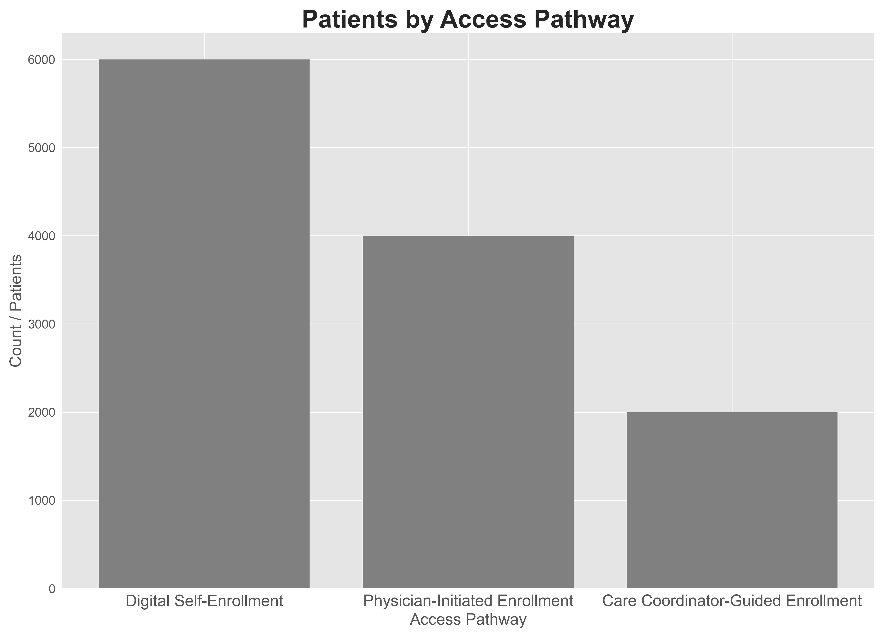
How patient count differs across access pathways
During the 12-week pilot, Digital Self-Enrollment recorded the highest patient volume. Physician-Initiated Enrollment followed, while Care Coordinator–Guided Enrollment had the lowest volume.
Digital enrollment required minimal staff involvement, which made it easier to scale. The other pathways depended more on clinician and coordinator time, which limited how many patients could be enrolled.
Pathways that require more staff time enrolled fewer patients but provided more personal support.

Slide 7
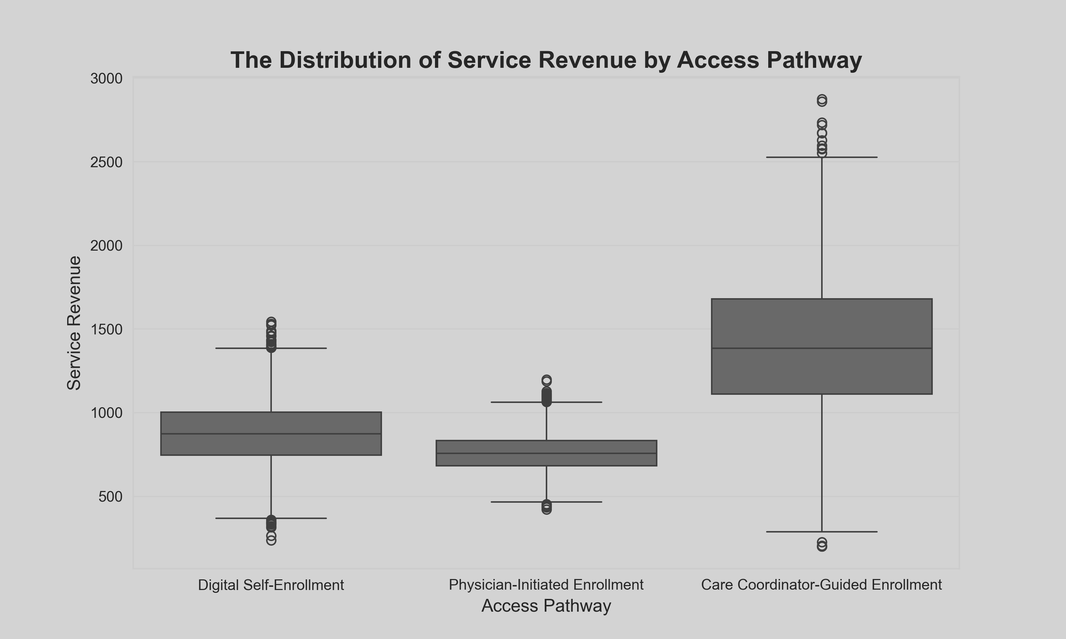
The spread of revenue across each pathway
Revenue varies clearly across the three pathways.
Care Coordinator–Guided Enrollment shows the widest revenue range, meaning patients in this pathway often selected higher-value services.
Digital Self-Enrollment shows a moderate revenue range, with most patients choosing mid-range packages.
Physician-Initiated Enrollment shows the narrowest range and generally lower revenue per patient.
Patients who receive more personal support tend to choose higher-value services.

Slide 8
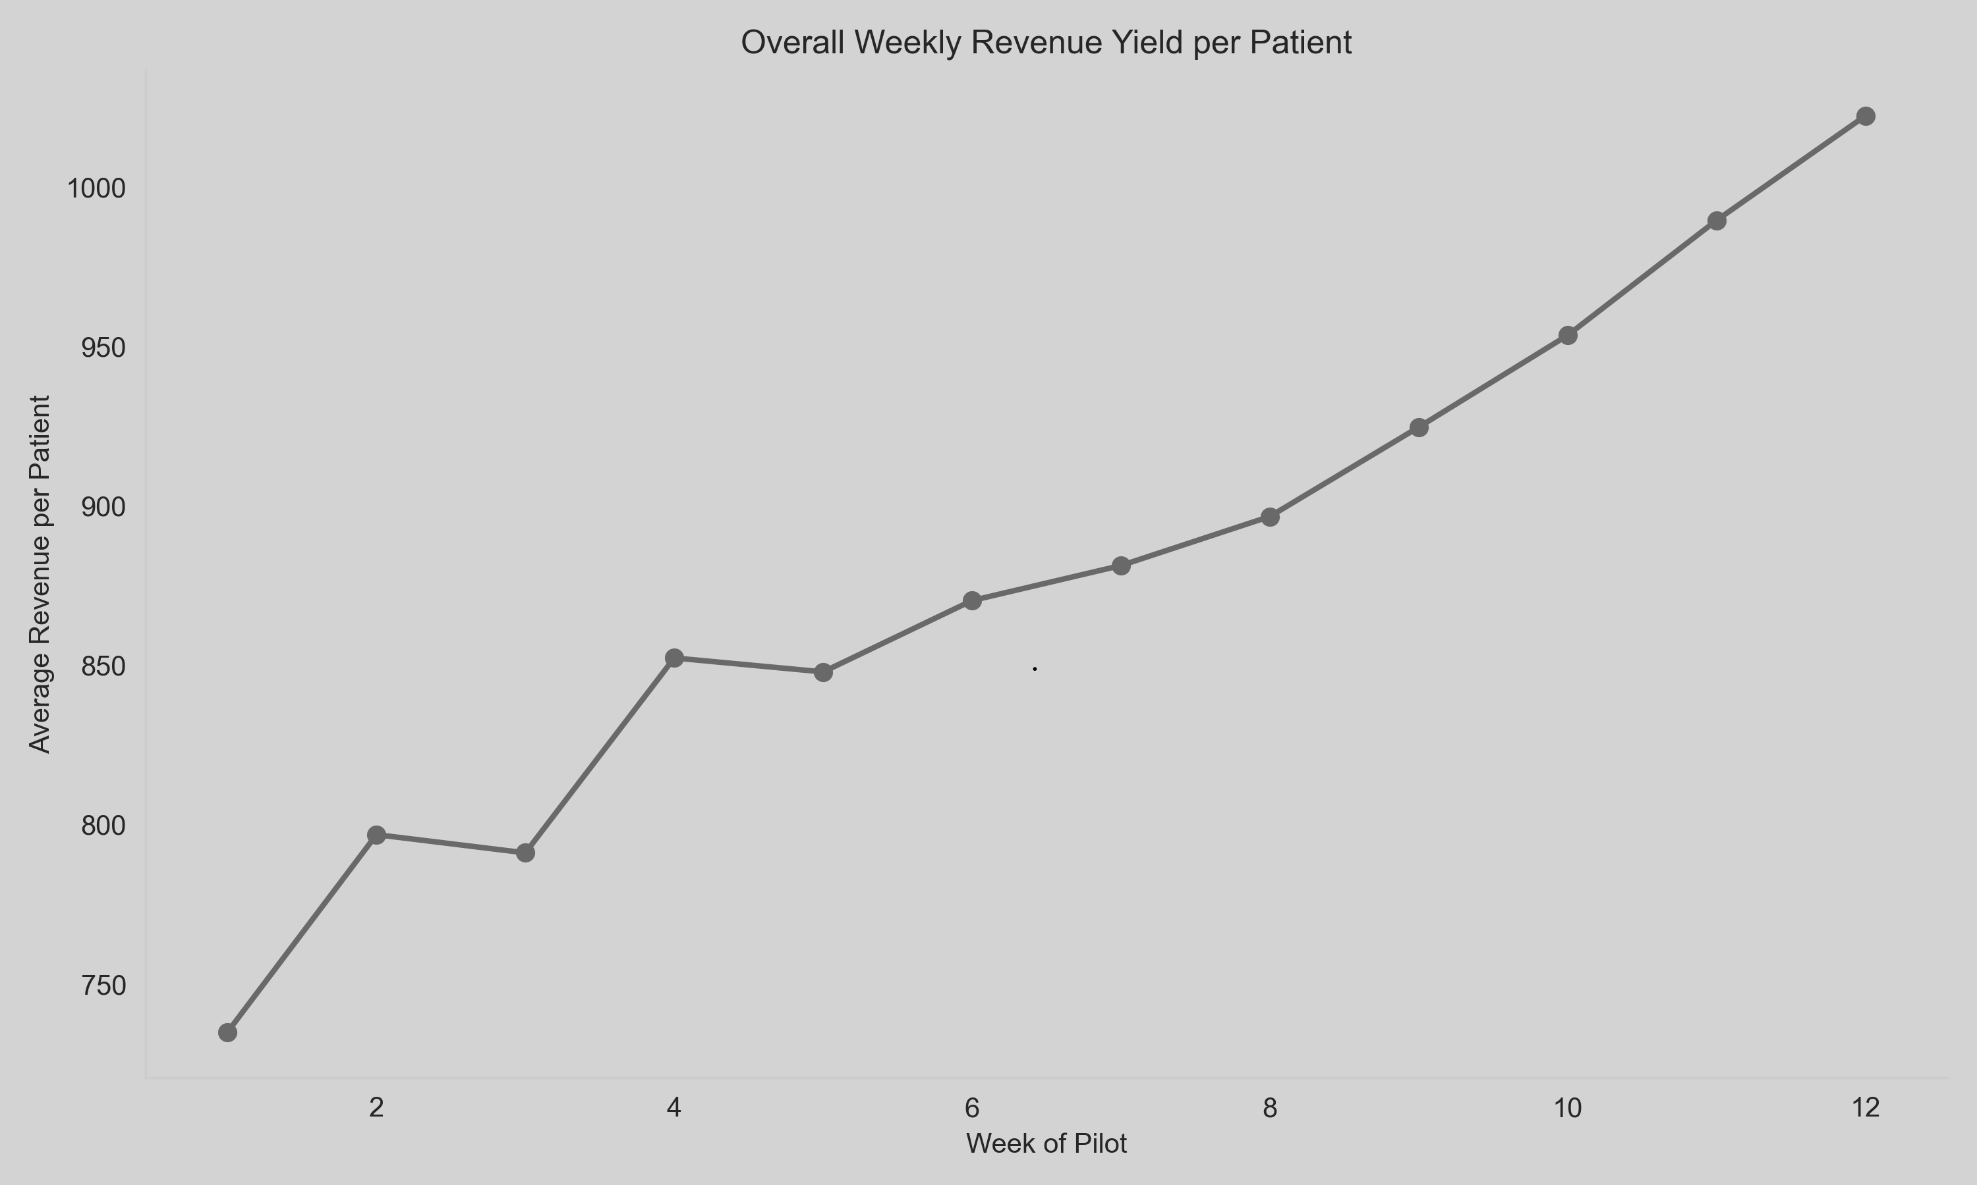
Adoption and Revenue Growth Over the 12-Week Pilot
Revenue increased steadily across the 12-week pilot, indicating stable and growing program adoption.
This shows that patient adoption strengthened over time and the program gained momentum as the pilot progressed.

Slide 9
Key Financial Indicator: Revenue Yield per Enrolled Patient (RYP)
RYP measures the average revenue generated per enrolled patient.
12-Week Results:
Digital Self-Enrollment: ~$875 per patient
Physician-Initiated Enrollment: ~$758 per patient
Care Coordinator–Guided Enrollment: ~$1,390 per patient
Care Coordinator–Guided Enrollment generates the strongest revenue per patient, even though it enrolls fewer patients overall.

Slide 10
Key Financial Indicator: Contribution Margin per Patient
Contribution margin shows how much revenue remains after pathway-specific costs are deducted.
12-Week Results:
Digital Self-Enrollment: Moderate margin driven by scale and low cost
Physician-Initiated Enrollment: Lower margin
Care Coordinator–Guided Enrollment: Strongest margin per patient
Higher engagement through Care Coordinator–Guided Enrollment justifies its higher cost because it delivers the strongest financial return per patient.

Slide 11
Recommendations
Based on the 12-week pilot:
Continue using Revenue Yield per Patient and Contribution Margin as the primary performance measures.
Continue using Digital Self-Enrollment as the primary growth pathway. It enrolled 6,000 patients and generated $5,251,463.17 in total revenue. It is scalable and operationally efficient.

Slide 12
Recommendations Contd.
Use Care Coordinator–Guided Enrollment selectively for higher-value patient groups. It enrolled 2,000 patients and generated $2,784,247.54 in revenue, with the highest revenue per patient.
Position Physician-Initiated Enrollment as a supportive pathway. It enrolled 4,000 patients and generated $3,033,640.35 but has lower revenue per patient and limited scalability.
Improve data collection to include service-level cost details and long-term patient retention to support future expansion decisions.

Slide 13
Assumptions & Considerations
This analysis is based on a 12-week pilot.
The following were not included:
Payer mix differences
Long-term retention
Clinical outcome impact
Detailed service-level cost breakdown
These factors should be included in future evaluations.

Slide 14
Conclusion
The 12-week pilot shows that the way patients enroll affects both patient volume and financial performance.
Digital pathways drive scale. Higher-engagement pathways drive stronger revenue per patient.
Using both strategically can help the hospital expand the program in a sustainable way.

