Slide 1
You are a documentation builder.
Analyze the code and user instructions, then output a JSON object with a 'project_info' field summarizing:
- Purpose
- Key modules/classes/functions
- Data models or entities
Code:
import axios from "axios";
import React, { useState } from "react";
import { FaEnvelope, FaLock, FaTimes, FaUser } from "react-icons/fa";
import { useNavigate } from "react-router-dom";
const Register = () => {
const navigate = useNavigate();
const [formData, setFormData] = useState({
username: "",
email: "",
password: "",
});
const [error, setError] = useState("");
// Use the direct video URL as the initial video source
const fallbackVideoUrl =
"https://www.pexels.com/video/close-up-of-a-plant-and-the-sunlight-8745490/";
const [videoSrc, setVideoSrc] = useState(fallbackVideoUrl);
const [videoLoadFailed, setVideoLoadFailed] = useState(false);
// Update state on input change
const handleChange = (e) => {
const { name, value } = e.target;
setFormData((prev) => ({ ...prev, [name]: value }));
};
// Handle form submission
const handleSubmit = async (e) => {
e.preventDefault();
setError("");
try {
// Use your deployed Node server URL on Render
const response = await axios.post(
"http://127.0.0.1:5000/register",
formData
);
console.log(response.data.message);
// Redirect to login page after successful registration
navigate("/login");
} catch (err) {
setError(err.response?.data?.message || "Registration failed.");
}
};
return (
<div className="relative h-screen w-screen overflow-hidden">
{/* Background Video or fallback black background */}
{!videoLoadFailed ? (
<video
autoPlay
loop
muted
className="absolute inset-0 w-full h-full object-cover pointer-events-none"
onError={() => setVideoLoadFailed(true)}
>
<source src={videoSrc} type="video/mp4" />
Your browser does not support the video tag.
</video>
) : (
<div className="absolute inset-0 bg-black"></div>
)}
{/* Dark Overlay for Readability */}
<div className="absolute inset-0 bg-black opacity-60"></div>
{/* Form Container */}
<div className="relative flex items-center justify-center h-full px-4">
<div className="relative bg-white/20 backdrop-blur-xl p-10 rounded-3xl shadow-2xl max-w-md w-full transition-transform transform hover:scale-105">
{/* Cross Button inside the card */}
<button
onClick={() => navigate(-1)}
className="absolute top-4 right-4 text-white text-2xl transition-transform duration-300 hover:scale-110"
>
<FaTimes />
</button>
<h1 className="text-center text-4xl font-bold text-white mb-6">
Register
</h1>
{error && (
<p className="text-red-500 text-center mb-4 animate-pulse">
{error}
</p>
)}
<form onSubmit={handleSubmit} className="space-y-6">
{/* Username Field */}
<div className="relative">
<span className="absolute left-4 top-1/2 transform -translate-y-1/2 text-gray-300">
<FaUser />
</span>
<input
type="text"
name="username"
value={formData.username}
onChange={handleChange}
placeholder="Username"
className="w-full pl-12 py-3 rounded-xl bg-white/20 border border-white/30 text-white placeholder-gray-300 focus:outline-none focus:ring-2 focus:ring-blue-400 transition-all"
required
/>
</div>
{/* Email Field */}
<div className="relative">
<span className="absolute left-4 top-1/2 transform -translate-y-1/2 text-gray-300">
<FaEnvelope />
</span>
<input
type="email"
name="email"
value={formData.email}
onChange={handleChange}
placeholder="Email Address"
className="w-full pl-12 py-3 rounded-xl bg-white/20 border border-white/30 text-white placeholder-gray-300 focus:outline-none focus:ring-2 focus:ring-blue-400 transition-all"
required
/>
</div>
{/* Password Field */}
<div className="relative">
<span className="absolute left-4 top-1/2 transform -translate-y-1/2 text-gray-300">
<FaLock />
</span>
<input
type="password"
name="password"
value={formData.password}
onChange={handleChange}
placeholder="Password"
className="w-full pl-12 py-3 rounded-xl bg-white/20 border border-white/30 text-white placeholder-gray-300 focus:outline-none focus:ring-2 focus:ring-blue-400 transition-all"
required
/>
</div>
{/* Submit Button */}
<button
type="submit"
className="w-full py-3 rounded-xl bg-blue-500 hover:bg-blue-400 text-white font-semibold transition-all shadow-lg"
>
Sign Up
</button>
</form>
</div>
</div>
</div>
);
};
export default Register;
Instructions:
Generate a detailed Word document and UML diagrams for this component
2025-06-15

Slide 2
Overview
Technical Report: React Registration Component

Slide 3
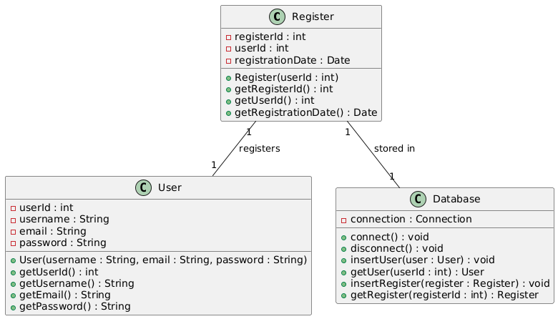
Class_Diagram
** Illustrates the classes, attributes, and methods of the system, including `Register` component and potential backend classes.

Slide 4
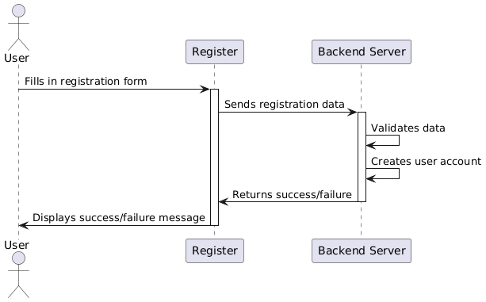
Sequence_Diagram
** Shows the interactions between the `Register` component, the user, and the backend server during registration.

Slide 5
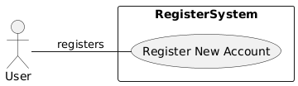
Use_Case_Diagram
** Depicts the user interactions with the system (registering a new account).

Slide 6
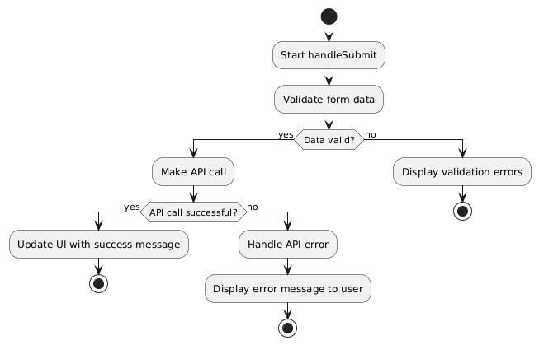
Activity_Diagram
** Models the flow of actions within the `handleSubmit` function, including API calls and error handling.

Slide 7
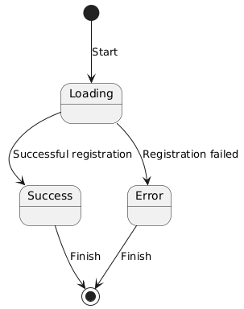
State_Machine_Diagram
** Represents the different states of the `Register` component (e.g., loading, success, error) and transitions between them.

Slide 8
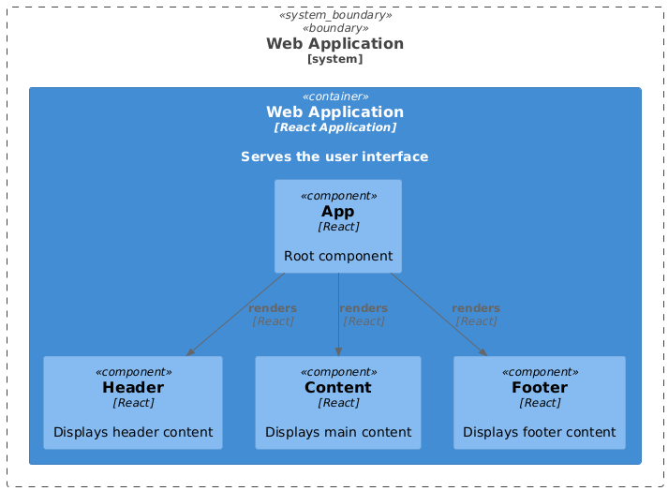
Component_Diagram
** Shows the relationships between the React components involved (though simple in this case).

Slide 9
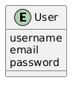
Data_Model_Diagram_Entity-Relationship_Diagram_-_ERD
** Represents the structure of the data stored on the backend, likely including a `User` entity with attributes like `username`, `email`, and `password`.

