Slide 1
You are a documentation builder.
Analyze the code and user instructions, then output a JSON object with a 'project_info' field summarizing:
- Purpose
- Key modules/classes/functions
- Data models or entities
Code:
// src/index.jsx
import React from "react";
import ReactDOM from "react-dom/client";
import App from "./App.jsx";
import "./index.css";
ReactDOM.createRoot(document.getElementById("root")).render(
<React.StrictMode>
<App />
</React.StrictMode>
);
Instructions:
Generate a detailed Word document and UML diagrams for this component
2025-06-15

Slide 2
Overview
Technical Report: React Application Documentation

Slide 3
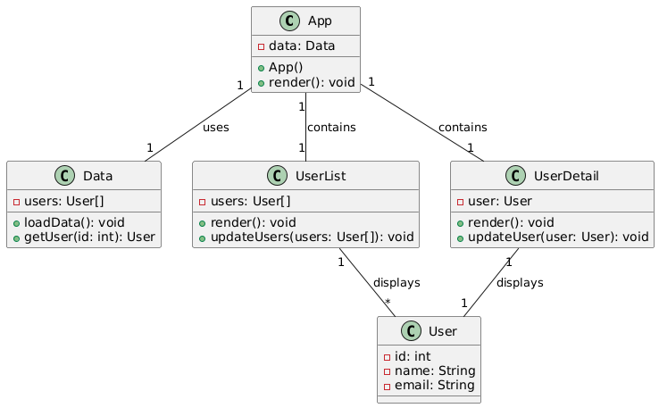
Class_Diagram
** Shows the classes, their attributes, and methods, including the relationships between them (App, React components etc.).

Slide 4
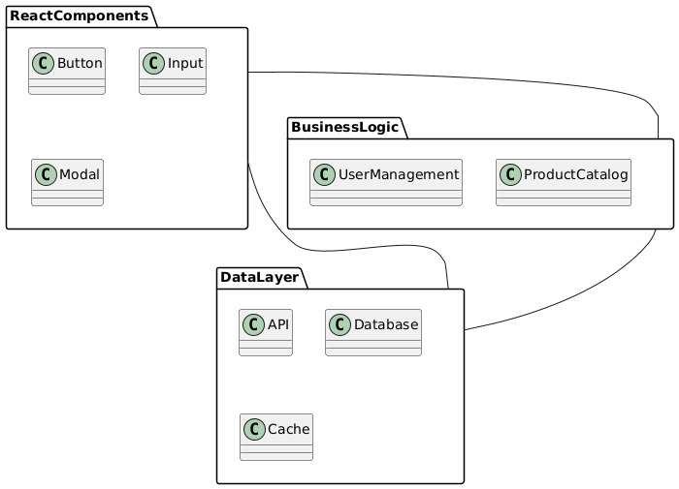
Package_Diagram
** Organizes the system into packages to show the structure of the codebase (e.g., separating React components from other modules).

Slide 5
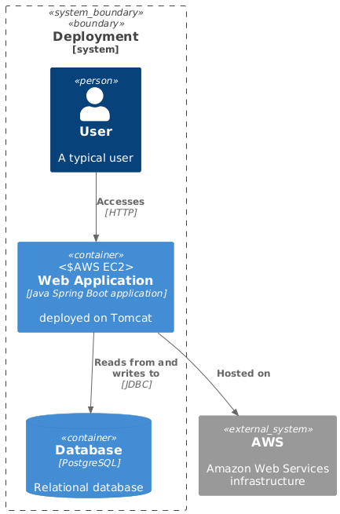
Deployment_Diagram
** Illustrates how the application is deployed across physical or virtual machines (servers, browsers). (While simple here, useful for completeness).

Slide 6
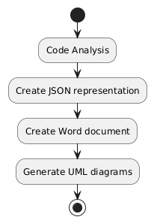
Activity_Diagram
** Models the workflow of the documentation generation process (code analysis, JSON creation, Word document creation, UML diagram generation).

Slide 7

Use_Case_Diagram
** Shows the interaction between the user (documentation builder) and the system (documentation generation tool). (Could be simplified to just showing "Generate Documentation").

Slide 8
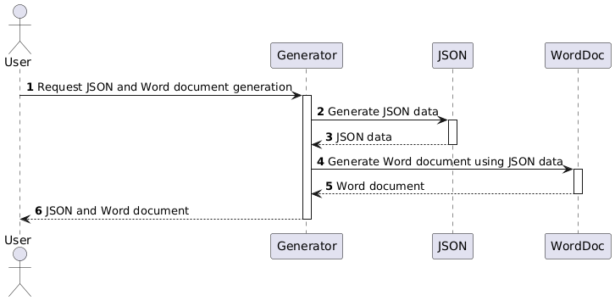
Sequence_Diagram
** Details the sequence of messages between the components during the generation of the JSON output and the Word document. (Useful to detail the data flow).

Slide 9
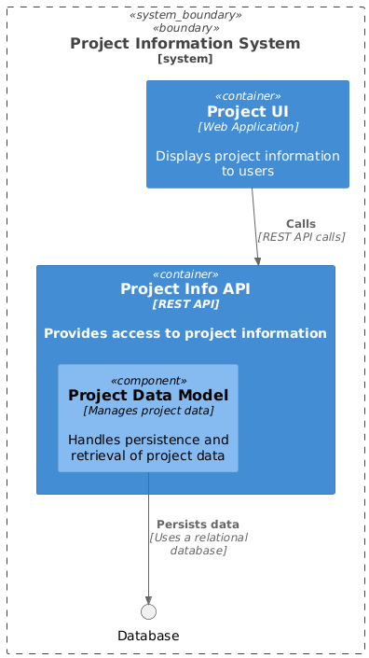
Data_Model_Diagram_Entity-Relationship_Diagram
** Visual representation of the 'project_info' JSON data structure (Purpose, Key Modules, Data Models).

