Slide 1
You are a documentation builder.
Analyze the code and user instructions, then output a JSON object with a 'project_info' field summarizing:
- Purpose
- Key modules/classes/functions
- Data models or entities
Code:
// src/index.jsx
import React from "react";
import ReactDOM from "react-dom/client";
import App from "./App.jsx";
import "./index.css";
ReactDOM.createRoot(document.getElementById("root")).render(
<React.StrictMode>
<App />
</React.StrictMode>
);
Instructions:
Generate a detailed Word document and UML diagrams for this component
2025-06-15

Slide 2
Overview
Technical Report: React Application Documentation
• 1. Project Overview
• 2. Documentation Plan
• 3. Next Steps

Slide 3
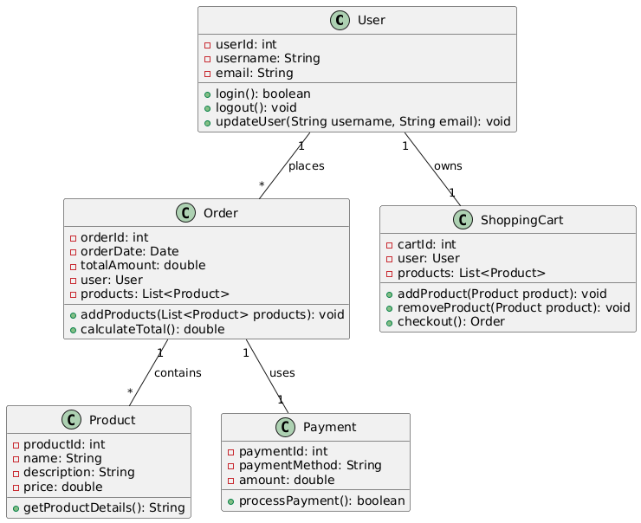
Class_Diagram
** Shows the classes, their attributes, methods, and relationships (like inheritance and association) within the application.

Slide 4
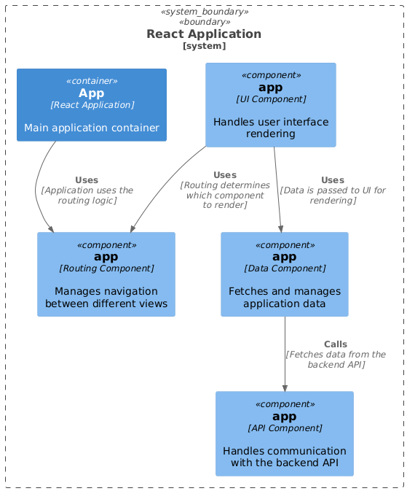
Component_Diagram
** Illustrates the high-level components of the React application (e.g., App, individual components) and their dependencies.

Slide 5
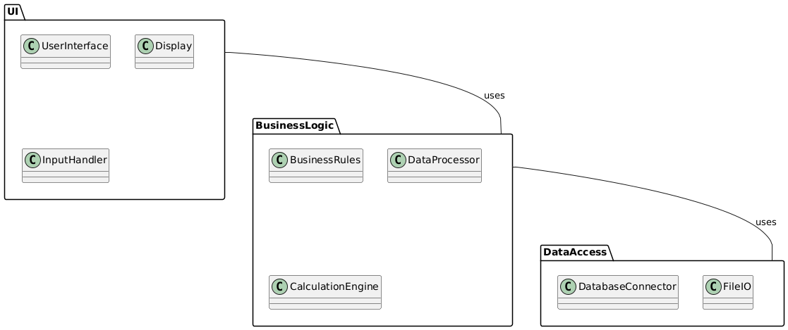
Package_Diagram
** Organizes the system into packages to show structural relationships between different parts of the codebase (e.g., separating UI components from business logic).

Slide 6
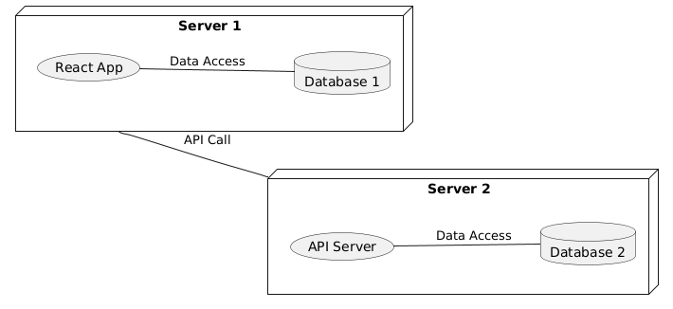
Deployment_Diagram
** (Potentially useful, depending on scope) Depicts the physical deployment of the application (servers, databases, etc.). Less critical for a small React app.

Slide 7
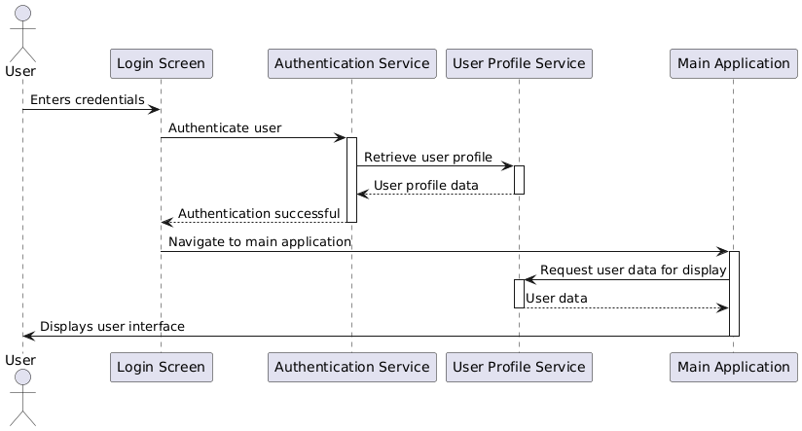
Sequence_Diagram
** (Potentially useful, for specific interactions) Shows the sequence of interactions between objects/components during a specific use case. This would mostly apply to analyzing user interactions within the application.

Slide 8
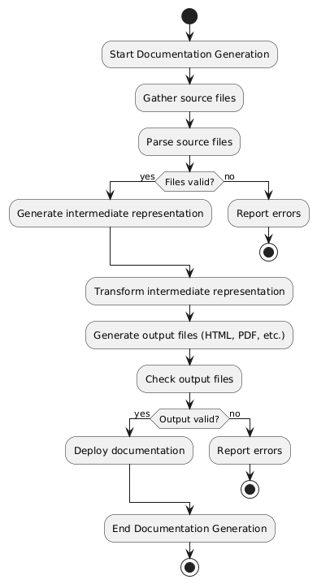
Activity_Diagram
** (Potentially useful, for specific workflows) Visualizes the flow of control within a specific function or process, such as the documentation generation process itself.

