Slide 1
You are a documentation builder.
Analyze the code and user instructions, then output a JSON object with a 'project_info' field summarizing:
- Purpose
- Key modules/classes/functions
- Data models or entities
Code:
// src/index.jsx
import React from "react";
import ReactDOM from "react-dom/client";
import App from "./App.jsx";
import "./index.css";
ReactDOM.createRoot(document.getElementById("root")).render(
<React.StrictMode>
<App />
</React.StrictMode>
);
Instructions:
Generate a detailed Word document and UML diagrams for this component
2025-06-15

Slide 2
Overview
Technical Report: React Application Documentation

Slide 3
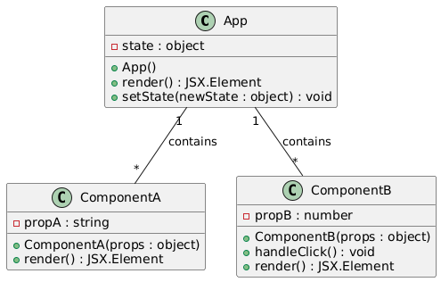
Class_Diagram
** Shows the classes (`App`, potentially others within `App.jsx`), their attributes, and methods.

Slide 4
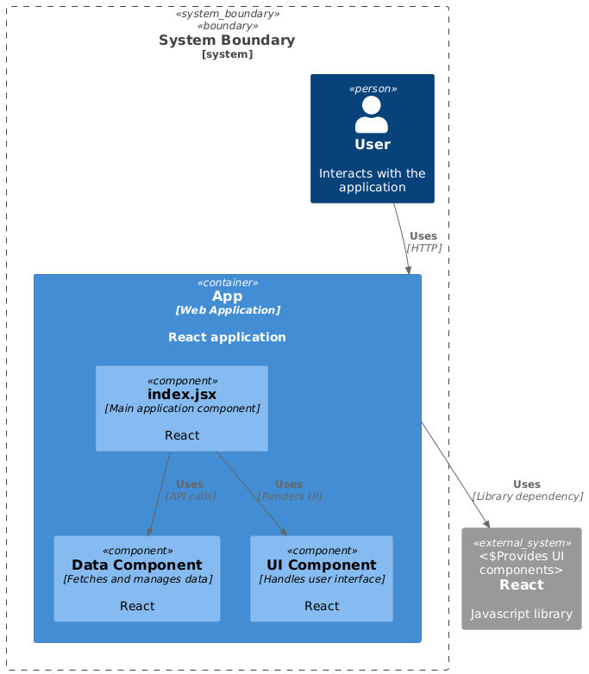
Component_Diagram
** Illustrates the high-level components of the system (e.g., `App`, `index.jsx`, external libraries like React).

Slide 5
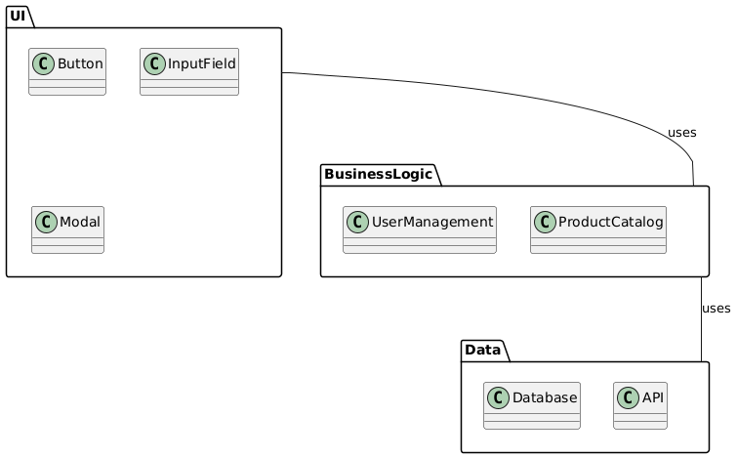
Package_Diagram
** Organizes the system into logical packages (e.g., a 'UI' package containing React components).

Slide 6
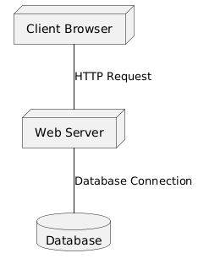
Deployment_Diagram
** Shows the deployment of the application (e.g., web server, client browser). Less relevant given limited system information.

Slide 7
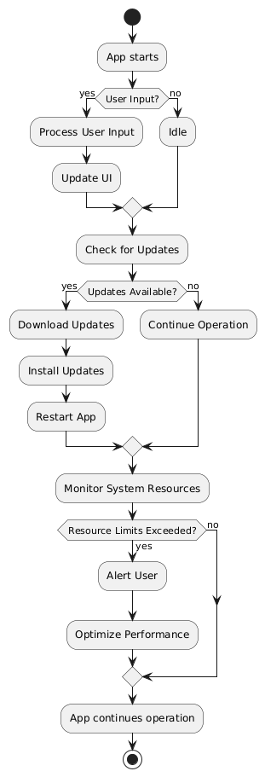
Activity_Diagram
** Could illustrate the flow of execution within the `App` component or other key functions.

Slide 8
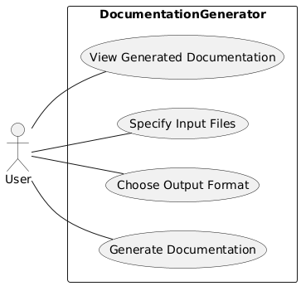
Use_Case_Diagram
** To represent user interactions and the functionality of the system as a whole. This would show the system's overall goal to generate documentation.

