Slide 1
Connect-A-PIC
Design Document

Slide 2
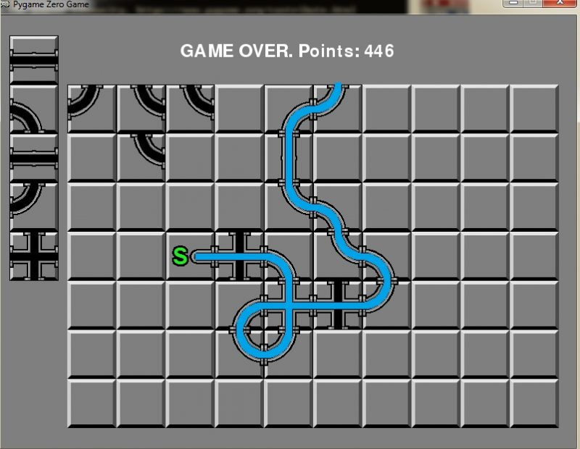
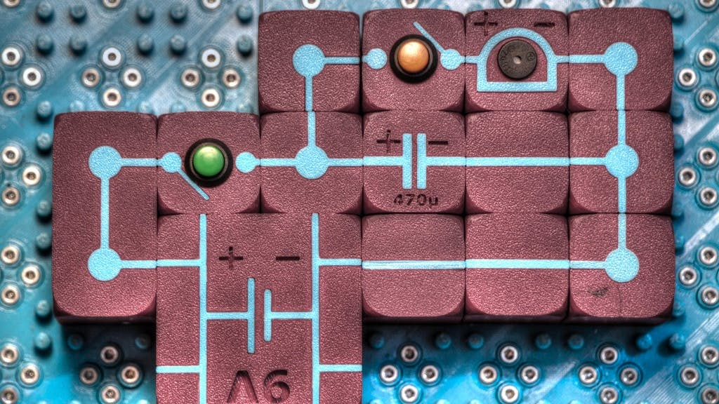
Inspiration
The overall game idea is inspired by pipe connecting and electronic connecting games:

Slide 3
Ideas
Team as talking heads giving advice or presenting level objective

Slide 4
General
Detect if player is accidently making a ring and give a note, that they should use the real ring structure instead
Playing field size varies from level difficulty
3-4 colors?
Use S-Matrix to transport light
Only CW operation, no pulse
Leave code open for possibility of non-linear elements (Amplifier, Optical Switch, …)

Slide 5
Art Style
Pure 2D
Pixel Art
Laser 4 brightness levels → Sprite Sheet
Colorable Sprites for wavelengths

Slide 6
Components
250nm x 250nm
Straight
Curve
Crossing
Termination
Grating
Directional Coupler (Tunable)
Delay (Tunable)
Ring (Tunable) ???
AWG (2 – 4?)

Slide 7
Nonlinear Components
Saturable Absorber (Tunable)
Saturable Amplifier (Tunable)
All-Optical Switch
Kerr Ring (Optical Phase Shifter)

Slide 8
Special – Connect-A-PIC Designer only
An „S-Matrix“ Box as component, which generates a simple square polygon in nazca

Slide 9
Delay (Tunable)
0
w0
w2
w1
pi
Radial Dial showing what wavelength has what phase change
0
0
Length Slider, moving it rotates the individual wavelengths around the dial
pi
pi
Block view, so we can have left and right half in different phase (i.e. 2 sprite sheets for animation? Mirrored?)

Slide 10
Levels
Splitting Light
Variable Splitting Light
Filtering 1 wavelength
Filtering 2 wavelengths
3 Colors in, filter out 1 color and out
2 Inputs, “XOR”
AWG, but re-ordering outputs using crossings
Analog Compute a + b
Analog Compute a * b
Analog Compute (a + b) * c

Slide 11
Nonlinear Levels
Logic Gates
Flip Flop
Activation / Threshold Function
Neural Network
Full Adder
Look-Up Table

Slide 12


UI
Target Output per Color
30%
50%
Laser Inputs
- Clickable to turn on/off
Components
0%
50%

Slide 13
S-Matrix
http://www.ittc.ku.edu/~jstiles/723/handouts/section_7_1_Properties_of_dividers_and_couplers_package.pdf
From all individual S-Matrix, we create one big transition matrix
Input is EVERY port (inputs, outputs, intermediary ports)
Output is EVERY port (same as above)
Transition Matrix = 1 Step for light
We take transition matrix to the power infinity (i.e. stable system)
We can also „just raise it to power X“ as an approximation
Complex valued math matrix library: Math.NET

