Slide 1
Connect-A-PIC
Design Document

Slide 2
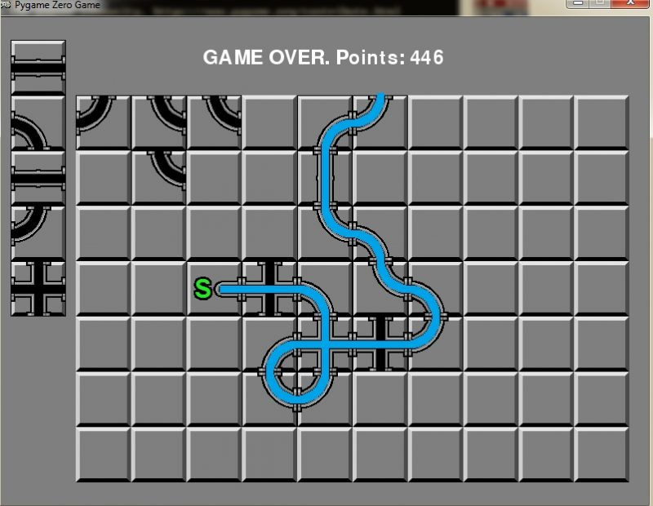
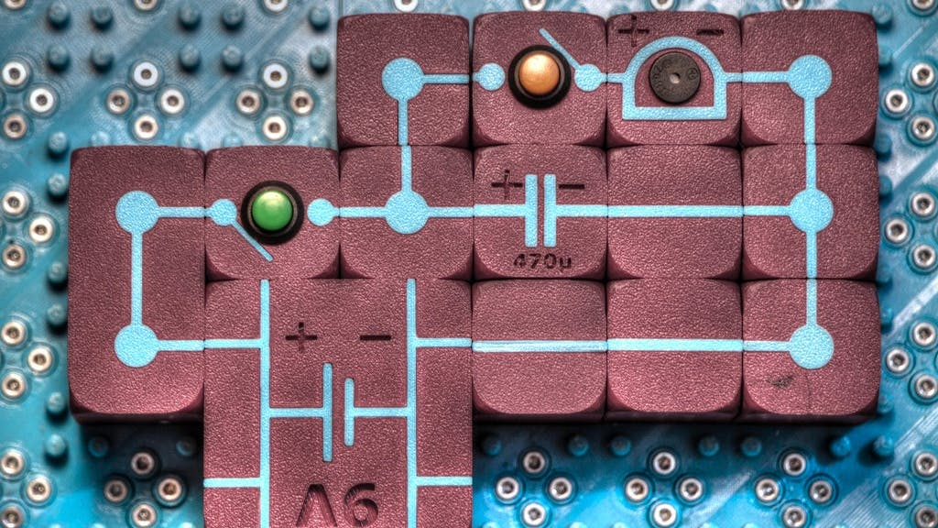
Inspiration
The overall game idea is inspired by pipe connecting and electronic connecting games:

Slide 3
Ideas
Team as talking heads giving advice or presenting level objective

Slide 4
General
Detect if player is accidently making a ring and give a note, that they should use the real ring structure instead
Playing field size varies from level difficulty
3-4 colors?
Use S-Matrix to transport light
Only CW operation, no pulse
Leave code open for possibility of non-linear elements (Amplifier, Optical Switch, …)

Slide 5
Art Style
Pure 2D
Pixel Art
Laser 4 brightness levels → Sprite Sheet
Colorable Sprites for wavelengths

Slide 6
Components
Straight
Curve
Crossing
Termination
Directional Coupler (Tunable)
Delay (Tunable)
Ring (Tunable) ???
AWG (2 – 4?)

Slide 7
Nonlinear Components
Saturable Absorber (Tunable)
Saturable Amplifier (Tunable)
All-Optical Switch
Kerr Ring (Optical Phase Shifter)

Slide 8
Delay (Tunable)
0
w0
w2
w1
pi
Radial Dial showing what wavelength has what phase change
0
0
Length Slider, moving it rotates the individual wavelengths around the dial
pi
pi
Block view, so we can have left and right half in different phase (i.e. 2 sprite sheets for animation? Mirrored?)

Slide 9
Levels
Splitting Light
Variable Splitting Light
Filtering 1 wavelength
Filtering 2 wavelengths
3 Colors in, filter out 1 color and out
2 Inputs, “XOR”
AWG, but re-ordering outputs using crossings
Analog Compute a + b
Analog Compute a * b
Analog Compute (a + b) * c

Slide 10
Nonlinear Levels
Logic Gates
Flip Flop
Activation / Threshold Function
Neural Network
Full Adder
Look-Up Table

Slide 11


UI
Target Output per Color
30%
50%
Laser Inputs
- Clickable to turn on/off
0%
Components
50%

