Slide 1
FACE MASK DETECTION USING DEEP LEARNING
By – Group 3
Guided By – Prof. P. P. Katgaonkar

Slide 2
Agenda
1. Introduction
2. Deep Learning
3. OpenCV
4. TensorFlow
5. Keras
6. How it actually happens?
7. Approach
8. Result
9. Conclusion
10. Future Scope
11. References

Slide 3
INTRODUCTION
The basic aim of the project is to detect the presence of a face mask on human faces on live streaming video as well as on images. We have used deep learning to develop our face detector model. Alongside this, we have used basic concepts of transfer learning in neural networks to finally output presence or absence of a face mask in an image.
It has been made a priority to stay safe from the virus as children and old people have proved to be at the high risk to get in the contact of the disease. A major precaution that people can take to stay safe from the virus is wearing face mask as the study says that the main medium of spreading of the virus is through air.
To build the Face Mask detection system, we have used different packages and libraries that are provided by the Python language especially for the machine learning purpose.

Slide 4
DEEP LEARNING
Deep learning is a subset of machine learning, which is essentially a neural network with three or more layers. These neural network attempts to stimulate the behaviour of human brain allowing it to learn from large amount of data. While a neural network with a single layer can still make approximate predictions, additional hidden layers can help to optimize and refine for accuracy.
We can also say that Deep Learning is an Artificial Intelligence (AI) function that imitates the workings of the human brain in processing data and creating patterns for use in decision making. Deep neural networks consist of multiple layers of interconnected nodes, each building upon the previous layer to refine and optimize the prediction for categorization. This progression of computations through the network is called as forward propagation. Another process called backbone propagation uses the algorithms, like gradient descent, to calculate errors in predictions and then adjust the weights and biases of the function by moving backwards through the layers in an effort to train the model.

Slide 5
OPEN-CV
OpenCV is a library in python for programming functions mainly aimed at real-time computer vision. The library is cross-platform and free for use under the open-source Apache 2 License. Computer Vision include understanding and analyzing digital images by the computer and process the images or provide relevant data after analyzing the image. OpenCV is a open-source library used in machine learning and image processing.
The library has more than 2500 optimized algorithms which includes a comprehensive set of both classic and state-of-the-art computer vision and machine learning algorithms. These algorithms can be used to detect and recognize faces, identify objects, classify human actions in videos, etc.

Slide 6
TENSORFLOW
TensorFlow is a free and open-source software library for machine learning. It can be used across a range of tasks but has a particular focus on training and inference of deep neural networks. Is a great system for handling all aspects of a machine learning system. However, this class focuses on using the unique tensor flow API to train and deploy machine learning models. Here, we used TensorFlow and Keras to train the classifier to automatically identify if a person is wearing a mask or not.
To develop and research on fascinating ideas on artificial intelligence, Google team created TensorFlow. TensorFlow is designed in Python programming language, hence it is considered an easy to understand framework.

Slide 7
KERAS
Keras is an open-source software library that provides a python interface for artificial neural networks. Keras acts as an interface for the TensorFlow library. Designed to enable fast experimentation with deep neural networks, it focuses on being user-friendly, modular and extensible. Keras allows users to productize deep models on smartphones, on the web or on the Java Virtual Machine (JVM). It also allows use of distributed training of deep-learning models on clusters of Graphical Processing Units (GPUs) and Tensor Processing Units (TPUs).
It has been developed by an artificial intelligence researcher at Google named Francois Chollet. Leading organizations like Google, Square, Netflix, Huawei and Uber are currently using Keras. Keras runs on top of open source machine libraries like TensorFlow, Theano or cognitive toolkit (CNTK). Theano is a python library used for fast numerical computation tasks.
Keras is based on minimal structure that provides a clean and easy way to create deep learning models based on TensorFlow or Theano. Keras is designed to quickly define deep learning models.

Slide 8
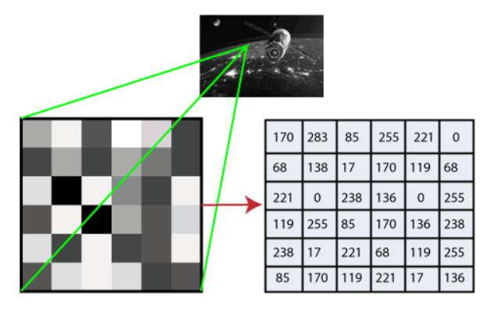
HOW IT ACTUALLY HAPPENS?
Convert the vision into numbers and then stores it in the memory.
First, the pixel value is used to convert images into numbers. A pixel is the
smallest unit of digital image or graphics that can be displayed and
represented on a digital display device.

Slide 9
APPROACH
1. Load the face mask dataset
2. Train face mask dataset
3. Serialize face mask classifier & save
4. Load face mask classifier on the disk
5. Detect faces in images & video stream
6. Extract Region Of Interest (ROI)
7. Apply face mask classifier to each face
8. Determine
Mask
No Mask

Slide 10
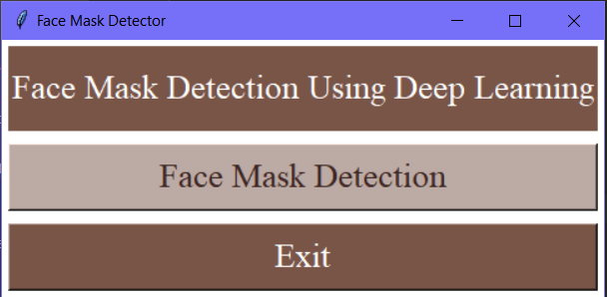
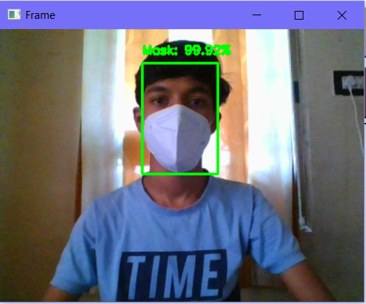
RESULT
Starting Interface
Mask in proper way

Slide 11
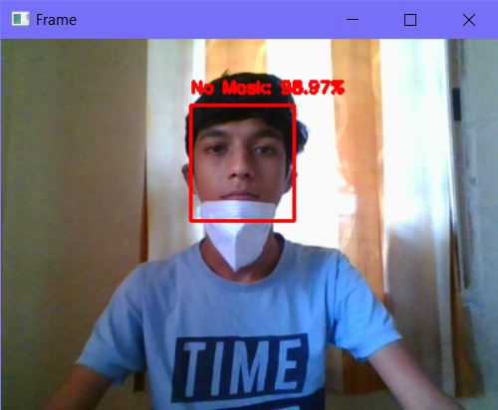
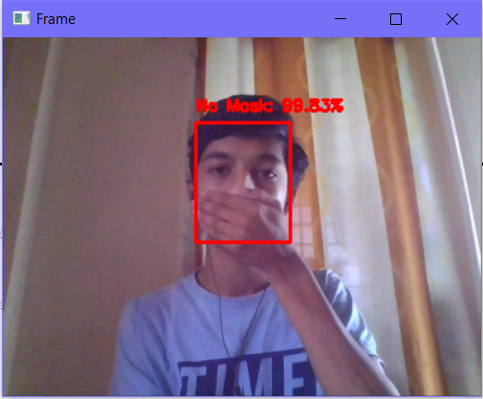
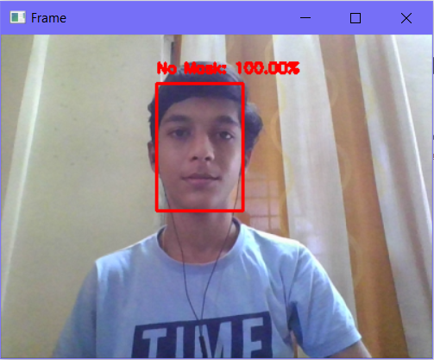
RESULT
Mask in improper way
Hand instead of mask
Without mask

Slide 12
CONCLUSION
As we can see, the technology is increasing rapidly and so is the demand with the trends emerging day-by-day. Hence, we have made a Face Mask Detection System Using Deep Learning which can possibly contribute in the health care of the public in public areas in such situation of crisis like COVID-19. This system is built with the help of machine learning and its various libraries such as OpenCV, TensorFlow, Keras, etc. successfully. This system importantly consists of the library OpenCV which we can also called as the backbone of the system. This system is successfully tested with real-time video streams of various people and it can successfully provide the accurate result by extracting the individual images from the video streams.

Slide 13
FUTURE SCOPE
In this work, a deep learning-based approach for detecting masks over faces in a public place to curtail community spread of coronavirus is presented. The proposed technique efficiently handles varying kinds of occlusions in the dense situation by making use of an ensemble of single and two stage detectors at the pre-processing level. Finally, the work opens interesting future directions for researchers. They can see who has not covered faces with masks through software, mobile app, device, or a website.
Firstly, the proposed technique can be integrated into any high-resolution video surveillance devices and not limited to mask detection only. Secondly, the model can be trained and upgraded to mask datasets that include different images related to correctly/incorrectly wear mask and achieve the ultimate purpose of detecting facemask for cutting down the risk of contagious diseases. We can use this system in the high-crowded public places such as malls where, there are very high chances of disease spreading.

Slide 14
REFERENCES
1. https://www.investopedia.com/terms/d/deep-learning.asp
2. https://www.javatpoint.com/opencv
3. https://www.tutorialspoint.com/tensorflow/index.htm
4. https://www.tutorialspoint.com/keras/keras_introduction.htm

Slide 15
ANY DOUBTS?

