Slide 1
By a hierarchic system, or hierarchy, I mean a
system that is composed of interrelated subsystems,
each of the latter being in turn hierarchic in structure
until we reach some lowest level of elementary
subsystem. In most systems of nature it is somewhat
arbitrary as to where we leave oﬀ the partitioning
and what subsystems we take as elementary. Physics
makes much use of the concept of “elementary
particle,” although the particles have a disconcerting
tendency not to remain elementary very long . . .
Empirically a large proportion of the complex
systems we observe in nature exhibit hierarchic
structure. On theoretical grounds we would expect
complex systems to be hierarchies in a world in
which complexity had to evolve from simplicity.
– Herbert A. Simon, 1996
c D. Poole and A. Mackworth 2016
Artiﬁcial Intelligence, Lecture 2.2, Page 1

Slide 2
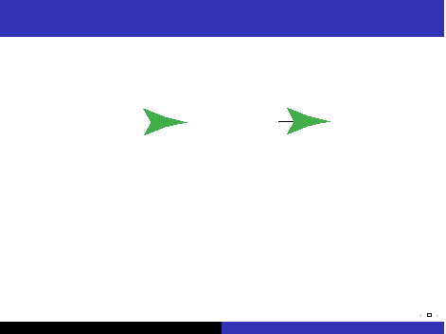
Agent Architectures
You don’t need to implement an intelligent agent as:
Action
as three independent modules, each feeding into the the next.
It’s too slow.
High-level strategic reasoning takes more time than the
reaction time needed to avoid obstacles.
The output of the perception depends on what you will
do with it.
Perception
Reasoning
c D. Poole and A. Mackworth 2016
Artiﬁcial Intelligence, Lecture 2.2, Page 2

Slide 3
Hierarchical Control
A better architecture is a hierarchy of controllers.
Each controller sees the controllers below it as a virtual
body from which it gets percepts and sends commands.
The lower-level controllers can
run much faster, and react to the world more quickly
deliver a simpler view of the world to the higher-level
controllers.
c D. Poole and A. Mackworth 2016
Artiﬁcial Intelligence, Lecture 2.2, Page 3

Slide 4
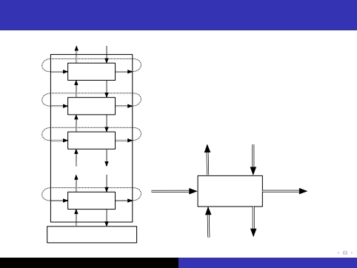
Hierarchical Robotic System Architecture
high-level
percepts
previous
memories
high-level
commands
next
memories
...
...
Agent
Environment
low-level
percepts
low-level
commands
c D. Poole and A. Mackworth 2016
Artiﬁcial Intelligence, Lecture 2.2, Page 4

Slide 5
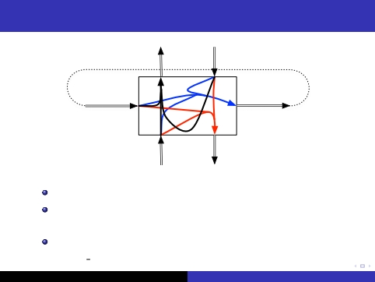
Functions implemented in a layer
percepts
memories
percepts
commands
memories
commands
memory function remember (memory , percept , command )
command function
do (memory , percept , command )
percept function
higher percept (memory , percept , command )
c D. Poole and A. Mackworth 2016
Artiﬁcial Intelligence, Lecture 2.2, Page 5

Slide 6
Example: delivery robot
The robot has three actions: go straight, go right, go left.
(Its velocity doesn’t change).
It can be given a plan consisting of sequence of named
locations for the robot to go to in turn.
The robot must avoid obstacles.
It has a single whisker sensor pointing forward and to the
right. The robot can detect if the whisker hits an object.
The robot knows where it is.
The obstacles and locations can be moved dynamically.
Obstacles and new locations can be created dynamically.
c D. Poole and A. Mackworth 2016
Artiﬁcial Intelligence, Lecture 2.2, Page 6

Slide 7
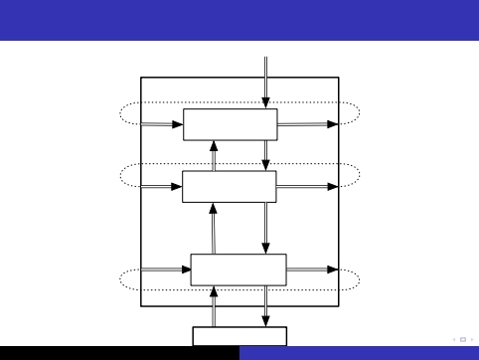
A Decomposition of the Delivery Robot
plan
follow plan
arrived
go to target and
avoid obstacles
rob_pos
rob_dir
to_do
target_pos
timeout
target_pos
steer
whisker
crashed
steer robot, report
obstacles and position
Delivery Robot
Environment
c D. Poole and A. Mackworth 2016
Artiﬁcial Intelligence, Lecture 2.2, Page 7

Slide 8
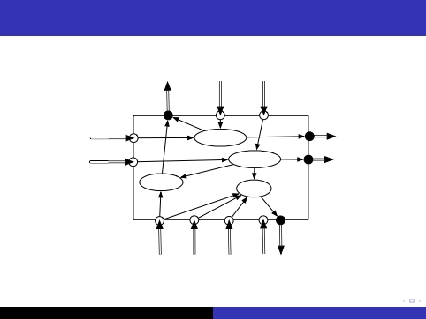
Middle Layer
timeout
target-pos
arrived
remaining
remaining
target_pos
target_pos
arrived
steer
rob_pos
rob_dir
whisker
crashed
steer
c D. Poole and A. Mackworth 2016
Artiﬁcial Intelligence, Lecture 2.2, Page 8

Slide 9
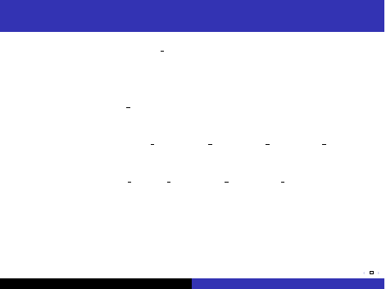
Middle Layer of the Delivery Robot
given timeout and target pos :
remaining ← timeout
while not arrived () and remaining = 0
if whisker sensor = on
then steer := left
else if straight ahead (rob pos , robot dir , target pos )
then steer := straight
else if left of (rob pos , robot dir , target pos )
then steer := left
else steer := right
do (steer )
remaining ← remaining − 1
tell upper layer arrived ()
c D. Poole and A. Mackworth 2016
Artiﬁcial Intelligence, Lecture 2.2, Page 9

Slide 10
Top Layer of the Delivery Robot
The top layer is given a plan which is a sequence of
named locations.
The top layer tells the middle layer the goal position of
the current location.
It has to remember the current goal position and the
locations still to visit.
When the middle layer reports the robot has arrived, the
top layer takes the next location from the list of positions
to visit, and there is a new goal position.
c D. Poole and A. Mackworth 2016
Artiﬁcial Intelligence, Lecture 2.2, Page 10

Slide 11
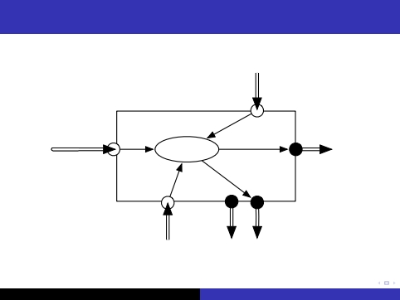
Top Layer
previous
to_do
plan
target-pos
follow plan
to_do
timeout
arrived
c D. Poole and A. Mackworth 2016
Artiﬁcial Intelligence, Lecture 2.2, Page 11

Slide 12
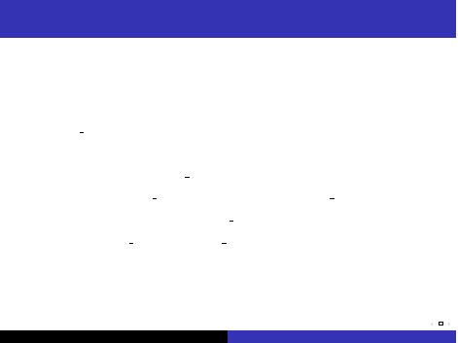
Code for the top layer
given plan:
to do ← plan
timeout ← 200
while not empty (to do )
target pos := coordinates (ﬁrst (to do ))
do (timeout , target pos )
to do := rest (to do )
c D. Poole and A. Mackworth 2016
Artiﬁcial Intelligence, Lecture 2.2, Page 12

Slide 13
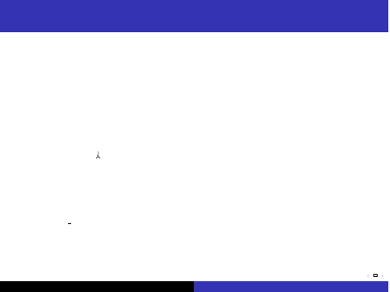
Simulation of the Robot
60
40
20
0
robot path obstacle goals start
0
20
40
60
80
100
to do = [goto (o 109), goto (storage ), goto (o 109),
goto (o 103)]
arrived = true
c D. Poole and A. Mackworth 2016
Artiﬁcial Intelligence, Lecture 2.2, Page 13

Slide 14
What should be in an agent’s belief state?
An agent decides what to do based on its belief state and
what it observes.
A purely reactive agent doesn’t have a belief state.
A dead reckoning agent doesn’t perceive the world.
— neither work very well in complicated domains.
It is often useful for the agent’s belief state to be a model
of the world (itself and the environment).
c D. Poole and A. Mackworth 2016
Artiﬁcial Intelligence, Lecture 2.2, Page 14

