Slide 1
Agent Architectures and Hierarchical Control
Overview:
Agents and Robots
Agent systems and architectures
Agent controllers
Hierarchical controllers
c D. Poole and A. Mackworth 2016
Artiﬁcial Intelligence, Lecture 2.1, Page 1

Slide 2
Example: smart house
A smart house will monitor your use of essentials, and buy
them before you run out.
Example: snack buying agent that ensures you have a
supply of chips:
abilities: buy chips (and have them delivered)
goals:
observations:
prior knowledge:
c D. Poole and A. Mackworth 2016
Artiﬁcial Intelligence, Lecture 2.1, Page 2

Slide 3
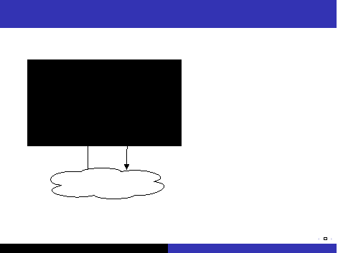
Agent Systems
Agent
Body
stimuli
A agent system is made
up of a agent and an
environment.
An agent receives
stimuli from the
environment
An agent carries out
actions
Environment
c D. Poole and A. Mackworth 2016
actions in the
environment.
Artiﬁcial Intelligence, Lecture 2.1, Page 3

Slide 4
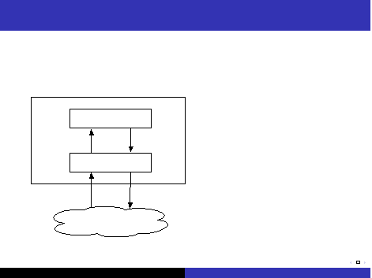
Agent System Architecture
An agent is made up of a body
and a controller.
Agent
Controller
An agent interacts with
the environment through
its body.
The body is made up of:
sensors that interpret
stimuli
actuators that carry
out actions
percepts
commands
Body
The controller receives
percepts from the body.
stimuli
actions
The controller sends
commands to the body.
Environment
c D. Poole and A. Mackworth 2016
The body can also have
reactions that are not
controlled.
Artiﬁcial Intelligence, Lecture 2.1, Page 4

Slide 5
Implementing a controller
A controller is the brains of the agent.
Agents are situated in time, they receive sensory data in
time, and do actions in time.
Controllers have (limited) memory and (limited)
computational capabilities.
The controller speciﬁes the command at every time.
The command at any time can depend on the current and
previous percepts.
c D. Poole and A. Mackworth 2016
Artiﬁcial Intelligence, Lecture 2.1, Page 5

Slide 6
The Agent Functions
Let T be the set of time points.
A percept trace is a sequence of all past, present, and
future percepts received by the controller.
A command trace is a sequence of all past, present, and
future commands output by the controller.
c D. Poole and A. Mackworth 2016
Artiﬁcial Intelligence, Lecture 2.1, Page 6

Slide 7
The Agent Functions
Let T be the set of time points.
A percept trace is a sequence of all past, present, and
future percepts received by the controller.
A command trace is a sequence of all past, present, and
future commands output by the controller.
A transduction is a function from percept traces into
command traces.
c D. Poole and A. Mackworth 2016
Artiﬁcial Intelligence, Lecture 2.1, Page 7

Slide 8
The Agent Functions
Let T be the set of time points.
A percept trace is a sequence of all past, present, and
future percepts received by the controller.
A command trace is a sequence of all past, present, and
future commands output by the controller.
A transduction is a function from percept traces into
command traces.
A transduction is causal if the command trace up to time
t depends only on percepts up to t .
c D. Poole and A. Mackworth 2016
Artiﬁcial Intelligence, Lecture 2.1, Page 8

Slide 9
The Agent Functions
Let T be the set of time points.
A percept trace is a sequence of all past, present, and
future percepts received by the controller.
A command trace is a sequence of all past, present, and
future commands output by the controller.
A transduction is a function from percept traces into
command traces.
A transduction is causal if the command trace up to time
t depends only on percepts up to t .
A controller is an implementation of a causal
transduction.
An agent’s history at time t is sequence of past and
present percepts and past commands.
A causal transduction speciﬁes a function from an agent’s
history at time t into its action at time t .
c D. Poole and A. Mackworth 2016
Artiﬁcial Intelligence, Lecture 2.1, Page 9

Slide 10
Belief States
An agent doesn’t have access to its entire history. It only
has access to what it has remembered.
c D. Poole and A. Mackworth 2016
Artiﬁcial Intelligence, Lecture 2.1, Page 10

Slide 11
Belief States
An agent doesn’t have access to its entire history. It only
has access to what it has remembered.
The memory or belief state of an agent at time t encodes
all of the agent’s history that it has access to.
The belief state of an agent encapsulates the information
about its past that it can use for current and future
actions.
c D. Poole and A. Mackworth 2016
Artiﬁcial Intelligence, Lecture 2.1, Page 11

Slide 12
Belief States
An agent doesn’t have access to its entire history. It only
has access to what it has remembered.
The memory or belief state of an agent at time t encodes
all of the agent’s history that it has access to.
The belief state of an agent encapsulates the information
about its past that it can use for current and future
actions.
At every time a controller has to decide on:
What should it do?
What should it remember?
(How should it update its memory?)
— as a function of its percepts and its memory.
c D. Poole and A. Mackworth 2016
Artiﬁcial Intelligence, Lecture 2.1, Page 12

Slide 13
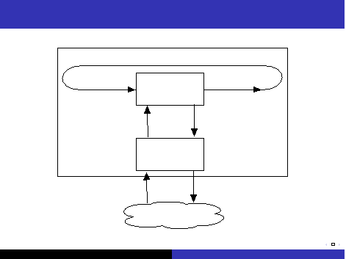

Controller
memories
percepts
stimuli
memories
commands
Agent
actions
Controller
Body
Environment
c D. Poole and A. Mackworth 2016
Artiﬁcial Intelligence, Lecture 2.1, Page 13

Slide 14
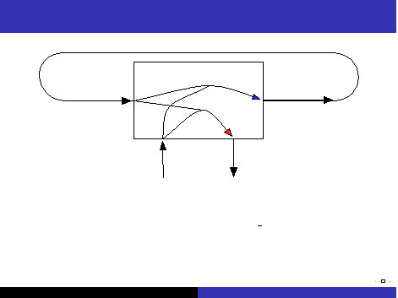

Functions implemented in a controller
memories
percepts
memories
commands
For discrete time, a controller implements:
belief state function remember (belief state , percept ),
returns the next belief state.
command function command (memory , percept ) returns
the command for the agent.
c D. Poole and A. Mackworth 2016
Artiﬁcial Intelligence, Lecture 2.1, Page 14

Slide 15
Example: smart house
A smart house will monitor your use of essentials, and buy
them before you run out.
Example: snack buying agent that ensures you have a
supply of chips:
abilities: buy chips (and have them delivered)
goals:
observations:
prior knowledge:
Percept trace:
Control trace:
Transduction:
Belief state:
Belief state transition function:
Control Function:
c D. Poole and A. Mackworth 2016
Artiﬁcial Intelligence, Lecture 2.1, Page 15

Slide 16
Implemented Example
Percepts: price, number in stock
Action: number to buy
Belief state: average
controller:
if price < 0.9 ∗ average and instock < 60 buy 48
else if instock < 12 buy 12
else buy 0
c D. Poole and A. Mackworth 2016
Artiﬁcial Intelligence, Lecture 2.1, Page 16

Slide 17
Implemented Example
Percepts: price, number in stock
Action: number to buy
Belief state: average
controller:
if price < 0.9 ∗ average and instock < 60 buy 48
else if instock < 12 buy 12
else buy 0
Belief state transition function:
average := average + (price − average ) ∗ 0.05
(Implemented in Python distribution)
c D. Poole and A. Mackworth 2016
Artiﬁcial Intelligence, Lecture 2.1, Page 17

