Slide 1
State Spaces and Search Techiques
Dr. Olawande Daramola

Slide 2
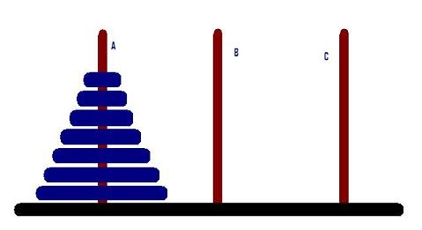
TOWER OF HANOI
How do move transfer the discs in A to B such that the larger disk is always at the base of a smaller one.

Slide 3
Missionary and Cannibal Problem: There are 3 Missionaries and 3 Cannibals by the river side. The boat can only carry 2 persons at a time. If the number of Cannibals is more than that of Missionaries at any time in the Journey, the Cannibals will overpower the missionary and eat them. How do you devise a transport protocol to have both Missionaries and Cannibals on the other side of the river?

Slide 4
Water Jug Problem: You are given two jugs, a 4-gallon one and a 3-gallon one. Neither has any measuring made on it. There is a pump that can be used to fill the jugs with water. How can you get exactly 2 gallons of water into the 4- gallon jug?

Slide 5
State Spaces for Water Jug Problem
• A state: (x, y)
x = 0, 1, 2, 3, or 4 y = 0, 1, 2, or 3.
• Start state: (0, 0).
• Goal state: (2, n) for any n, n = 0, 1, 2, 3.
• Attempting to end up in a goal state by using rules.

Slide 6
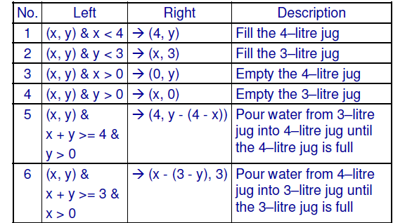
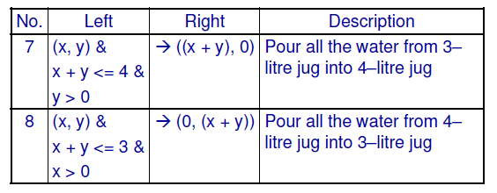

Slide 7
Transition Rules
1. current state = (0, 0)
2. Loop until reaching the goal state (2, 0)
– Apply a rule whose left side matches the current state
– Set the new current state to be the resulting state
(0 0) 2nd rule
(0 3) 7th rule
(3 0) 2nd rule
(3 3) 7th rule
(4 2) 3rd rule
(0 2) 7th rule
(2 0)

Slide 8
Water Jug Problem
– The role of the condition in the left side of a rule restrict the application of the rule more efficient
– Special-purpose rules to capture special-case knowledge that can be used at some stage in solving a problem
• (x, y) & x < 4 →(4, y)
• (x, y) & x > 0 →(0, y)

Slide 9
To provide a formal description of a problem:
– Define a state space that contains all the possible configurations of the relevant objects.
– Specify the initial states.
– Specify the goal states.
– Specify a set of rules:
• What are unstated assumptions?
• How general should the rules be?
• How much knowledge for solutions should be in the rules?
Solving a problem = search in the state space by using
the rules + control strategy

Slide 10
Requirements of a good search strategy:
– It causes motion.
• Otherwise, it will never lead to a solution.
– It is systematic.
• Otherwise, it may use more steps than necessary.
– It is efficient.
• Find a good, but not necessarily the best, answer.

Slide 11
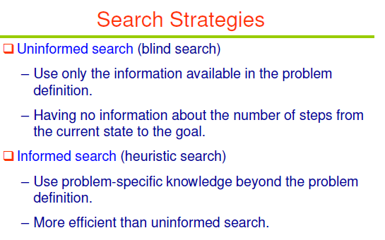

Slide 12
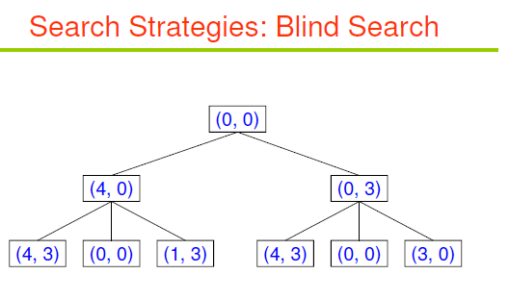
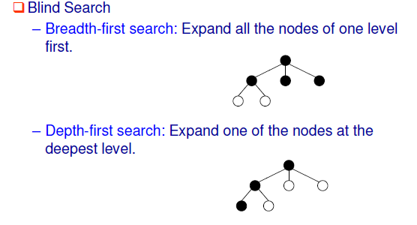

Slide 13
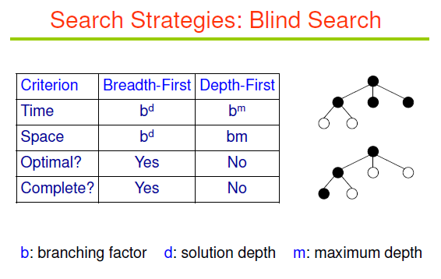

Slide 14
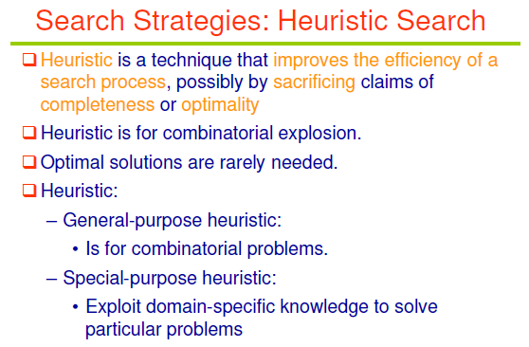

Slide 15
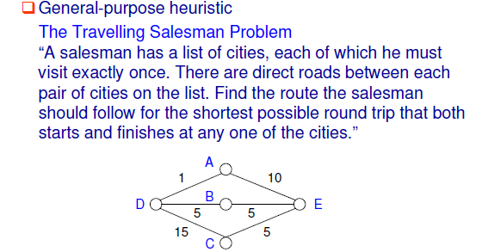
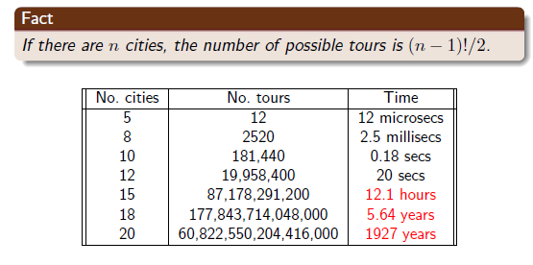

Slide 16
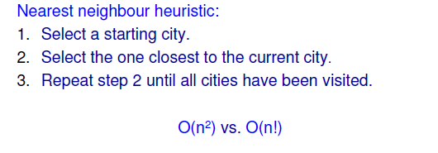
Heursitics for TSP
Branch and bound Technique:
Begin generating complete paths, keeping track of the shortest path found so far. Give up exploring any path as soon as its partial length becomes greater than the shortest path found so far.

Slide 17
Assume you have the task to design a software agent that periodically allocates additional memory to as many nodes as possible on a computer network from a mutual resource pool. Discuss a suitable heuristic you would employ to realise an efficient resource allocation scheme for the network
Exercise

Slide 18
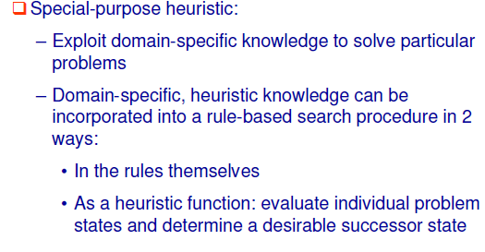
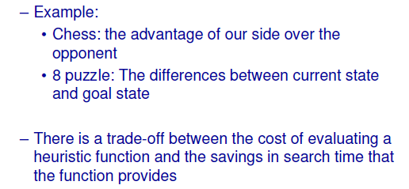

Slide 19
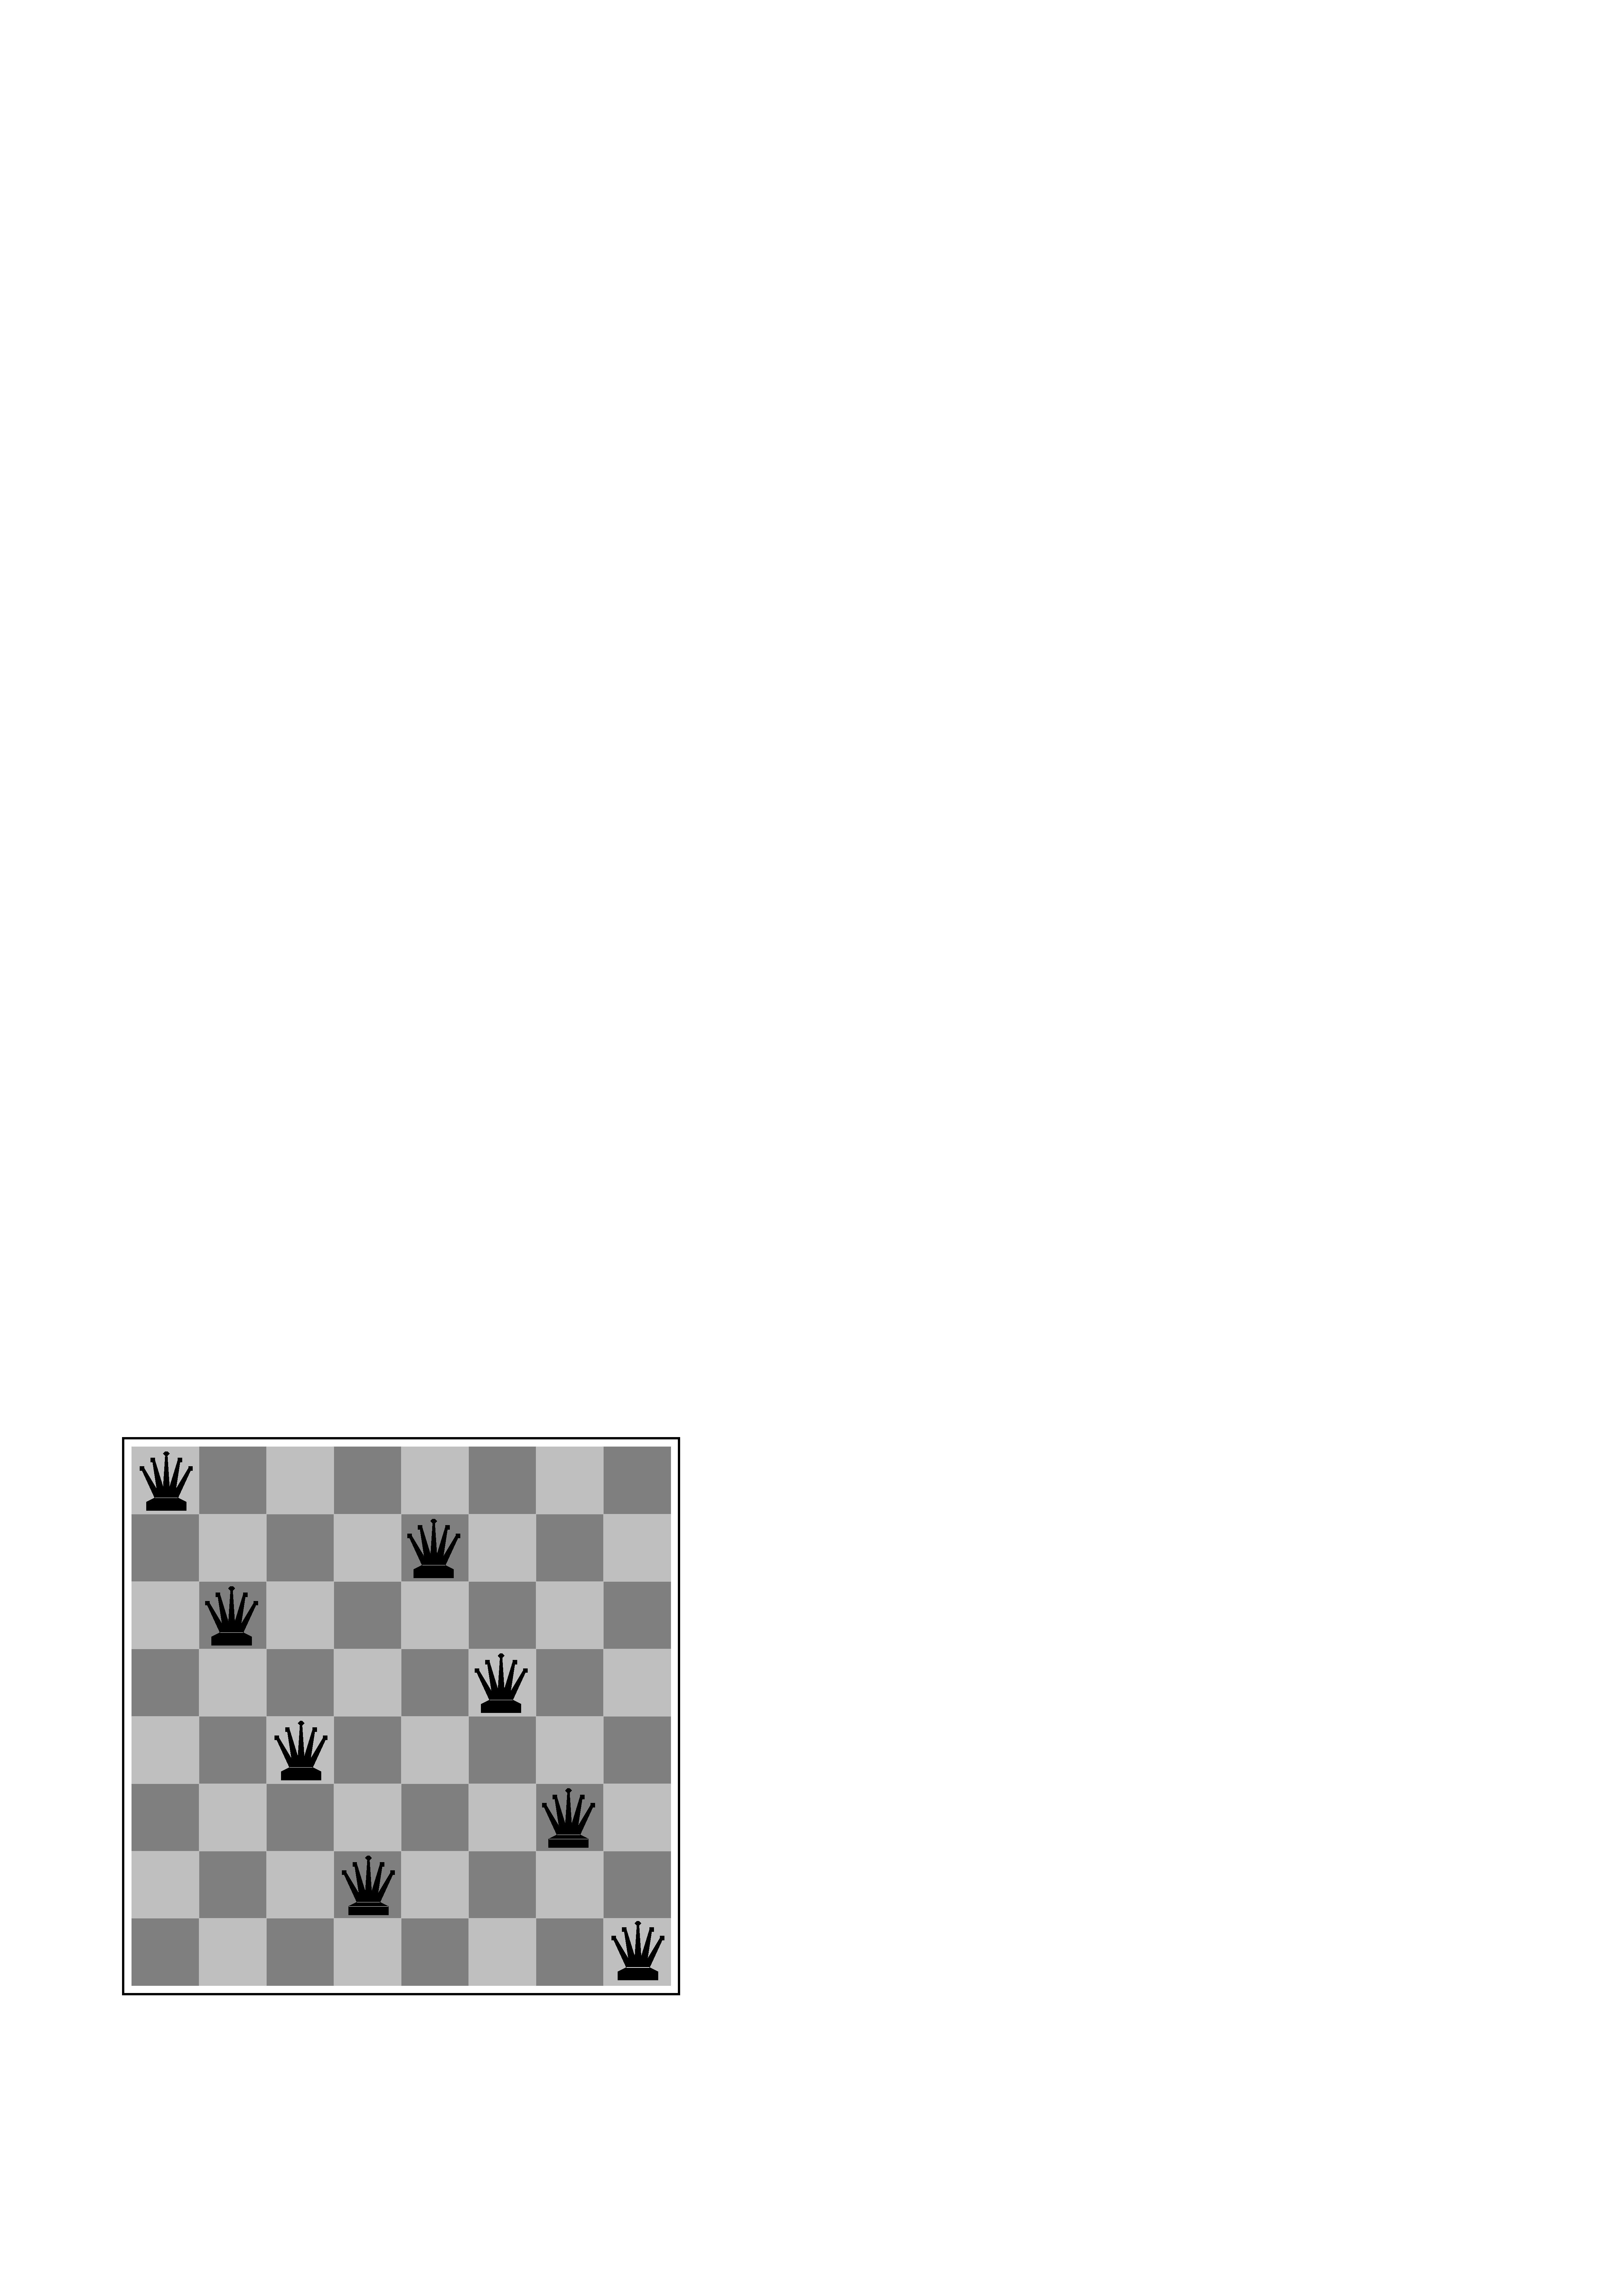

Example: 8-puzzle
Chess
SSP
states? -any arrangement of n<=8 queens
-or arrangements of n<=8 queens in leftmost n columns, 1 per column, such that no queen attacks any other.
initial state? no queens on the board
actions? -add queen to any empty square
-or add queen to leftmost empty square such that it is not attacked by other queens.
goal test? 8 queens on the board, none attacked.
path cost? 1 per move
State Space Problem (SSP) formulation
states? locations of tiles
initial state? Given
actions? move blank left, right, up, down
goal test? goal state (given)
path cost? 1 per move

Slide 20
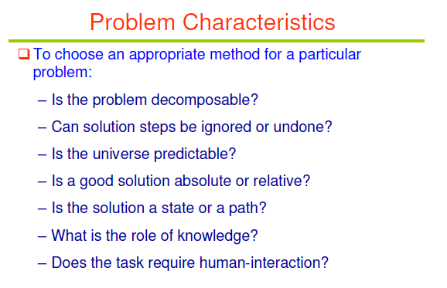

Slide 21
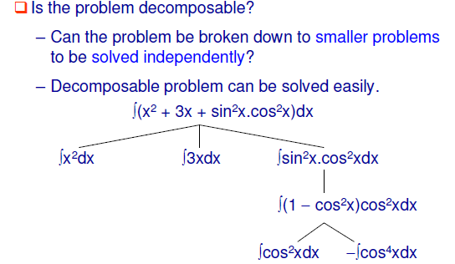
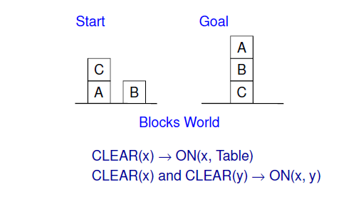

Slide 22
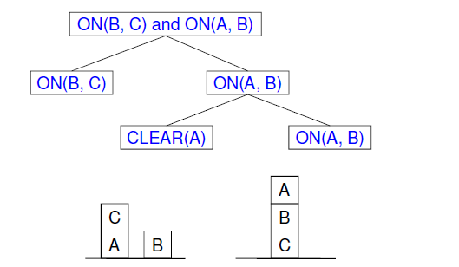
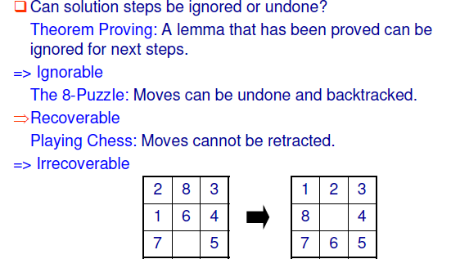

Slide 23
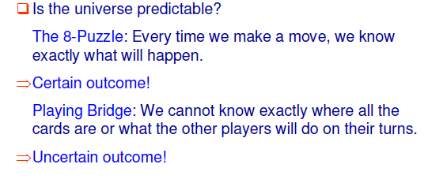
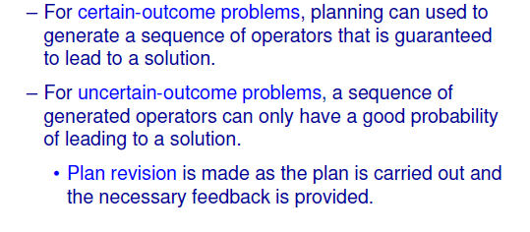

Slide 24
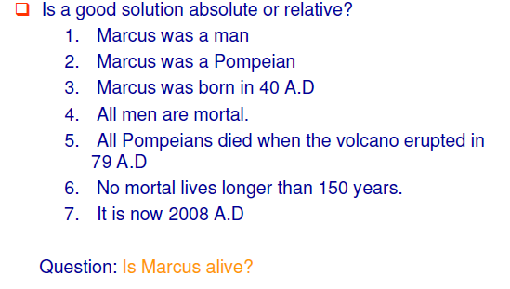
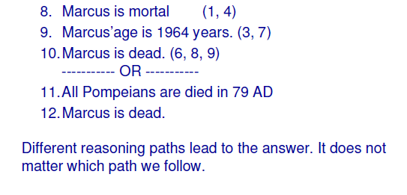

Slide 25
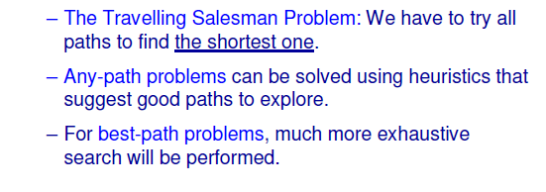
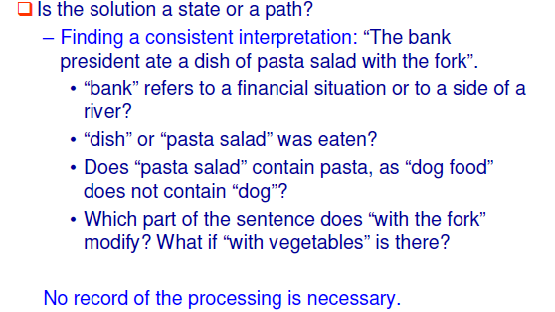

Slide 26
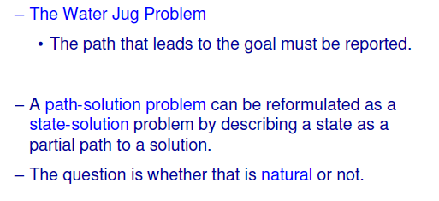
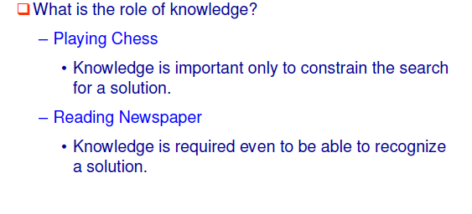

Slide 27
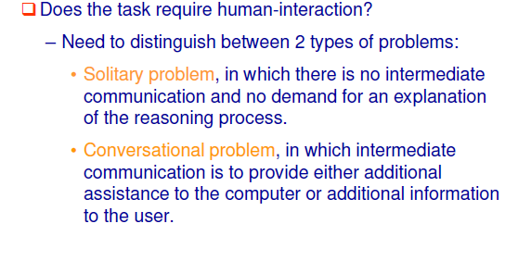
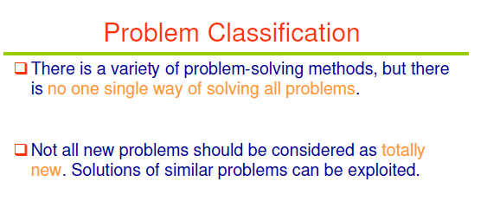

Slide 28
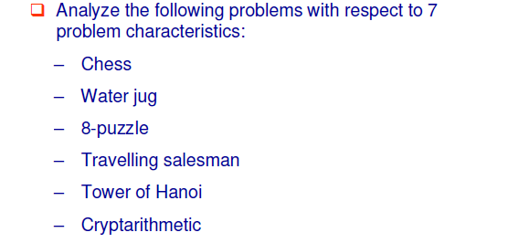
Tutorial Question

Slide 29
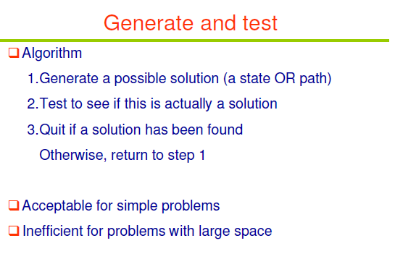

Slide 30
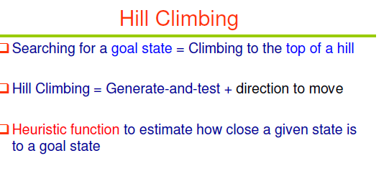

Slide 31
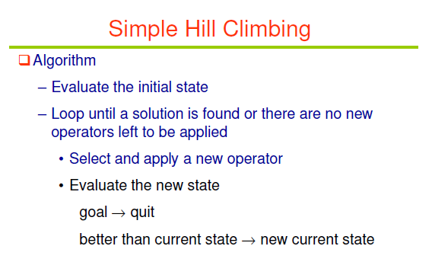
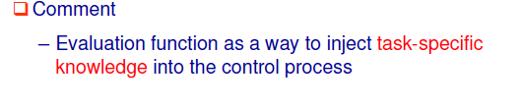

Slide 32
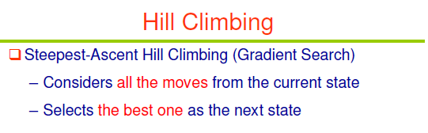
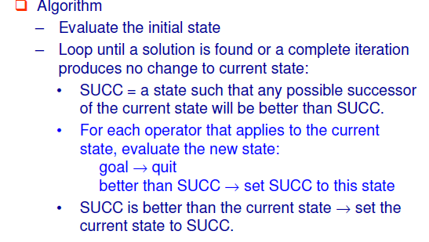

Slide 33
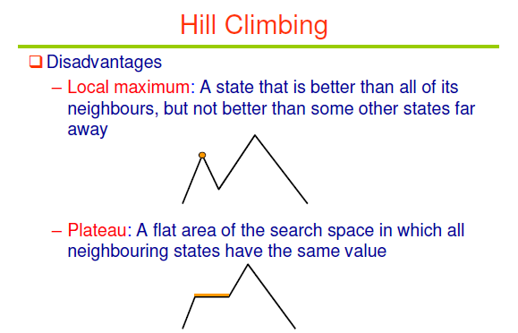
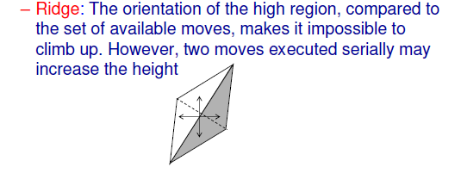

Slide 34
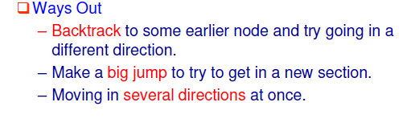
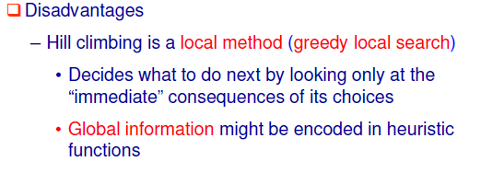
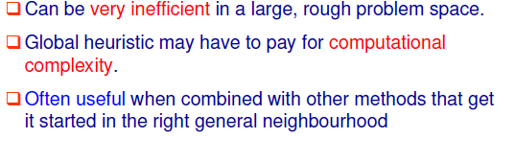

Slide 35
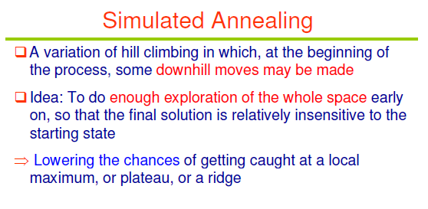
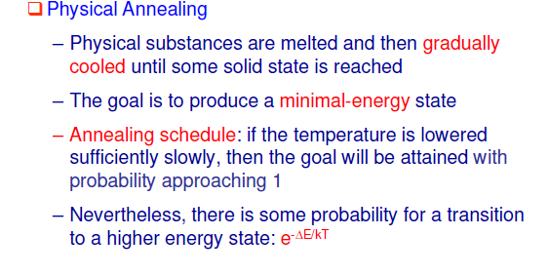

Slide 36
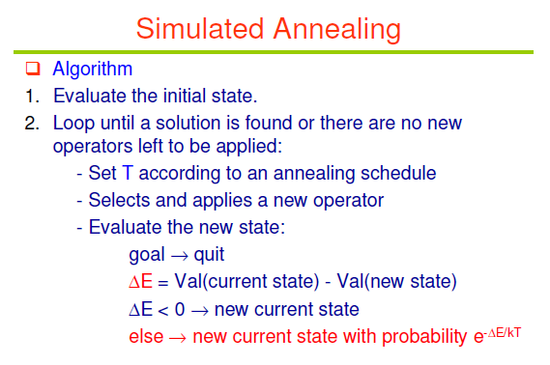

Slide 37
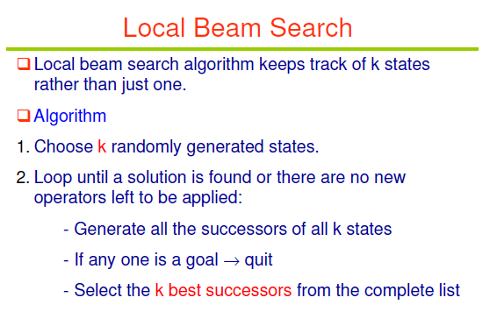

Slide 38
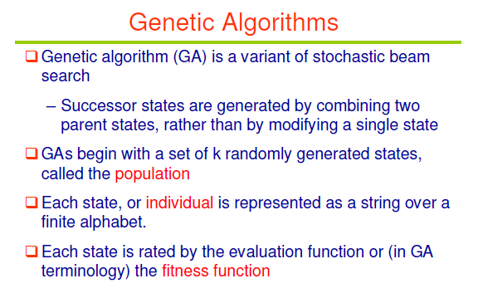

Slide 39
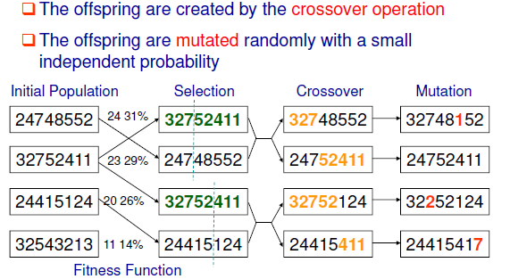

Slide 40
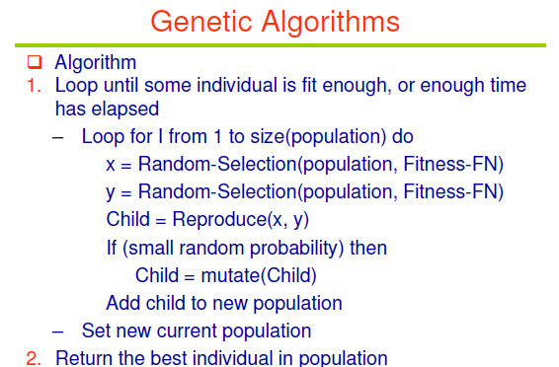

Slide 41
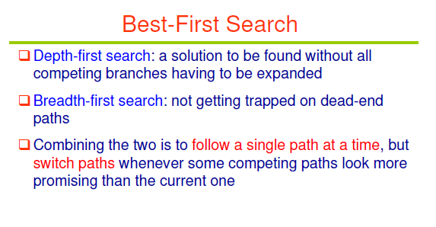
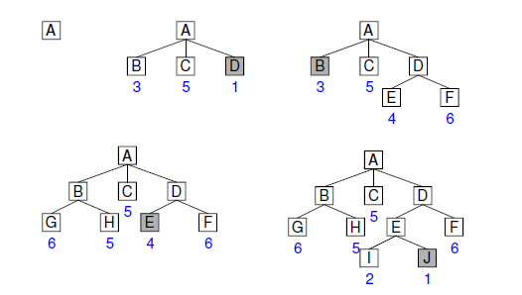

Slide 42


Slide 43


Slide 44



Slide 45



