Slide 1
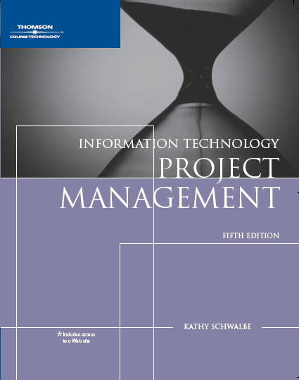
Chapter 5:
Project Scope Management
Information Technology Project Management,
Fifth Edition

Slide 2
What is Project Scope Management?
Scope refers to all the work involved in creating the products of the project and the processes used to create them
A deliverable is a product produced as part of a project, such as hardware or software, planning documents, or meeting minutes
Project scope management includes the processes involved in defining and controlling what is or is not included in a project
Project Scope Management

Slide 3
Project Scope Management Processes
Scope planning: deciding how the scope will be defined, verified, and controlled
Scope definition: reviewing the project charter and preliminary scope statement and adding more information as requirements are developed and change requests are approved
Creating the WBS: subdividing the major project deliverables into smaller, more manageable components
Scope verification: formalizing acceptance of the project scope by key project stakeholders
Scope control: controlling changes to project scope which impact project cost and time goals
Project Scope Management

Slide 4
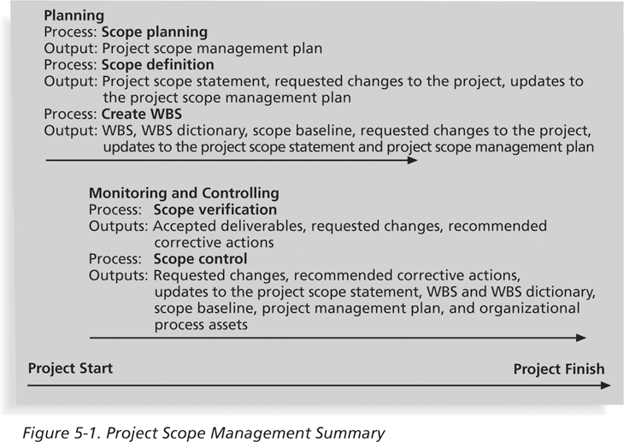
Project Scope Management Summary
Project Scope Management

Slide 5
Scope Planning and the
Scope Management Plan
The scope management plan is a document that includes descriptions of how the team will prepare the project scope statement, create the WBS, verify completion of the project deliverables, and control requests for changes to the project scope
Key inputs include the project charter, preliminary scope statement, and project management plan
It should be reviewed with the project sponsor to make sure the approach meets expectations
Project Scope Management

Slide 6
What Went Right?
Many financial service companies use customer relationship management (CRM) systems to improve their understanding of and responsiveness to customers
A senior management team at the Canadian money management company Dynamic Mutual Funds (DMF) launched an enterprise-wide, national program to build and manage its customer relationships
They needed a faster and more organized, highly participative approach, so they proposed a new seven-step concept called project scope design
DMF won an eCustomer World Golden Award for world-class innovation
Project Scope Management

Slide 7
What Went Right?
The Seven Steps
Analyze the project atmosphere, staekholders and centers of influence
Align the project scope with the organization’s strategic objectives and business challenges
Determine where to add value to the business
Study the process flow between the business units
Develop an efficient communication strategy
Develop the project approach
Coordinate the new project with the other initiatives already under way
Project Scope Management

Slide 8
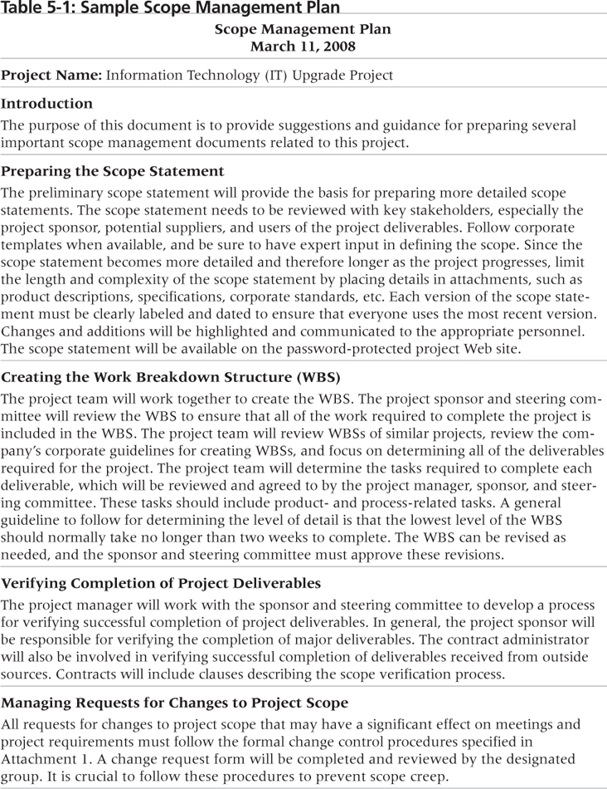
Sample Scope Management Plan
Project Scope Management

Slide 9
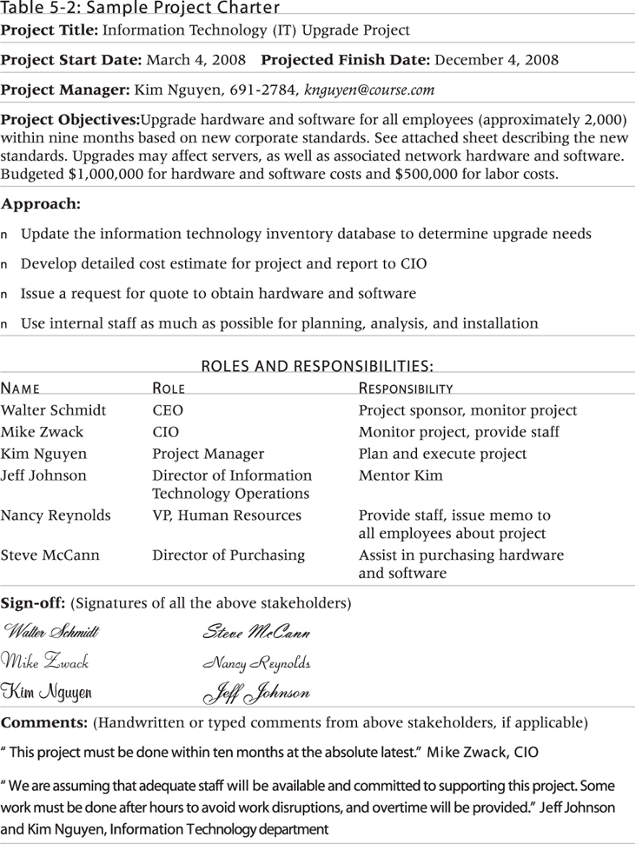
Sample Project Charter
Project Scope Management

Slide 10
Scope Definition and the
Project Scope Statement
The project team develops a preliminary scope statement in initiating a project as part of the project integration management knowledge area
The preliminary scope statement, project charter, organizational process assets, and approved change requests provide a basis for creating the more specific project scope statement
Project Scope Management

Slide 11
Scope Definition and the
Project Scope Statement
Project scope statements should contain at a minimum:
  Description of the project – overall objectives, justification
  Detailed descriptions of all project deliverables
  Characteristics and requirements of products and services produced as part of the project
Other helpful information:
  Project success criteria
  Project boundaries
  Product acceptance criteria
  Schedule milestones
  Order of magnitude costs estimates…
Project Scope Management

Slide 12
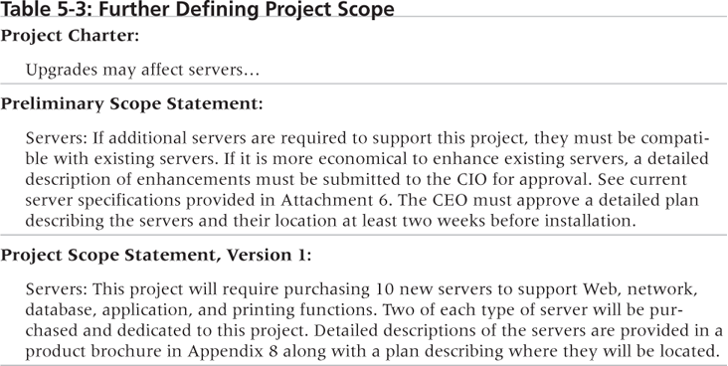
Further Defining Project Scope
Project Scope Management

Slide 13
Media Snapshot
Many people enjoy watching television shows like Changing Rooms or Trading Spaces, where participants have two days and $1,000 to update a room in their neighbor’s house. Since the time and cost are set, it’s the scope that has the most flexibility. Designers on these shows often have to change initial scope goals due to budget or time constraints.
Although most homeowners are very happy with work done on the show, some are obviously disappointed. Unlike most projects where the project team works closely with the customer, homeowners have little say in what gets done and cannot inspect the work along the way… What happens when the homeowners don’t like the work that’s been done? The FAQ section of tlc.com says, “Everyone on our show is told upfront that there’s a chance they won’t like the final design of the room. Each applicant signs a release acknowledging that the show is not responsible for redecorating a room that isn’t to the owner’s taste.”
Too bad you can’t get sponsors for most projects to sign a similar release form. It would make project scope management much easier!
Project Scope Management

Slide 14
Work Breakdown Structure (WBS)
A WBS is a deliverable-oriented grouping of the work involved in a project that defines the total scope of the project
WBS is a foundation document that provides the basis for planning and managing project schedules, costs, resources, and changes
Decomposition is subdividing project deliverables into smaller pieces
  A work package is a task at the lowest level of the WBS
  Tasks on a WBS represent work that needs to be done to complete the project, not specifications (e.g., type of server)
Project Scope Management

Slide 15
Work Breakdown Structure (WBS)
The project scope statement and project management plan are the primary inputs for creating a WBS
The outputs include the WBS itself, the WBS dictionary, a scope baseline and updates to the project scope statement and scope management plan
The WBS is often depicted as a task-oriented family tree of activities
  The WBS can be organized around project products, project phases or using the project management process groups
Project Scope Management

Slide 16
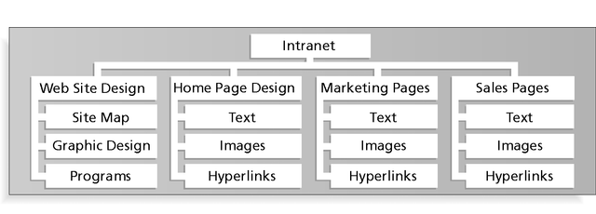
Partial WBS Organized by Product Areas
Project Scope Management

Slide 17
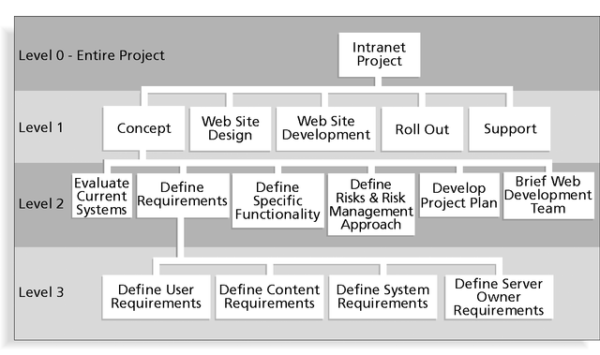
Partial WBS Organized by Project Phase
Project Scope Management

Slide 18
Partial Intranet WBS in Tabular Form
1.0 Concept
1.1 Evaluate current systems
1.2 Define Requirements
1.2.1 Define user requirements
1.2.2 Define content requirements
1.2.3 Define system requirements
1.2.4 Define server owner requirements
1.3 Define specific functionality
1.4 Define risks and risk management approach
1.5 Develop project plan
1.6 Brief Web development team
2.0 Web Site Design
3.0 Web Site Development
4.0 Roll Out
5.0 Support
Project Scope Management

Slide 19
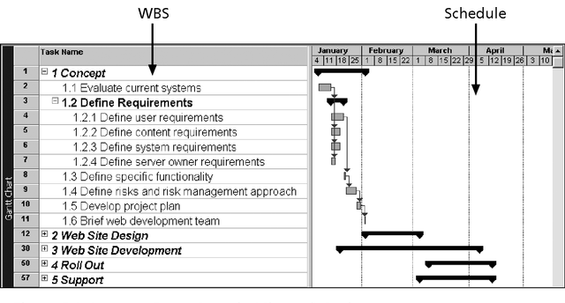
Intranet WBS and Gantt Chart in Microsoft Project
Project Scope Management

Slide 20
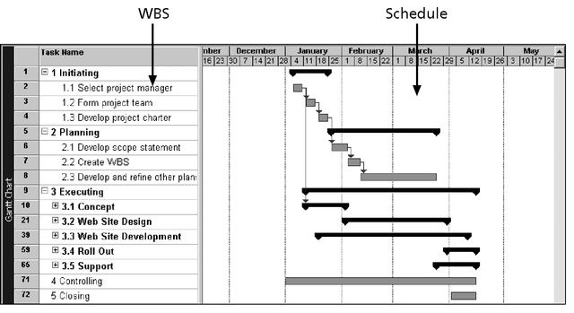
Intranet Gantt Chart Organized by Project Management Process Groups
Project Scope Management

Slide 21
Approaches to Developing WBSs
Using guidelines: some organizations, like the DOD, provide guidelines for preparing WBSs
The analogy approach: review WBSs of similar projects and tailor to your project
The top-down approach: start with the largest items of the project and break them down
The bottom-up approach: start with the specific tasks and roll them up
Mind-mapping approach: mind mapping is a technique that uses branches radiating out from a core idea to structure thoughts and ideas
Project Scope Management

Slide 22
Mind Mapping
Mind Mapping is a way of creating pictures that show ideas in the same way that they are represented in your brain.
Your brain uses words, pictures, numbers, logic, rhythm, color and spatial awareness to build up unique pictures of information.
The ideas are linked together in a way that makes it easy to understand and remember.
http://www.novamind.com/mind-mapping/
http://www.youtube.com/watch?v=MlabrWv25qQ
Project Scope Management

Slide 23
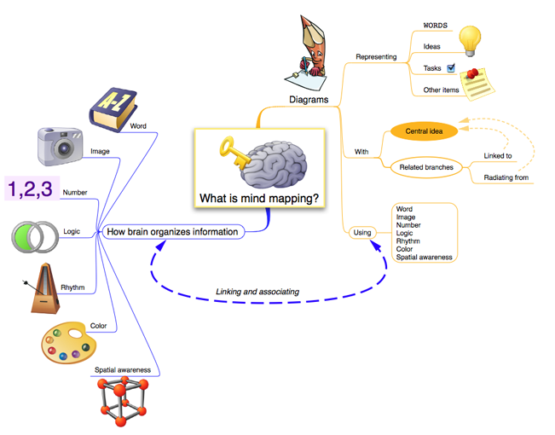
Mind Mapping
Project Scope Management

Slide 24
Mind Mapping
Use just key words, or wherever possible images.
Start from the center of the page and work out.
Make the center a clear and strong visual image that depicts the general theme of the map.
Create sub-centers for sub-themes.
Put key words on lines. This reinforces structure of notes.
Print rather than write in script. It makes them more readable and memorable. Lower case is more visually distinctive (and better remembered) than upper case.
Use color to depict themes, associations and to make things stand out.
Anything that stands out on the page will stand out in your mind.
Think three-dimensionally.
Use arrows, icons or other visual aids to show links between different elements.
Don't get stuck in one area. If you dry up in one area go to another branch.
Put ideas down as they occur, wherever they fit. Don't judge or hold back.
Break boundaries. If you run out of space, don't start a new sheet; paste more paper onto the map. (Break the 8x11 mentality.)
Be creative. Creativity aids memory.
From http://www.peterrussell.com/MindMaps/HowTo.php
Project Scope Management

Slide 25
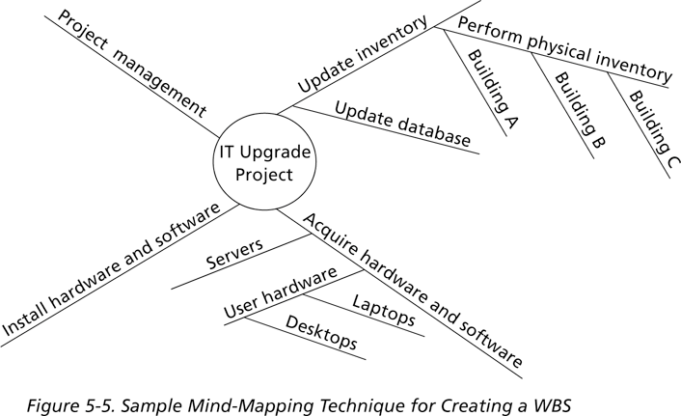
Sample Mind-Mapping Approach for Creating a WBS
Project Scope Management

Slide 26
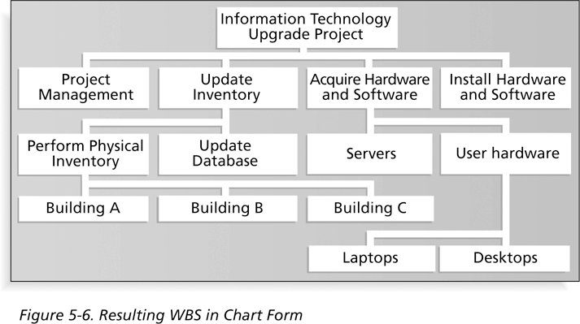
Resulting WBS in Chart Form
Project Scope Management

Slide 27
The WBS Dictionary and Scope Baseline
Many WBS tasks are vague and must be explained more so people know what to do and can estimate how long it will take and what it will cost to do the work
A WBS dictionary is a document that describes detailed information about each WBS item
The approved project scope statement and its WBS and WBS dictionary form the scope baseline, which is used to measure performance in meeting project scope goals
Project Scope Management

Slide 28
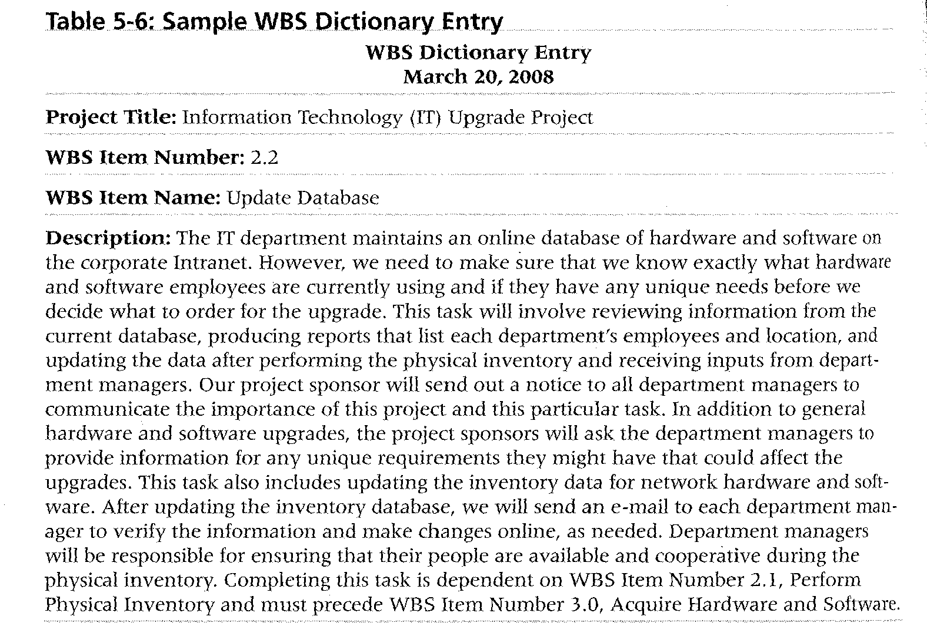
Sample WBS Dictionary Entry
Project Scope Management

Slide 29
Creating a WBS and WBS Dictionary*
A unit of work should appear at only one place in the WBS
The work content of a WBS item is the sum of the WBS items below it
A WBS item is the responsibility of only one individual, even though many people may be working on it
The WBS must be consistent with the way in which work is actually going to be performed; it should serve the project team first, and other purposes only if practical
*Cleland, David I. Project Management: Strategic Design and Implementation, 1994
Project Scope Management

Slide 30
Creating a WBS and WBS Dictionary *
Project team members should be involved in developing the WBS to ensure consistency and buy-in
Each WBS item must be documented in a WBS dictionary to ensure accurate understanding of the scope of work included and not included in that item
The WBS must be a flexible tool to accommodate inevitable changes while properly maintaining control of the work content in the project according to the scope statement
*Cleland, David I. Project Management: Strategic Design and Implementation, 1994
Project Scope Management

Slide 31
Scope Verification
It is very difficult to create a good scope statement and WBS for a project
It is even more difficult to verify project scope and minimize scope changes
Scope verification involves formal acceptance of the completed project scope by the stakeholders
Acceptance is often achieved by a customer inspection and then sign-off on key deliverables
Project Scope Management

Slide 32
What Went Wrong?
A project scope that is too broad and grandiose can cause severe problems
  Scope creep and an overemphasis on technology for technology’s sake resulted in the bankruptcy of a large pharmaceutical firm, Texas-based FoxMeyer Drug
  In 2001, McDonald’s fast-food chain initiated a project to create an intranet that would connect its headquarters with all of its restaurants to provide detailed operational information in real time; after spending $170 million on consultants and initial implementation planning, McDonald’s realized that the project was too much to handle and terminated it
Project Scope Management

Slide 33
Scope Control
Scope control involves controlling changes to the project scope
Goals of scope control are to:
  Influence the factors that cause scope changes
  Assure changes are processed according to procedures developed as part of integrated change control
  Manage changes when they occur
Tools for performing scope control include a change control system and configuration management
Variance is the difference between planned and actual performance
Project Scope Management

Slide 34
Best Practices for Avoiding Scope Problems
1. Keep the scope realistic: Don’t make projects so large that they can’t be completed; break large projects down into a series of smaller ones
2. Involve users in project scope management: Assign key users to the project team and give them ownership of requirements definition and scope verification
3. Use off-the-shelf hardware and software whenever possible: Many IT people enjoy using the latest and greatest technology, but business needs, not technology trends, must take priority
4. Follow good project management processes: As described in this chapter and others, there are well-defined processes for managing project scope and others aspects of projects
Project Scope Management

Slide 35
Suggestions for Improving User Input
Develop a good project selection process and insist that sponsors are from the user organization
Have users on the project team in important roles
Have regular meetings with defined agendas, and have users sign off on key deliverables presented at meetings
Deliver something to users and sponsors on a regular basis
Don’t promise to deliver when you know you can’t
Co-locate users with developers
Project Scope Management

Slide 36
Suggestions for Reducing Incomplete and Changing Requirements
Develop and follow a requirements management process
Use techniques such as prototyping, use case modeling, and JAD to get more user involvement
Put all requirements in writing, keep them current and readily available
Create a requirements management database for documenting and controlling requirements (CASE tools)
Project Scope Management

Slide 37
Suggestions for Reducing Incomplete and Changing Requirements
Provide adequate testing and conduct testing throughout the project life cycle
Review changes from a systems perspective
  Project scope changes must include associated cost and schedule changes
  Focus on approved scope goals and don’t get side tracked
Emphasize completion dates to help focus on what’s most important
  What should we drop in order to add something new?
Allocate resources specifically for handling change requests/enhancements like NWA did with ResNet
Project Scope Management

Slide 38
Using Software to Assist in
Project Scope Management
Word-processing software helps create several scope-related documents
Spreadsheets help to perform financial calculations and weighed scoring models, and develop charts and graphs
Communication software like e-mail and the Web help clarify and communicate scope information
Project management software helps in creating a WBS, the basis for tasks on a Gantt chart
Specialized software is available to assist in project scope management
Project Scope Management

