Slide 1
PHYSICS-BASED SIMULATION & MULTI-OBJECTIVE OPTIMISATION
MAGNETOCALORIC COOLING
FOR DATA CENTERS
Toward Refrigerant-Free, Low-Carbon HVAC&R
Presented by: AKHIL PILLAI • AMRUTA PATIL
ASHRAE Region XV — 3rd CRC 2026 | Student Competition | Theme: SAMUDRA
Department of Mechanical Engineering, SPCE, Mumbai | Guide: Kunal Bhavsar

Slide 2
PART I
Motivation & Methodology
Timeline
Why This Matters
The AMR Cycle
Research Gap
Key Literature
Objectives
Methodology Pipeline
MAGCOOL-DC · ASHRAE REGION XV · SAMUDRA 2026
2

Slide 3
PROJECT JOURNEY
Timeline
Feb
Mar
Apr
Literature review; mean-field & Landau material models
AMR cycle model; Gd / benchmark-device validation
Loss calibration; Sobol sensitivity; RSM surrogate
May
Jun–Jul
Aug–Sep
NSGA-III multi-objective optimisation; cascade design
Economics, emissions, extension studies
Design recommendations; report & CRC presentation
MAGCOOL-DC · ASHRAE REGION XV · SAMUDRA 2026
3

Slide 4
THE PROBLEM
Why This Matters
~40%
High GWP
Solid-State
of a data center's total energy goes to cooling — the single largest non-IT load
HFC/HFO refrigerants in vapor-compression and liquid cooling carry high Global Warming Potential
Magnetocaloric cooling promises a refrigerant-free alternative — no compressor, no leak pathway
MAGCOOL-DC · ASHRAE REGION XV · SAMUDRA 2026
4

Slide 5
THE CORE PHYSICS
The Active Magnetic Regenerator (AMR) Cycle
1
→
2
→
3
→
4
MAGNETIZE
HOT BLOW
DEMAGNETIZE
COLD BLOW
Field applied — material heats (adiabatic)
Heat rejected to the sink
Field removed — material cools (adiabatic)
Heat absorbed from the load
Regeneration amplifies one stage's small ΔT into a usable temperature span across the bed.
MAGCOOL-DC · ASHRAE REGION XV · SAMUDRA 2026
5

Slide 6
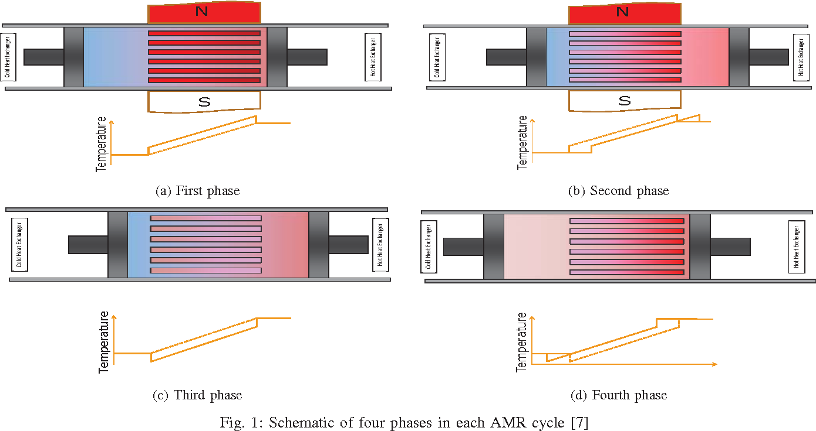
HARDWARE LAYOUT
Anatomy of the AMR Unit
NdFeB permanent-magnet assembly cycles field across the packed bed
Regenerator bed: packed spheres or parallel plates of the MCM
Hot/cold-side heat exchangers reject/absorb heat each half-cycle
Pump drives working fluid through the bed in sync with the field
MAGCOOL-DC · ASHRAE REGION XV · SAMUDRA 2026
6

Slide 7
POSITIONING
Research Gap
Gap | This Work | Typical Literature
Loss modeling | State-dependent (f, ṁ, Qc-based) | Constant parasitic-fraction assumption
Design scope | Material + geometry co-optimized | Fixed material, manual geometry choice
Honesty on gap vs. VCC | Explicit crossover search, reported | Rarely benchmarked against real HVAC
Scale | Data-center 5–20K span | Mostly domestic-refrigeration scale
MAGCOOL-DC · ASHRAE REGION XV · SAMUDRA 2026
7

Slide 8
STANDING ON SIX SOURCES
Key Literature This Work Builds On
Foundation | Source | What It Anchors in This Work
Giant MCE discovery | Pecharsky & Gschneidner, PRL 78, 4494 (1997) | First-order Gd₅Si₂Ge₂ transition — motivates the Landau extension
Gd benchmark data | Dan’kov et al., PRB 57, 3478 (1998) | ΔT_ad at 1/2/5 T — primary material-model validation target
AMR concept | Barclay, US Patent 4332135 (1982) | Defines the four-stage cycle this model simulates
Prototype benchmarks | Kamran, Ahmad & Wang (2020); Greco et al. (2019) | Comparative device tables behind this repo's 16-device benchmark set
Loss & geometry physics | Tušek et al. (2013); Klinar et al. (2024) | Geometry-dependent pumping power and the Hypereg parallel-hydraulic model
Mean-field limits | de Oliveira & von Ranke, Phys. Rep. 489 (2010) | Documents the near-Tᴄ bias this model's own validation reproduces
MAGCOOL-DC · ASHRAE REGION XV · SAMUDRA 2026
8

Slide 9
SCOPE
Objectives
Material & Cycle Modeling
Loss Calibration & Sensitivity
Multi-Objective Optimization
• Mean-field (Gd) + Landau (giant-MCE)
• 0-D AMR cooling/COP model
• Validate vs. literature & real devices
• State-dependent eddy/pumping/base loss model
• Calibrate to real AMR prototypes
• Sobol sensitivity analysis
• RSM surrogate + NSGA-III
• Techno-economic + emissions comparison
• Assess feasibility vs. conventional HVAC
MAGCOOL-DC · ASHRAE REGION XV · SAMUDRA 2026
9

Slide 10
HOW IT ALL FITS TOGETHER
Methodology Pipeline
Material
Physics
AMR Cycle
Model
Benchmark
Validation
Loss
Calibration
Sobol
Sensitivity
RSM
Surrogate
NSGA-III
Optimization
Design
Recs
Economics &
Emissions
→
→
→
→
→
→
→
→
9 stages · ~30 core modules · 452 automated tests · 35 auto-generated figures
Each stage feeds validated outputs into the next, ensuring traceable, reproducible results.
MAGCOOL-DC · ASHRAE REGION XV · SAMUDRA 2026
10

Slide 11
PART II
Material & System Modeling
Material Physics Primer
Material Validation
Giant-MCE Honesty Flag
AMR Device Physics
Loss Modeling
System Validation
MAGCOOL-DC · ASHRAE REGION XV · SAMUDRA 2026
11

Slide 12
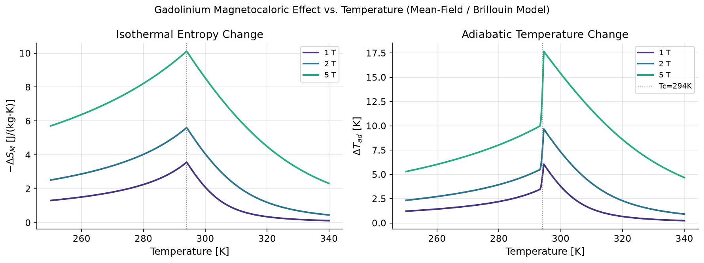
FOUNDATIONS
How the Model “Sees” a Magnetocaloric Material
Gd: mean-field (Brillouin/Weiss) theory, H_eff = H + λM — λ fixed by the known Curie temperature, not fit
Giant-MCE families (Gd₅Si₂Ge₂, La(Fe,Si)₁₃Hy, (Mn,Fe)₂(P,Si)): 6th-order Landau free energy
Needed because these are first-order transitions mean-field theory cannot capture
Entropy change & ΔT_ad vs. temperature (1/2/5 T), peak at Tc = 294 K
MAGCOOL-DC · ASHRAE REGION XV · SAMUDRA 2026
12

Slide 13
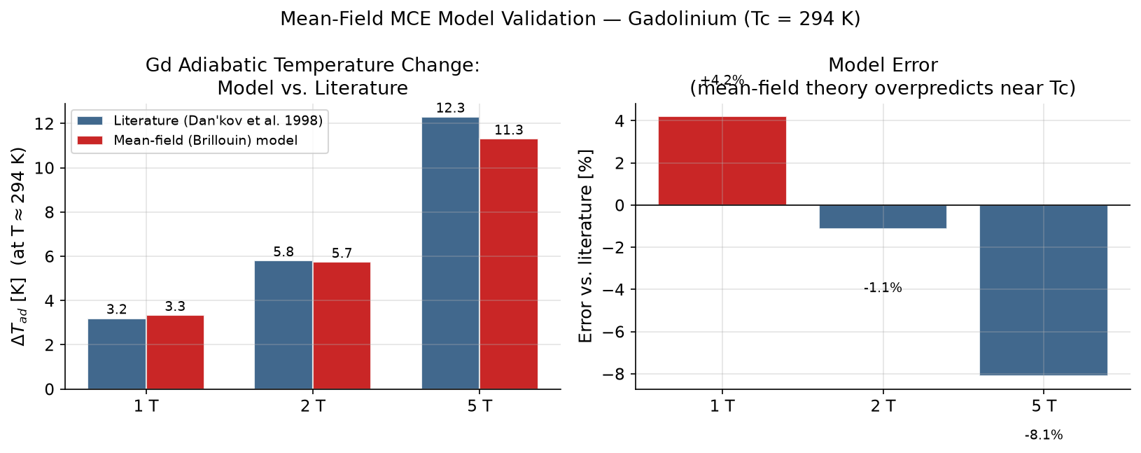
VALIDATION
Gd Model Validation vs. Dan’kov et al. (1998)
+4.2%
−1.1%
−8.1%
at 1 T
at 2 T
at 5 T
Mean-field theory's known near-Tc bias — physically explained, not hidden
Error trend consistent with textbook mean-field limitations near the Curie point
MAGCOOL-DC · ASHRAE REGION XV · SAMUDRA 2026
13

Slide 14
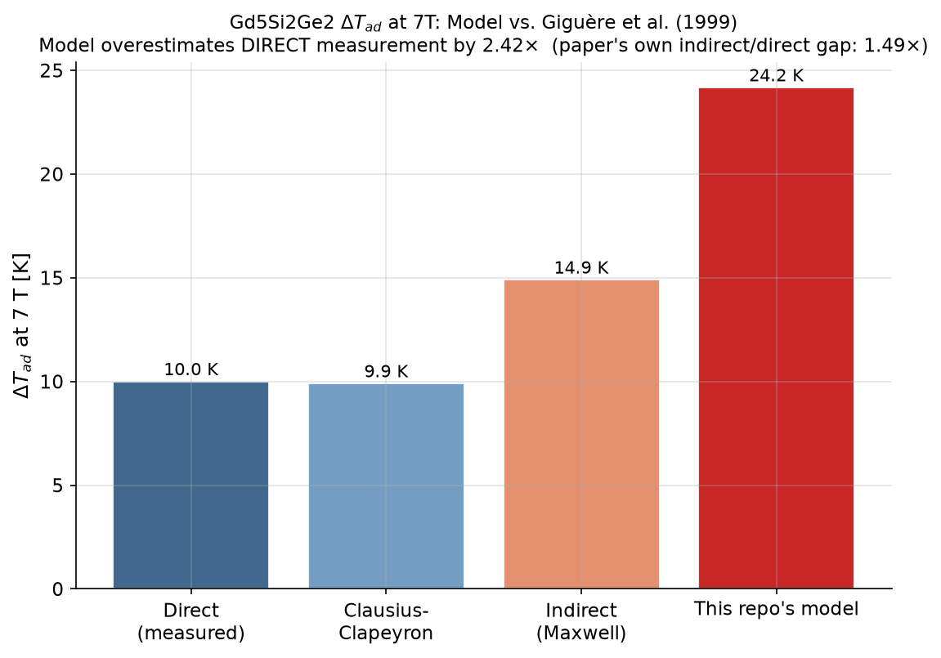
REPORTED OPENLY
An Honest Calibration Gap: Giant-MCE ΔT_ad
Model: 24.2 K Direct measurement (Giguère et al. 1999): 10.0 K Overestimate: 2.42×
Every downstream giant-MCE / cascade number in this talk should be read as an upper bound.
MAGCOOL-DC · ASHRAE REGION XV · SAMUDRA 2026
14

Slide 15
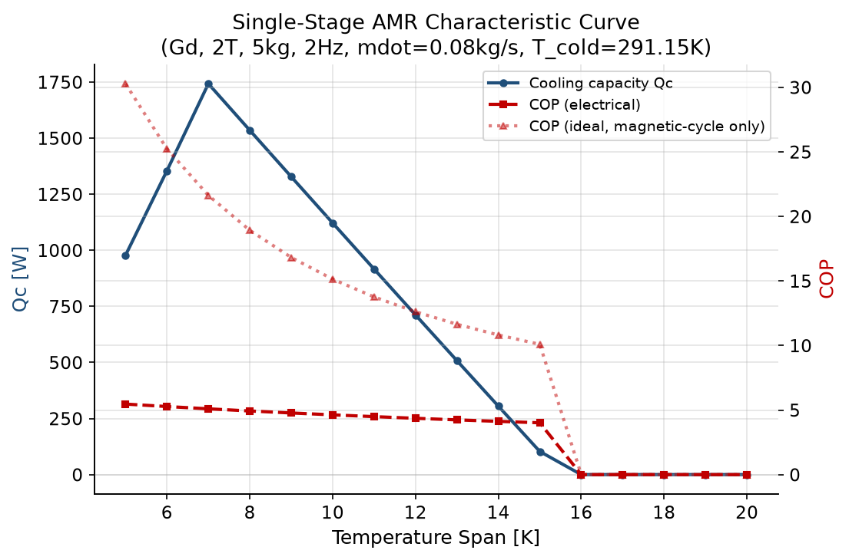
SYSTEM BEHAVIOR
The AMR Characteristic Curve
Cooling capacity and COP both fall as span widens — and there is a hard structural ceiling near 16 K for a single stage.
MAGCOOL-DC · ASHRAE REGION XV · SAMUDRA 2026
15

Slide 16
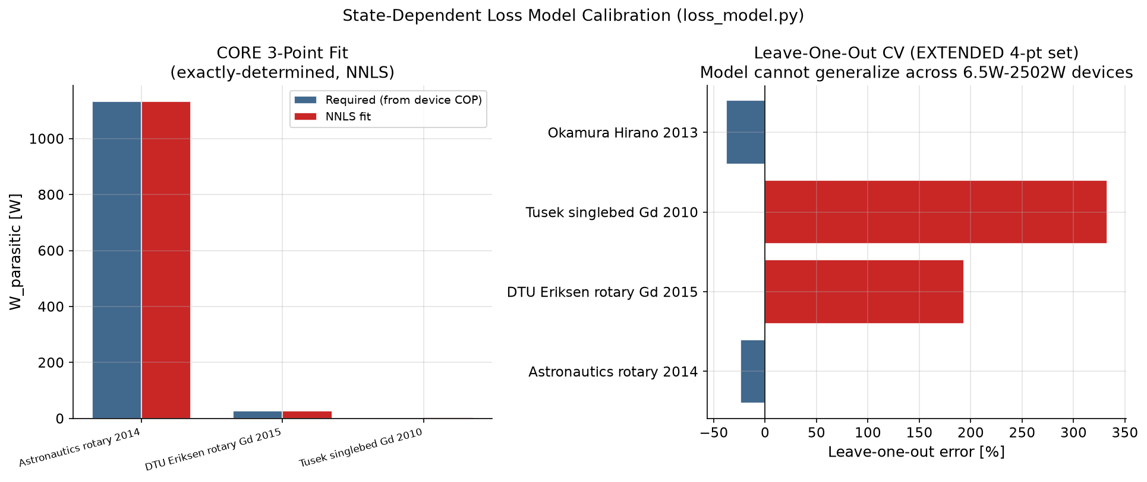
REALISM
Why “Ideal” COP Is the Wrong Number
W_eddy ∝ f · H² W_pump ∝ ṁ² W_base ∝ Qc
Calibrated to 3 real devices — an exactly-determined fit, not a regression.
MAGCOOL-DC · ASHRAE REGION XV · SAMUDRA 2026
16

Slide 17
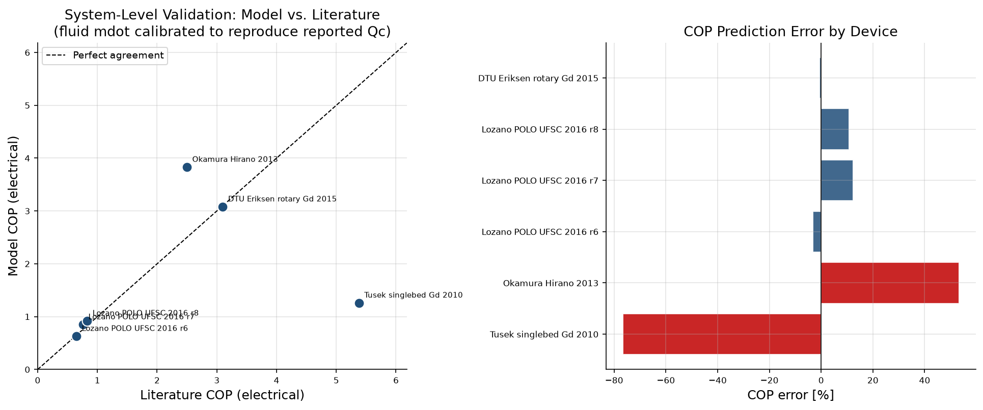
CREDIBILITY CHECK
System-Level Validation — 6 Real AMR Prototypes
4 of 6 devices within ±15% · 2 outliers identified and physically explained
MAGCOOL-DC · ASHRAE REGION XV · SAMUDRA 2026
17

Slide 18
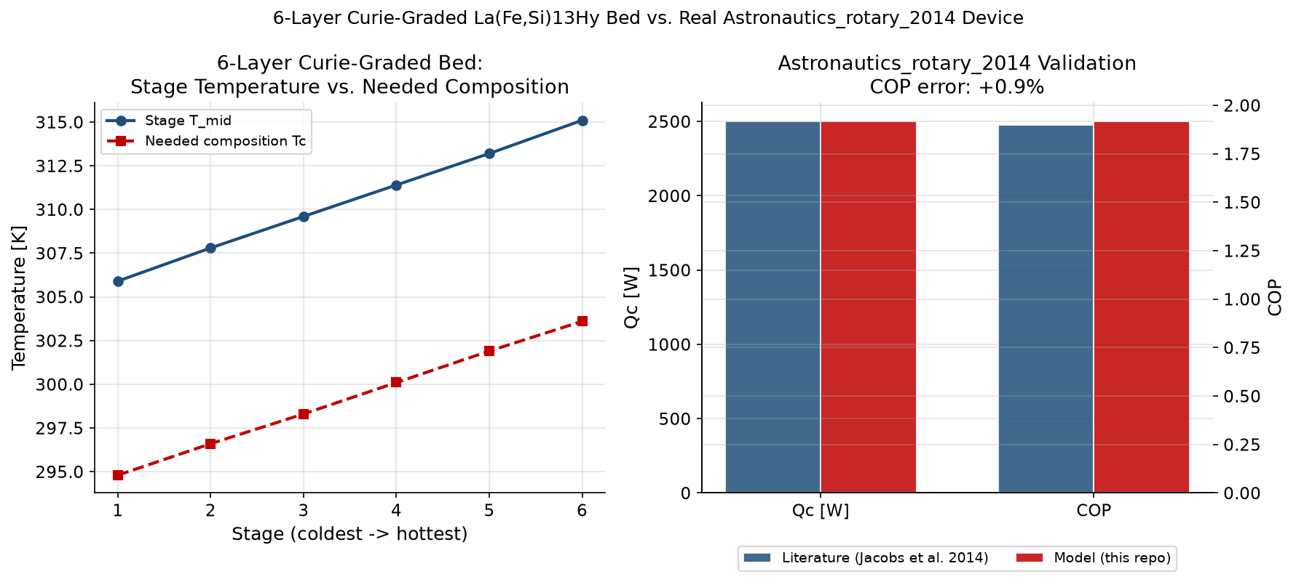
GOING BEYOND 0-D
1-D Transient Model vs. 3 More Prototypes
Direction-inconsistent across devices (undershoots 2 of 3, overshoots 1) — a genuine, unresolved calibration gap, reported openly rather than smoothed over.
MAGCOOL-DC · ASHRAE REGION XV · SAMUDRA 2026
18

Slide 19
PART III
Optimization & Design
Sobol Discovery
Surrogate Modeling
Optimization Setup
Pareto Front Hero
Recommended Design Point
Geometry Optimum
Multi-Stage Cascades
MAGCOOL-DC · ASHRAE REGION XV · SAMUDRA 2026
19

Slide 20
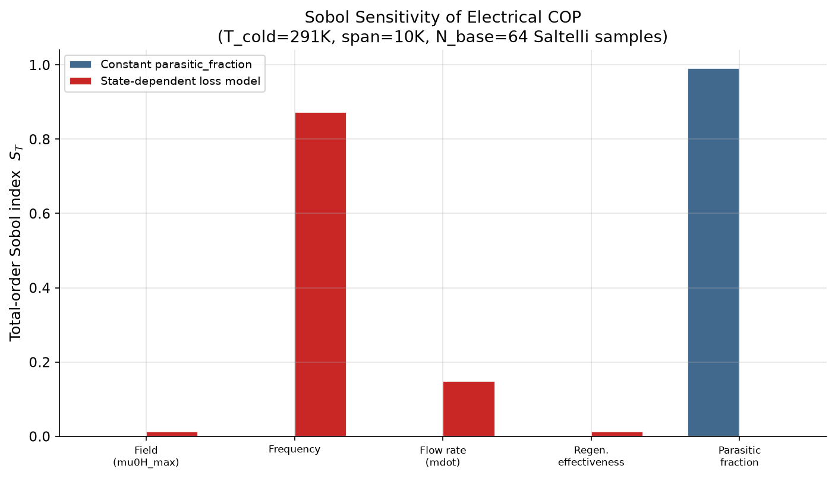
THE #2 INSIGHT
Frequency, Not Field, Runs the Show
Frequency
0.87
Flow rate
0.15
Field
0.01
Regen. effectiveness
0.01
A naive constant-loss model attributes 100% of sensitivity to a made-up parameter instead.
MAGCOOL-DC · ASHRAE REGION XV · SAMUDRA 2026
20

Slide 21
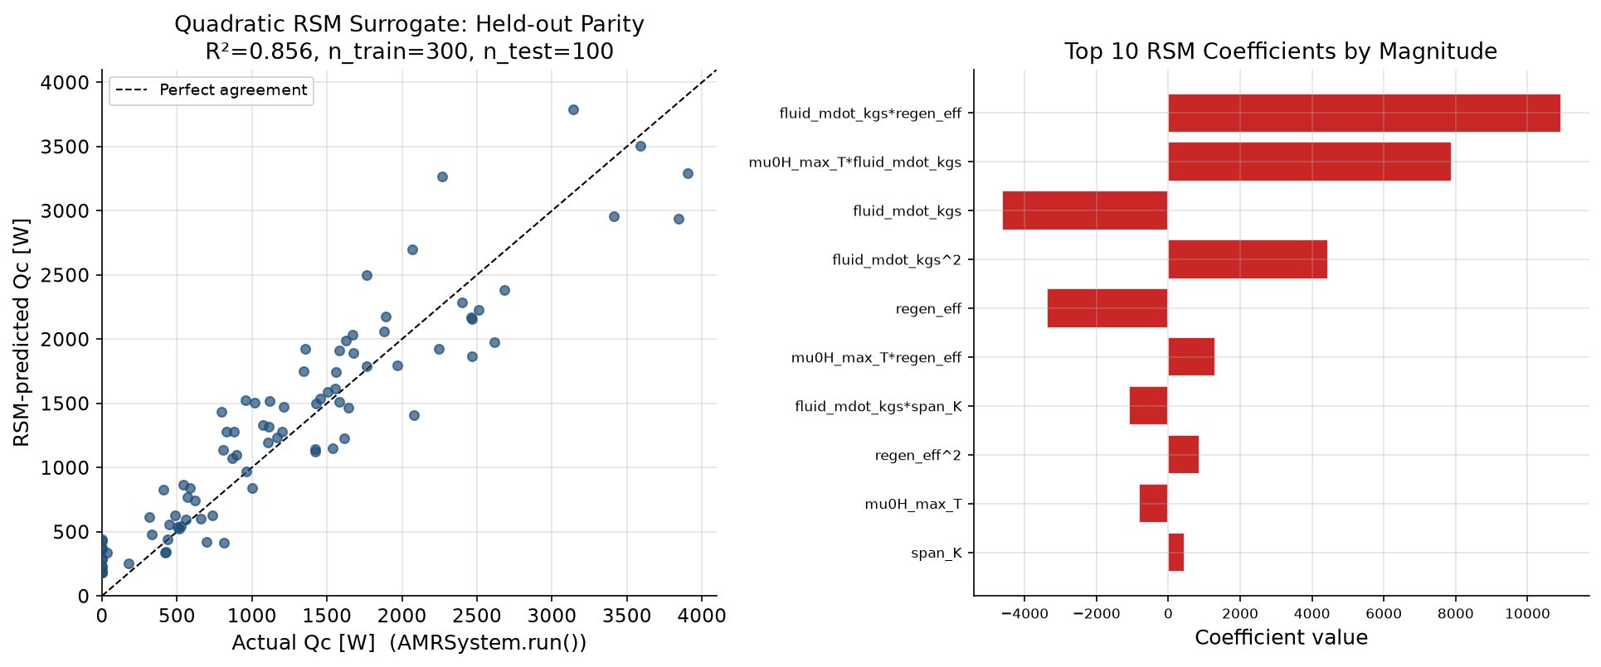
SCALING UP
Making 40,000+ Evaluations Possible
Held-out R² = 0.856 · RMSE = 365 W · 300 training samples · 100 held-out test samples · 5 design variables
MAGCOOL-DC · ASHRAE REGION XV · SAMUDRA 2026
21

Slide 22
NSGA-III
Optimization Setup
Design Variables (7 + 1 categorical)
Objectives
Field · frequency · flow rate · regenerator mass · effectiveness · blow fraction · particle diameter
Material family is co-optimized as an 8th, categorical choice.
Maximize COP
Maximize cooling capacity (Qc)
Minimize BOM cost ($)
Across 3 independent NSGA-III seeds for stability.
MAGCOOL-DC · ASHRAE REGION XV · SAMUDRA 2026
22

Slide 23
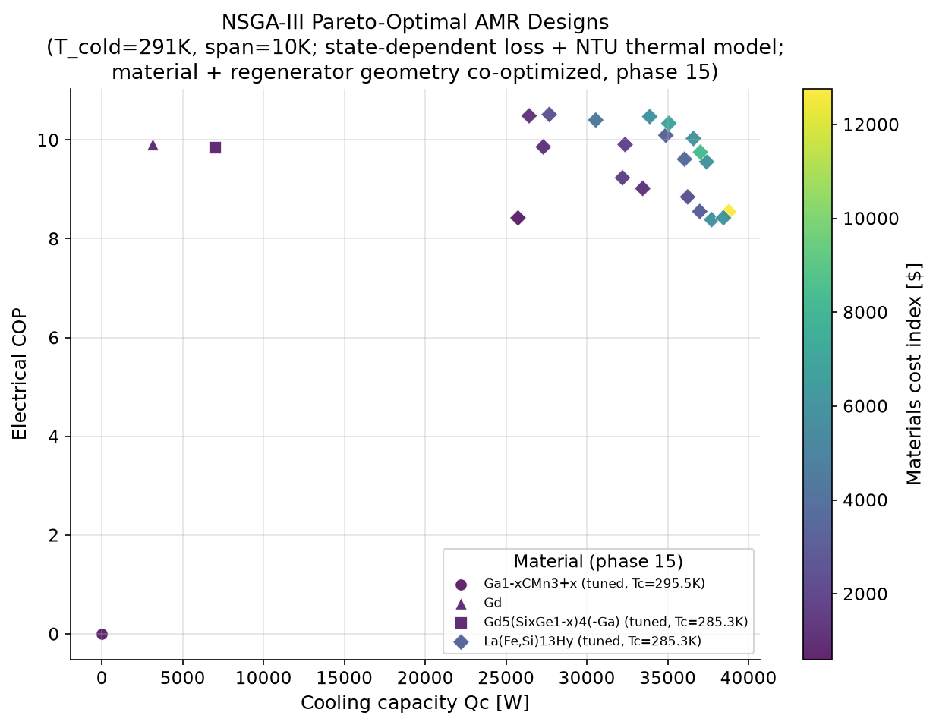
HERO FINDING
The Pareto Front & a Material Discovery
La(Fe,Si)₁₃Hy dominates 67–100% of Pareto-optimal designs across 3 independent seeds — a genuine, seed-stable finding.
MAGCOOL-DC · ASHRAE REGION XV · SAMUDRA 2026
23

Slide 24
SPEC SHEET
Recommended Design Point
Material
Field
Frequency
La(Fe,Si)₁₃Hy, tuned, Tc = 285.3 K
1.01 T
2.52 Hz
Flow
Mass
Effectiveness
0.49 kg/s
3.29 kg
0.90
Particle diameter
0.54 mm
COP_electrical = 9.91 · Qc = 32.4 kW · Cost = $1,919
MAGCOOL-DC · ASHRAE REGION XV · SAMUDRA 2026
24

Slide 25
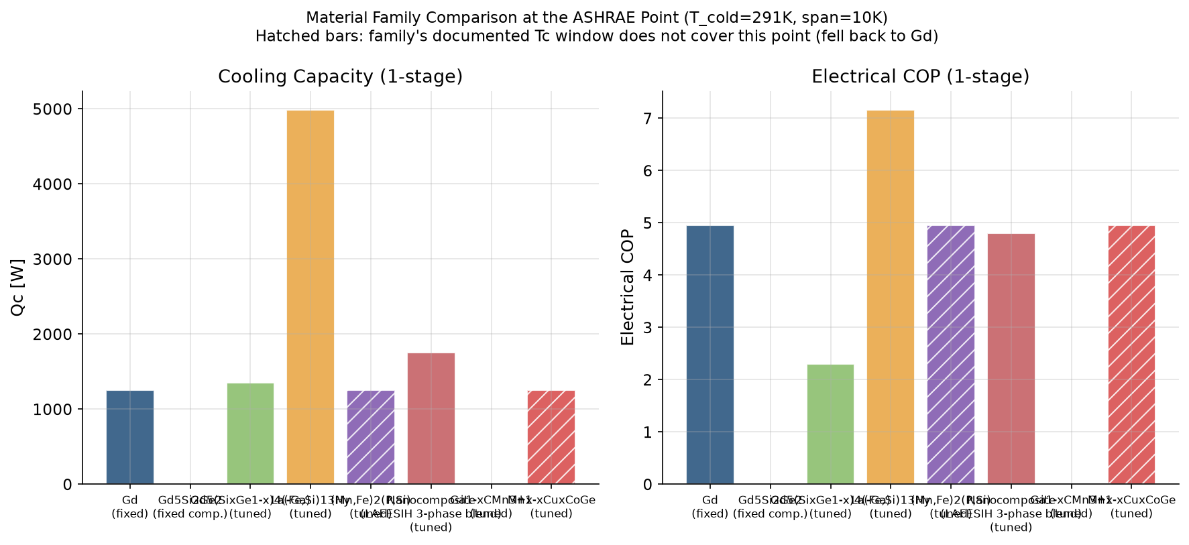
EIGHT CANDIDATES, ONE WINNER
Material Family Comparison at the ASHRAE Point
La(Fe,Si)₁₃Hy leads every span tested (5–20K, 2T, 5kg/stage) — consistent with its Pareto dominance.
MAGCOOL-DC · ASHRAE REGION XV · SAMUDRA 2026
25

Slide 26
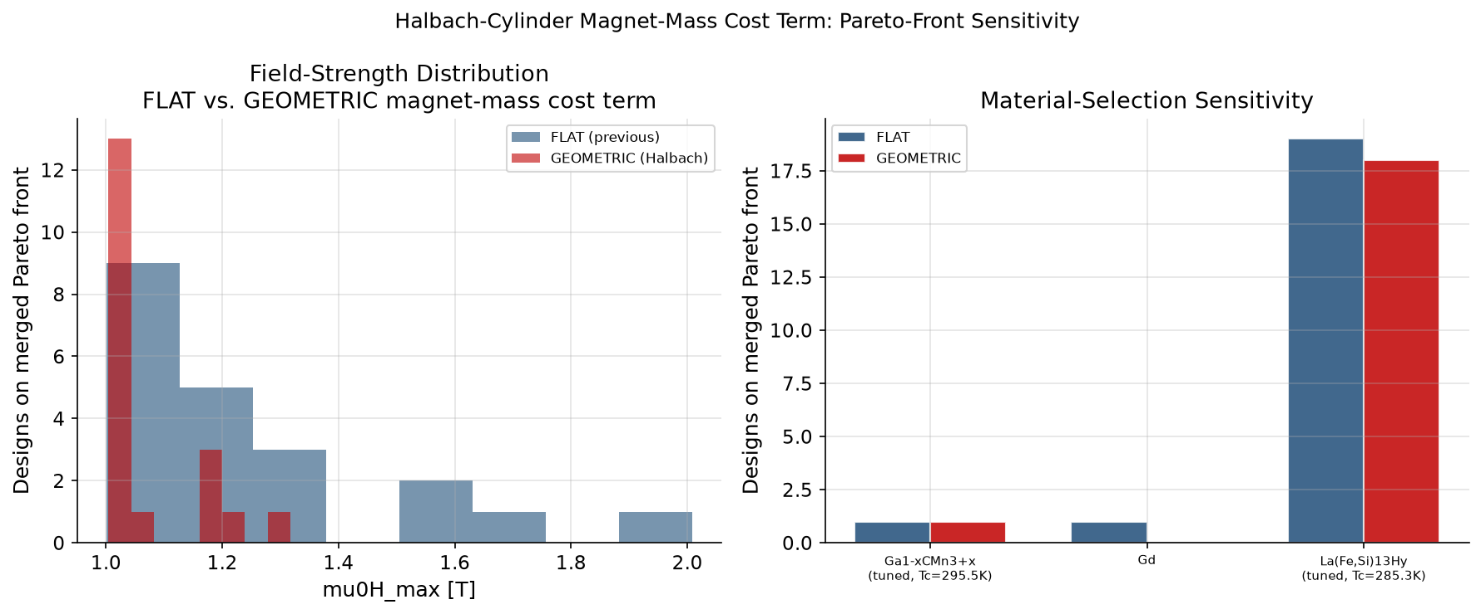
ROBUSTNESS CHECK
Does the Cost Model Change the Winner?
Pareto front size shrinks slightly under a geometric magnet-cost term (21→19), but La(Fe,Si)₁₃Hy still dominates — the material finding is robust to how magnet cost is modeled.
MAGCOOL-DC · ASHRAE REGION XV · SAMUDRA 2026
26

Slide 27
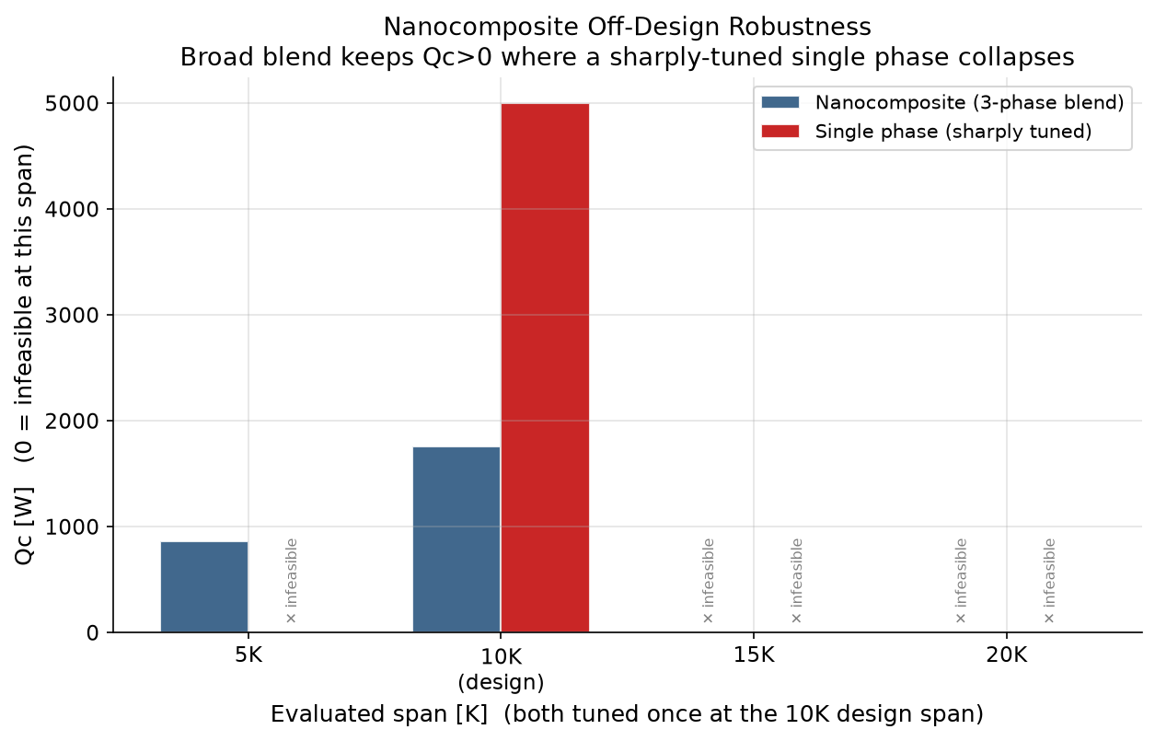
DESIGN EXPLORATION
A Broader Blend Trades Peak Performance for Range
At the design span the sharply-tuned single-phase material wins outright — but off-design, it can collapse to zero cooling while the nanocomposite blend still delivers positive Qc.
MAGCOOL-DC · ASHRAE REGION XV · SAMUDRA 2026
27

Slide 28
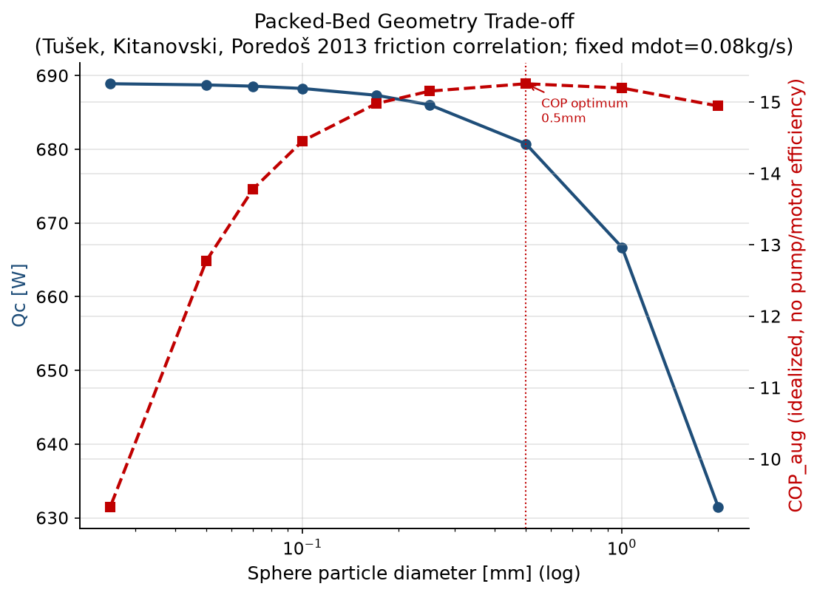
DESIGN TRADEOFF
Regenerator Geometry: an Interior Optimum
Smaller particles improve heat transfer but raise pumping loss. Optimum packed-bed sphere diameter: 0.5 mm
MAGCOOL-DC · ASHRAE REGION XV · SAMUDRA 2026
28

Slide 29
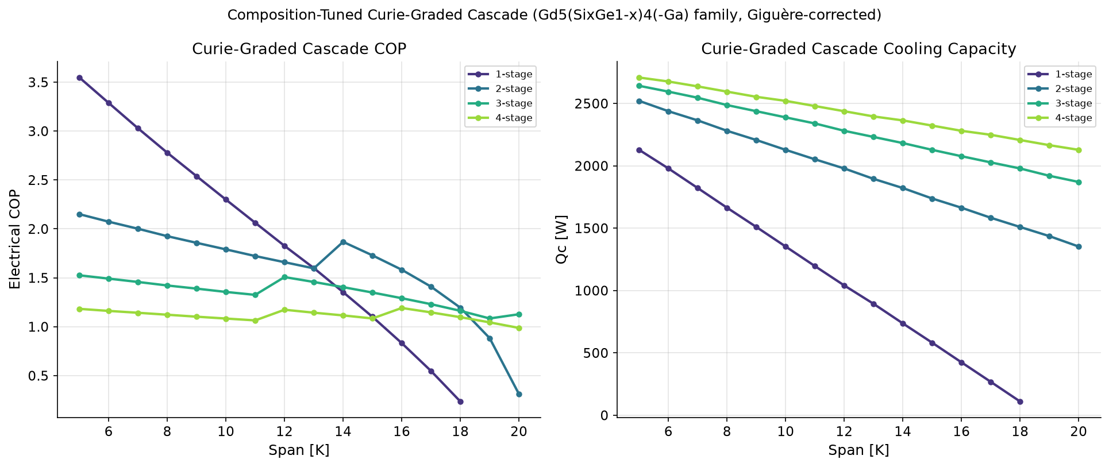
EXTENDING SPAN
Staging Beats the Single-Stage Ceiling
Curie-graded, multi-stage regenerators extend usable span well past the single-stage collapse.
MAGCOOL-DC · ASHRAE REGION XV · SAMUDRA 2026
29

Slide 30
PART IV
Results & Honest Verdict
Honest Verdict Hero
Economics
Emissions & Water
Design Roadmap
Limitations & Open Items
Conclusion
MAGCOOL-DC · ASHRAE REGION XV · SAMUDRA 2026
30

Slide 31
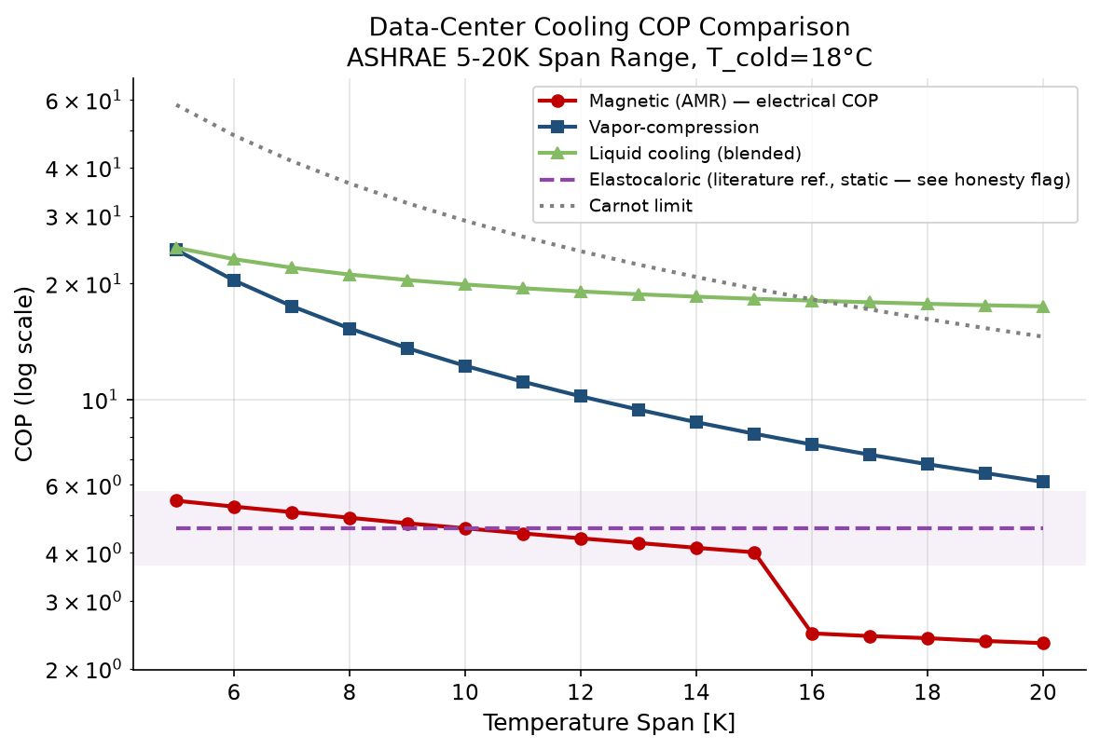
HERO FINDING #2
The Honest Verdict vs. Conventional Cooling
A systematic search — span 3–30K, vapor-compression η = 0.25–0.55 — found NO combination where calibrated AMR beats vapor-compression on COP. Best AMR COP found: 5.89 vs. VCC's own worst-case COP: 24.33
MAGCOOL-DC · ASHRAE REGION XV · SAMUDRA 2026
31

Slide 32
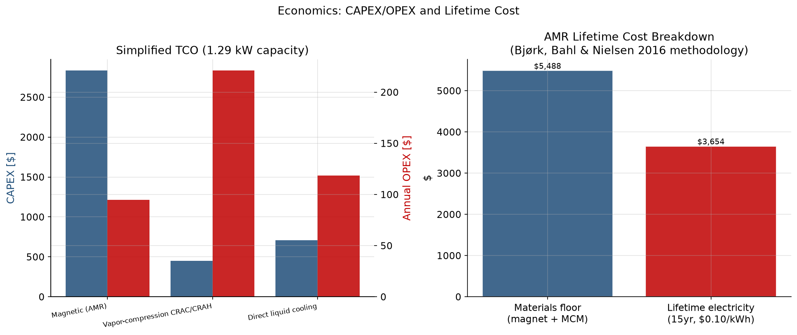
TECHNO-ECONOMICS
Economics: Where the Cost Actually Lives
$0.1027/kWh_cooling
Levelized cost of cooling ($0.0535 capital + $0.0492 electricity, 15-yr, 6% discount)
$5,825
Materials BOM (2T, 5kg Gd): Magnet $5,388 (134.7kg) · MCM $100 · Yoke $337 (67.4kg)
Magnet mass is the dominant cost driver — not electronics, not electricity.
MAGCOOL-DC · ASHRAE REGION XV · SAMUDRA 2026
32

Slide 33
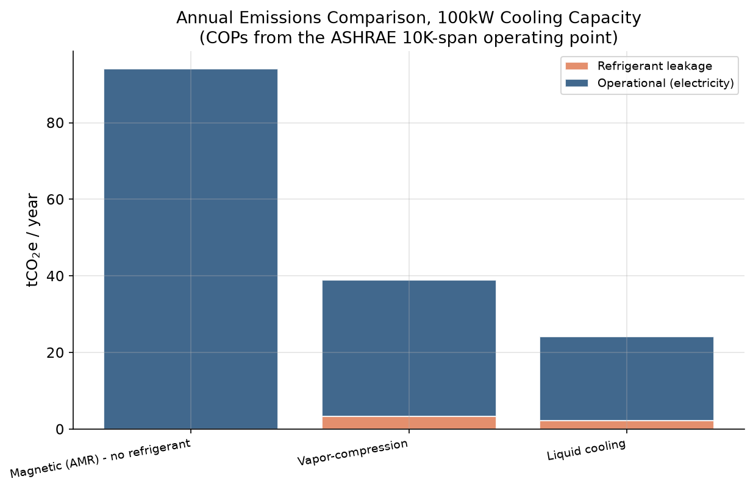
TOLD HONESTLY
Emissions & Water: the Refrigerant-Free Case
Emissions: AMR runs ~3.6× higher than VCC (0.989 vs 0.275 tCO₂e/yr) — operational electricity dominates. Water: AMR uses ~36× less water than VCC (0.05 vs 1.80 L/kWh) — a genuine advantage today.
MAGCOOL-DC · ASHRAE REGION XV · SAMUDRA 2026
33

Slide 34
RANKED, NOT GUESSED
What Would Actually Close the Gap
1
Operating frequency
Dominant lever (Sobol S_T = 0.87)
2
Material / composition choice
La(Fe,Si)₁₃Hy: +44% COP vs. plain Gd
3
Curie-grading / staging
Extends usable span past the single-stage ceiling
4
Regenerator geometry
Interior optimum at 0.5mm particle size
5
Field / flow balance
Co-optimized, not maximized independently
MAGCOOL-DC · ASHRAE REGION XV · SAMUDRA 2026
34

Slide 35
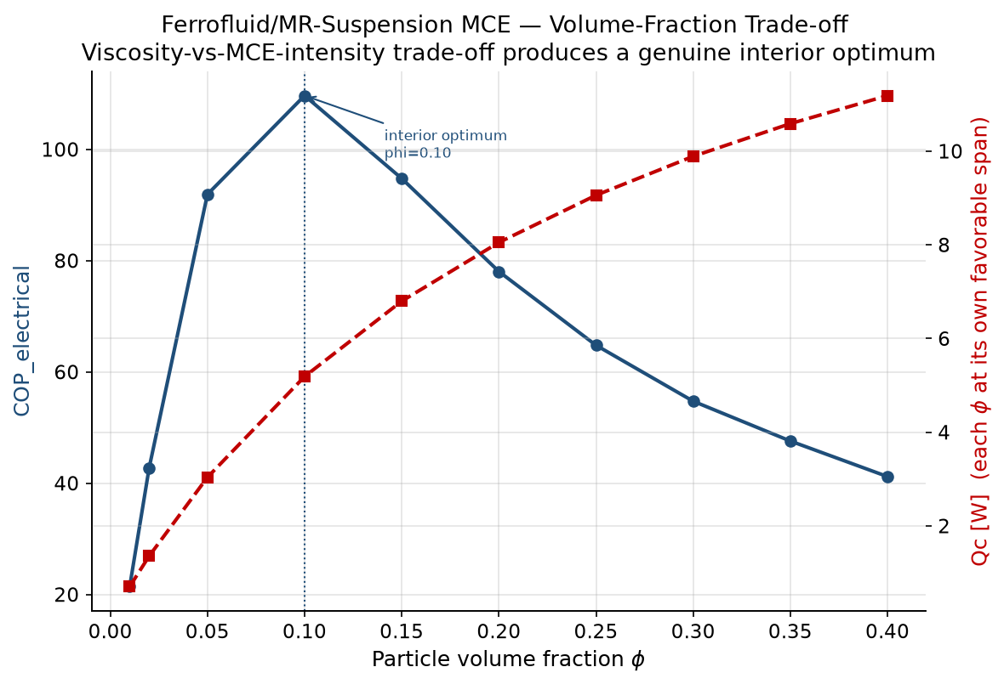
DESIGN EXPLORATION
Magnetocaloric Fluids: an Alternative Working Body
Ferrofluid / MR-suspension bed, swept over volume fraction φ. COP_elec peaks near φ ≈ 0.10 — too little MCE mass hurts capacity, too much raises viscosity/pumping loss. Design-exploration tool, not yet validated against a real device.
MAGCOOL-DC · ASHRAE REGION XV · SAMUDRA 2026
35

Slide 36
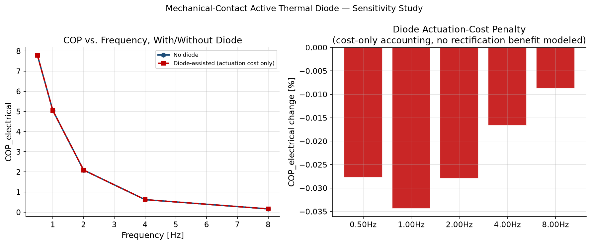
COST-ONLY STUDY
Mechanical Thermal Diode: an Upper-Bound Check
Illustrative actuation cost reduces COP_electrical by ≤ 0.03% across 0.5–8 Hz — a small, cost-only effect; no offsetting heat-transfer benefit is modeled here.
MAGCOOL-DC · ASHRAE REGION XV · SAMUDRA 2026
36

Slide 37
TOLD STRAIGHT
Limitations, Future Scope & Open Items
Future scope and unresolved items deliberately documented — a roadmap for the next hardware build.
Purpose-built experimental prototype and hardware-in-the-loop validation needed for data-center-relevant spans and loads.
Resolve the open 1-D regenerator calibration gap (directionally-inconsistent axial-conduction fit across benchmark devices).
Magnetocaloric-fluid and passive/hybrid-regenerator architectures are mature design-exploration tools, but need to become validated features.
Full bottom-up manufactured-system BOM (pumps, motors, controls) needed to replace the current order-of-magnitude cost multiplier.
Targeted OCR/access required to mine remaining chapters in Halbach design, AMR cycle topology, and thermal-diode heat switching.
AI-assisted or digital-twin real-time optimisation for adaptive data-center cooling control.
MAGCOOL-DC · ASHRAE REGION XV · SAMUDRA 2026
37

Slide 38
CONCLUSION
Gd model validated to +4.2% / −1.1% / −8.1% vs. Dan’kov et al. (1998)
System model validated against 6 real AMR prototypes — 4 of 6 within ±15%
Sobol sensitivity: electrical COP dominated by frequency (S_T = 0.87), not field
NSGA-III discovered a La(Fe,Si)₁₃Hy-dominated Pareto front (67–100% share, seed-stable)
No design point found where calibrated AMR beats vapor-compression on COP or emissions
Refrigerant-free operation + ~36× lower water use are real advantages today
“A validated, self-checking engineering framework that tells you exactly where it stands today, why, and what would have to change.”

