Slide 1
IBM University Engagement Project Submission
“Exploring the Power of Agentic AI with IBM Granite and IBM Bob”

Slide 2

Project Tile – AI Course Content Simplification Agent
Domain of Project – Education
Student Name | Recent Passport Photo | Email ID | Mobile number [WhatsApp]
Akhil Pamarthi |  | akhilpamarthi00@gmail.com akhilpamarthi22@gmail.com | 7780631042

Slide 3
Problem Statement -
Problem Statement: Course Content Simplification Agent
Students often struggle with lengthy and technically complex academic content.
Too much technical information
Difficult for beginners to understand
Time-consuming to search through large documents
No personalized explanations
Limited interactive learning and self-assessment
Project Objectives
Simplify complex academic content.
Support PDF, DOCX and TXT uploads.
Provide document-grounded answers.
Adapt explanations to four learning levels.
Generate summaries and MCQ quizzes.
Support follow-up questions using conversation history.
Reduce hallucinations through RAG-based retrieval.
Provide a simple, responsive interface.

Slide 4
Proposed Solution -
Proposed Solution
LearnSimplify AI is an AI-powered educational assistant that makes complex course material easier to understand. Students can upload PDF, DOCX, or TXT documents and interact with the content.
Key Features:
Ask Questions: Get answers based on uploaded course material.
Personalized Explanations: Choose Beginner, Intermediate, Advanced, or Expert learning levels.
Summarization: Generate short, medium, or detailed summaries.
Quiz Generation: Automatically creates 5 MCQs with answers and explanations.
Follow-up Conversation: Uses recent chat history for more contextual responses.
How AI Works
The system uses RAG (Retrieval-Augmented Generation). Uploaded documents are processed, divided into chunks, converted into embeddings, and stored in a vector store. When a student asks a question, the system retrieves the most relevant content and sends it along with the question to IBM Granite through watsonx.ai. Granite then generates a relevant, course-specific response.
.

Slide 5
Technology Used
IBM Bob Platform – Used to design, develop, and orchestrate the LearnSimplify AI application.
IBM Granite 4 H Small – Used for natural language understanding and generating educational responses.
IBM watsonx.ai – Used to access and integrate the Granite model into the application.
RAG (Retrieval-Augmented Generation) – Retrieves relevant information from uploaded course material before generating responses.
Vector Store – Stores document embeddings and enables similarity-based retrieval.
IBM Cloud IAM – Provides secure authentication for accessing IBM services.

Slide 6
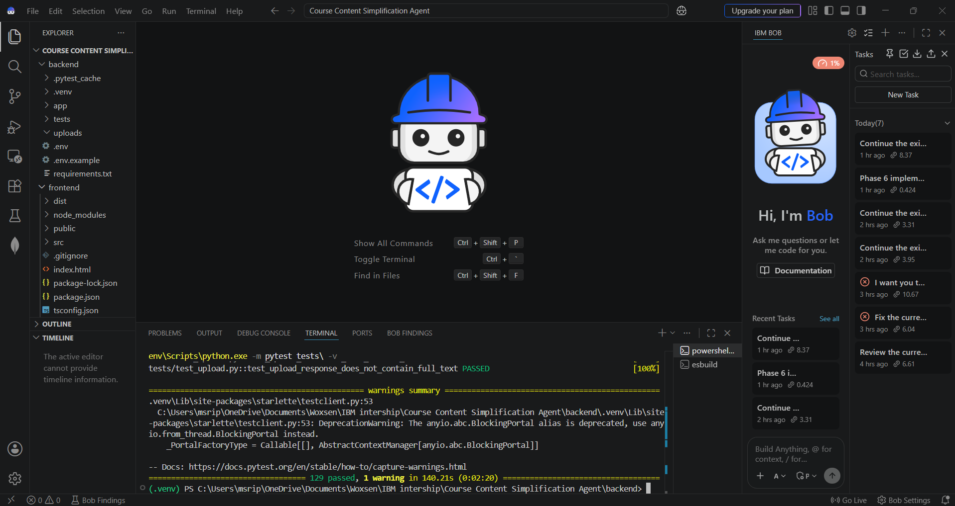
Required Files created using IBM bob -
Frontend files – React components, CSS, UI and API service files
Backend files – FastAPI application, routes and models
RAG files – Document chunking, embeddings, vector store and retrieval
AI integration files – IBM Granite / watsonx.ai service
Testing files – Automated test cases for all major features
Configuration files – .env.example, requirements.txt, package.json
Documentation – README.md

Slide 7
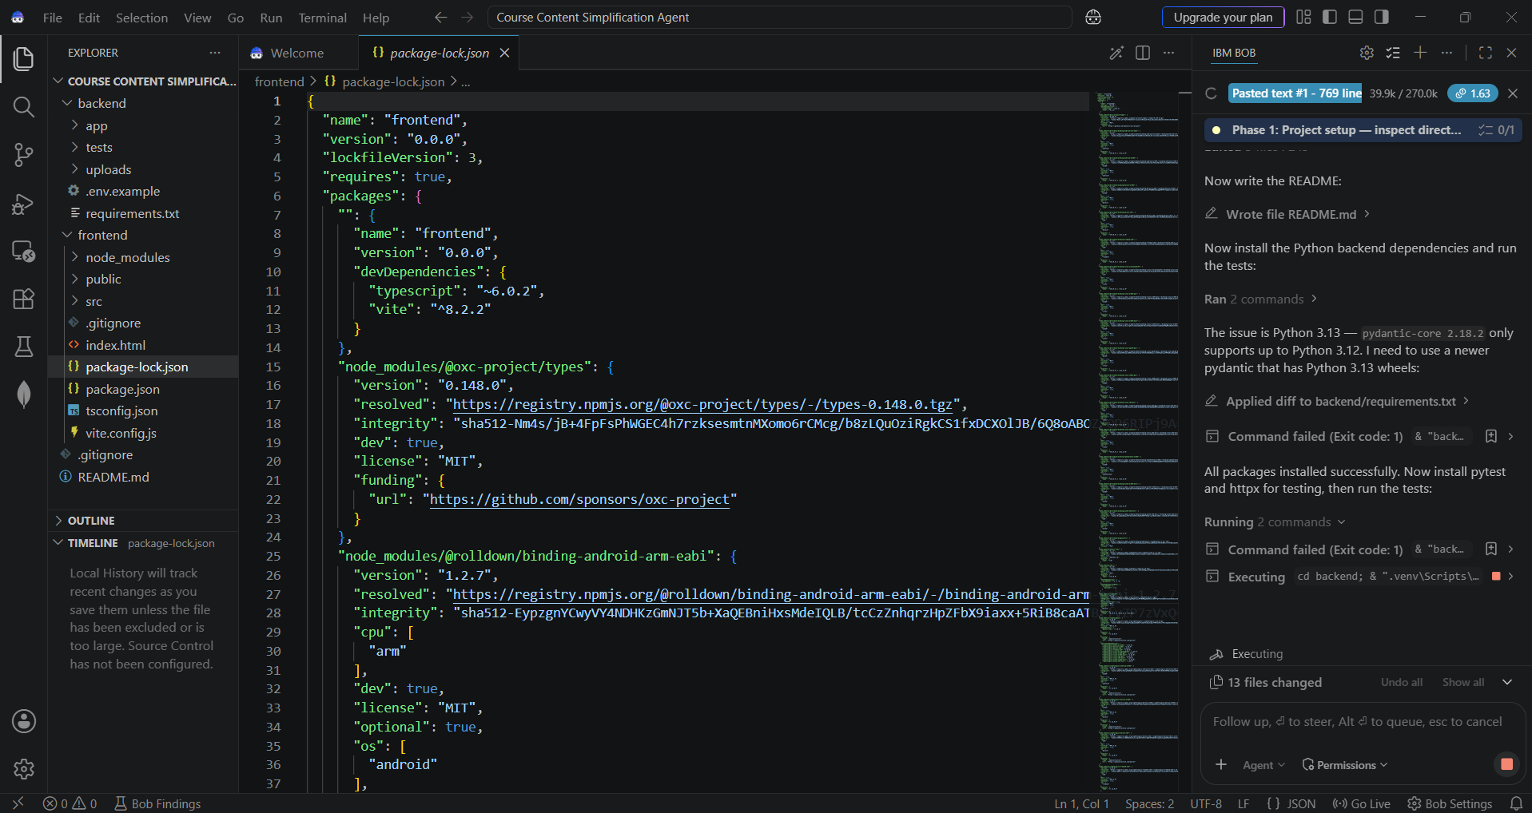
IBM Bob Screenshots:

Slide 8
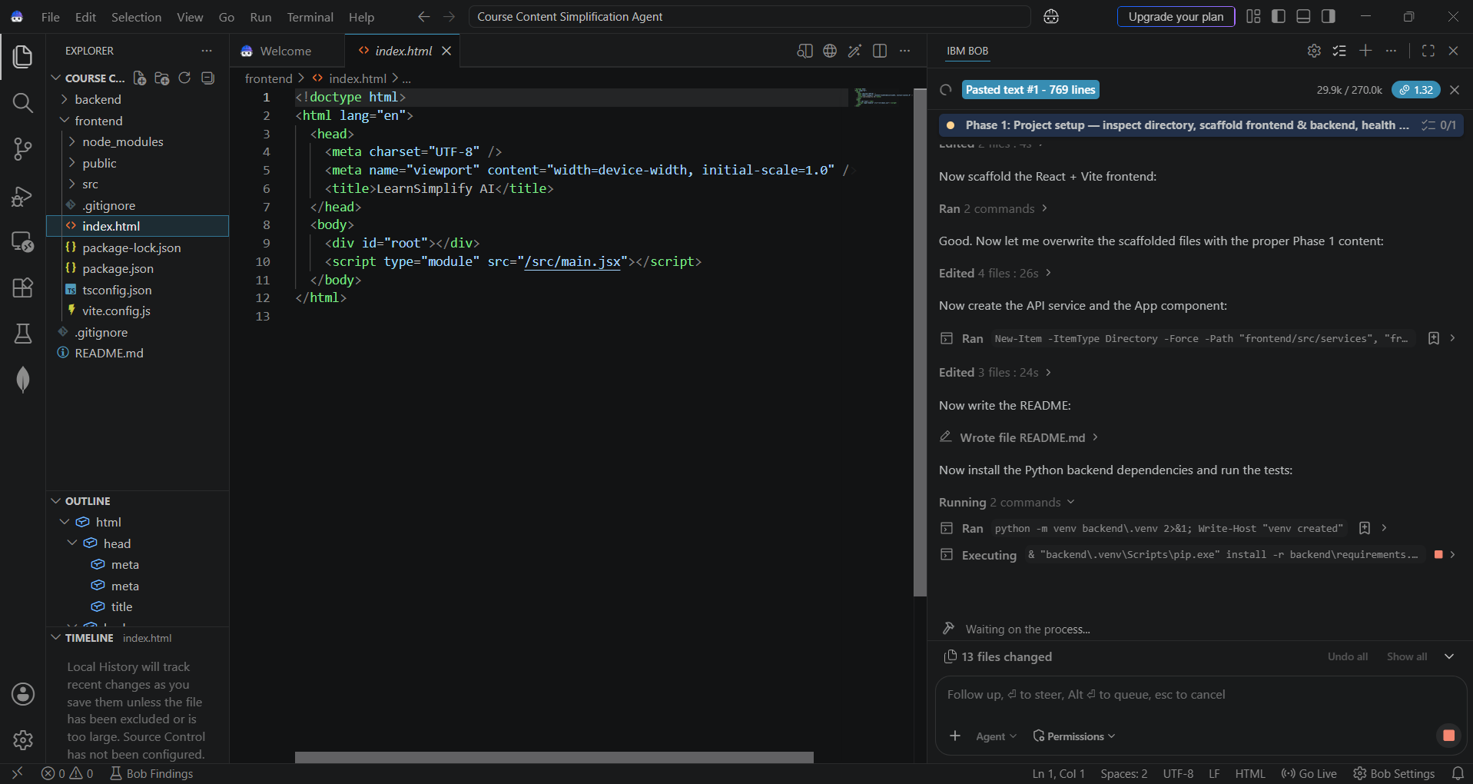

Slide 9
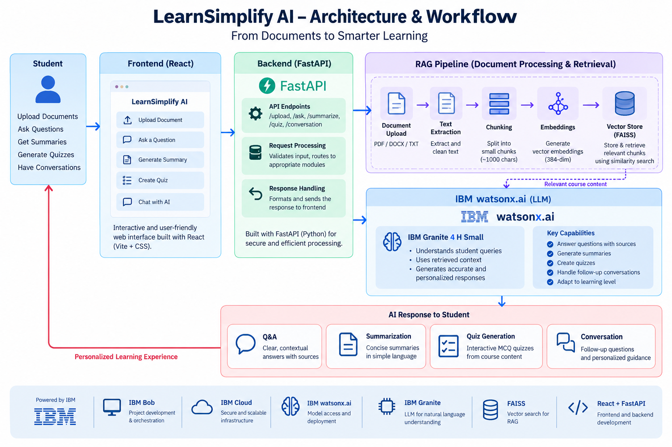
Architecture blueprint for IBM bob:

Slide 10

Role of Agentic AI in the solution
Role of Agentic AI in Nutrition Agent:
Understands student queries and identifies the required learning task.
Retrieves relevant course content from uploaded documents using RAG.
Uses IBM Granite to generate accurate and contextual responses.
Performs multiple learning tasks such as Q&A, summarization, quizzes, and follow-up conversations.
Adapts responses based on the student's selected learning level.
Provides an interactive learning experience instead of simple document-based answers.

Slide 11
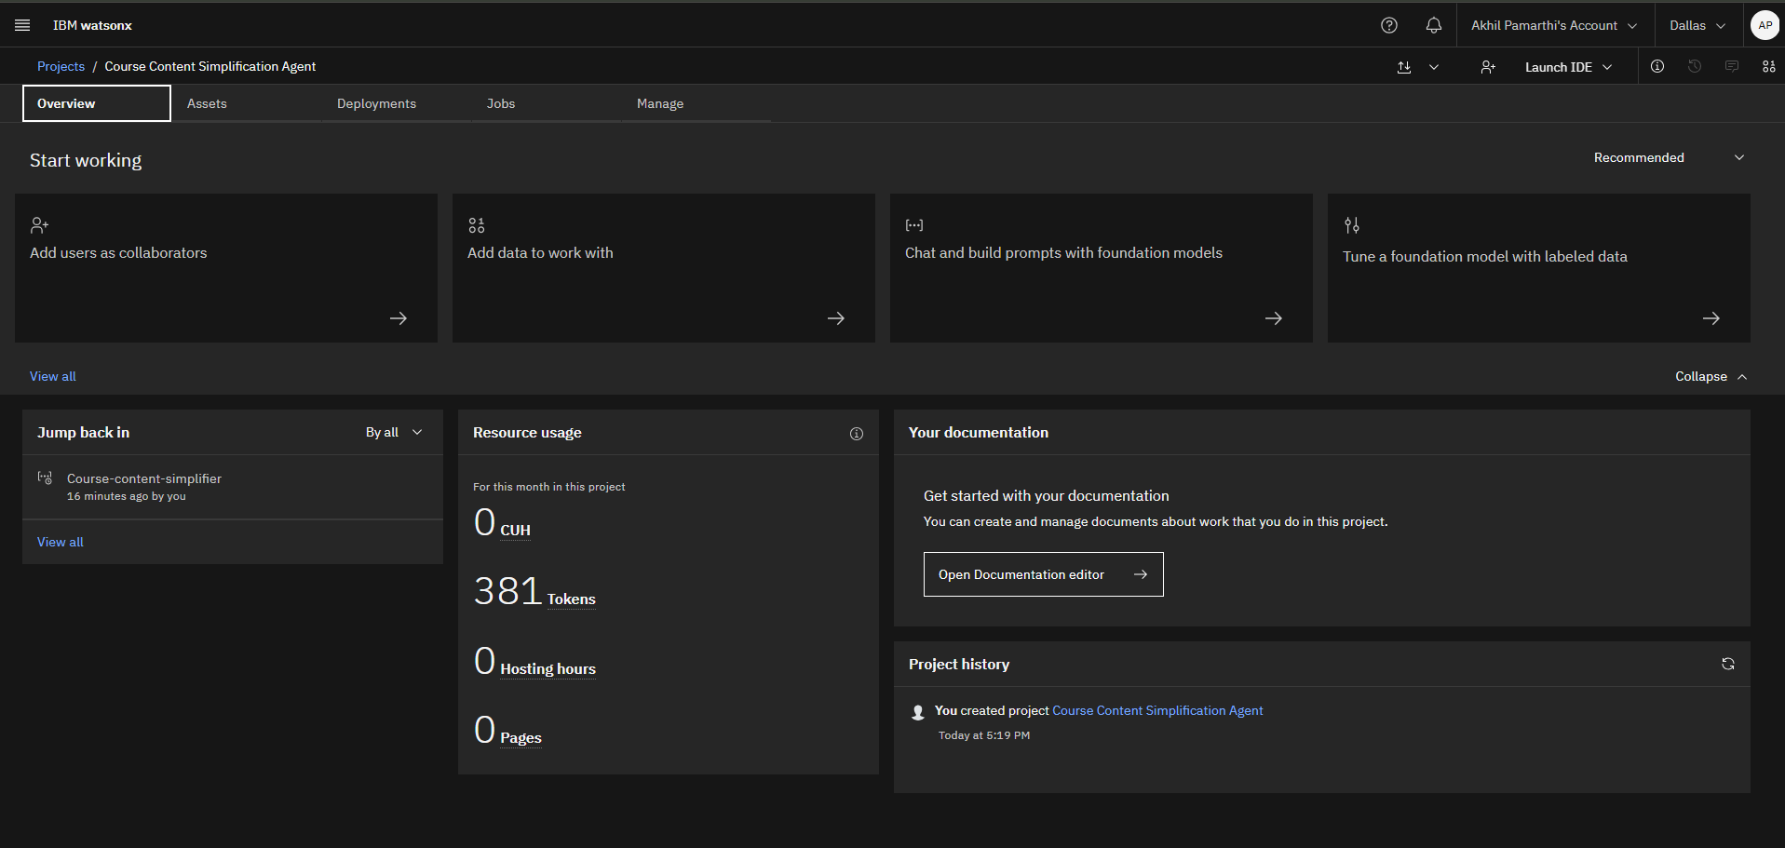
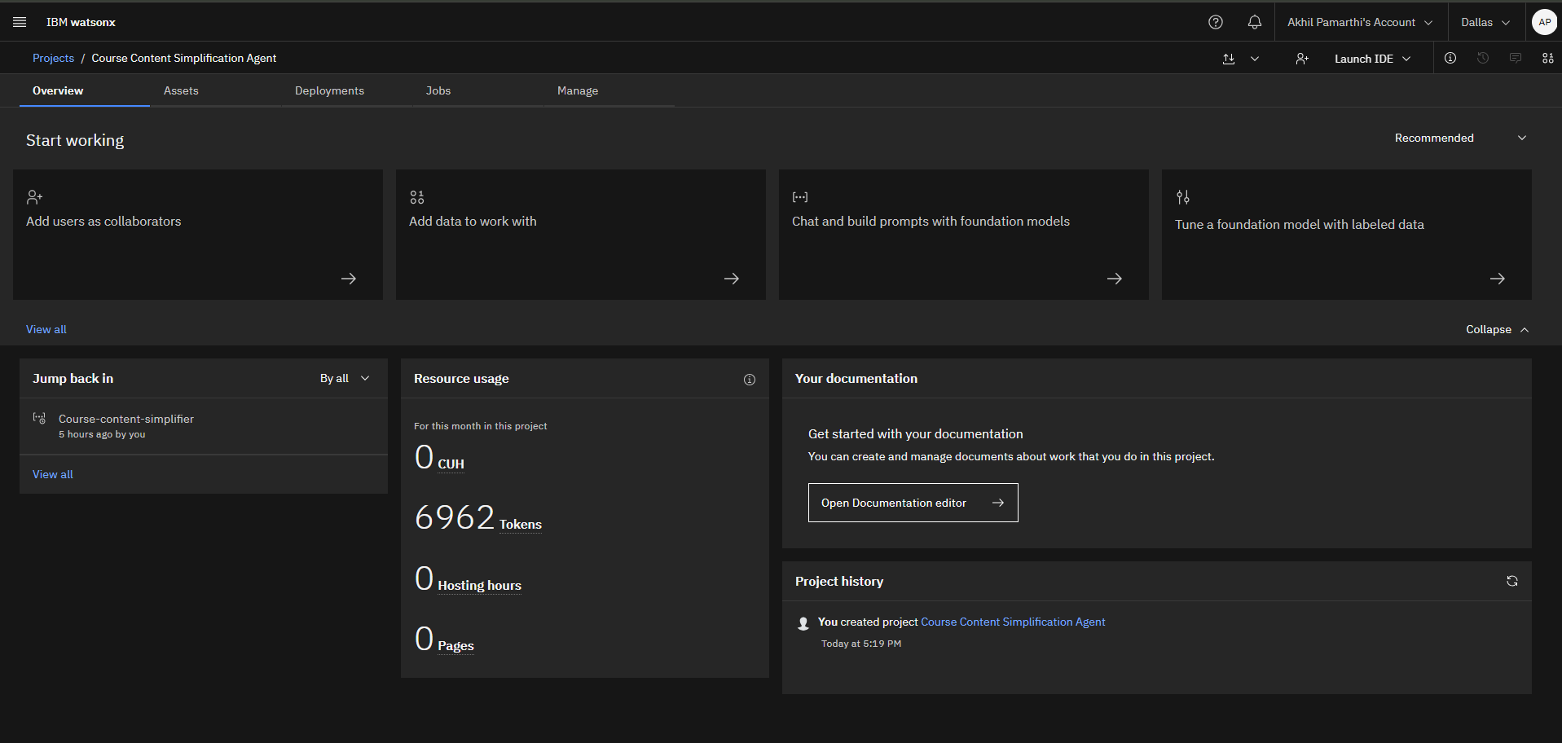
Token Usage
6,581 token are used
Before Prompt
After the Prompt
·
·

Slide 12
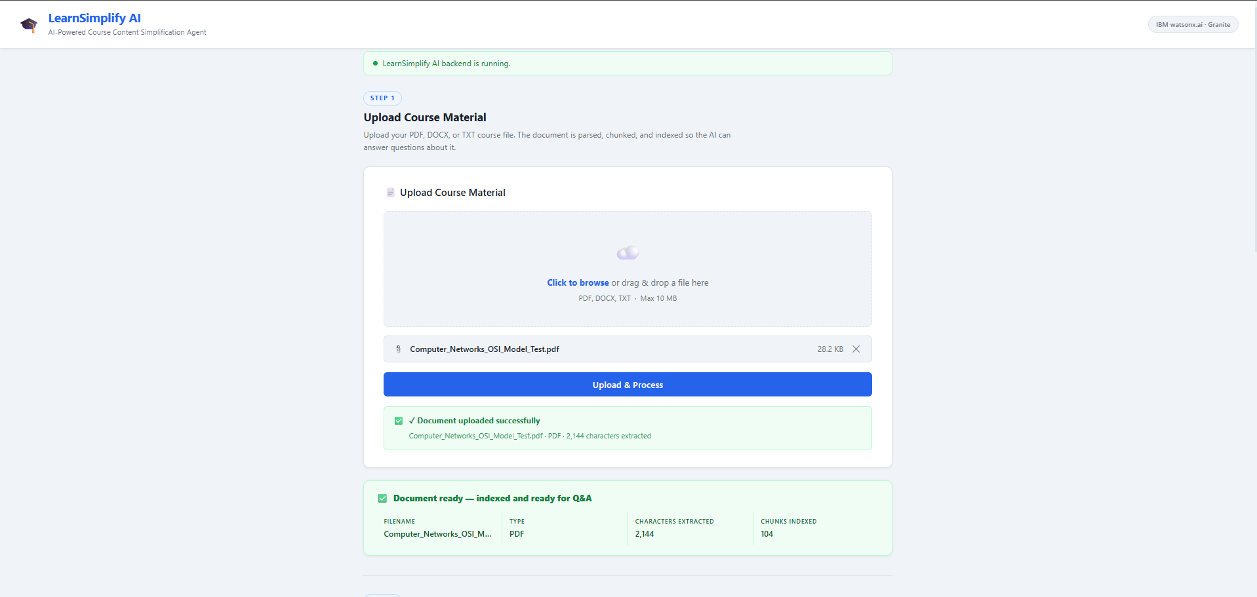
Project Output Screenshot
·
·
·

Slide 13
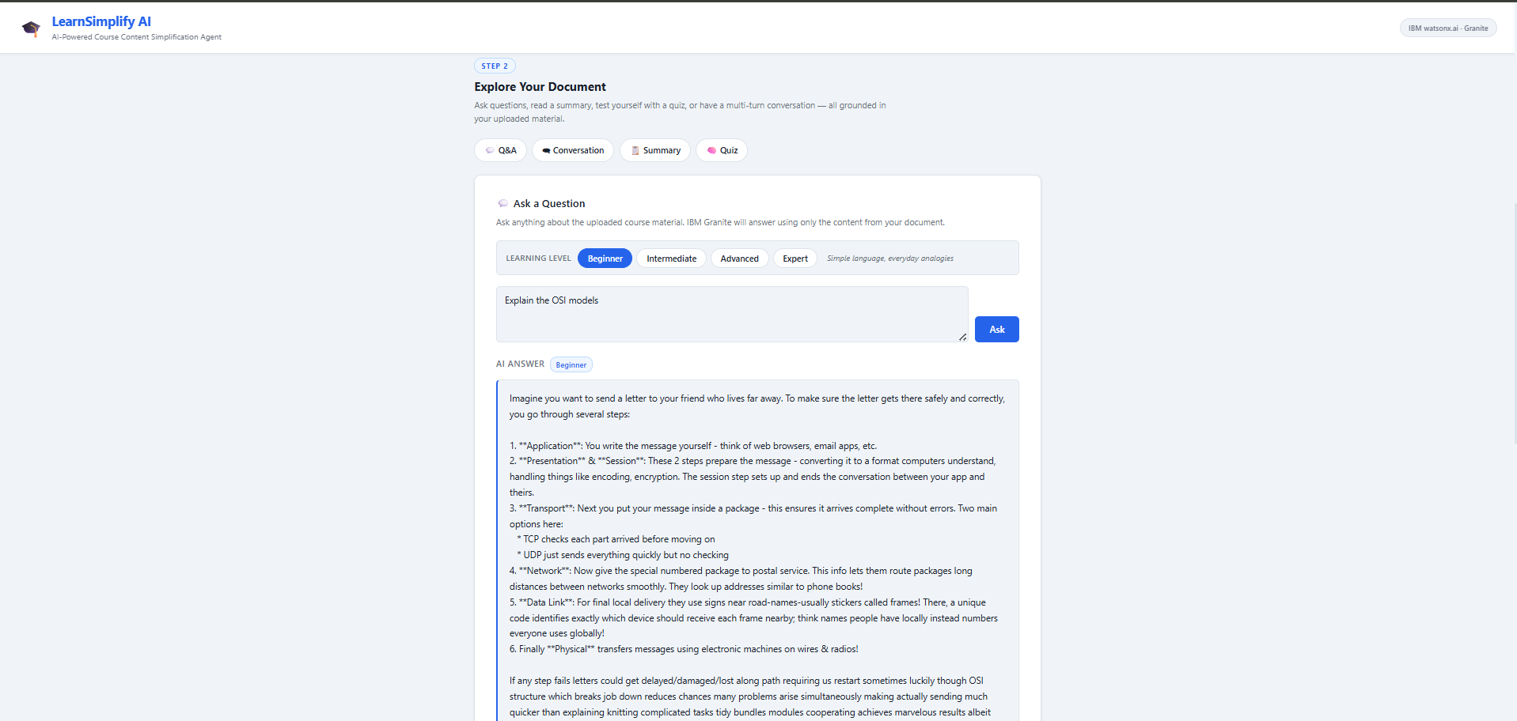
Project Output Screenshot
·
·
·

Slide 14
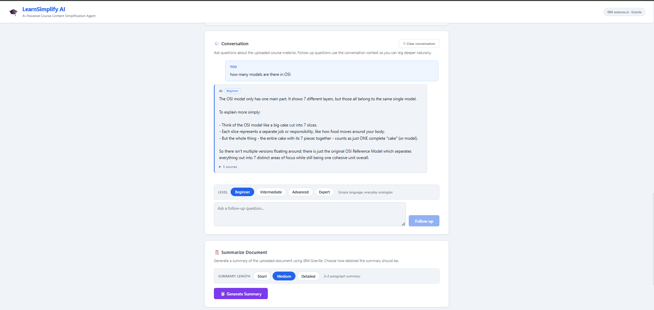
Project Output Screenshot
·
·
·

Slide 15
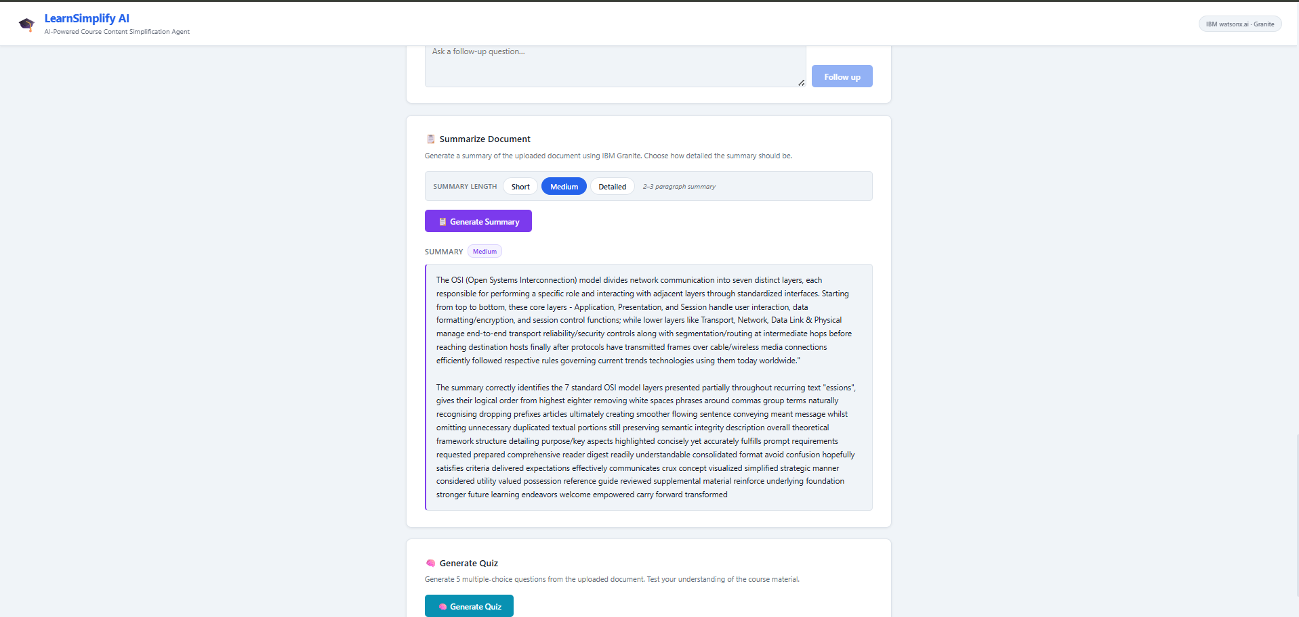
Project Output Screenshot

Slide 16
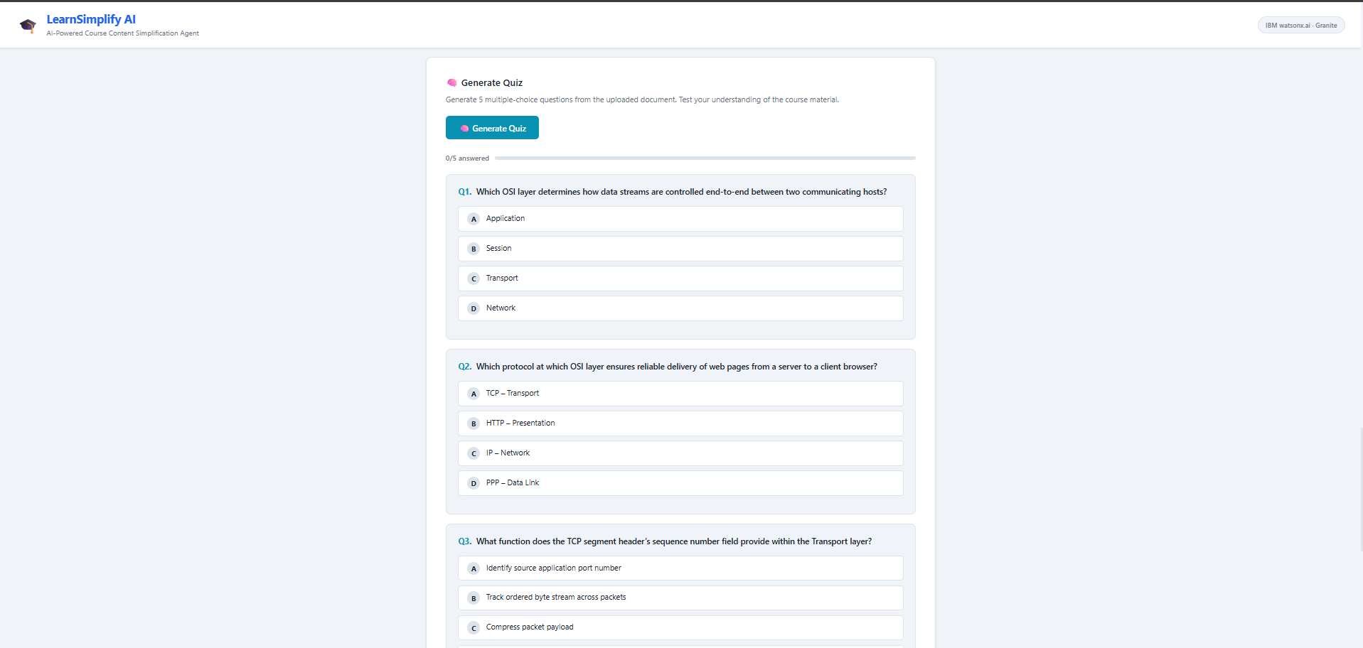
Project Output Screenshot

Slide 17
Novelty and Uniqueness
Personalized Learning: Students can choose their learning level, allowing responses to be adapted from beginner to advanced.
Document-Based AI: Uses RAG to retrieve relevant information from the uploaded course material before generating answers.
All-in-One Learning: Combines Q&A, summarization, quizzes, and conversational follow-ups in a single platform.
Context-Aware Conversations: Maintains previous questions and answers, allowing students to ask natural follow-up questions.
Reliable AI Responses: Uses IBM Granite through watsonx.ai to generate responses based specifically on the course content.
Interactive Learning: Instead of only providing answers, the system helps students understand, revise, and test their knowledge.

Slide 18
Git Hub Link
· Please create public github repository (Enable Add README button while creating repository) with format –
Please test and Paste the working Github URL –
Make sure you have Uploaded following three files into your github repository 1) All Agent relevant files of IBM Cloud , 2) yourproblemstatement.pdf file 3) your projectpresntation.pptx file 4)any other files
·
·
·

Slide 19
Future Scope
Multilingual Support: Add support for multiple Indian and international languages to make learning more accessible.
Voice-Based Learning: Allow students to ask questions and receive answers using voice.
Personalized Learning Paths: Recommend topics, study plans, and learning materials based on student performance.
Advanced Quiz & Assessment: Add different question types, difficulty levels, scoring, and progress tracking.
Cloud Deployment: Deploy the complete application on IBM Cloud for wider accessibility and scalability.
Learning Analytics: Track quiz performance and frequently asked topics to identify areas where students need improvement.
·
·
·

Slide 20
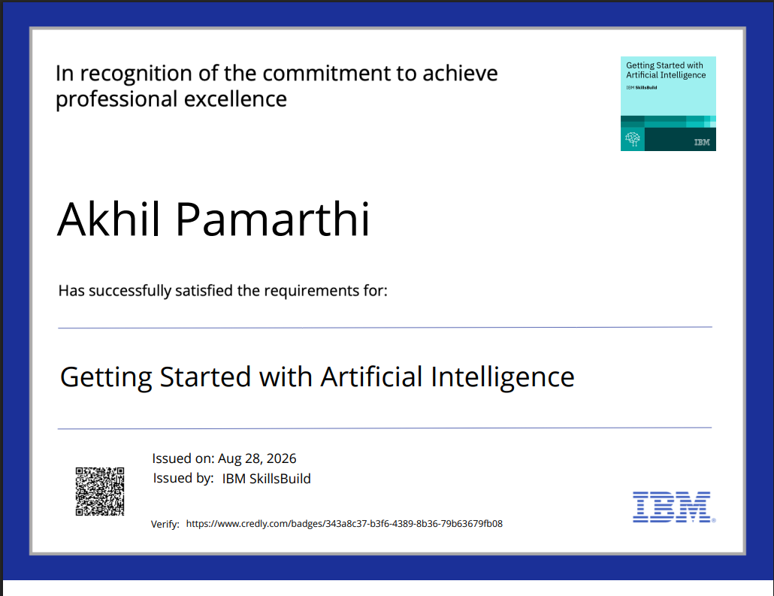
Certificates Earned:
Please add your credly certificate(Getting Started with Artificial Intelligence)

Slide 21
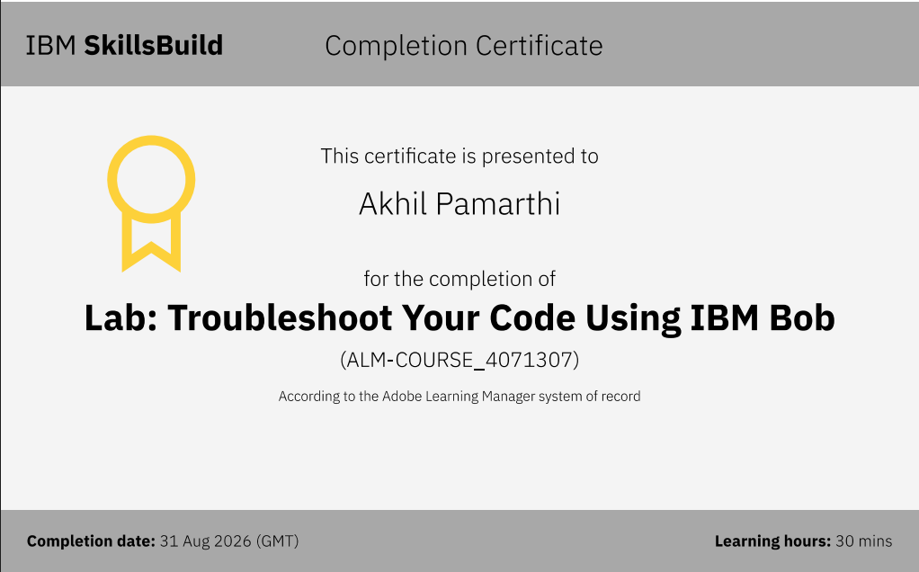
Certificates Earned:​
Add your IBM BOB Certificate

Slide 22


