Slide 1
PROJECT REPORT
Social Network Analysis Metrics
Finding the Most Important People in a Network Using Centrality
Advanced Text and Social Media Analytics | CSE4039 | Slot L39+L40

Slide 2
Team Members
A
J
P
A S Akhil
Jidiga Charan Reddy
Pothuraju Vyshrawan
Reg. No. 23BCB7073
Reg. No. 23BCB7120
Reg. No. 23BCB7129
Guided by Gundimeda Venugopal
Code: github.com/Akhil-710/Karate-club-centrality-analysis

Slide 3
The Dataset: Zachary's Karate Club
In the 1970s, researcher Wayne Zachary recorded who was friends with whom in a university karate club.
A conflict between the instructor (Node 0) and the club president (Node 33) split the club into two groups.
The real outcome is known, so we can check whether the metrics point to the right people.
34
78
People (nodes)
Friendships (edges)
0.139
1
Density: about 14% of ties exist
Single connected network

Slide 4
Four Ways to Measure Importance
1
2
3
4
Degree
Closeness
Betweenness
Eigenvector
Who has the most friends?
Who reaches everyone fastest?
Who is the bridge?
Who knows important people?
Counts direct connections. Measures popularity.
Few steps to reach all others. Spreads news fast.
Sits on shortest paths between others. Measures brokers.
Connected to other well-connected people. Measures influence.
Scores range from 0 to 1. A higher score means the person is more central.

Slide 5
How We Did It
1
2
3
4
5
Load data
Calculate
Combine
Visualise
Explain
Load the 34-person network and check its size.
Compute degree, closeness, betweenness and eigenvector scores.
Put all scores in one table and save it as a CSV file.
Draw one graph per metric, plus bar charts and a heatmap.
Compare the metrics and link results to real events.
Tools: NetworkX (centrality) · Pandas (tables) · Matplotlib (graphs) · Jupyter Notebook (code and results)

Slide 6
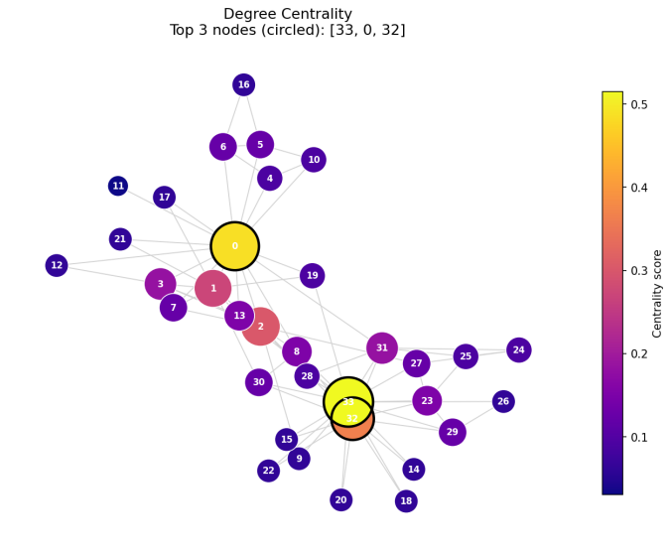
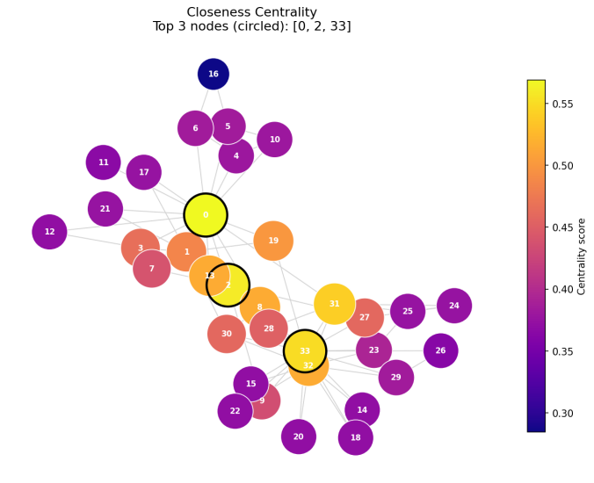
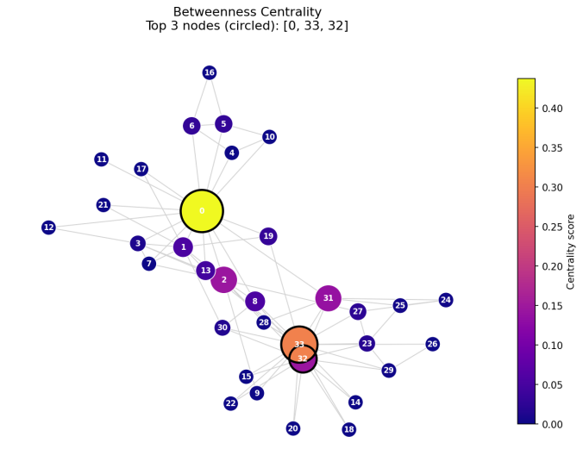
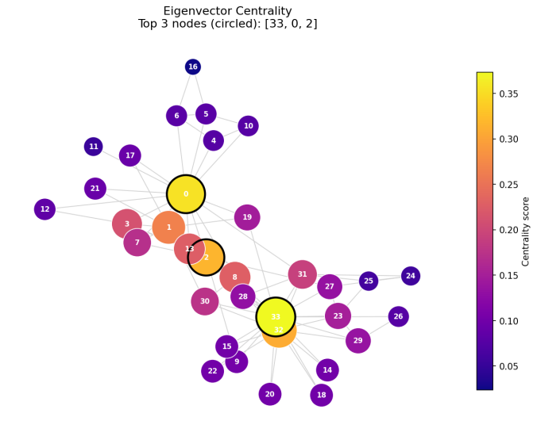
Output 1: One Graph per Metric
How to read the graphs
Each dot is a person and each line is a friendship.
Bigger and brighter dots have higher scores.
The three top-scoring people are circled in black.
Node 33 stands out in degree and eigenvector. Node 0 leads in closeness and betweenness.

Slide 7
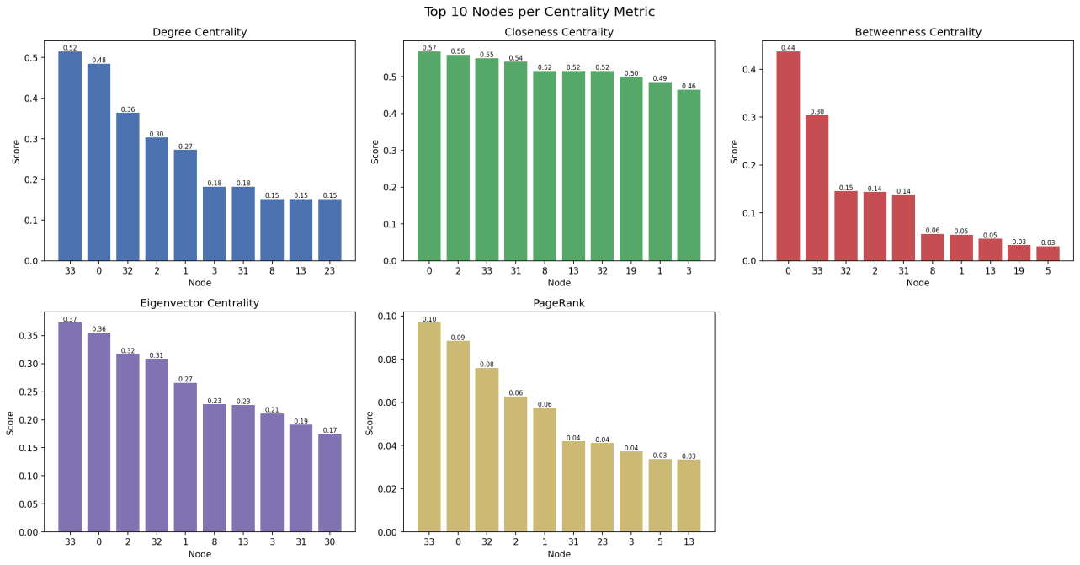
Output 2: Top 10 People per Metric

Slide 8
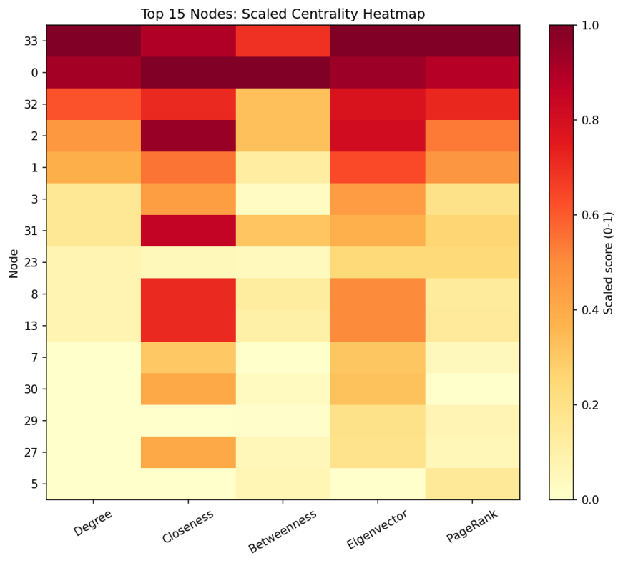
Result: Nodes 0 and 33 Lead
Metric | Top node | Score | Meaning
Degree | 33 | 0.515 | Most friends
Closeness | 0 | 0.569 | Reaches all fastest
Betweenness | 0 | 0.438 | Main bridge
Eigenvector | 33 | 0.373 | Knows key people
PageRank | 33 | 0.097 | Most influential
Nodes 0 and 33 top almost every measure, matching the real split of the club into two groups.

