Slide 1

VARDHAMAN COLLEGE OF ENGINEERING, HYDERABAD
Autonomous Institute affiliated to JNTUH
DEPARTMENT OF ARTFICIAL INTELLIGENCE AND MACHINE LEARNING
Title:Emotionally Intelligent Virtual Personal Assistant (E-VPA)
BATCH ID : - B10
S. No | Roll. No | Student Name
1 | 21881A7308 | Ch. Shruthi
2 | 21881A7309 | D. Ashish Nayak
3 | 21881A7310 | D. Vedasarayu
4 | 21881A7312 | Eruva Akhil
Guide Details
Mr. Syed Ahmeduddin
(Assistant professor)
Department of AIML

Slide 2
Project Work Phase-I Review-1 Outlines
Main idea of the Project
Existing Vs Proposed System
Proposed Project Objectives
Proposed Project Outcomes
Process Model
Architectural Diagram
Software and Hardware Requirements
Summary of First Review
DEPARTMENT OF AIML MINIPROJECT REVIEW-1

Slide 3
Main idea of the Project
Proposal: Develop Emotionally Intelligent Virtual Assistant
(E-VPA) with Cloud-Based Social Optimization
Functions as a smart assistant managing schedules, reminders, and answering queries
Offers secure diary encryption for user thoughts and experiences
Detects emotional distress and provides tailored stress-relief content
Utilizes cloud-based algorithm to analyze contacts and schedules for social interaction suggestions
Curates calming content like music, videos, and pictures from personal gallery
Prioritizes user autonomy with voice-command control for halting suggestions
DEPARTMENT OF AIML MINIPROJECT REVIEW-1

Slide 4
Existing System Vs Proposed
Existing virtual assistants lack emotion detection and stress relief features
Our E-VPA will utilize advanced AI algorithms to detect user emotions and provide tailored stress relief content, such as calming music or funny videos.
Additionally, it will analyze user schedules and leisure time to suggest and facilitate casual meetings between friends, enhancing social interactions and well-being
The cloud-based approach not only ensures user privacy but also allows for seamless integration across devices and access to a wide range of resources for enhanced functionality
With regular updates and improvements, our E-VPA will continuously evolve to meet the changing needs and preferences of users, ensuring a personalized and effective experience.
DEPARTMENT OF AIML MINIPROJECT REVIEW-1

Slide 5
Proposed Project Objectives
Objectives:-
Develop an emotionally intelligent virtual personal assistant (E-VPA) capable of performing various tasks including scheduling, reminders, and answering queries.
Implement stress detection functionality within the E-VPA to identify when the user is stressed or frustrated.
Integrate stress-relief features such as playing calming music, displaying funny videos/memes, or suggesting calls with friends or relatives to help calm the user.
Add a secure digital diary for personal thoughts.
Upgrade E-VPA to schedule friend meetings respecting privacy.
Implement a feature for reconnecting with old contacts.
DEPARTMENT OF AIML MINIPROJECT REVIEW-1

Slide 6
Proposed Project Outcomes
Development of an Emotionally Intelligent Virtual Personal Assistant (E-VPA) with comprehensive features:
-> Schedule management
-> Reminders
-> Knowledge base access
Stress detection and relief features:
-> Calming music
-> Funny videos/memes
-> Suggesting calls with friends or relatives
Integration of a secure digital diary for:
-> Recording thoughts and experiences
-> Privacy protection measures
DEPARTMENT OF AIML MINIPROJECT REVIEW-1

Slide 7
Proposed Project Outcomes
Innovative meeting scheduling capability:
-> Considers leisure time of friends
-> Maintains user privacy
Increased user engagement and well-being through:
-> Proactive suggestions for reconnecting with contacts
-> Managing social interactions
Improved user experience with:
-> Voice-command functionality for halting suggestions
-> Ensuring user autonomy and control
Positive impact on user mental health and productivity:
-> Provides effective stress relief mechanisms
-> Facilitates meaningful social connections
DEPARTMENT OF AIML MINIPROJECT REVIEW-1

Slide 8
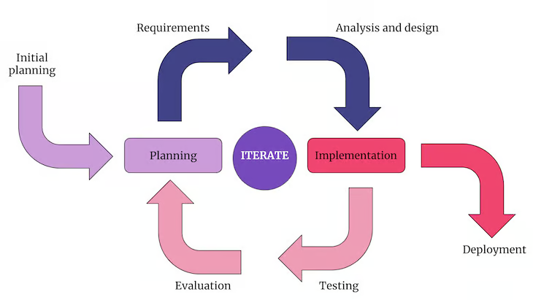
Process Model
Iterative and incremental development model
DEPARTMENT OF AIML MINIPROJECT REVIEW-1

Slide 9
Process Model
Planning and Requirements Gathering:
The project begins with gathering requirements from stakeholders and defining the scope of the E-VPA. This involves identifying the key features, functionalities, and user needs that the E-VPA should address.
Design:
In this phase, the overall architecture of the E-VPA is designed, including its various components such as the speech recognition module, natural language processing module, stress detection algorithms, and user interface. Design decisions are made to ensure scalability, flexibility, and modularity.
Implementation and Testing:
Development of the E-VPA begins based on the design specifications. The system is implemented incrementally, with each iteration focusing on delivering a subset of features. Continuous testing is performed throughout the development process to identify and address any issues or bugs.
Integration and Deployment:
As features are developed and tested, they are integrated into the overall E-VPA system. Integration testing ensures that different components work together seamlessly. Once a satisfactory level of functionality is achieved, the E-VPA is deployed to a testing environment for further validation.
DEPARTMENT OF AIML MINIPROJECT REVIEW-1

Slide 10
Process Model
Stress Detection and Relief Features Integration: Specific attention is given to integrating stress detection algorithms and stress relief features into the E-VPA. This involves implementing machine learning models for stress detection, integrating APIs for accessing calming music and funny videos, and designing user interfaces for presenting stress relief options.
Digital Diary and Social Interaction Features Integration: Similarly, the digital diary functionality and social interaction features are integrated into the E-VPA. This includes developing secure storage mechanisms for personal thoughts, implementing algorithms for suggesting friend meetings, and designing user interfaces for managing social interactions.
Final Testing and Deployment: The E-VPA undergoes comprehensive testing to ensure its stability, performance, and usability. Once all issues are addressed and the E-VPA meets the desired quality standards, it is deployed for production use.
Maintenance and Support: After deployment, ongoing maintenance and support are provided to address any issues that may arise and to incorporate new features or updates based on user feedback and changing requirements.
DEPARTMENT OF AIML MINIPROJECT REVIEW-1

Slide 11
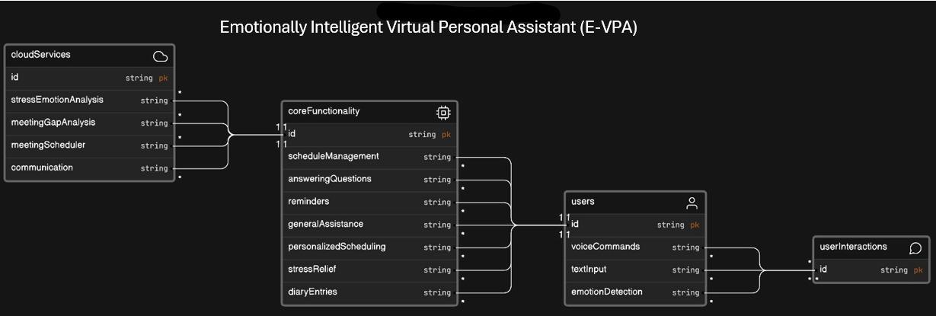
Architectural Diagram
DEPARTMENT OF AIML MINIPROJECT REVIEW-1

Slide 12
Software and Hardware Requirements
Software Requirements:
Development environment: Python programming language, cloud-based development platform (e.g., AWS, Google Cloud)
AI and machine learning libraries for emotion detection and scheduling algorithms (e.g., TensorFlow, scikit-learn)
Web search API integration for answering questions
Database management system for storing user schedules and diary entries securely
Media player integration for playing calming music and displaying videos/memes/pictures
Voice recognition and natural language processing (NLP) for voice commands and interactions
DEPARTMENT OF AIML MINIPROJECT REVIEW-1

Slide 13
Software and Hardware Requirements
Hardware Requirements:
Server infrastructure for hosting the E-VPA backend and database
Compatible devices for running the E-VPA application (e.g., smartphones, tablets, computers)
Microphones and speakers for voice interactions
Optional: Cameras for facial expression analysis (for advanced emotion detection)
DEPARTMENT OF AIML MINIPROJECT REVIEW-1

Slide 14
Summary of First Review
Summary:-
Develop an Emotionally Intelligent Virtual Personal Assistant (E-VPA) with various features.
E-VPA will manage schedules, and reminders, answer queries, and serve as a secure digital diary.
Unique upgrades involve detecting and alleviating user stress using methods like playing calming music, showing funny content, or suggesting calls with friends.
It will facilitate scheduling meetings between friends based on leisure time while maintaining user privacy.
Additionally, E-VPA will prompt reconnections with individuals the user hasn't interacted with recently.
User autonomy is prioritized, allowing them to halt suggestions with a voice command.
DEPARTMENT OF AIML MINIPROJECT REVIEW-1

Slide 15
THANK YOU
DEPARTMENT OF AIML MINIPROJECT REVIEW-1

