Slide 1


Social Buzz
Data Analysis

Slide 2


Today's agenda
Project recap
Problem
The Analytics team
Process
Insights
Summary

Slide 3

Social Buzz is a fast growing technology unicorn that need to adapt quickly to it's global scale.
Accenture has begun a 3 month POC focusing on these basics:
An audit of Social Buzz's big data practice
Recommendations for a successful IPO
Analysis to find Social Buzz's top 5 most popular categories of content
Project Recap

Slide 4


Problem
500M active users/month
Generates over 100,000+ pieces of content daily
36,500,000 pieces of content per year
So there is a need for scaling the business and identify critical insights from the available data (Top 5 most popular content category)

Slide 5



Akhil Krishna
Data Analyst
The Analytics team
Marcus Rompton
Senior Principle
Andrew Fleming
Chief Technical Architect

Slide 6
Process
1
Project & Data Understanding
2
Data Cleaning
3
Data Modeling
4
Data Analysis
5
Uncover Insights

Slide 7
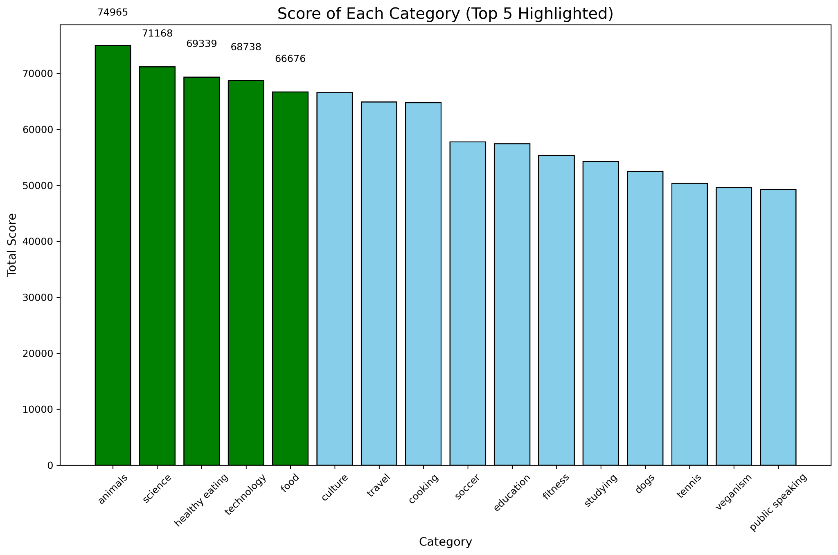

Insights
Top 5 Content Categories
Animals: 74,965
Science: 71,168
Healthy Eating: 69,339
Technology: 68,738
Food: 66,676

Slide 8
Unique Categories and Reactions
Additional insights:
Number of unique categories: 16.
Reactions to the most popular category ("Animals"): 1,897 reactions.

Slide 9
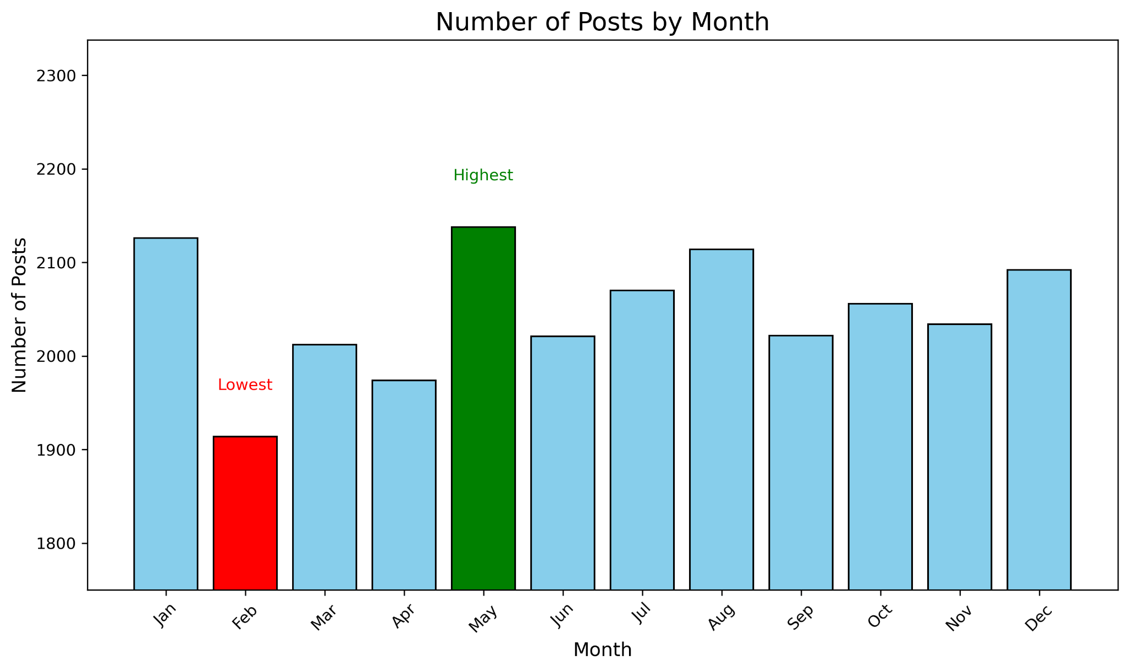
Monthly Trends
The month with the most posts: May.
The month with the least posts: February

Slide 10

Objective Achieved:
Identified the top 5 content categories driving popularity on Social Buzz.
Key Insights:
The most popular category is "Animals" with a total score of 74,965.
A total of 16 unique categories were analyzed.
The highest activity month was May, indicating seasonal trends.
Recommendations:
Focus on creating more content in high-performing categories like "Animals" and "Science".
Maximize engagement during peak months like May.
Summary

Slide 11

Thank you!
ANY QUESTIONS?

