Slide 1

GITINSIGHT
Revolutionizing Git Insights

Slide 2

Introduction
GitInsight is an innovative web application designed to offer intuitive and insightful analytics on Git repositories. By leveraging advanced AI/ML models, including GPT-4 and RAG, GitInsight allows users to interact through a user-friendly chat interface, asking open-ended questions to gain a deeper understanding of Git commits.
Our aim is to make complex Git data accessible to developers, project managers, and non-technical users alike, without the need for command-line expertise.
Technologies:
Backend: Flask, Astra DB, llama-index, Cassio
Frontend: React, Tailwind CSS
AI/ML Modeling: RAG
Deployment: Render

Slide 3

Summarizing progress
Completed Action Items:
Completed initial design of landing page frontend part.
Completed initial design of the chatbot component.
Committed Action Items Since Last Meetup:
Start frontend development, focusing on refining the chat interface.
Continue improving AI model training for increased query response accuracy.
Missing Milestone (if any): N/A
Current Milestone in Progress: Backend development is ongoing, with frontend development and AI integration also in focus, aiming for completion by Week 6.

Slide 4
Instructions to run
Steps to run project locally:
Clone the project from the github using git command git clone “github repo link”.
Navigate to the root directory of the project and command “npm install”. This command will install all the dependencies.
Then run the command “npm run dev”. This command runs the app in the development mode.
Open http://localhost:3000 to view it in your browser.

Slide 5
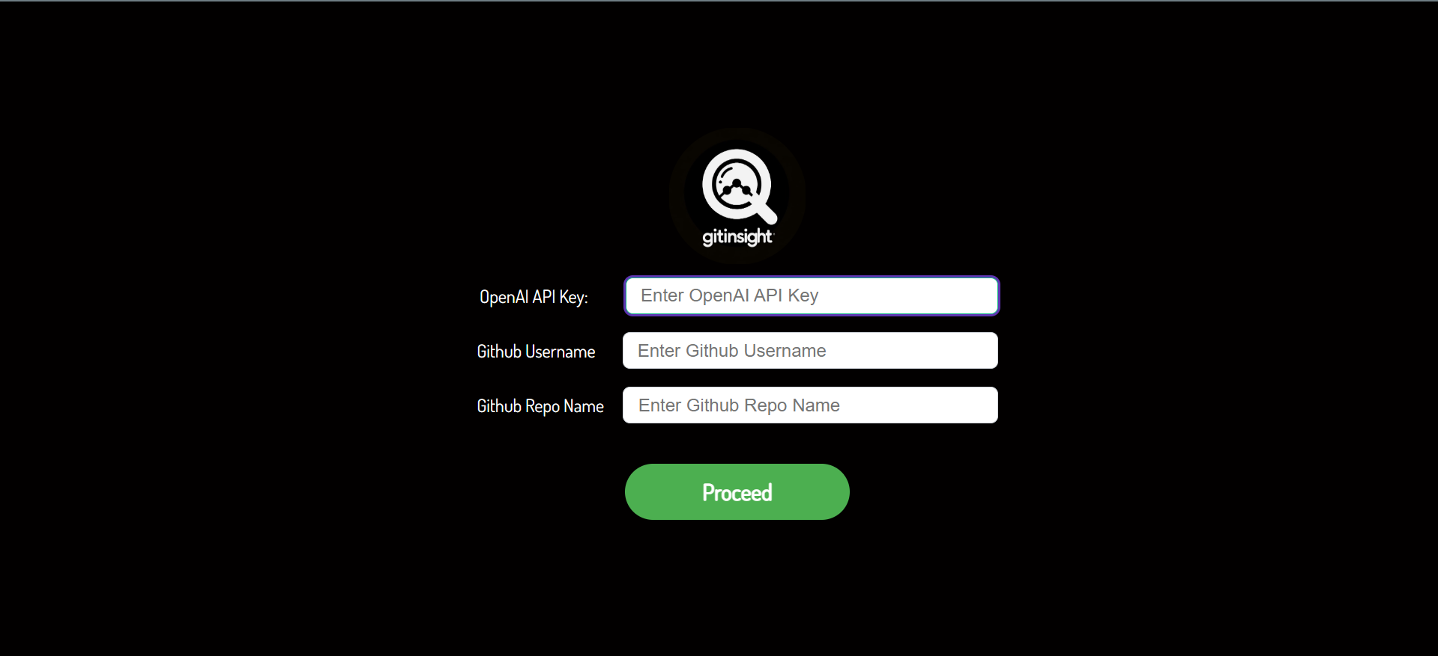
Landing page
Our landing page displays the logo and the below input boxes for the user to enter when the user first visits our project. Open API Key: This field requires user to input in the Open API key which can be obtained by visiting the site OpenAI API. This key is necessary for our model to run and generate the results based on the user query. Github Username: User should enter his/her github username. Github Repo name: User should enter github repo name

Slide 6
Demo
Project Live Demo

Slide 7
List of finished features
Designed Logo and Title for the project.
Completed App setup of React.
Completed initial design for the landing page which contains the logo, and an input box for the user to enter details.
The input box is completed which collects the basic info from the user such as OpenAI key, Github username, Github Repo name.
Completed initial design of Chatbot component.

Slide 8
improvements
As of now there are no major issues with the project’s progress so far.
Improvements:
Improve the landing page design to be visually attractive and appealing to the end user.
Setup a user login/signup page before accessing the current input box.
Setup navigation between the pages so that user is redirected to different page when he/she submits the details.

Slide 9

Feedback From the partner team
Bug: Currently, there are no bugs that requires immediate action.
Enhancement:
Partner Team Feedback:
Implement User login Page instead of directly taking inputs from the user without any login functionality. (Byte Squad) - Partner Team is able to run the project by following the build instructions.

Slide 10

Looking ahead
Immediate Focus: Completing frontend development and ensuring full AI model integration.
Upcoming Milestones: Start comprehensive testing, focusing on usability and performance. Implement enhancements based on early feedback.
Long-Term Vision: Expand GitInsight's capabilities to support a wider range of Git analytics and introduce more collaborative features for team environments.

Slide 11
Conclusion
GitInsight stands at the intersection of technology and ease, offering a unique solution to navigate and understand Git repositories effortlessly.
Our journey is ongoing, and we're excited about the potential GitInsight has to transform project management and development workflows.

