Slide 1

GITINSIGHT
Revolutionizing Git Insights

Slide 2

Introduction
GitInsight is an innovative web application designed to offer intuitive and insightful analytics on Git repositories. By leveraging advanced AI/ML models, including GPT-4 and RAG, GitInsight allows users to interact through a user-friendly chat interface, asking open-ended questions to gain a deeper understanding of Git commits.
Our aim is to make complex Git data accessible to developers, project managers, and non-technical users alike, without the need for command-line expertise.
Technologies:
Backend: Flask, Astra DB, llama-index, Cassio
Frontend: React, Tailwind CSS
AI/ML Modeling: RAG
Deployment: Render

Slide 3
Instructions to Build
Steps to run project locally:
Clone the project from the github using git command git clone “github repo link”.
Navigate to the directory of the project using “cd frontend” and run command “npm install”. This command will install all the dependencies.
Then run the command “npm run dev”. This command runs the app in the development mode.
Open http://localhost:3000 to view it in your browser.

Slide 4
Demo
Project Live Demo

Slide 5
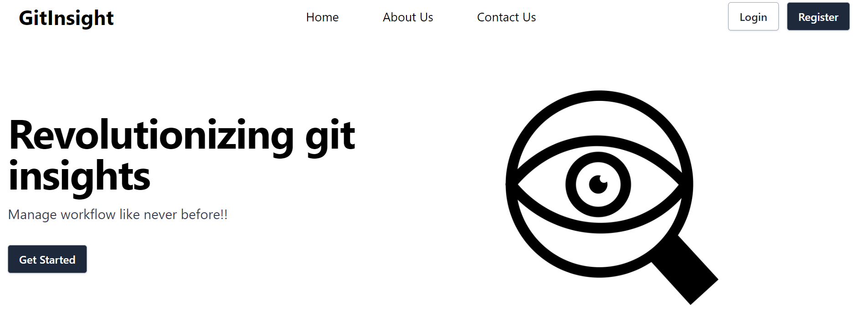
Landing page
Our landing page displays the Logo, Navbar and Hero Sections as shown in the picture. Below are the few functionalities available to user on the landing page. Home: Clicking home on the landing page navigates the page to the landing page home screen from anywhere else.
About us: This section will have the details of the project developers.
Contact: This section will have contact input box where users can put in their feedback and the email id. Log In: This option navigates the users to the login page. Register: This option navigates the users to the sign up page where they can create their new account.

Slide 6

Summarizing progress
Completed Action Items:
Completed Landing Page with improved design and functionalities such as user login and logout.
Improved Chatbot UI and user input boxes.
Added quick chat feature on the chatbot.
Committed Action Items Since Last Meetup:
Work on frontend development, focusing on refining the chat interface.
Continue improving AI model training for increased query response accuracy.
Missing Milestone (if any): N/A
Current Milestone in Progress: Backend development is ongoing, with frontend development and AI integration also in focus, aiming for completion by Week 11.

Slide 7
Hosting methods
Frontend Hosting: The React-based frontend is hosted on AWS, providing a globally accessible and fast user experience.
Backend Services: Our Flask backend runs on AWS, ensuring reliable and scalable request handling for GitInsight's operations.
Deployment: Utilizing AWS for both frontend and backend, we ensure a streamlined and secure deployment process, focusing on performance and scalability.

Slide 8
List of finished features
Completed App setup of React.
Completed Landing Page with improved design and functionalities such as user login and logout.
Improved Chatbot UI and user input boxes.
Added quick chat feature on the chatbot.
OpenAI API key is not mandatory anymore.

Slide 9

Feedback From the partner team
Bug: Currently, there are no bugs that requires immediate action.
Enhancement:
Partner Team Feedback:
Implement User login Page instead of directly taking inputs from the user without any login functionality. (Byte Squad).
Make OpenAI API key as optional (Professor) - Partner Team is able to run the project by following the build instructions.

Slide 10
Conclusion
GitInsight stands at the intersection of technology and ease, offering a unique solution to navigate and understand Git repositories effortlessly.
Our journey is ongoing, and we're excited about the potential GitInsight has to transform project management and development workflows.

