Slide 1
IMPORTANT INSTRUCTIONS
Please ensure below pointers are met while submitting the Idea PPT:
Kindly keep the maximum slides limit up to six (6). ( Including the title slide)
Try to avoid paragraphs and post your idea in points /diagrams / Infographics /pictures
Keep your explanation precise and easy to understand
Idea should be unique and novel.
You can only use provided template for making the PPT without changing the idea details pointers (mentioned in previous slides).
You need to save the file in PDF and upload the same on portal. No PPT, Word Doc or any other format will be supported.
Note - You can delete this slide (Important Pointers) when you upload the details of your idea portal.

Slide 2
TITLE PAGE
Problem Statement ID –HW-SIH-2026-SOC
Problem Statement Title-Enterprise Real-Time Behavioral Anomaly Detection & Threat Intelligence Platform
Theme-Cybersecurity & Industrial IoT Security
PS Category- Software
Student Name (Registered on portal)- Akhil Astitva
Student ID-20509613

Slide 3
IDEA TITLE
PROPOSED SOLUTION & INNOVATION
• Idea Title: SentinelAI — AI-Powered Cascaded Anomaly & Threat Detection Engine
• Core Solution: Sequence-aware ML engine detecting zero-day lateral movement, stolen credential abuse, brute force, & ransomware.
• Multi-Entity Telemetry Delineation: Explicit operational delineation across Users (👤), Service Accounts (⚙️), and Edge Devices (🖥️).
• Auth Method Tracking: Monitors 4 distinct authentication protocols: Password, Token (OAuth/SAML/JWT), Certificate (mTLS), and Biometric (Passkey/FIDO2).
• Explainability & MITRE Mapping: Local SHAP feature attributions paired with MITRE ATT&CK technique IDs (T1078, T1110, T1041, T1486) for plain-English threat storytelling.
• Active SOC Containment: 1-click response buttons for session token revocation, credential reset, and network host endpoint isolation.

Slide 4
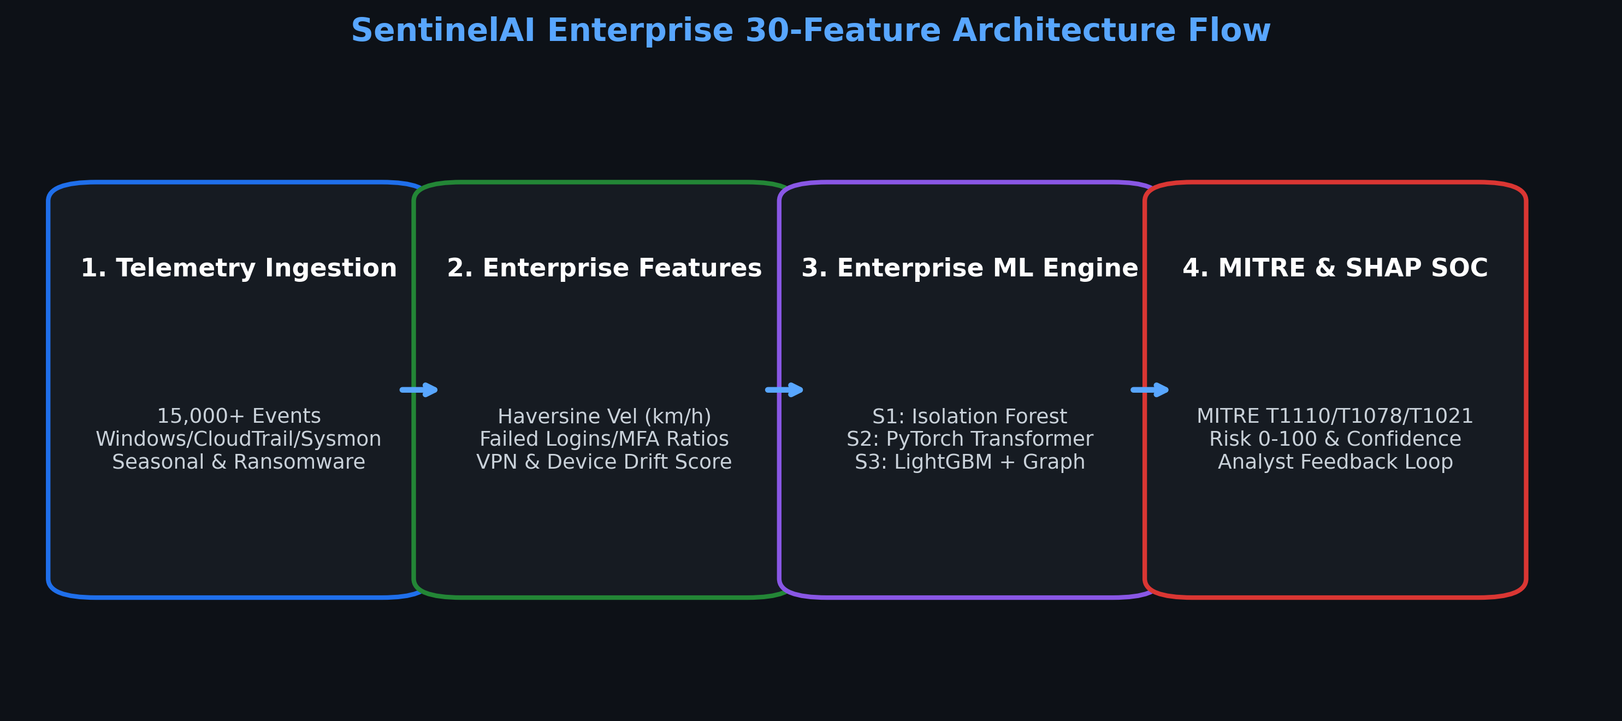
TECHNICAL APPROACH
TECHNICAL APPROACH & ARCHITECTURE
• Core ML & Backend: Python 3.12, FastAPI (REST & WebSockets), LightGBM Classifier, Isolation Forest, SHAP Explainability Engine.
• Frontend SOC Dashboard: React 18, Vite 5, Tailwind CSS, Lucide Icons, Recharts Analytics.
• Feature Engineering Pipeline: Extracts 30 spatiotemporal & sequence features including Haversine Velocity (km/h), cyclical time, and device drift.
• Cascaded 3-Stage Architecture: Stage 1 Unsupervised Anomaly Scoring -> Stage 2 Sequence Window -> Stage 3 LightGBM Multi-Class Classifier.
• Model Disk Caching: Pre-trained models serialized with joblib for 0.06s instant server startup and sub-millisecond inference per log event.

Slide 5
FEASIBILITY AND VIABILITY
FEASIBILITY, VIABILITY & RISK MITIGATION
• Feasibility & Performance: 0.06s server launch time, ~1,200 events/sec throughput, and clean production Vite build (10.72s compile time).
• Analyst Alert Budget: Dynamic 97th percentile cutoff isolates top 1% critical threats, reducing alert fatigue by 99%.
• PSI Concept Drift Monitoring: Tracks population stability index (PSI = 0.0167) to automatically detect data drift and maintain model accuracy.
• Potential Challenges & Risks: High-velocity telemetry bursts during DDoS/brute-force attacks and risk of false positives interrupting business workflows.
• Mitigation Strategies: Analyst Feedback Loop (/api/feedback) for online active learning + 1-click SOC false-positive dismissal.

Slide 6
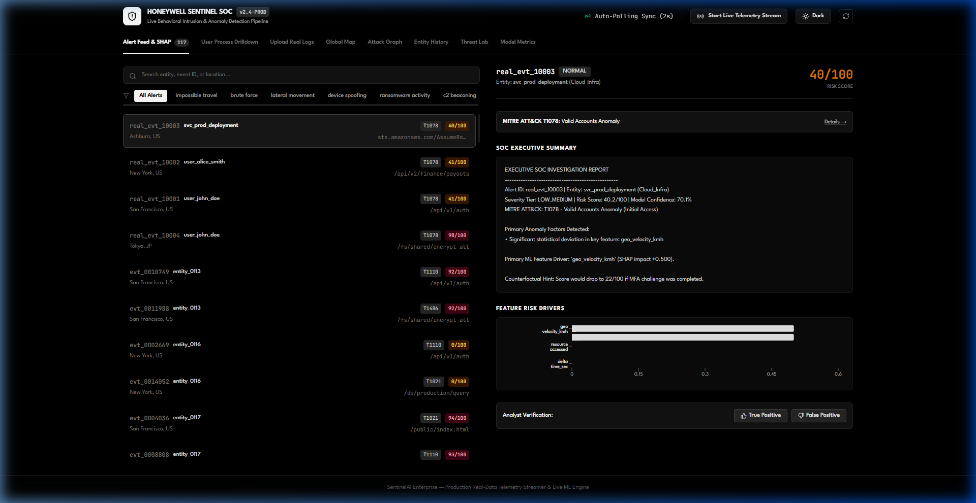
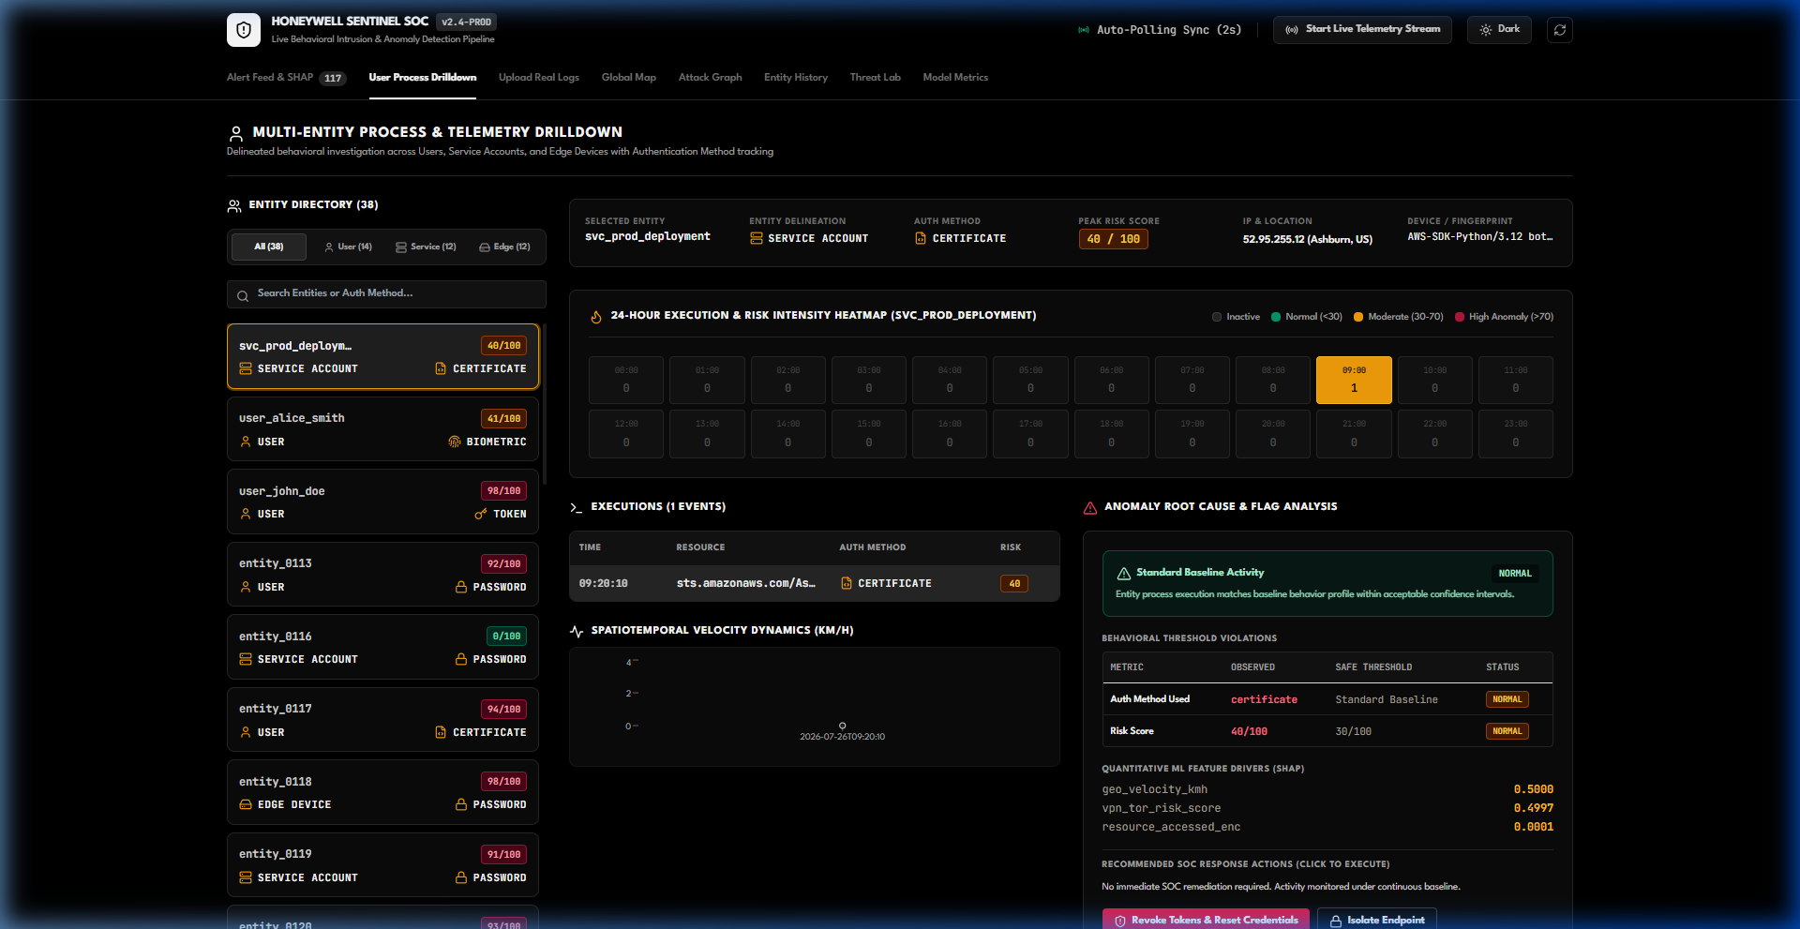
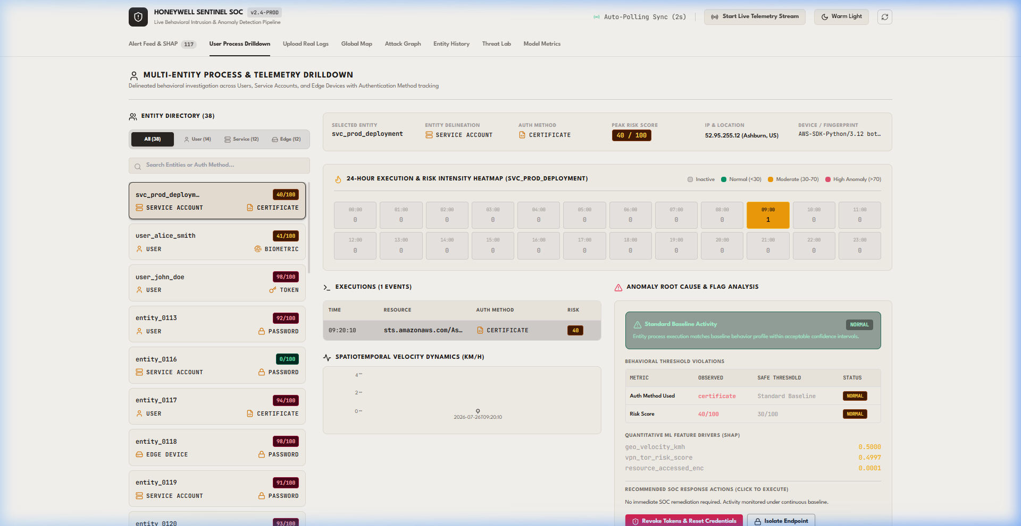
ARTIFACTS
SYSTEM ARTIFACTS & LIVE DASHBOARD PROTOTYPE
• Modular Codebase: backend/api_server.py (FastAPI core), backend/feature_engine.py, frontend/src/components/UserProcessDashboard.jsx.
• Live Dashboard Interfaces: Executive Alert Feed & SHAP Panel + Multi-Entity Process Drilldown & 24-Hour Heatmap Matrix (Dark & Light Themes).
• Automated Testing & Builds: Clean Vite production bundle, sub-millisecond batch vector inference, and REST polling integration.

Slide 7
RESEARCH AND REFERENCES
RESEARCH, FRAMEWORKS & REFERENCES
• MITRE ATT&CK Framework: Mapped detection logic to T1078 (Valid Accounts), T1110 (Brute Force), T1041 (Exfiltration), & T1486 (Ransomware Encrypt).
• SHAP Explainability (Lundberg & Lee, 2017): A Unified Approach to Interpreting Model Predictions (NeurIPS 2017) for quantitative feature attributions.
• Haversine Spatiotemporal Dynamics: Great-Circle Distance calculation for high-velocity physical travel anomaly detection (>800 km/h).
• LightGBM Engine (Ke et al., 2017): LightGBM: A Highly Efficient Gradient Boosting Decision Tree (Advances in Neural Information Processing Systems 30).
• Project Documentation & Repository: Complete technical documentation in README.md and PDF Guide (AI_Powered_Behavioral_Anomaly_Detection_Comprehensive_Guide.pdf).

