Slide 1
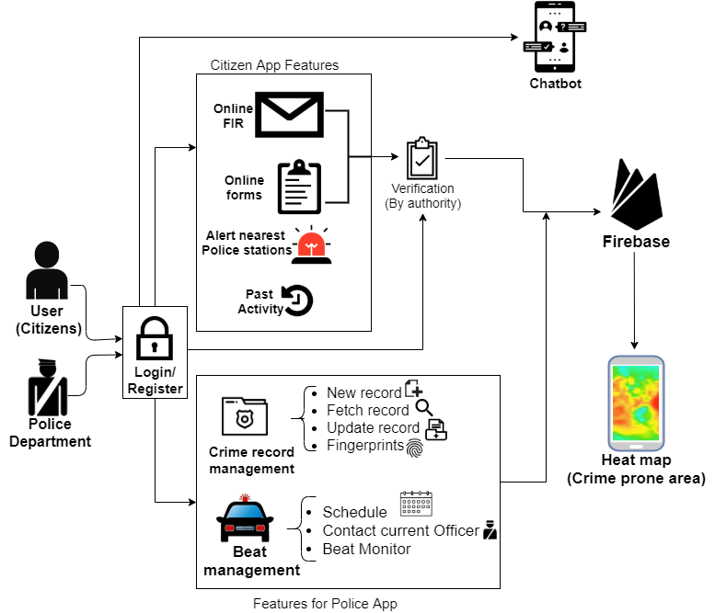





Technology Bucket :- Software-Mobile app development Category :- Software
Company Name :- National Crime Records Bureau Problem code :- SK215
Problem statement:- Mobile Apps for Citizens and Police College Code :- 1-3512387138
for management of crime records
Team leader name :- Sahyog Saini Team name :- Codevelopers
OVERVIEW OF APPROACH
This application will help to form a centralised system for police department and citizens also.
This application will help citizens to file FIR , complains and upload evidences online.
Citizen can fill online forms and NOC for which they have to report in Police station earlier.
Citizens can take appointments online for meeting.
Chatbot helps citizen in easy communication.
Police department can manage crime records efficiently with features of adding new record , update record and fetch data .
Police can detect criminals using fingerprint verification.
Police officers can contact with Beat officers easily as in beat scheduling live locations and contact info of all officers will be available.
Police can have an insight to most crime prone areas using heat map.
TECHNOLOGICAL STACK
React Native
Firebase
/ SQL
Android Studio
Frontend
Backend

Slide 2
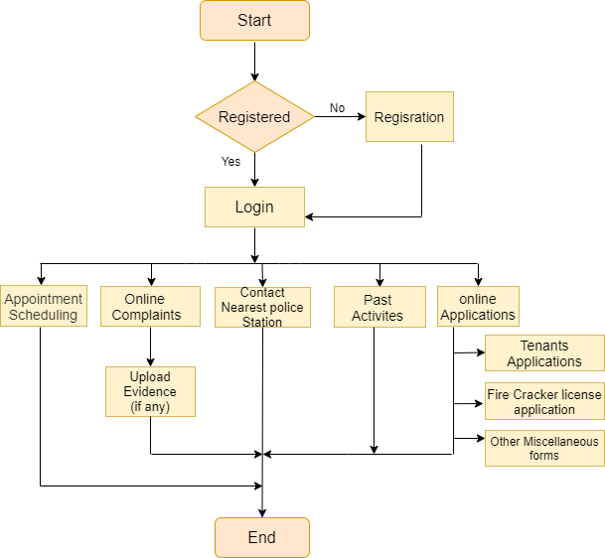
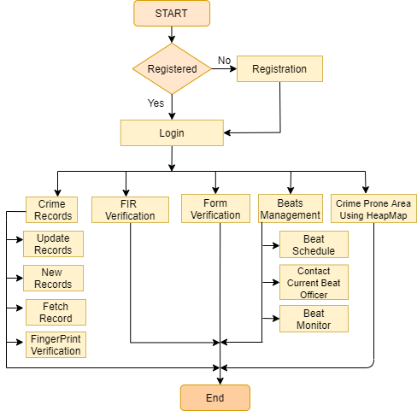
0
WORKFLOW DIAGRAM FOR CITIZEN’s APP
WORKFLOW DIAGRAM FOR POLICE DEPARTMENT
Key Features:-
Citizens can file online complaints and FIR
Easy communication with chatbot
User can access past activities
FingerPrint verification making criminal detection easy.
Crime record management and beat monitoring and scheduling system.
Police can have an insight of crime prone area through heat map.

Slide 3
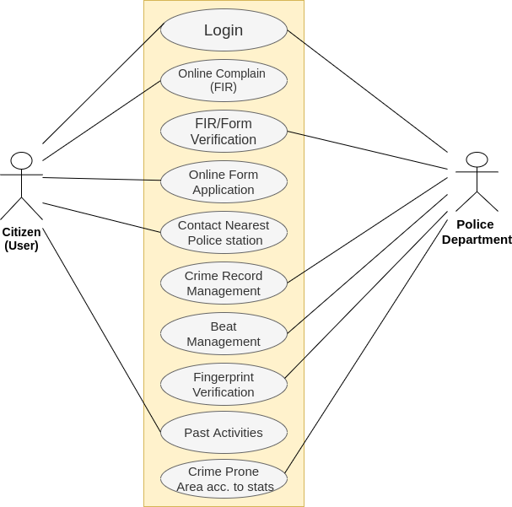
USE CASE DIAGRAM
App and WebApp UI Illustrations
Android App
Website
Dependencies:-
Internet to connect to the server.
Fingerprint Scanner for verification of criminal fingerprint.
File access for citizen app to upload evidence during complaints.

