Slide 1
C programming language

Slide 2
Language
Language is a mode of communication that is used to share ideas, opinions with each other. For example, if we want to teach someone, we need a language that is understandable by both communicators
Language is a communication tool or medium of communication to convey our thoughts
Data transfer or information transfer
Malayalam,English,Tamil,etc.
Language
Malayalam
English
Tamil
Hindi

Slide 3
Malayalam
English
Hindi
56 letters
Grammar
Set of rules
26 letters
Grammar
Set of rules
52 letters
Grammar
Set of rules
Different grammar
Different set of rules
Numbers of letters or symbols are different

Slide 4
Malayalam
Malayalam
Hindi
Hindi
Tamil
Tamil
If both are same language communication is possible

Slide 5
Malayalam
English
Hindi
Malayalam
Tamil
Hindi
If both are different language communication is not possible

Slide 6
Translator
a person who translates from one language into another
Malayalam
Translator
English
Hindi
Translator
Malayalam
English
Translator
Hindi
If both languages are different we use translator
Translator know both languages

Slide 7
Programming language
A programming language is a computer language that is used by programmers (developers) to communicate with computers. It is a set of instructions written in any specific language ( C, C++, Java, Python) to perform a specific task
Between person(programmer)and electronic device;
Between electronic devices.
(0’s and 1’s)are the language of electronic devices.
person
Electronic device
Electronic device
Electronic device

Slide 8
Programming language translators
A translator is a programming language processor that modifies a computer program from one language to another. It takes a program written in the source program and modifies it into a machine program. It can find and detect the error during translation
Assembler
Assembly code
Machine code
Compiler
C,Java,C++ code
Machine code
Interpreter
python code
Machine code

Slide 9
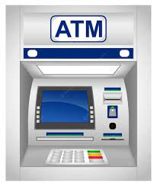
Why programming language
person

Slide 10
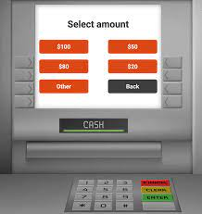
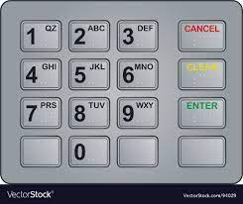
Touch screen
Keypad
HMI(Human Machine Interface Device)
Both are programmed to do specific task

Slide 11
Types of programming languages
The programming languages are broadly classified into three types
Programming language
Low-level language
Middle level language
High level language

Slide 12
Low-level language
It is machine-dependent.
It works based on the binary number 0’s and 1’s.
The processor runs low-level programs directly without the need of a compiler or interpreter so the program written in low-level language can be run very fast
Low-level language is further divided into two parts
Low-level language
Machine language
Assembly language

Slide 13
Machine Language
Assembly Language
Machine language is also called machine code or object code.
Machine language is easier to read because it is normally displayed in binary or hexadecimal form (base 16) form.
It does not require a translator to convert the programs because computers directly understand the machine language programs
Assembly language is designed for specific processors.
It represents the set of instructions in a symbolic and human-understandable form.
It uses an assembler to convert the assembly language to machine language.

Slide 14
Middle-level programming language
High-level programming language
Middle-level programming language lies between the low-level programming language and the high-level programming language.
It is also known as the intermediate programming language and pseudo-language.
A middle-level programming language's advantages are that it supports the features of high-level programming, it is a user-friendly language, and is closely related to machine language and human language
High-level programming language (HLL) is designed for developing user-friendly software programs and websites.
This programming language requires a compiler or interpreter to translate the program into machine language (execute the program).
Example: Python, Java, JavaScript, PHP, C#, C++, etc

Slide 15
Difference between compiler &interpreter
compiler
interpreter
Compiled language
Object code
4step
*preprocessing
*compiling
*Assembler
*linking
Converting before program execution
Fast
No recompile
List of errors
Interpreted language
No object code
Interpreting
While program execution
Slow
Re interpretation
Line of errors

Slide 16
History of C
Dennis Ritchie
1972
Bel laboratory
DEC PDP 11(Test computer)
DEC(digital equipment cooperation)
PDP(programmed data processor)
11(11th generation)
16 bit operating system
C was originally developed to beat the issues of previous
Language such as B,BPCL

Slide 17
Fortran
Fortra1st language
numeric&scientific calculation
1950(IBM)
A
1960
International group
BCPL
1967
Martin Richard
A
1960
International group
B
1970
Ken Thompson
C
1972
Dennis Ritchi

Slide 18
K&RC
1978
Kernighan&Dennis Ritchie
ANSIC
1989
ANSI committee
ANSI/ISOC
1990
ISO committee
C99
1999
Standardization committee
K&RCC11
2011
Standardization committee
C17
2017
Standardization committee

Slide 19
Features of C
High level language
Middle level language
Small programming language(32 key words)
Core or Mother language
Portable source code
C is platform dependent
Pointer
C mainly used in embedded system
Compiled language
Case Sensitive
Structured language
Dynamic memory allocation
Libraries rich

