Slide 1
Team Name
Project: KisanSetu — AI-Powered Smart Agriculture & Pathology Platform
Team Leader Name: [Your Name]
Team Leader Mobile Number: [Your Mobile Number]
Team Leader Email: [Your Email]
No. of Team Members: 4
Mentor Name (if any): [Mentor / Faculty Advisor Name]
Team Members Details: [Member 1, Member 2, Member 3, Member 4]
College Name: [Your College / University Name]
1

Slide 2
Domain and Problem Statement
Domain: Smart Agriculture, Computer Vision (AI/ML) & Precision Agronomy
Delayed Pathogen Identification: Fungal, bacterial, and viral crop diseases are identified too late, destroying 20% to 40% of seasonal yield for smallholder farmers.
Uncalibrated Chemical & Fertilizer Usage: Farmers lack accessible knowledge on exact chemical/bio-fungicide dosages, leading to excessive chemical toxicity or ineffective disease control.
Severe Language & Literacy Barriers: Existing advisory apps rely on dense English/Hindi text, excluding millions of vernacular-speaking farmers.
Welfare Information Gap: Eligible farmers miss out on crucial central & state government welfare schemes (PM-KISAN, PMFBY insurance, SMAM 50% machinery subsidies) due to lack of awareness.
2

Slide 3
Idea/Solution
Core Concept: An AI-Powered Agronomist & Pathology Doctor in Every Farmer’s Pocket
1-Click AR Camera Diagnosis: Farmers snap a photo of any crop leaf; edge vision AI instantly classifies the disease, calculates severity (%), and tracks lesion hotspots in < 2 seconds.
Tailored Fertilizer & Treatment Prescriptions: Delivers calibrated chemical controls (e.g. Mancozeb 75% WP @ 2g/L), bio-fungicides (Trichoderma), and recovery nutrients (NPK 19:19:19) with exact mixing dosages.
Voice Copilot with "Read Screen" Engine: Draggable multilingual AI assistant (Groq Llama-3.3) that reads aloud and explains screen content in 14+ Indian regional languages (Telugu, Hindi, Tamil, Kannada, etc.).
Intelligent Non-Plant Guardrails: Automatically recognizes and filters non-plant objects (shoes, electronics, furniture) with friendly guidance, preventing false diagnoses.
3

Slide 4
Existing Vs Proposed System
Key Feature | Existing Traditional Solutions | KisanSetu (Proposed Solution)
Disease Diagnosis | Slow manual lab visits or generic photo uploads with hours of delay. | Real-time Edge/WebAR inference in < 2 seconds with severity %.
Fertilizer Advice | Vague suggestions ("spray fungicide") without specific dosages. | 3-tier calibrated dosage (Chemical, Bio-fungicide, NPK) with exact g/L.
Voice & Language | Text-heavy English/Hindi interfaces requiring high literacy. | 14+ Indian regional languages + Voice input + "Read Screen" audio.
Non-Plant Guardrails | Hallucinates and gives false disease outputs for non-plant images. | Pixel & feature filter detects non-plant items and guides the user.
Govt. Subsidies | Scattered across unnavigable government websites. | Direct integrated advice on PM-KISAN, PMFBY, KCC & SMAM subsidies.
4

Slide 5
Innovation & USP
🎙️ Voice-First "Read Screen" Agronomist
⚡ Dual AI Architecture Pipeline
Farmers can listen to complete diagnostic summaries and dosage steps in their native dialect by tapping one button or using voice input.
Seamlessly couples real-time Computer Vision for foliar lesion mapping with Groq-accelerated Llama-3.3 70B for agricultural reasoning.
🛡️ Intelligent Non-Plant Guardrails
🌱 Integrated Pest & Nutrient Strategy
Eliminates AI hallucinations by inspecting leaf chlorophyll and rejecting non-agricultural items (electronics, clothing, shoes).
Provides balanced 3-tier prescriptions: Emergency Chemical Cure + Organic Bio-fungicide + Restorative NPK Micronutrients.
5

Slide 6
Objective & Scope of Solution
Key Objectives:
Scope of Solution:
Instant Field Diagnosis: Provide zero-friction plant disease detection on mobile devices without lab dependency.
Precision Chemical Dosage: Reduce input costs and environmental toxicity through calibrated chemical & bio-fungicide ratios.
Universal Vernacular Access: Break the literacy barrier using spoken voice output in 14+ Indian languages.
Current Scope: Field pathology for Tomato, Potato, Corn, Rice, Wheat, Cotton, and Chili; Multilingual voice Copilot; Government scheme advisories; Web PWA & Flutter mobile client.
Future Roadmap: Multispectral drone scouting integration, IoT soil moisture/NPK telemetry, and direct marketplace linkage for fair mandi prices.
6

Slide 7
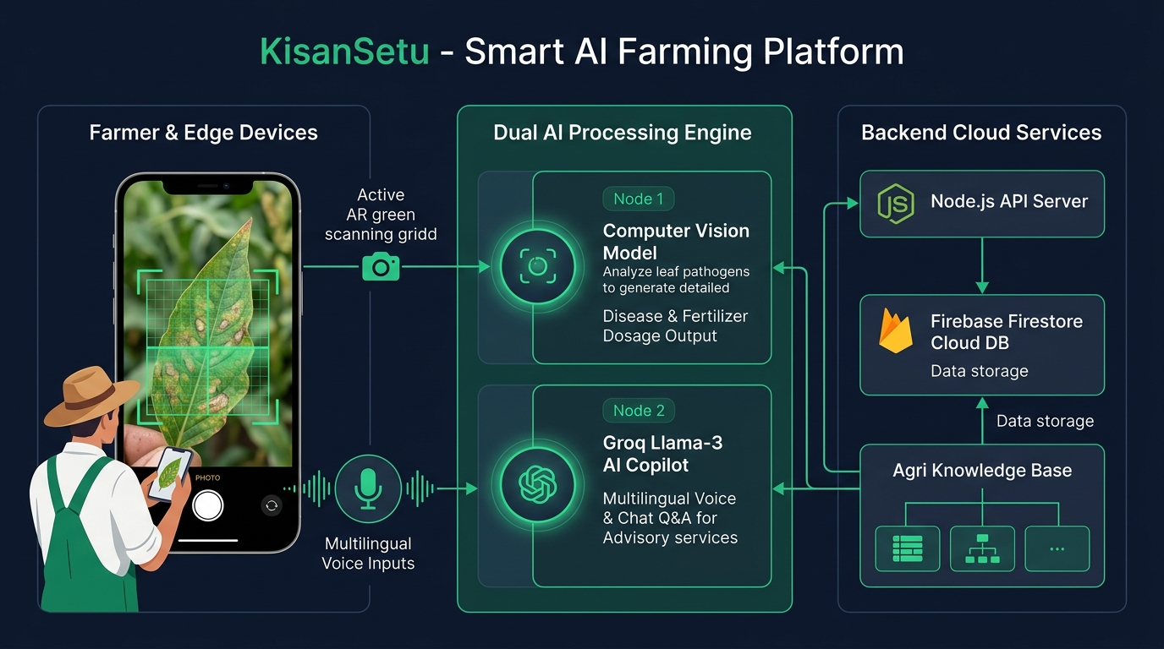
System Architecture
1. Presentation Layer:
Flutter App + React PWA with WebAR camera stream and Web Speech voice input.
2. Application Core:
Real-time pixel analyzer, lesion hotspot pin mapper, and Zustand state store.
3. Dual AI Processing Engine:
• Vision Model: Pathogen classification & fertilizer dosage mapping.
• Groq Llama-3.3 70B: Multilingual conversational agronomist & scheme intelligence.
4. Backend & Cloud:
Node.js REST API + Firebase Cloud Firestore for historical health tracking.
7

Slide 8
Resources Required
💻 Technologies & Frameworks
• Frontend: React 18, TypeScript, Vite, TailwindCSS, Flutter (Dart), Three.js
• Backend: Node.js, Express REST API, Firebase Firestore & Auth
• AI/ML: Groq Cloud (Llama-3.3 70B), Web Speech API, Computer Vision Pipeline
📊 Datasets & Agronomic Repositories
• PlantVillage Dataset: 50,000+ curated leaf images of diseased & healthy crops
• ICAR & Agri University Standards: Calibrated chemical/bio-fungicide dosage formulas
• Government Welfare Portals: Data on PM-KISAN, PMFBY, KCC, and SMAM subsidies
📱 Hardware & Deployment Resources
• User Hardware: Any smartphone with 5MP+ camera & web browser / Android OS
• Cloud Infrastructure: Serverless cloud functions, Firebase DB, and edge neural caching
8

Slide 9
Thank You!
KisanSetu — Empowering Every Farmer with Accessible AI Intelligence 🌱
Live Application: http://localhost:5173
GitHub Repository: https://github.com/your-team/kisansetu
Open for Questions & Discussion with the Jury.
9

