Slide 1

SMART HEALTH ADVISOR USING MACHINE LEARNING
Rajiv Gandhi University of Knowledge Technologies, Basar Computer Science and Engineering
Team Members:
G. Abhilash (B200232)
G. Purushotham (B201058)
R. Akhil (B201226)
Under the Guidance of:
Mrs. Geetla Srujana Mam
Assistant Professor

Slide 2

INTRODUCTION:
The Smart Health Advisor Using Machine Learning is an intelligent system that analyzes user-provided symptoms to predict possible diseases and provide personalized health guidance.
By leveraging machine learning algorithms, it enables users to receive instant, reliable, and affordable medical insights, even in areas with limited healthcare access.
This project aims to make healthcare faster, smarter, and preventive, helping individuals monitor their health effectively and take early precautions.

Slide 3
Machine Learning in Healthcare
Problem Statement:
Access to healthcare remains a global challenge, especially in rural and developing regions. Common issues include:
Delayed Diagnosis due to doctor shortages
High medical consultation costs
Lack of health awareness and preventive care
Unequal access between urban and rural area
These problems often lead to late-stage disease detection and unnecessary suffering.
Hence, there is a need for an AI-based system that provides early, accurate, and accessible health predictions.

Slide 4

Extended Features:
Health Report Analyzer: Analyzes medical reports.
voice-based symptom:
Voice to text of symptoms.
confidence percentage: Based on confidence percentage disease prediction.
Health Tips Based on Disease:
Health tips based on tips.

Slide 5

System Workflow: How It Works?
User Input
ML Model
Disease Prediction
Health recommendations
The system begins with user symptom input, which is then processed by our intelligent machine learning models.
This leads to a predicted disease and comprehensive health recommendations Like Description,Medicines,Diet Plan,Workouts and Precautions of Disease.

Slide 6
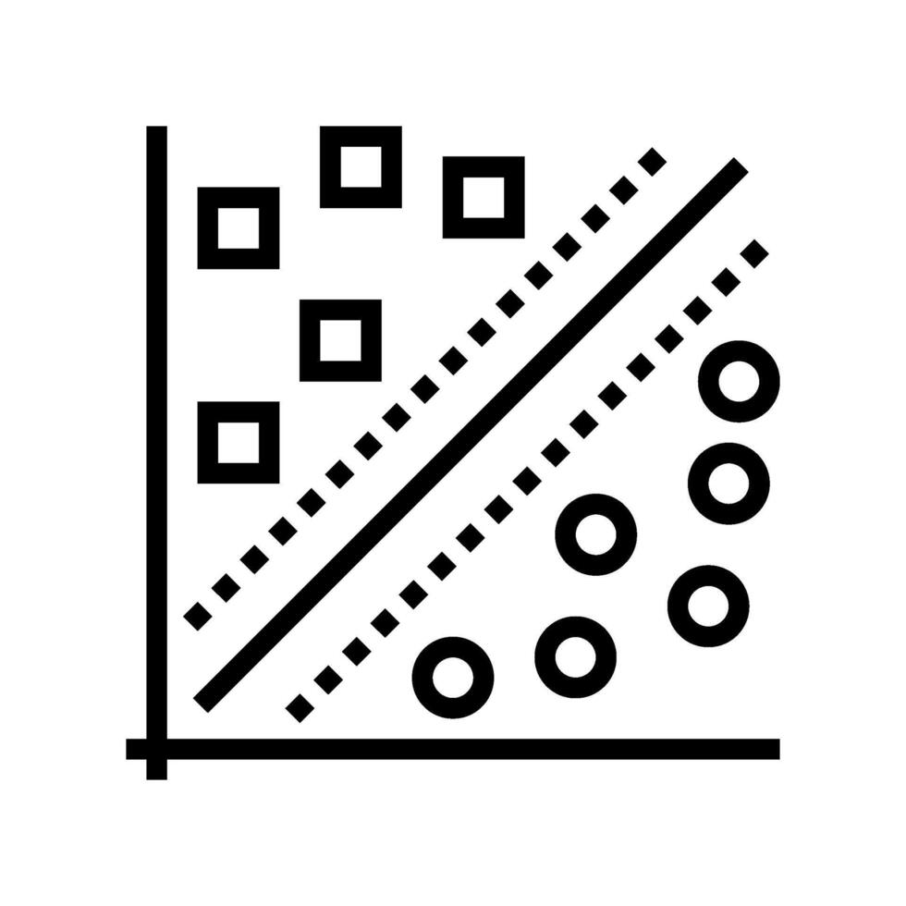

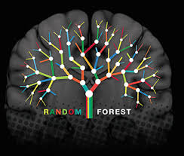
Machine Learning Models:
Support Vector Machine (SVM):
Finds the optimal boundary
separating diseases based on
symptoms.
Performs well with overlapping
symptom data.
Offers high accuracy for
structured datasets.
Decision Tree (DT):
Uses a tree-like structure for
decision-making.
Easy to interpret and visualize.
Provides explainable predictions
for users and doctors.(Depth)
Random Forest (RF):
Ensemble model combining
multiple decision trees.
Reduces overfitting and increases prediction reliability.
Suitable for complex datasets
with many features.

Slide 7
Dataset Details:
Symptoms Target
itching, skin rash, joint pain | Fungal infection
fatigue, cough, high fever | Typhoid
chest pain, shortness of breath | Heart Disease
Fever, Headache, Muscle pain | Dengue Fever
The dataset used for training and testing consists of symptoms and corresponding diseases.
It is derived from publicly available healthcare data and manually curated medical sources.
Dataset Overview:
Number of Records: 4,920 entries
Number of Symptoms: 132 distinct symptoms
Number of Diseases: 41 disease categories
Format: CSV (Comma-Separated Values)
Source: Open-source medical symptom datasets (e.g., Kaggle: “Disease Prediction Dataset”)

Slide 8

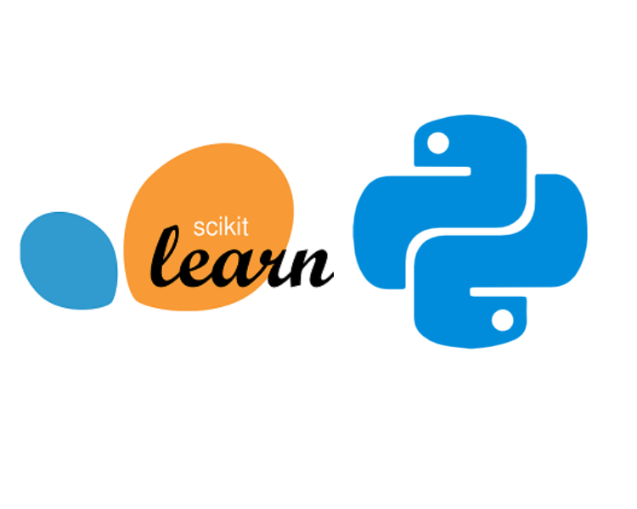






Tech Stack:

Slide 9
Conclusion
The Smart Health Advisor Using Machine Learning demonstrates the power of AI in revolutionizing healthcare.
By predicting diseases from symptoms and providing personalized recommendations, it helps users make informed health decisions.
The system is fast, affordable, and user-friendly, serving as an early health warning and prevention tool — bridging the gap between patients and medical experts.
This project highlights how machine learning can promote preventive healthcare, enhance accessibility, and support global well-being.

Slide 10

Thank you

