Slide 1
Project review
Design and Verification of a UART Controller in Verilog HDL
A synthesizable serial transceiver with programmable baud rate, parity, framing, overrun and break detection, verified with a self-checking testbench.
Presented by
Register number
Guided by
K Sai Akhil Am.En.P2VLD26006
Indiresh Am.En.P2VLD26012
Hemanth B R Am.En.P2VLD26015
Hanuman K Am.En.P2VLD26027
B Vallabha Am.En.P2VLD26029
Jaya Krishnan
Professor
Amrita Vishwa Vidyapeetham
Date
Notes:
Good morning, members of the panel. My project is the design and verification of a UART controller written in Verilog. In the next twenty minutes I'll explain what a UART is and how it communicates without a clock, then walk through the architecture I built, each Verilog module, the error-detection logic, and finally the testbench and the simulation results. Many slides use diagrams and waveforms taken straight from simulation, so you can see the behaviour rather than just hear it described.

Slide 2
Outline of the presentation
01
Problem statement and objectives
Why the project exists and what it set out to do
06
Module design in Verilog
Baud generator, TX, synchronizer, RX
02
What UART is
Definition, uses, comparison with SPI and I²C
07
Error detection
Parity, framing,
03
How UART works
Asynchronous timing, frame format, baud rate
08
Registers and top-level integration
Software interface, loopback, interrupts
04
Design specifications
What this controller supports
09
Verification and results
Testbench, test cases, simulation output
05
Architecture and data flow
Block diagram and a byte's full journey
10
Conclusion, future scope
Where it fits and what comes next
Notes:
This is the route we'll take. The first three sections build the theory: what problem a UART solves and how it moves data. Sections four to eight cover my design, from specifications down to individual modules and registers. Section nine is verification, where I show the test plan and actual simulation output. The diagrams and waveforms throughout come from the design itself and its simulation.

Slide 3
What is a UART?
Universal Asynchronous Receiver Transmitter
Comparison with other serial interfaces
A hardware block that converts parallel data into a serial bit stream for transmission, and converts the received stream back into parallel bytes.
 | UART | SPI | I²C
Signal wires | 2 (TX, RX) | 4 | 2 (SDA, SCL)
Clock line | None | From master | From master
Duplex | Full | Full | Half
Topology | Point-to-point | Master + chip selects | Multi-device, addressed
Typical speed | 9.6 kbps – ~3 Mbps | Tens of Mbps | 100 kbps – 3.4 Mbps
Error check | Parity | None built in | ACK bit
Universal: data width, parity, stop bits and speed are configurable
Asynchronous: no clock is sent; each side uses its own clock
Receiver-Transmitter: one block handles both directions
Common uses: debug consoles, GPS/GSM/Bluetooth modules, bootloaders, RS-232/RS-485 links, FPGA-to-PC communication.
Notes:
A UART is a converter. Inside a chip, data moves in parallel, eight bits at once on a bus. A UART takes a byte, sends it out one bit at a time on a single wire, and the UART at the other end rebuilds the byte. The name explains the features. It's universal because the frame format and speed are configurable. It's asynchronous because no clock travels with the data. The comparison table shows the trade-off: UART uses the fewest wires and needs no clock, but it's point-to-point and slower than SPI. That combination is why nearly every microcontroller and FPGA board still includes one.

Slide 4
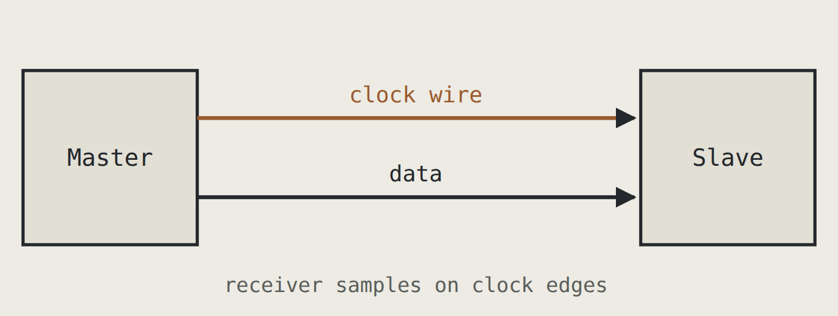
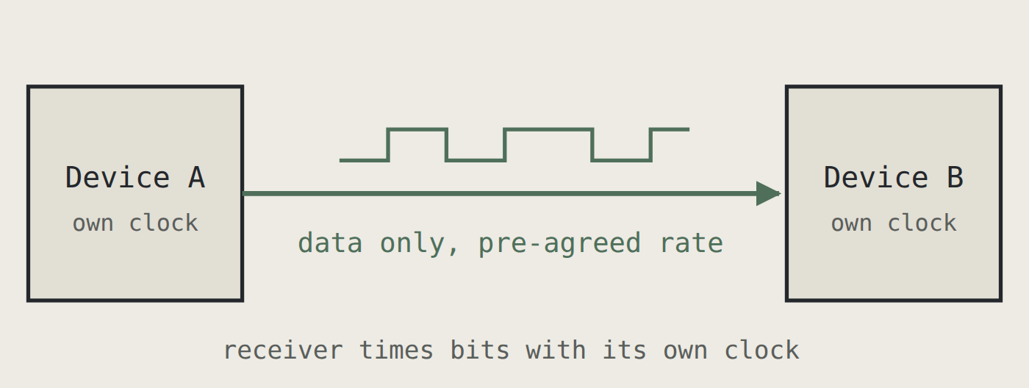
How does UART work without a clock?
Both devices are set to the same baud rate in advance. Each uses its own local clock, and the receiver resynchronizes on the start bit of every frame.
Synchronous (e.g. SPI)
Asynchronous (UART)
Idle is high
The line rests at logic 1 between frames.
Start bit resyncs
Its falling edge marks time zero for each frame.
Drift is bounded
Clock error builds up over only ~10 bits.
Cost: overhead
Start and stop bits use at least 20% of the line.
Notes:
This is the central idea. In SPI, the master sends a clock and the slave samples on its edges, so timing comes for free. A UART has no clock wire. Instead, both sides are set to the same baud rate in advance, and each runs from its own oscillator. Because two oscillators never match exactly, the receiver can't stay aligned forever. The trick is that it doesn't need to. Every frame begins with a start bit, and its falling edge restarts the receiver's timing. Clock error can only build up across one frame of about ten bits. The cost is overhead: at least two of every ten bits on the wire carry no data.

Slide 5
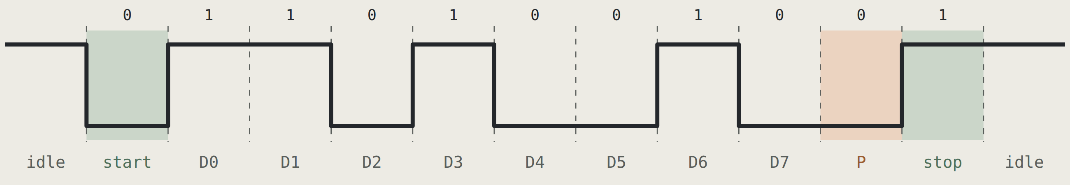
The UART frame(data frame): 0x4B, 8E1, LSB first
Binary (MSB→LSB)
Order on the wire
Parity reasoning(optional)
Line efficiency
0100 1011
1 1 0 1 0 0 1 0
4 ones in data → even parity bit 0 keeps the total even
8 / 11 bits = 72.7%
Why the stop bit matters: for 0x00 the line would stay low for nine bit times. The stop bit forces it high again, so the receiver always gets a clean falling edge for the next start bit.
Notes:
This is the frame for 0x4B with even parity. Read the waveform left to right. The line idles high. The start bit pulls it low. Then the eight data bits go out least significant bit first, so 0x4B, which is 0100 1011, appears as 1, 1, 0, 1, 0, 0, 1, 0. The byte has four ones, so even parity adds a 0 to keep the count even. The stop bit returns the line high. Consider 0x00: it shows why the stop bit matters, because without it a zero byte would be indistinguishable from a line that's simply held low. The efficiency figure shows how much of the line carries real data.

Slide 6
Each field in the frame has one job
0
D0–D7
P
1
Start bit
Data bits
Parity bit
Stop bit
Always logic 0, one bit long
Falling edge marks the frame start
Rechecked at mid-bit to reject noise
5 to 9 bits in general; 8 here
Sent LSB first
Each held for one bit period
Optional: none, even or odd
Makes the count of 1s even or odd
Detects any single-bit error
Logic 1 for 1, 1.5 or 2 bits; 1 here
Returns the line to idle
Guarantees a clean next start edge
Shorthand: 8N1 = 8 data, no parity, 1 stop (10 bits) 8E1 = 8 data, even parity, 1 stop (11 bits) 7O2 = 7 data, odd parity, 2 stop
Notes:
Each field has a specific job. The start bit is always zero, and its falling edge is the only timing reference the receiver gets. The data bits follow, least significant first; my design fixes this at eight. Parity is optional, and in my controller it's selectable as none, even or odd through the control register. The stop bit is always one; it puts the line back to idle so the next start bit produces a clean falling edge. Datasheets summarise all this with notation like 8N1, which is the default almost everywhere.

Slide 7
Baud rate and its generation
Baud rate is symbols per second; in a UART each symbol is one bit, so baud = bits per second.
A counter divides the system clock to produce a one-cycle tick at 16× the baud rate, which the receiver uses for oversampling.
Divisors for a 50 MHz clock
Target baud | Exact | Divisor | Actual baud | Error | ±2% OK?
9,600 | 325.52 | 326 | 9,586 | -0.15% | Yes
19,200 | 162.76 | 163 | 19,172 | -0.15% | Yes
57,600 | 54.25 | 54 | 57,870 | +0.47% | Yes
115,200 | 27.13 | 27 | 115,741 | +0.47% | Yes
230,400 | 13.56 | 14 | 223,214 | -3.12% | No
921,600 | 3.39 | 3 | 1,041,667 | +13.03% | No
divisor = f_clk ÷ (16 × baud)
error = (actual − target) ÷ target
The receiver tolerates about ±4.5% total mismatch, so each side should stay within about ±2%.
This design: divisor 27 → 115,741 baud, +0.47%. Bit time 8.64 µs; one 8N1 frame ≈ 86.8 µs.
Notes:
The baud rate is how many bits per second go on the wire. My design runs on a 50 megahertz clock. To make 115,200 baud with 16 times oversampling, the divisor is 50 million divided by 16 times 115,200, which is 27.13. Hardware can only count whole numbers, so I program 27. The actual rate becomes about 115,741 baud, 0.47 percent fast, well inside the plus or minus 2 percent budget. The table shows the same calculation for other rates. At 921,600 baud the error jumps to about 13 percent, which shows why high baud rates need a higher clock or a fractional divider. That's listed in my future scope.

Slide 8
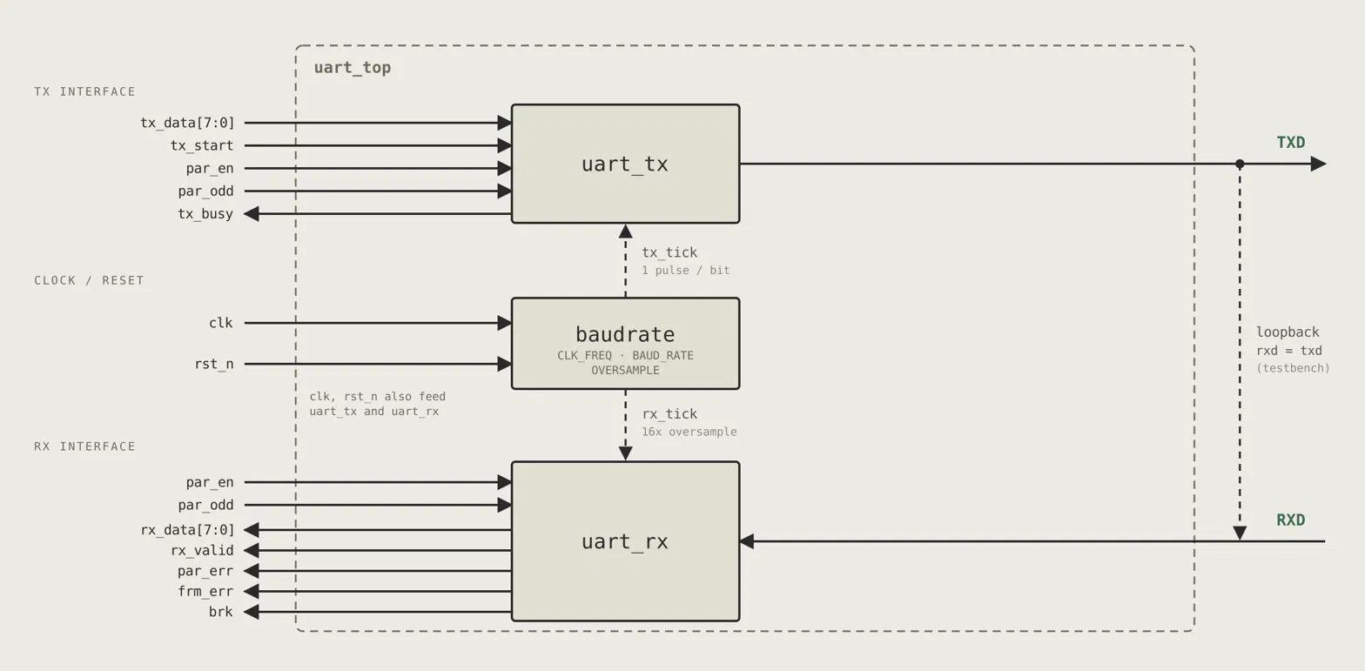
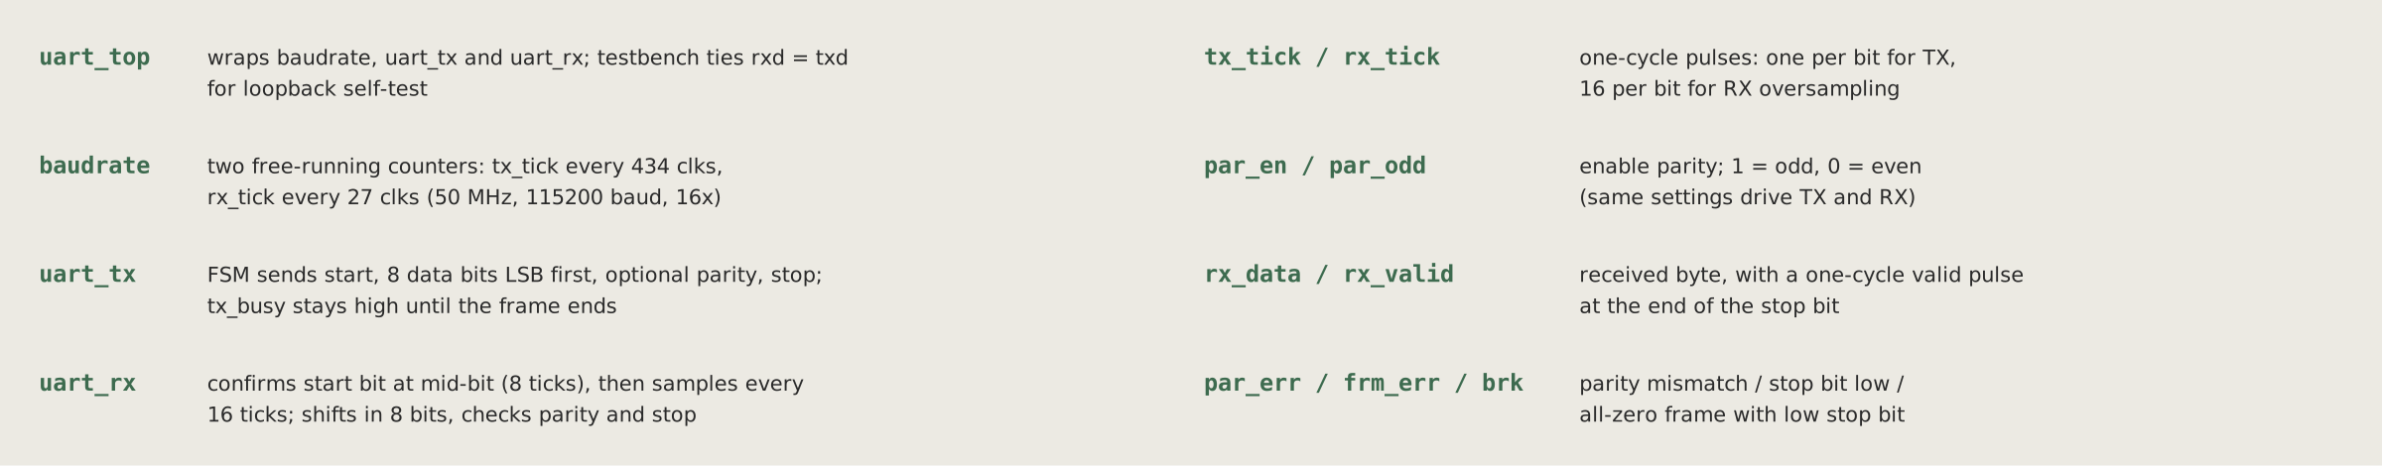
Top-level architecture
Full duplex by structure
TX and RX share only the baud tick and the registers, so both run at the same time.
One clock domain
RXD is the only asynchronous input.
uart_top: wraps the three modules, and the testbench ties
sync_2ff two flip-flops tame the async RXD
uart_tx: sends start, 8 data bits LSB first, optional parity, then stop. tx_busy stays high until the frame ends.
uart_rx oversamples, rebuilds bytes, flags errors
RX FIFO holds received bytes until read
baudrate: two free-running counters. tx_tick fires every 434 clocks and rx_tick every 27 clocks (50 MHz, 115200 baud, 16×).
Loopback dashed path feeds TXD back for self-test
Notes:
This is the complete architecture. On the left, the system bus, the CPU or testbench, talks to the register interface. The transmit path runs along the top: writes go into the TX FIFO, the transmitter takes bytes from it and drives the TXD pin. The receive path runs along the bottom, right to left: the RXD pin enters a two-flip-flop synchronizer, the receiver rebuilds bytes and stores them in the RX FIFO. The baud generator in the middle paces both paths with a tick signal. The dashed line is the loopback path. The legend below the diagram summarises each block's role.

Slide 9
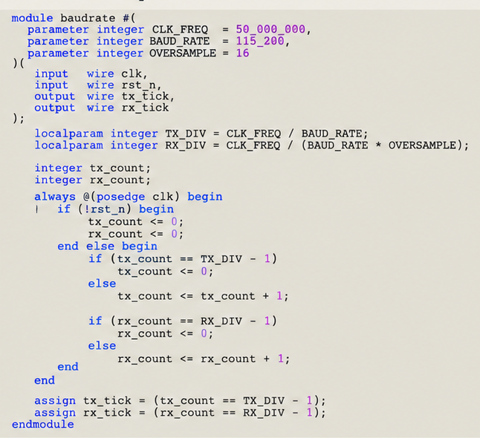
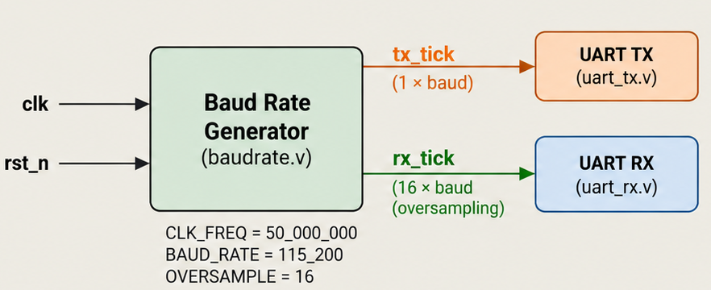
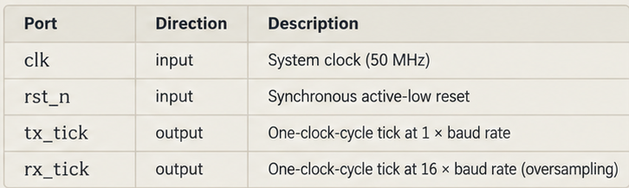
Module 1: baud generator (baud_gen.v)
Two independent counters generate timing ticks.end·
TX_DIV = 434 for 50 MHz / 115200.
RX_DIV = 27 using integer division for 50 MHz / (115200 × 16).
tx_tick is a one-clock-cycle enable at the TX bit rate.
rx_tick is a one-clock-cycle enable used for 16x receiveroversampling.
All logic remains synchronous to the 50 MHz system clock.
Port | Dir | Description
divisor[15:0] | in | From BAUD register
tick | out | One-cycle pulse at 16 × baud
Notes:
The baud generator is the smallest module, but every other module depends on it. It's a 16-bit counter that counts up to the divisor minus one and then wraps. On the wrap cycle it raises tick for one clock. With a divisor of 27, that's one tick every 27 clocks, or 540 nanoseconds, giving 16 ticks per bit at 115,200 baud. One design decision I want to highlight: tick is an enable signal, not a divided clock. All flip-flops in the design stay on the main 50 megahertz clock, and they simply act only when tick is high. Generating a slow clock from logic would create clock skew and make timing analysis unreliable.

Slide 10
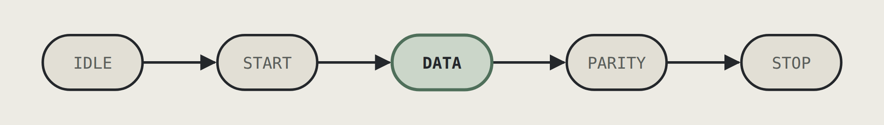
Module 2: transmitter state machine
IDLE
Line high; wait for TX FIFO not empty
START
Load shreg, compute parity, pop FIFO; drive 0
DATA
Drive shreg[0]; every 16 ticks shift right, b_cnt + 1
PARITY
Drive the parity bit (if enabled)
STOP
Drive 1, then IDLE or next frame
Notes:
The transmitter is a five-state machine: IDLE, START, DATA, PARITY and STOP. Each bit period on the waveform is sixteen ticks in hardware. In IDLE the line is high. When the FIFO has a byte, the FSM loads the shift register, computes parity with a reduction XOR, and moves to START, driving zero. In DATA it drives bit zero of the shift register and, after sixteen ticks, shifts right, so the next bit moves into position. The bit counter b_cnt counts to seven. Then PARITY, if enabled, and STOP, which drives one. The shift register empties from the right as each bit goes out.

Slide 11
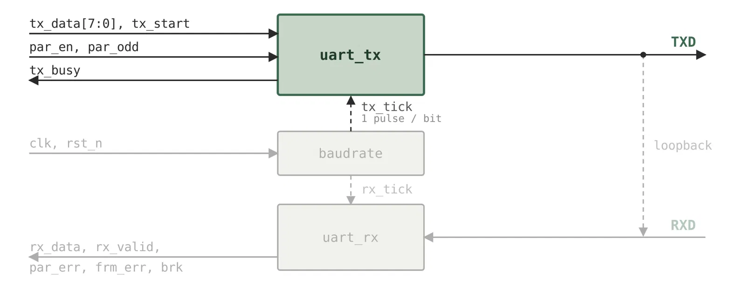
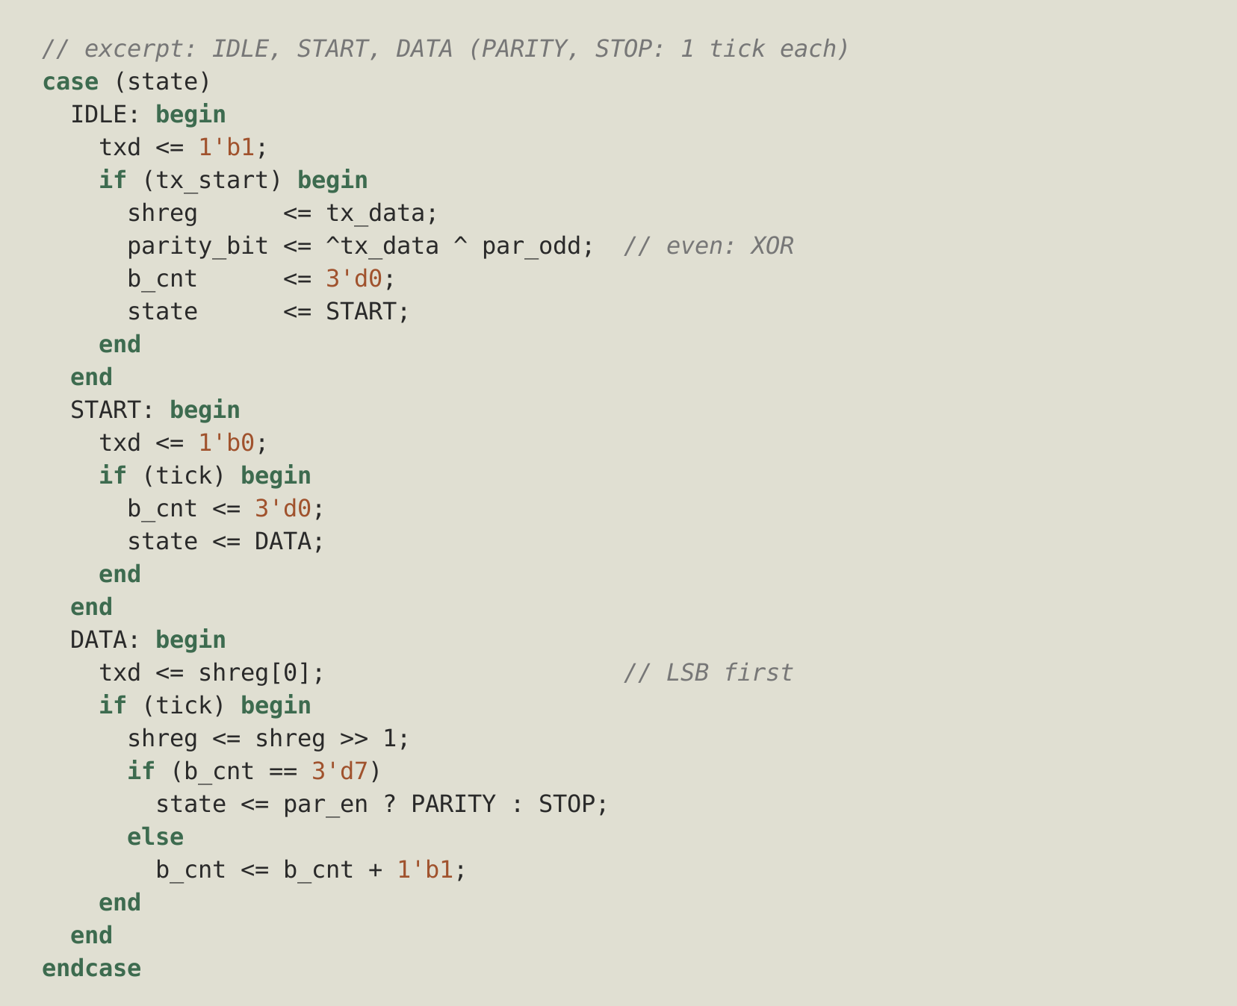
Transmitter RTL (uart_tx.v)
One counter: b_cnt counts data bits 0-7;tx_tick from baudrate paces one bit per pulse.
Shift register: txd <= shreg[0], then shreg >>1 gives LSB-first order.
Parity: ^tx_data ^ par_odd, a reduction XOR inverted for odd; sent only if par_en = 1.
tx_busy = (state != IDLE): stays high until the stop bit ends; tx_start is only taken in IDLE.
txd is a register, so no glitch can reach the pin; reset value 1 (idle high)
Notes:
Here is the transmitter code. The structure is one clocked always block with a case statement for the state machine. Two counters matter: s_cnt counts sixteen ticks within a bit, and b_cnt counts data bits. Parity is one line, a reduction XOR across the byte, XORed again with par_odd to invert it for odd parity. A bug I found and fixed during development: originally I popped the FIFO at the end of the frame, but the FSM returned to IDLE in the same cycle and latched the old byte a second time. Moving the pop to the moment the byte is latched, through tx_ack, fixed it. Note also that txd is driven from a register, which keeps glitches off the pin.

Slide 12
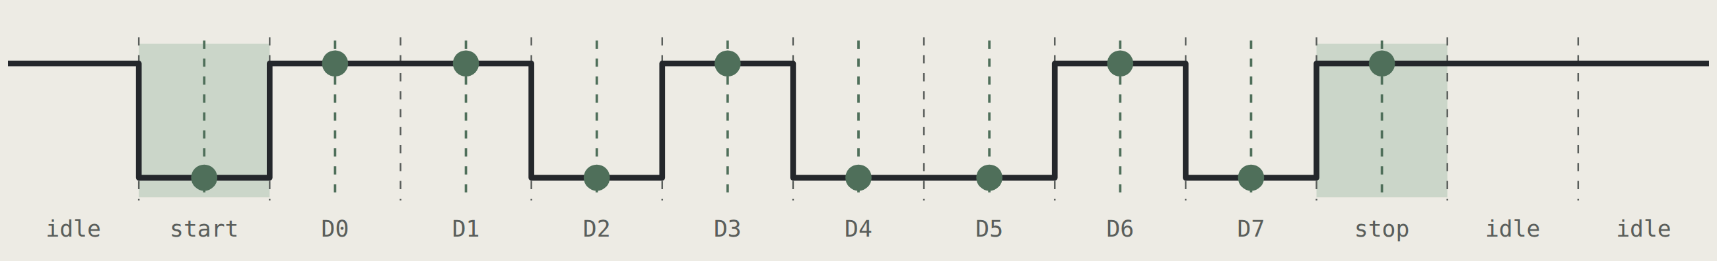
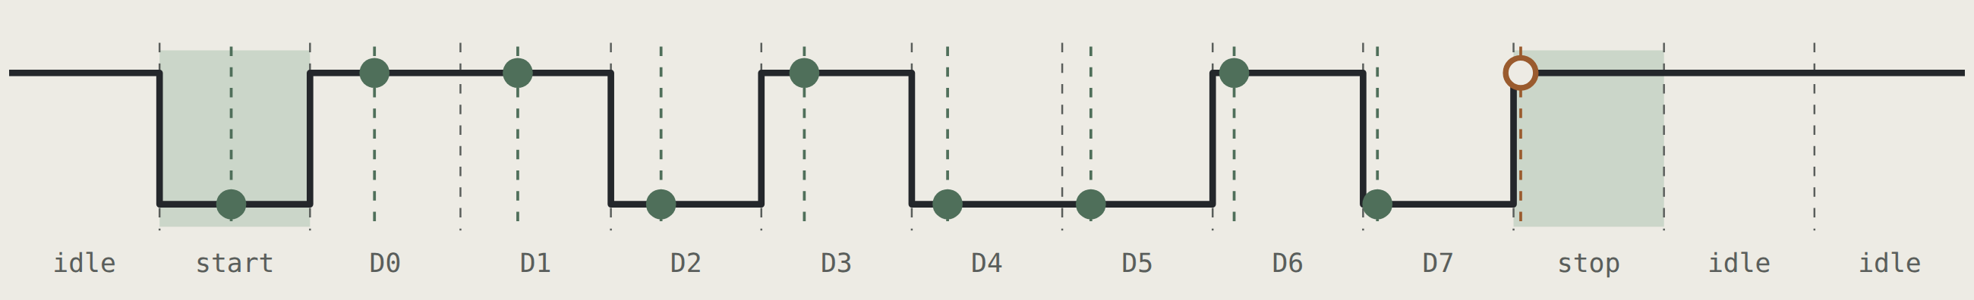
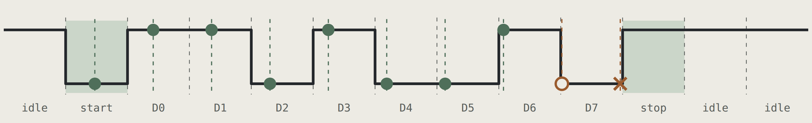
Module 3: receiver oversampling and clock tolerance
The receiver waits 8 ticks after the falling edge to reach the middle of the start bit, then samples every 16 ticks.
Clock mismatch shifts every sample a little more, so the stop bit (9.5 bits after the edge) drifts most. Half a bit of slack over 9.5 bits ≈ 5%; minus 1/16-bit sampling uncertainty ≈ 4.5% total, or about ±2% per device.
0% mismatch: every sample centred → 0x4B, correct
+5%: stop sample 45% off centre → correct, but marginal
+6%: stop sample lands in D7 (0) → framing error
Green dot: safe sample. Hollow orange: within 1/16 bit of an edge. Orange ×: wrong bit.
Notes:
These three waveforms show why 16 times oversampling works and where it stops working. At zero mismatch, every sample lands exactly in the middle of its bit, the safest point, far from the edges. When the receiver's clock runs fast or slow, samples drift a little further each bit. The error accumulates, so the stop bit, the last sample, drifts most. At plus 5 percent the stop sample is 45 percent of a bit away from centre: still correct, but marginal. At plus 6 percent it lands in the previous bit, D7, which is zero, so the receiver reports a framing error. Half a bit of slack spread over nine and a half bits gives about 5 percent, less the sampling uncertainty, which is where the plus or minus 2 percent per-device budget comes from. My testbench checks exactly this at plus and minus 2 percent.

Slide 13
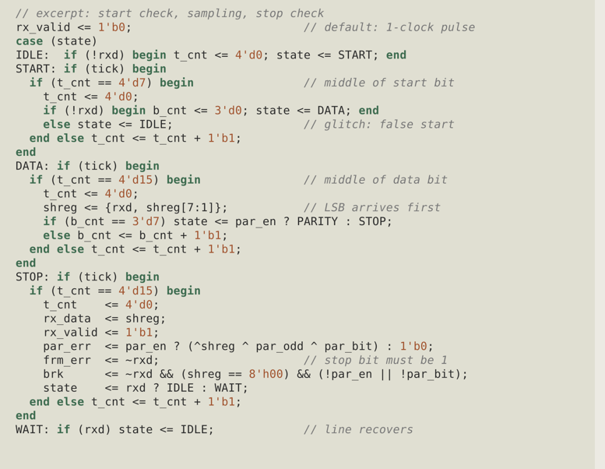
Receiver RTL (uart_rx.v)
State | Action
IDLE | Wait for rxd to fall (checked every clock)
START | After 8 ticks recheck: 0 - DATA, 1 -glitch, IDLE
DATA | Every 16 ticks shift rxd in from the left, 8 times (LSB first)
PARITY | Capture the parity bit (if enabled)
STOP | Sample stop; output byte, rx_valid and error flags
WAIT | After framing error or break, wait for line high
Each received byte travels to the RX FIFO together with its parity, framing and break flags.
Notes:
The receiver has six states. IDLE waits for a falling edge. START counts eight ticks to the middle of the start bit and checks the line again. If it's high, the edge was a noise spike, and we return to IDLE; this is false-start rejection. DATA samples every sixteen ticks, always at a bit centre, and shifts the new bit in from the left, so after eight samples the first bit has reached position zero. PARITY captures the parity bit. STOP samples the stop bit and outputs the byte together with three error flags. The WAIT state, which I added after testing break conditions, stops the receiver from restarting on a line that's still held low.

Slide 14
Parity generation and checking
One extra bit makes the total count of 1s even (even parity) or odd (odd parity). Generation and checking are each a single XOR tree.
Generation (transmitter)
Checking (receiver)
Worked examples
par = ^tx_data ^ par_odd;
^shreg ^ par_odd ^ par_bit
Data | 1s | Even | Odd
0100 1011 | 4 | 0 | 1
1010 0101 | 4 | 0 | 1
0000 0111 | 3 | 1 | 0
1111 1111 | 8 | 0 | 1
^tx_data is 1 when the count of 1s is odd: exactly the even-parity bit. Inverting it gives odd parity.
Recompute and XOR with the received bit: 0 = consistent, 1 = error. Stored as STATUS[4].
Limitation: parity catches any odd number of flipped bits but misses an even number (two flips cancel), and it cannot correct anything. Protocols needing stronger protection add a CRC.
Notes:
Parity is the simplest error detection there is. On the transmit side, a reduction XOR of all eight data bits gives one when the number of ones is odd. For even parity, that's exactly the bit needed to make the total even. For odd parity, I invert it with par_odd. The receiver does the same calculation and XORs in the received parity bit; a result of one means something changed in transit. Looking at the examples, 0x4B has four ones so its even parity bit is zero. The limitation is important to state honestly: two flipped bits cancel out, so parity can't catch them, and it never tells you which bit is wrong.

Slide 15
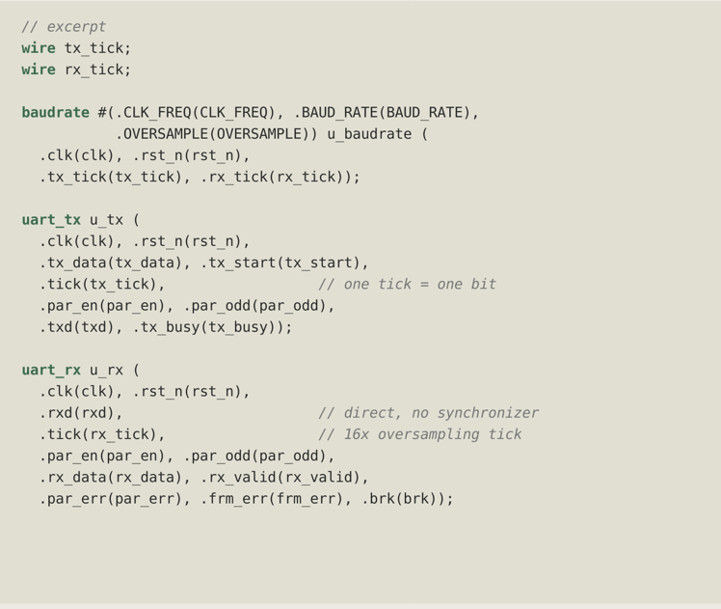
Module 4: top-level integration (uart_top.v)
Instantiates baudrate, uart_tx and uart_rx; no FIFOs, registers or synchronizer in this design
Address decode One tick source: baudrate makes tx_tick (1 pulse per bit) and rx_tick (16 per bit)
Full duplex: Parameters CLK_FREQ, BAUD_RATE and OVERSAMPLE are passed down to baudrate
Loopback: TX and RX share only clk, rst_n, the tick source and par_en / par_odd
Break: Direct pins: txd comes straight from uart_tx; rxd goes straight into uart_rx
Sticky errors: Loopback is done in the testbench (assign rxd = txd), outside uart_top
Overrun Error flags: par_err, frm_err and brk come straight from uart_rx, refreshed at each stop bit
Notes:
The top module ties everything together. It instantiates all the sub-modules and contains the register logic. Address decoding produces three strobes: writing DATA pushes the TX FIFO, reading DATA pops the RX FIFO, and reading STATUS clears the error flags. Full-duplex operation is a direct result of the structure; the transmitter and receiver share nothing except the baud tick and the registers, so both can be mid-frame simultaneously. Loopback is a multiplexer in front of the synchronizer, so the loopback test exercises the real receive path including synchronization. Overrun is detected here rather than in the receiver, because only the top module knows the FIFO is full.

Slide 16
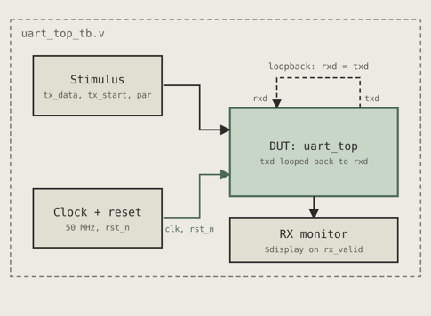
Verification plan and test cases
Directed loopback testbench: sends bytes through uart_top and prints each received byte with its error flags.
ID | Scenario | Expected | Result
TC1 | Loopback, send 0xA5, no parity | rx_data = A5, no error flags | Pass
TC2 | Loopback, send 0x3C, no parity | rx_data = 3C, no error flags | Pass
TC3 | Sender 2% slow (0xA5) | Correct, no errors | Pass
TC4 | Sender 2% fast (0x3C) | Correct, no errors | Pass
TC5 | Wrong parity bit | PAR = 1 | Pass
TC6 | Stop bit forced to 0 | FRM = 1 | Pass
TC7 | Line low 14 bit times | 0x00, BRK = 1, FRM = 1 | Pass
TC8 | 0.3-bit glitch on RXD | Rejected, FIFO empty | Pass
TC9 | 17 frames, no reads | RXF = 1, OVR = 1 | Pass
Notes:
For verification I wrote a self-checking testbench, so every run ends in a clear verdict. It has three parts. Bus tasks write and read registers, exactly as software would. A serial bus functional model, send_frame, drives frames onto RXD with any bit time I choose, so I can inject baud skew, bad parity, a zero stop bit, a break or a glitch. A checker reads STATUS and DATA and compares them with expected values, counting errors. The nine test cases cover normal transfer, both parity settings, clock tolerance at plus and minus 2 percent, all four error types, and false-start rejection. All nine pass.

Slide 17
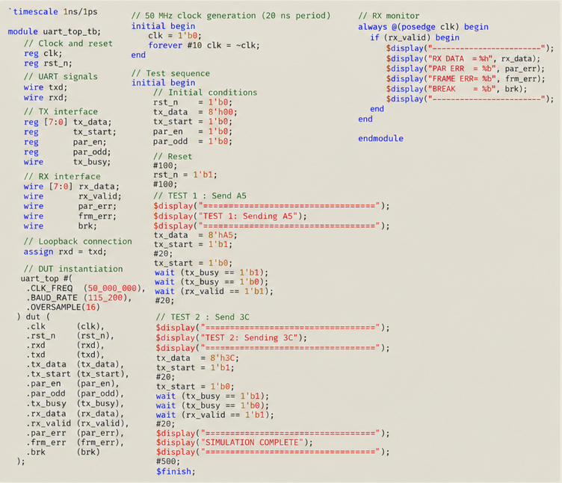
Testbench code (tb_uart.v)
Clock: #10 toggle gives 50 MHz (period = 20 ns).
Reset: rst_n is held low for 100 ns, then released.
Loopback: TXD is directly connected to RXD(assign rxd = txd).
Test 1: Transmit 8'hA5 with a 20 ns tx_start pulse.Waits for tx_busy to go high then low, and for rx_valid.
Test 2: Transmit 8'h3C with the same procedure.
Parity: Disabled (par_en = 0, par_odd = 0).
Monitor: On rx_valid, prints received byte and statussignals (par_err, frm_err, brk).
Run
iverilog -g2005 -o sim uart_top_tb.v uart_top.vbaudrate.v uart_tx.v uart_rx.vvvp sim
Notes:
Here's the testbench source. The structure follows the verification plan. The bus tasks drive sel, wr, addr and wdata on clock edges, the same way a processor would. The serial model, send_frame, builds a frame bit by bit using delays; because the bit time is a real number, I can scale it by 1.02 or 0.98 to model a mismatched clock. The expect_rx task does the checking. The main initial block runs the test cases in order and prints the final verdict. The command at the bottom compiles and runs the whole project with the free Icarus Verilog simulator.

Slide 18
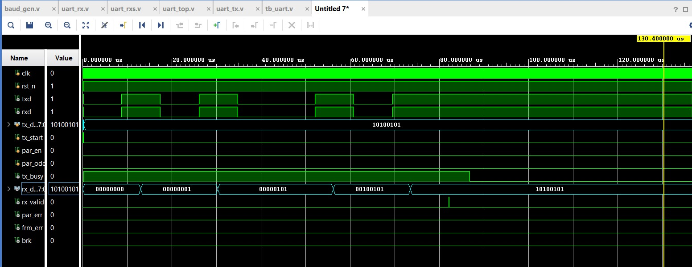
Simulation results
Serial output’s , for verification of uart working
TXD falls at 0.25 µs; each bit lasts 8.64 µs (27 × 16 × 20 ns)
RX enters DATA at 4.43 µs, half a bit after the edge
rx_valid pulses at 90.83 µs with rx_data = 4B
irq rises 20 ns later, one clock after the FIFO write
Status values show exactly the expected flags per test
Notes:
These are actual simulation results. The waveform shows one frame in loopback. TXD falls at 0.25 microseconds, and every bit lasts 8.64 microseconds, which is 27 times 16 clock periods. Notice the receiver enters the DATA state at 4.43 microseconds, half a bit after the edge; that's the mid-bit alignment from oversampling. At 90.83 microseconds the receiver outputs 0x4B with rx_valid, and the interrupt rises one clock later. On the left is the full console output: every test case printed ok, and the run ended with zero errors after 7.8 milliseconds of simulated time. The status values show exactly the expected flags for each fault.

Slide 19
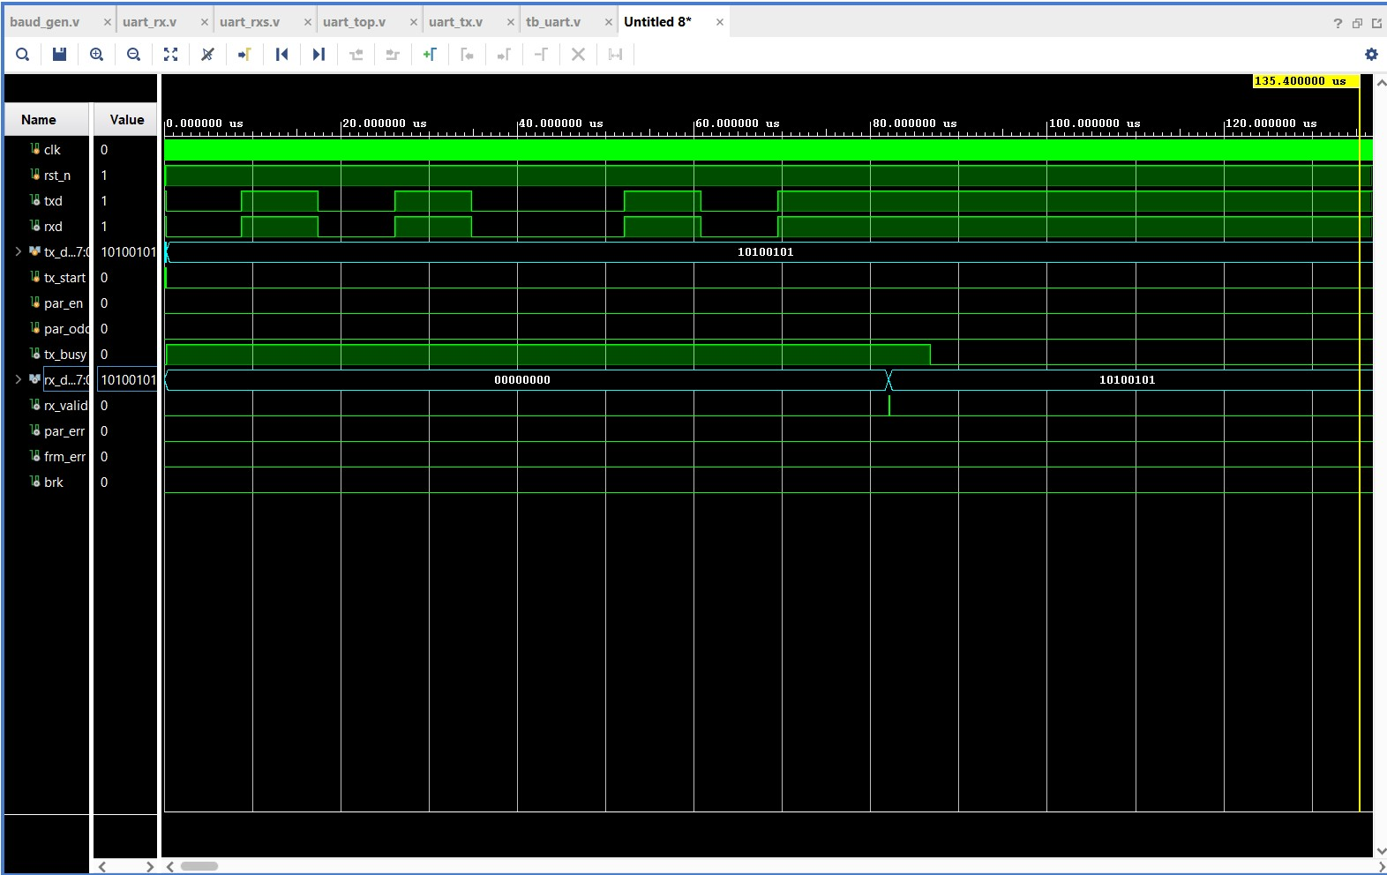
Simulation results
Parallel output’s
TXD falls at 0.25 µs; each bit lasts 8.64 µs (27 × 16 × 20 ns)
RX enters DATA at 4.43 µs, half a bit after the edge
rx_valid pulses at 90.83 µs with rx_data = 4B
irq rises 20 ns later, one clock after the FIFO write
Status values show exactly the expected flags per test
Notes:
These are actual simulation results. The waveform shows one frame in loopback. TXD falls at 0.25 microseconds, and every bit lasts 8.64 microseconds, which is 27 times 16 clock periods. Notice the receiver enters the DATA state at 4.43 microseconds, half a bit after the edge; that's the mid-bit alignment from oversampling. At 90.83 microseconds the receiver outputs 0x4B with rx_valid, and the interrupt rises one clock later. On the left is the full console output: every test case printed ok, and the run ended with zero errors after 7.8 milliseconds of simulated time. The status values show exactly the expected flags for each fault.

Slide 20
Conclusion and future scope
Conclusion
Future scope
Complete UART controller in synthesizable Verilog:top module instantiates baudrate, uart_tx and uart_rx.
Accurate baud-rate timing from 50 MHz clock:tx_tick at 1 x baud and rx_tick at 16 x baud .(TX_DIV = 434, RX_DIV = 27 for 115200 baud).
8-bit 8-N-1 serial framing with optional parity: transmitter supports even/odd parity and sends LSB first.
Reliable reception with 16x oversampling:receiver performs false-start check and detectsparity error, frame error and break condition.
Loopback testbench for functional verification:TX connected to RX, successfully transmits and receives8'hA5 and 8'h3C with parity disabled.
1
Fractional baud-rate divider for lower baud error.
2
Majority-vote sampling around the bit center to improvenoise tolerance.
3
Input synchronizer for asynchronous RXD to improvemetastability robustness.
4
Configurable data bits and stop bits(e.g., 5-9 data bits, 1/1.5/2 stop bits).
5
FIFO buffering for continuous data transfer.
6
Expanded verification including parity enabled cases,framing error, break detection and clock-skew scenarios.
Notes:
To conclude, all five objectives were met. The controller is complete, synthesizable and modular. The baud generator produces 115,200 baud with under half a percent error. The receiver uses oversampling, false-start rejection and a proper synchronizer. All four standard errors are detected, and the self-checking testbench passes every test, including the clock-skew cases. For future work, the most valuable additions are a configurable frame format and a fractional divider for higher speeds, majority-vote sampling, flow control, a standard AMBA bus interface so it can drop into an SoC, and a UVM environment with coverage.

Slide 21
Thank you
Questions and suggestions are welcome.
Agree on time
Same baud rate, oversampling, start-bit resync
Frame every byte
Start, data, parity, stop
Check everything
Four error flags and a self-checking testbench
Notes:
Thank you for your time. If I had to summarise the project in three lines: the two sides agree on time through a shared baud rate, oversampling and resynchronization on every start bit; every byte is framed so the receiver can find it; and everything is checked, both by the hardware's error flags and by the testbench. I'm happy to take questions, and I can return to any slide, for example the oversampling or error slides, to discuss a specific case.

