Slide 1
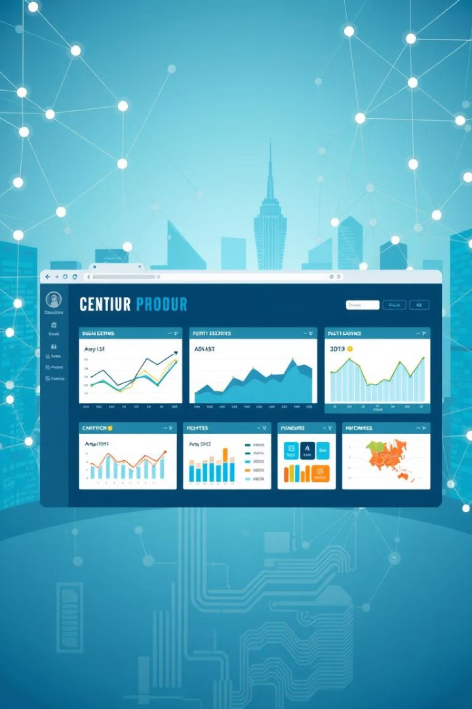
Scalable Web Application Deployment
This project will involve designing and deploying a web application capable of handling dynamic levels of user traffic. This will require leveraging cloud computing services like AWS, Azure, or GCP to create a highly scalable architecture.
by Akhil G(192211009)

Slide 2
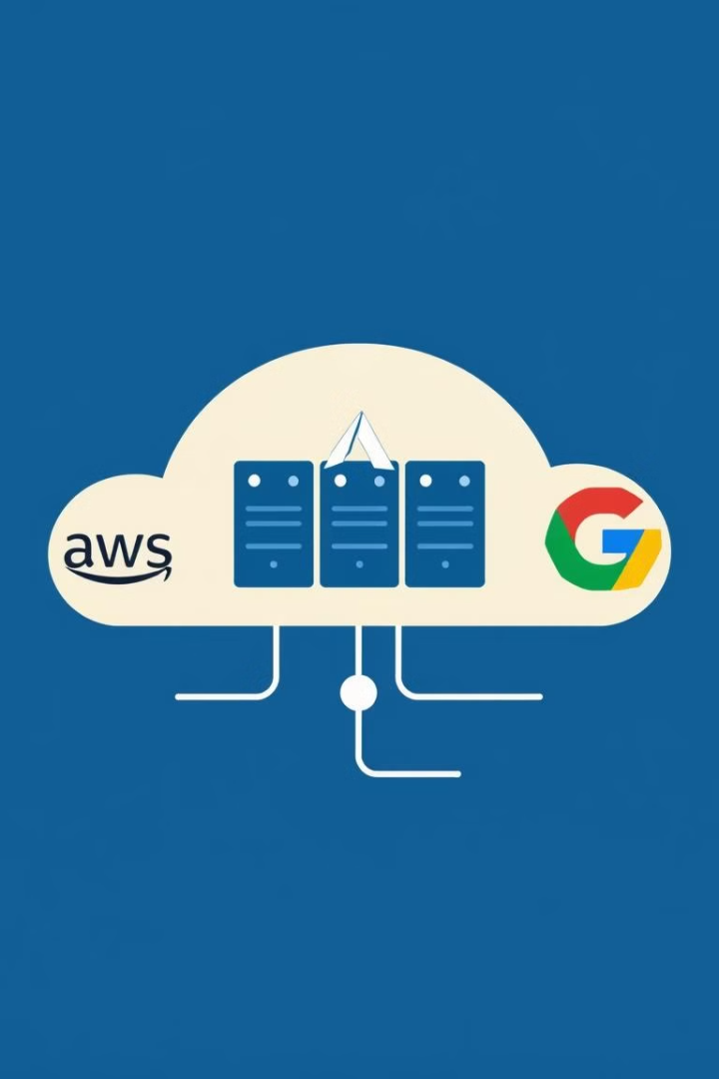
Cloud Computing Services
AWS
Azure
Amazon Web Services (AWS) offers a comprehensive suite of cloud computing services, including EC2, S3, and Lambda, providing a robust platform for scalable web applications.
Microsoft Azure provides a wide range of cloud services, including virtual machines, storage, and databases, enabling businesses to build and deploy scalable web applications.
GCP
Google Cloud Platform (GCP) offers a scalable and flexible infrastructure, including Compute Engine, Cloud Storage, and Cloud SQL, ideal for deploying web applications.

Slide 3
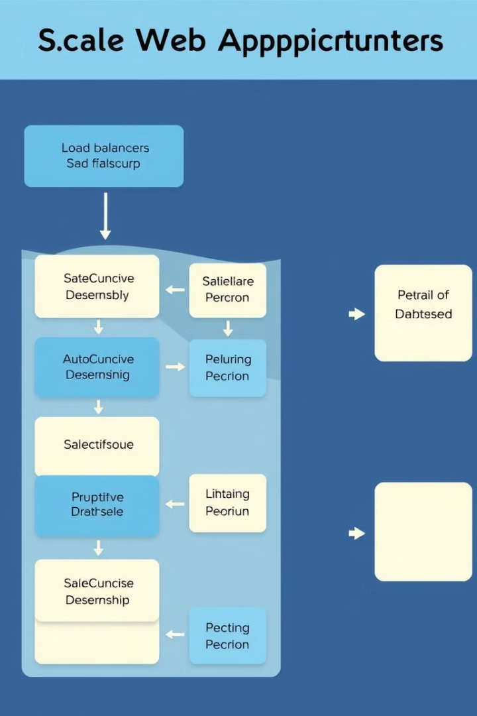
Architectural Design for Scalability
1
Microservices Architecture
Breaking down an application into independent, self-contained services enables individual components to scale independently, enhancing overall scalability.
2
Horizontal Scaling
Adding more instances of the same server or service to distribute the workload across multiple machines, ensuring smooth performance even under high traffic.
3
Content Delivery Networks (CDNs)
Distributing static content like images and scripts across geographically dispersed servers, minimizing latency and improving user experience.

Slide 4
Load Balancing and Auto-Scaling
Load Balancing
Auto-Scaling
Distributes incoming traffic across multiple instances of the application, preventing any single server from being overloaded and ensuring consistent performance.
Automatically adjusts the number of instances based on real-time metrics like CPU usage and request rate, dynamically scaling up or down to meet fluctuating demands.

Slide 5

Cloud-based Database Solutions
1
Relational Databases
2
NoSQL Databases
3
Cache Systems
Traditional SQL-based databases like Amazon RDS, Azure SQL Database, and Google Cloud SQL provide a structured and reliable data storage solution for complex web applications.
Non-relational databases like MongoDB, DynamoDB, and Cloud Firestore offer flexibility and scalability for handling large volumes of unstructured data, ideal for rapidly growing applications.
Caching frequently accessed data in memory or a dedicated cache layer significantly improves performance by reducing database queries and speeding up data retrieval.

Slide 6
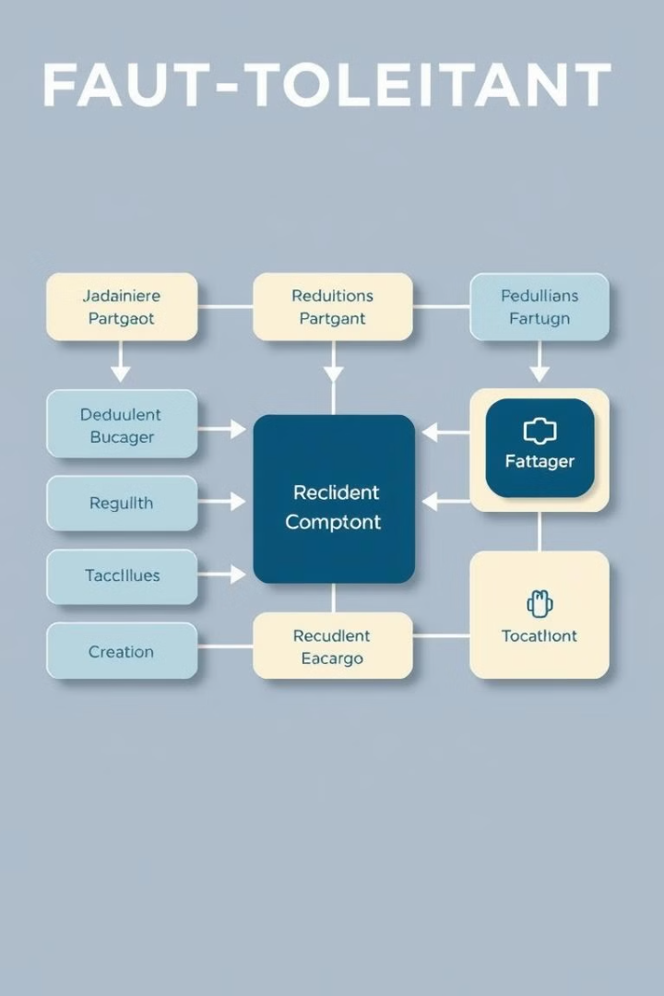



Fault Tolerance and Redundancy
Redundancy
Creating multiple copies of critical components, including servers, databases, and network connections, ensuring that if one fails, the others can take over, maintaining uninterrupted service.
Failover Mechanisms
Automatic switching to a backup system in case of failure, minimizing downtime and ensuring seamless service continuity.
Monitoring and Alerting
Continuously monitoring system health and performance metrics, triggering alerts and notifications in case of anomalies, enabling prompt identification and resolution of issues.

Slide 7
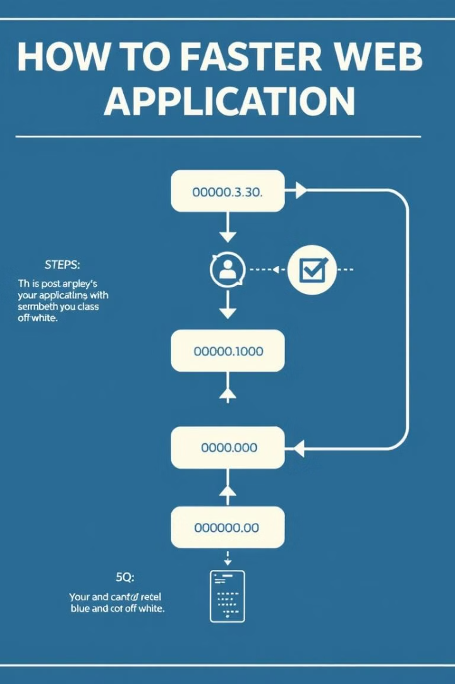
Performance Optimization
Code Optimization
Reducing code complexity, minimizing unnecessary operations, and utilizing efficient algorithms to improve code performance.
Caching
Storing frequently accessed data in memory or on disk to reduce the need for repeated computations and database queries, enhancing responsiveness.
Content Delivery Networks (CDNs)
Distributing static content across geographically distributed servers, minimizing latency and improving user experience.
Server Configuration
Optimizing server settings, including resource allocation, memory management, and network configuration, to ensure optimal performance.

Slide 8
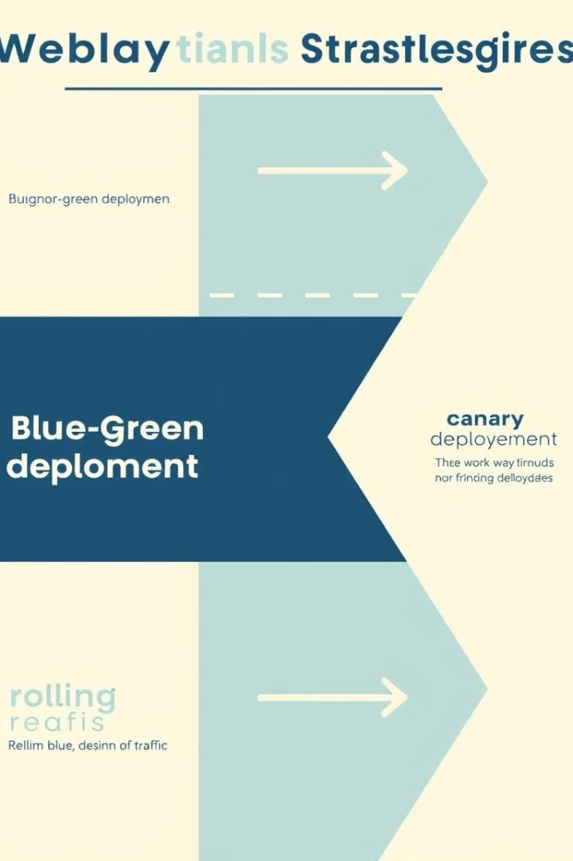



Deployment Strategies
Blue-Green Deployment
Deploying a new version of the application on a separate set of servers, testing it thoroughly, and then switching traffic to the new version.
Canary Deployment
Gradually routing a small percentage of traffic to the new version, monitoring performance and gradually increasing the traffic volume based on results.
Rolling Updates
Deploying the new version to a few servers at a time, gradually replacing the old version while monitoring for any issues.

Slide 9

Conclusion and Key Takeaways
By effectively implementing cloud computing services, architecting for scalability, and utilizing performance optimization techniques, this project will enable the creation of highly scalable web applications capable of handling dynamic user traffic, ensuring a seamless and reliable user experience. The key takeaway is that deploying scalable web applications requires careful planning and execution to ensure optimal performance and stability, ultimately leading to a successful online presence.

