Slide 1
Introduction to MongoDB
Akhilanand Singh

Slide 2
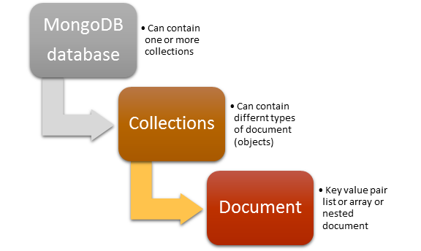
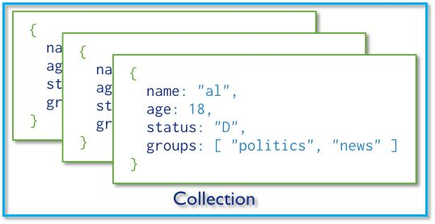
What’s MongoDB?
MongoDB is an open source, document-oriented database designed with both scalability and agility in mind.
Instead of storing your data in tables and rows as you would with a relational database, in MongoDB you store JSON-like documents.
In mongodb database, you need not define a fixed schema for your collection.

Slide 3
Accessing and Manipulating Data
Non-programmatic access- Mongo Shell
CRUD operations using JavaScrit
Programmatic access-
Native driver
Mongoose Driver
https://docs.mongodb.com/manual/mongo/

Slide 4
CRUD operations in Mongo Shell- I
db.dropDatabase()
use VehiclesDB
show collections
db.dropDatabase();
db.createCollection('Vehicles');
var coll = db.getCollection('Vehicles');
db.Vehicles.drop();
coll.insert({vehicle:'bycicle', model:‘Hero', speed:10, qty:20});
coll.insert({vehicle:'aircraft', model:'Airbus', speed:1200});
coll.insert({vehicle:'train', model:'TGV', speed:350});
coll.insert({vehicle:'train', model:'Maglev', speed:450});

Slide 5
CRUD operations in Mongo Shell- II
coll.find();
coll.find({vehicle:'car'});
coll.find({speed:600}).pretty();
coll.find({speed:{$gt:150}});
coll.update({model:'TGV'}, {$set:{qty:3}}, {multi:false});
coll.update({model:‘Driverless Car'}, {$set:{qty:3}}, {upsert:true});
coll.remove({model:'Airbus'});
coll.count({vehicle:'car'});
coll.distinct( "model" );

Slide 6
Using Native Driver
var mongodb = require('mongodb');
var mongoclient = mongodb.MongoClient;
mongoclient.connect("mongodb://127.0.0.1/cricketDB", function(err, db){
var adminDB = db.admin();
if (err){
console.log("could not connect to db");
}else{
adminDB.serverStatus(function(err1, status){
console.log(status);
});
}
});
console.log("End");

Slide 7
Using Mongoose for schema based access
var mongoose = require('mongoose');
var Schema = mongoose.Schema;
var VehSchema = new Schema({
vehicle: {type: String, required:true},
model: {type: String},
speed: {type: Number},
qty:{type:Number}
}, {collection: 'Vehicles'});
exports.VehiclesSchema = VehSchema;
var mongoose = require('mongoose');
var VehSch = require("./VehiclesSchema.js").VehiclesSchema;
mongoose.connect('mongodb://127.0.0.1/VehiclesDB');
var VehiclesModel = mongoose.model('VehiclesModel', VehSch);
mongoose.connection.once('open', function(){
VehiclesModel.find({model:'Blueliner'}, function(er, array){
if (!er){
console.log(JSON.stringify(array));
}//if (!er)
mongoose.disconnect();
}); //VehiclesModel.find
});//mongoose.connection.once

