Slide 1
DAA PROJECT IMPLEMENTION
Module-:Program Level Ojective Setting
Submitted By : TEAM HACKERS
G.AKHIL BABU - AP23110011185
D.ABHIRAM - AP23110011166
CH.PRADNISH - AP23110011198
P.NIDHI CHANDRA - AP23110011200
K.AKASH - AP23110011162
BTECH|CSE-Q|SEMESTER-3|2023-27

Slide 2
Introduction to Project
The Course Articulation Matrix is a critical framework within Outcome-Based Education (OBE) that aligns course objectives and outcomes with program-level goals. It ensures that each course contributes meaningfully to the overall learning outcomes expected from students in a program. By defining a matrix that maps specific course objectives to relevant program outcomes, institutions can measure how well individual courses are supporting broader educational goals.

Slide 3
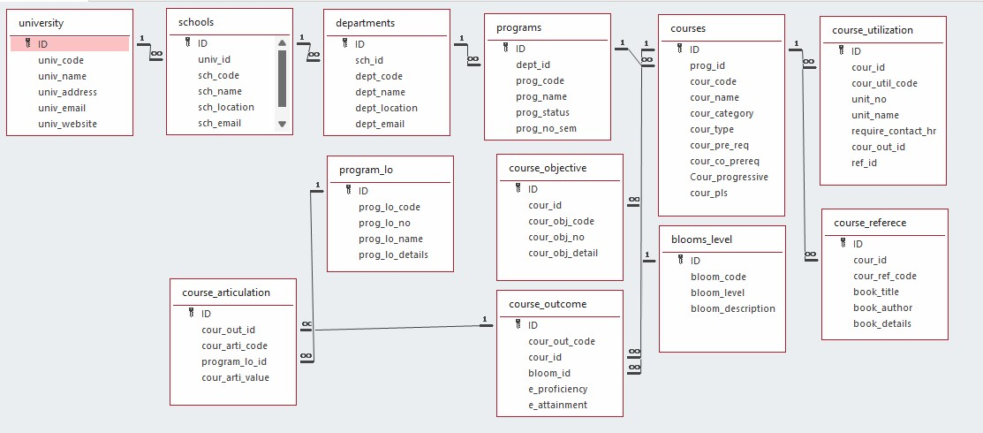

Architecture Diagram

Slide 4
Module Description : Program Level Objective Setting
Module Description
The Course Articulation Matrix program serves as a comprehensive tool for educators and academic institutions to systematically organize, analyze, and evaluate course outcomes. This module is designed to facilitate the input, manipulation, and retrieval of data related to the articulation of course outcomes.
Key Features:
Input Matrix: Populate the matrix with course data.
Display Matrix: Visualize the matrix for clarity.
Sort Matrix: Sort courses based on criteria.
Search Course: Find specific course articulations.
Benefits:
Efficient: Automates data handling.
Organized: Keeps course data accessible.
Analytical: Enhances decision-making.
User-Friendly: Easy to use with clear prompts.

Slide 5
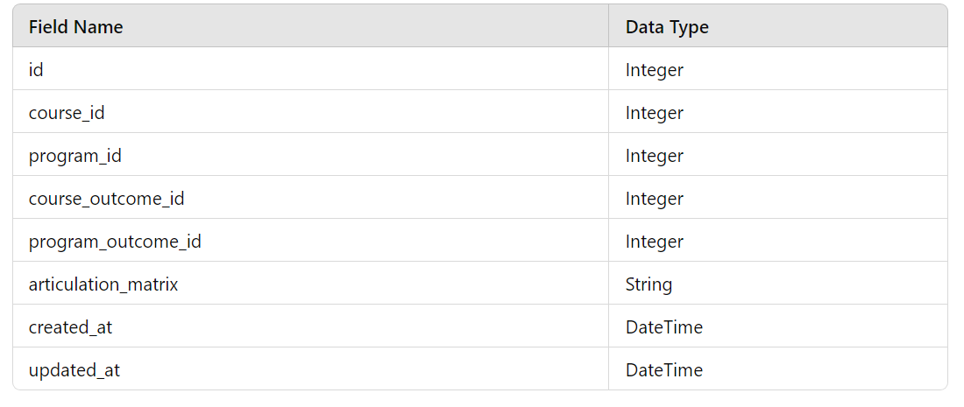
Field/table details: For Programs

Slide 6
Program level objective setting:Programming Details
File name:TEAM_HACKERS_DAA_PROJECT.txt
Function/method name
Input: TEAM_HACKERS _Course_Matrix_input
Display:TEAM_HACKERS_Course_Matrix_display
Sort: TEAM_HACKERS _Course_Matrix_sort
Search: TEAM_HACKERS _Course_Matrix_search
Store: TEAM_HACKERS _Course_Matrix_store

Slide 7
Program_lo :Programming Details
Comparison (both Searching and Sorting):
For Searching - TEAM HACKERS_compare_searching_algorithms
For Sorting - TEAM HACKERS_66compare_sorting_algorithms
Time Complexity (both Searching and Sorting):
For Searching/Sorting - TEAM HACKERS_display_time_complexity

Slide 8
Program_lo :Programming Details
Input: TEAM HACKERS
_Course_Matrix_input
Display: TEAM HACKERS
_Course_Matrix_display
Sort: TEAM HACKERS
_Course_Matrix_sort
Search: TEAM HACKERS
_Course_Matrix_search
Store: TEAM HACKERS
_Course_Matrix_store
Comparison:
Searching: TEAM HACKERS
_compare_searching_algorithms
Sorting: TEAM HACKERS
_compare_sorting_algorithms
Time Complexity:
Searching/Sorting: TEAM HACKERS
_display_time_complexity
Algorithm Details:
For Searching/SortingTEAM HACKERS
_display_pseudocode
File Name:
TEAM_HACKERS_DAA_PROJECT.txt

Slide 9
Sorting Algorithm used
Start
Input matrix of size courses x outcomes
For i = 0 to courses - 1:
For j = i + 1 to courses:
Initialize sum_i = 0 and sum_j = 0
For k = 0 to outcomes - 1:
sum_i += matrix[i][k]
sum_j += matrix[j][k]
If sum_i > sum_j:
For k = 0 to outcomes - 1:
Swap matrix[i][k] and matrix[j][k]
Output sorted matrix
End

Slide 10
Sorting Algorithm used
Selection Sort :
Algorithm:
Step-1: Ask user to choose a field to sort by (code or name).
Step-2:loop from 0 to program_count-1
Step-3: set min_index = I
Step -4:loop from i+1 to program_count
Step-5: if programs[j]<program[j+1] then replace the values of min_index to j
Step-6: swap prorams[i] = programs[min_index]
Step-7: continue the program until complete array to be sorted
Step-8: print success message

Slide 11
Time Complexity of Sorting Algorithm
S.NO | SORTING | TIME COMPLEXITY
01 | QUICK SORT | O(n^2)

Slide 12
SORTED MATRIX ALGORITHM :
Start
Input matrix of size courses x outcomes
For i = 0 to courses - 1:
For j = i + 1 to courses:
Initialize sum_i = 0 and sum_j = 0
For k = 0 to outcomes - 1:
sum_i += matrix[i][k]
sum_j += matrix[j][k]
If sum_i > sum_j:
For k = 0 to outcomes - 1:
Swap matrix[i][k] and matrix[j][k]
Output sorted matrix
End

Slide 13
ALGORITHM FOR COURSE ARTICULATION:
Start
Identify the course to be articulated
Check if the course is in the articulation database
If course is in the database:
Retrieve existing articulation information
Else:
Evaluate the course content for equivalency
If course content is equivalent:
Update the articulation database with new information
Else:
Notify relevant stakeholders of the decision
End

Slide 14
Time Complexity of Searching Algorithm
Sl.No | Algorithm Name | Complexity of Algorithm
01 | Course articulation | O(k)
02 | Sorted matrix | O(kn^2)

Slide 15
OVERVEIW OF THE CODE
#include <stdio.h>
#define MAX_COURSES 5
#define MAX_OUTCOMES 5
// Function to input the matrix
void inputMatrix(int matrix[MAX_COURSES][MAX_OUTCOMES], int courses, int outcomes) {
printf("Enter the course articulation matrix:\n");
for (int i = 0; i < courses; i++) {
for (int j = 0; j < outcomes; j++) {
printf("Matrix[%d][%d]: ", i + 1, j + 1);
scanf("%d", &matrix[i][j]);
}
}
}
// Function to display the matrix
void displayMatrix(int matrix[MAX_COURSES][MAX_OUTCOMES], int courses, int outcomes) {
printf("\nCourse Articulation Matrix:\n");
for (int i = 0; i < courses; i++) {
for (int j = 0; j < outcomes; j++) {
printf("%d ", matrix[i][j]);
}
printf("\n");
}
}

Slide 16
// Function to calculate the sum of a row
int rowSum(int matrix[MAX_COURSES][MAX_OUTCOMES], int row, int outcomes) {
int sum = 0;
for (int i = 0; i < outcomes; i++) {
sum += matrix[row][i]; }
return sum;}
// Quick Sort Helper Functions
void swapRows(int matrix[MAX_COURSES][MAX_OUTCOMES], int row1, int row2, int outcomes) {
for (int i = 0; i < outcomes; i++) {
int temp = matrix[row1][i];
matrix[row1][i] = matrix[row2][i];
matrix[row2][i] = temp;
}
}
int partition(int matrix[MAX_COURSES][MAX_OUTCOMES], int low, int high, int outcomes) {
int pivot = rowSum(matrix, high, outcomes);
int i = low - 1;
for (int j = low; j < high; j++) {
if (rowSum(matrix, j, outcomes) <= pivot) {
i++;
swapRows(matrix, i, j, outcomes);
}
}
swapRows(matrix, i + 1, high, outcomes);
return i + 1;
}

Slide 17
int main() {
int courses, outcomes;
int target[MAX_OUTCOMES];
printf("Enter the number of courses: ");
scanf("%d", &courses);
printf("Enter the number of outcomes: ");
scanf("%d", &outcomes);
int matrix[MAX_COURSES][MAX_OUTCOMES];
inputMatrix(matrix, courses, outcomes);
// Sorting using Quick Sort
quickSort(matrix, 0, courses - 1, outcomes);
printf("\nSorted ");
displayMatrix(matrix, courses, outcomes);
printf("Enter the course articulation to search for:\n");
for (int i = 0; i < outcomes; i++) {
printf("Target[%d]: ", i + 1);
scanf("%d", &target[i]);
}

Slide 18
// Searching using Linear Search
int linearIndex = linearSearch(matrix, courses, outcomes, target);
if (linearIndex != -1) {
printf("Course articulation found using Linear Search at index: %d\n", linearIndex + 1);
} else {
printf("Course articulation not found using Linear Search.\n");
}
// Searching using Binary Search
int binaryIndex = binarySearch(matrix, 0, courses - 1, outcomes, target);
if (binaryIndex != -1) {
printf("Course articulation found using Binary Search at index: %d\n", binaryIndex + 1);
} else {
printf("Course articulation not found using Binary Search.\n");
}
return 0;
}

Slide 19
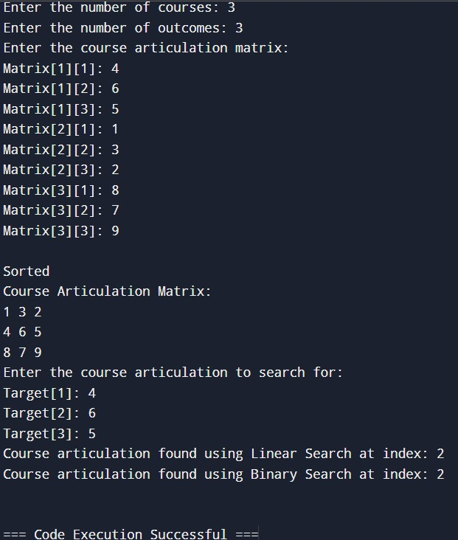
OUTPUT

Slide 20
Conclusion
In the programming section, we designed a comprehensive C program that handles a Course Articulation Matrix. This program includes functionalities for inputting the matrix, displaying it, sorting the courses based on specific criteria, and searching for a particular course articulation. We provided detailed steps to capture screenshots and explained how to document the code with an architecture diagram.
By implementing these concepts, you gained valuable insights into both discrete mathematics and practical programming, enhancing your problem-solving skills and ability to organize and present technical information effectively.

Slide 21


