Slide 1
DAA PROJECT IMPLEMENTION
Module-:Program Level Ojective Setting
Submitted By : TEAM HACKERS
G.AKHIL BABU - AP23110011185
D.ABHIRAM - AP23110011166
CH.PRADNISH - AP23110011198
P.NIDHI CHANDRA - AP23110011200
K.AKASH - AP23110011153
BTECH|CSE-Q|SEMESTER-3|2023-27

Slide 2
Introduction to Project
The Course Articulation Matrix is a critical framework within Outcome-Based Education (OBE) that aligns course objectives and outcomes with program-level goals. It ensures that each course contributes meaningfully to the overall learning outcomes expected from students in a program. By defining a matrix that maps specific course objectives to relevant program outcomes, institutions can measure how well individual courses are supporting broader educational goals.

Slide 3
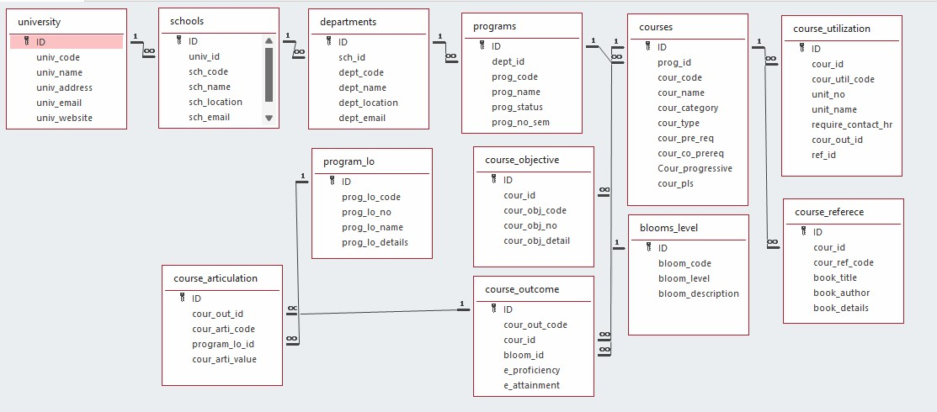

Architecture Diagram

Slide 4
Module Description : Program Level Objective Setting
Module Description
The Course Articulation Matrix program serves as a comprehensive tool for educators and academic institutions to systematically organize, analyze, and evaluate course outcomes. This module is designed to facilitate the input, manipulation, and retrieval of data related to the articulation of course outcomes.
Key Features:
Input Matrix: Populate the matrix with course data.
Display Matrix: Visualize the matrix for clarity.
Sort Matrix: Sort courses based on criteria.
Search Course: Find specific course articulations.
Benefits:
Efficient: Automates data handling.
Organized: Keeps course data accessible.
Analytical: Enhances decision-making.
User-Friendly: Easy to use with clear prompts.

Slide 5
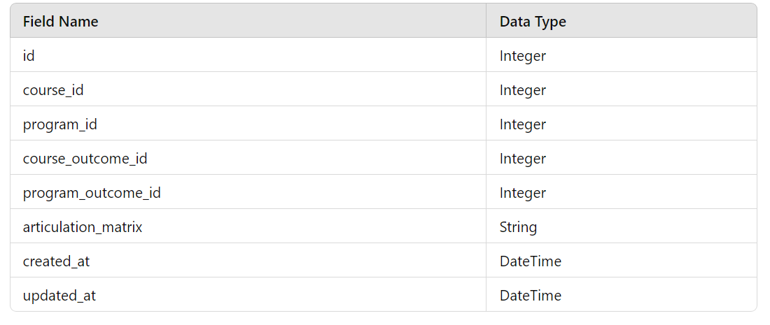
Field/table details: For Programs

Slide 6
Program level objective setting:Programming Details
File name:TEAM_HACKERS_DAA_PROJECT.txt
Function/method name
Input: TEAM_HACKERS _Course_Matrix_input
Display:TEAM_HACKERS_Course_Matrix_display
Sort: TEAM_HACKERS _Course_Matrix_sort
Search: TEAM_HACKERS _Course_Matrix_search
Store: TEAM_HACKERS _Course_Matrix_store

Slide 7
Program_lo :Programming Details
Comparison (both Searching and Sorting):
For Searching - AP23110011166compare_searching_algorithms
For Sorting - AP23110011178_compare_sorting_algorithms
Time Complexity (both Searching and Sorting):
For Searching/Sorting - AP23110011198_display_time_complexity

Slide 8
Program_lo :Programming Details
Input: AP23110011185_Course_Matrix_input
Display: AP23110011185_Course_Matrix_display
Sort: AP23110011200_Course_Matrix_sort
Search: AP231100111200_Course_Matrix_search
Store: AP23110011200_Course_Matrix_store
Comparison:
Searching: AP23110011200_compare_searching_algorithms
Sorting: AP2311001153_compare_sorting_algorithms
Time Complexity:
Searching/Sorting: AP23110011153_display_time_complexity
Algorithm Details:
For Searching/Sorting: AP23110011153_display_pseudocode
File Name:
TEAM_HACKERS_DAA_PROJECT.txt

Slide 9
Sorting Algorithm used
Start
Input matrix of size courses x outcomes
For i = 0 to courses - 1:
For j = i + 1 to courses:
Initialize sum_i = 0 and sum_j = 0
For k = 0 to outcomes - 1:
sum_i += matrix[i][k]
sum_j += matrix[j][k]
If sum_i > sum_j:
For k = 0 to outcomes - 1:
Swap matrix[i][k] and matrix[j][k]
Output sorted matrix
End

Slide 10
Sorting Algorithm used
Selection Sort :
Algorithm:
Step-1: Ask user to choose a field to sort by (code or name).
Step-2:loop from 0 to program_count-1
Step-3: set min_index = I
Step -4:loop from i+1 to program_count
Step-5: if programs[j]<program[j+1] then replace the values of min_index to j
Step-6: swap prorams[i] = programs[min_index]
Step-7: continue the program until complete array to be sorted
Step-8: print success message

Slide 11
Time Complexity of Sorting Algorithm
Sl.No | Algorithm Name | Complexity of Algorithm
01 | Bubble Sort | O(n^2)
02 | Selection Sort | O(n^2)

Slide 12
SORTED MATRIX ALGORITHM :
Start
Input matrix of size courses x outcomes
For i = 0 to courses - 1:
For j = i + 1 to courses:
Initialize sum_i = 0 and sum_j = 0
For k = 0 to outcomes - 1:
sum_i += matrix[i][k]
sum_j += matrix[j][k]
If sum_i > sum_j:
For k = 0 to outcomes - 1:
Swap matrix[i][k] and matrix[j][k]
Output sorted matrix
End

Slide 13
ALGORITHM FOR COURSE ARTICULATION:
Start
Identify the course to be articulated
Check if the course is in the articulation database
If course is in the database:
Retrieve existing articulation information
Else:
Evaluate the course content for equivalency
If course content is equivalent:
Update the articulation database with new information
Else:
Notify relevant stakeholders of the decision
End

Slide 14
Time Complexity of Searching Algorithm
Sl.No | Algorithm Name | Complexity of Algorithm
01 | Course articulation | O(k)
02 | Sorted matrix | O(kn^2)

Slide 15
Overview Code[overview of searching,Sorting,CRUD and Storage options]
// 1. CRUD Operations
void inputMatrix() { /* Create: Inputs new course articulation matrix */ }
void displayMatrix() { /* Read: Displays the course articulation matrix */ }
void sortMatrix() { /* Update: Sorts the course articulation matrix */ }
void searchCourse() { /* Read: Searches for a specific course articulation in the matrix */ }
// 2. Sorting (e.g., by sum of elements in rows)
void sortMatrix(int matrix[MAX_COURSES][MAX_OUTCOMES], int courses, int outcomes) {
// Sorts matrix rows based on the sum of their elements
for (int i = 0; i < courses - 1; i++) {
for (int j = i + 1; j < courses; j++) {
int sum_i = 0, sum_j = 0;
for (int k = 0; k < outcomes; k++) {
sum_i += matrix[i][k];
sum_j += matrix[j][k];
}
if (sum_i > sum_j) {
for (int k = 0; k < outcomes; k++) {
int temp = matrix[i][k];
matrix[i][k] = matrix[j][k];
matrix[j][k] = temp;
}
}
}
}
}

Slide 16
// 3. Searching (e.g., by course articulation)
int* searchCourse(int matrix[MAX_COURSES][MAX_OUTCOMES], int courses, int outcomes, int target[MAX_OUTCOMES]) {
for (int i = 0; i < courses; i++) {
int found = 1;
for (int j = 0; j < outcomes; j++) {
if (matrix[i][j] != target[j]) {
found = 0;
break;
}
}
if (found) {
return matrix[i]; // Return pointer to found course articulation
}
}
return NULL; // Not found
}

Slide 17
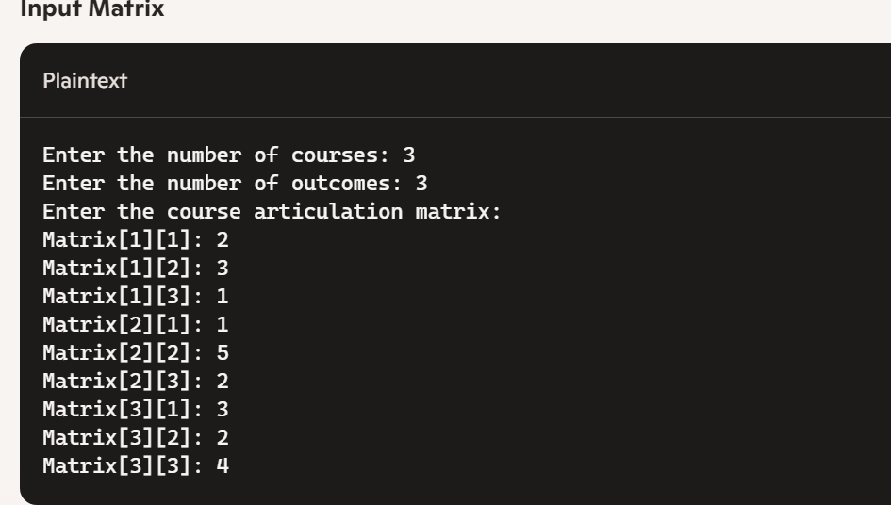
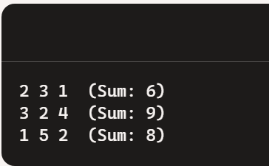
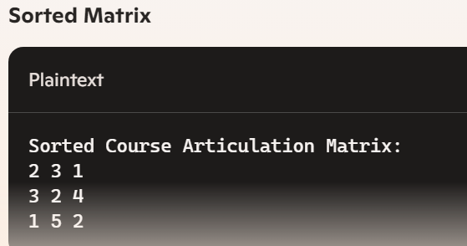
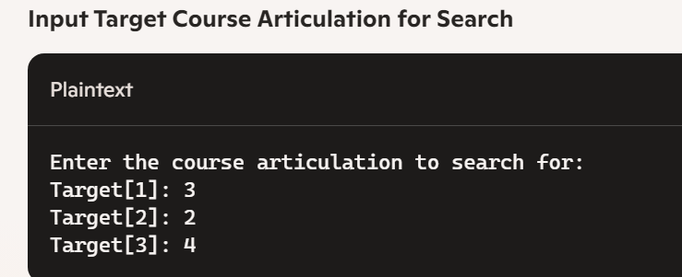
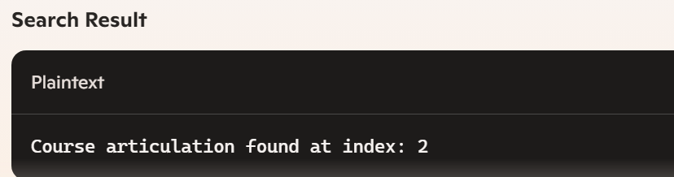
screenshots

Slide 18
Conclusion
In the programming section, we designed a comprehensive C program that handles a Course Articulation Matrix. This program includes functionalities for inputting the matrix, displaying it, sorting the courses based on specific criteria, and searching for a particular course articulation. We provided detailed steps to capture screenshots and explained how to document the code with an architecture diagram.
By implementing these concepts, you gained valuable insights into both discrete mathematics and practical programming, enhancing your problem-solving skills and ability to organize and present technical information effectively.

Slide 19


