Slide 1

Google Playstore apps analysis
TEAM -TYRANT
AKHIL AIE19049
AIShWARYA AIE19068
TANUJ AIE19041

Slide 2
OBJECTIVES
1. Dataset
01
2. Machine Learning Theory
02
3. Implementation steps
03
4. Data Visualization
04
5. Regression models implementation
05
6. Conclusion
06

Slide 3
Dataset
Data set from Kaggle
(10841 rows× 13 columns)
https://www.kaggle.com/lava18/google-play-store-apps

Slide 4

Machine learning algorithms
Linear regression
Random Forest

Slide 5
Linear Regression
Linear regression is perhaps one of the most well-known and well understood algorithms in statistics and machine learning
Attempts to model the relationship between two variables by fitting a linear equation to observed data.
Allows you to learn the role of each independent variable without worrying about the other variables in the model.
Predicted output is continuous and has a constant slope.
Prediction of App Ratings

Slide 6
Random forest Regression
Random forests
Random forest classifier.
Accuracy
The mode of the classes or mean/average prediction of the individual trees
Prediction of app Ratings
Results

Slide 7
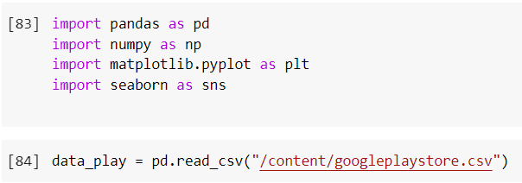
IMPLEMENTATION
IMPLEMENTATION

Slide 8
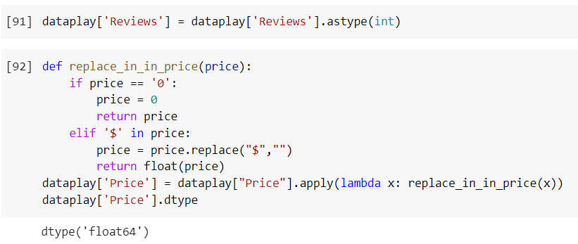
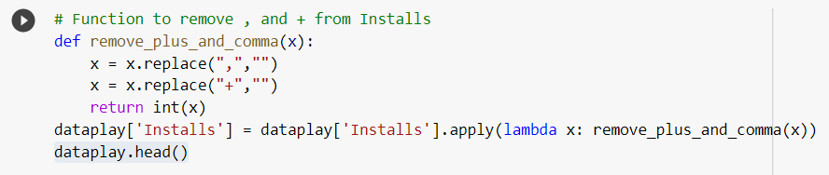
Changes Made In Dataset

Slide 9
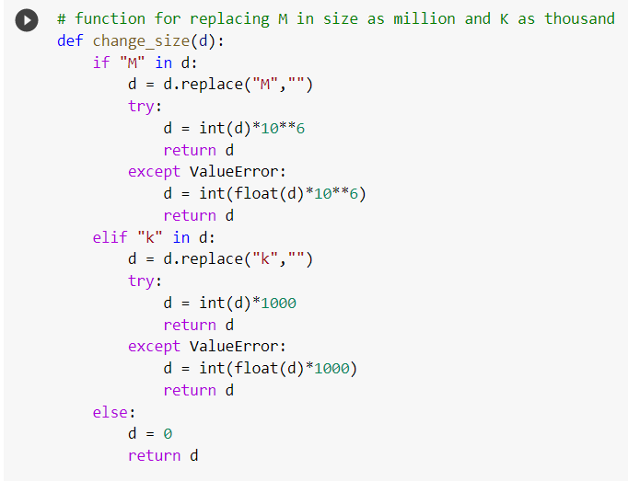

Slide 10
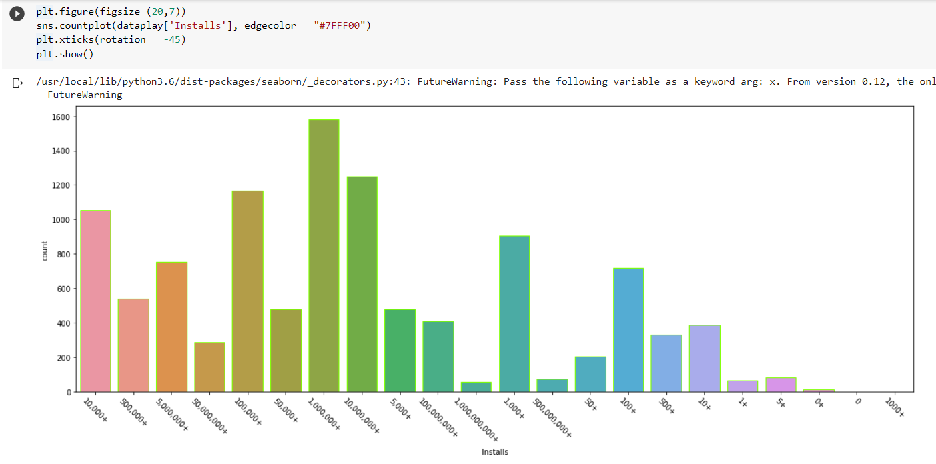
DATA VISUALIZATION

Slide 11
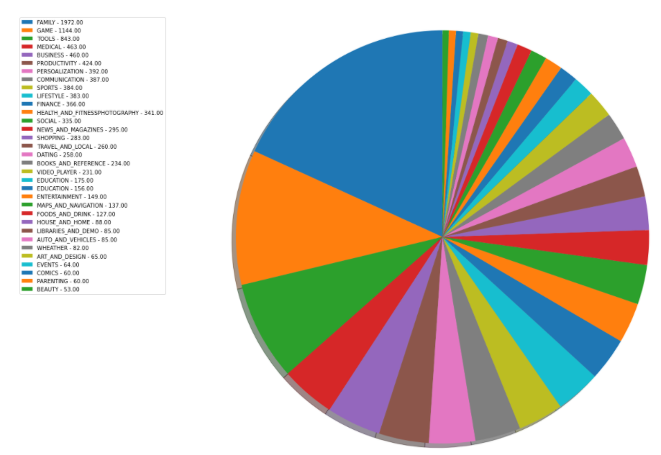
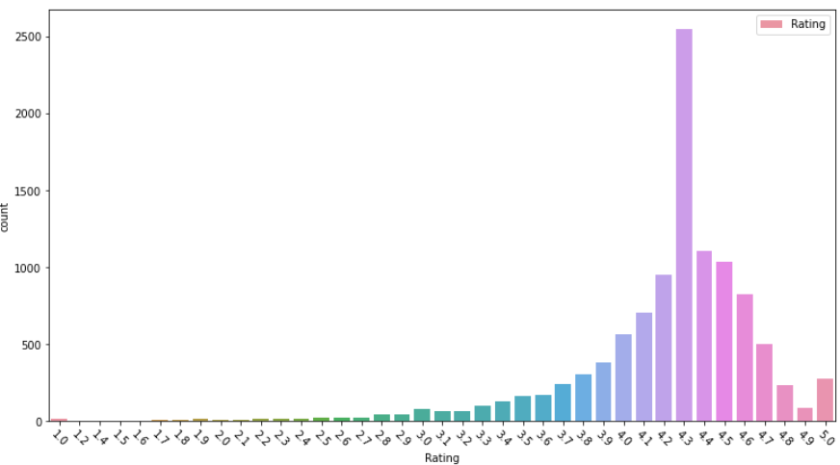
visualizing ratings of apps
visualizing categories of apps

Slide 12
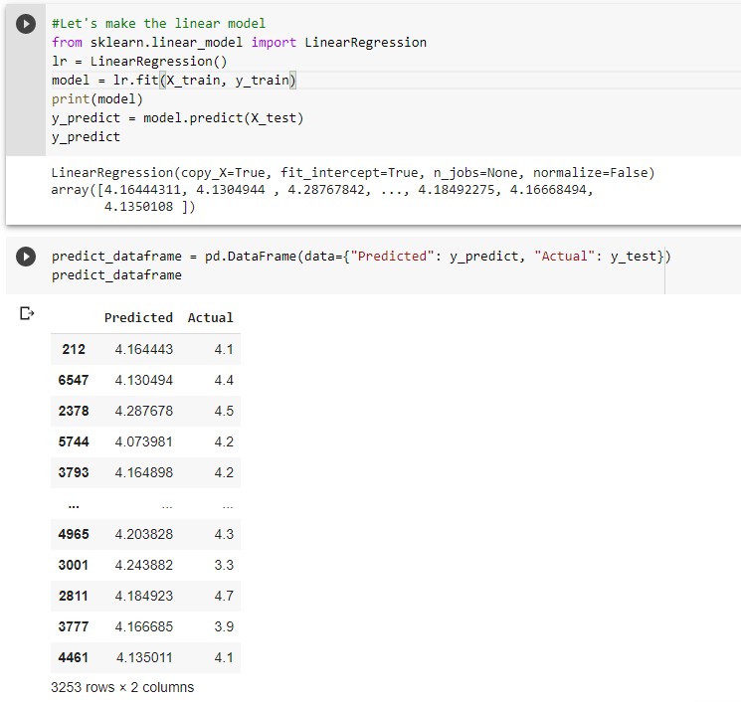
Linear regression

Slide 13
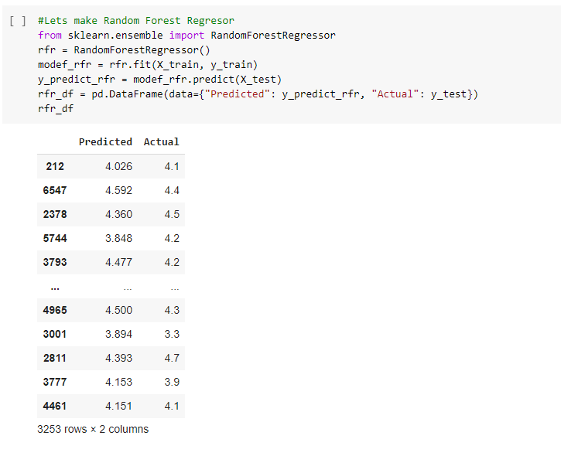
Random forest regression

Slide 14
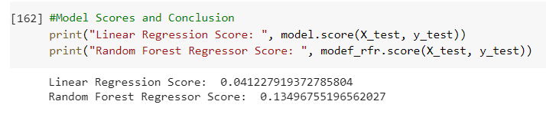
Comparing the scores

Slide 15
Conclusion
Thus, we have done the data analysis of many features of the Google Play Store Apps which include installs, reviews, size, prices, ratings, payment, versions, etc.
App ratings were predicted using Linear Regression model.
App ratings were predicted using Random Forest Regression model.
Both the models were finally compared using model scores, opting the best model for prediction of App Ratings in Google Play Store.
And regarding further approaches, we could do the prediction using Ridge regression and Support vector regression as well.

Slide 16

Thank You

