Slide 1

Visualization of Heterogenous Network of Publication Data
Advisors: Dr.Chunjiang Zhu, Dr.Lixin FU
Vaishnavi Peddireddy,

Slide 2

Introduction
Utilizing the PubMed dataset to create a graph-based representation and apply community detection algorithms and also applied the same to ACM dataset.
Objectives:
Graph-based dataset representation
Community detection algorithm application
Development of interactive visualizations

Slide 3

Environment Setup
Software and Libraries Used:
Python 3.8
NetworkX
Pyvis
MongoDB

Slide 4
Data Preparation
Approach: Reverse engineering techniques from the link.dat dataset for the ACM dataset.
Key Steps:
Edge List Reading Technique adaptation
Integration of Edge Attributes
Normalization and Cleaning

Slide 5
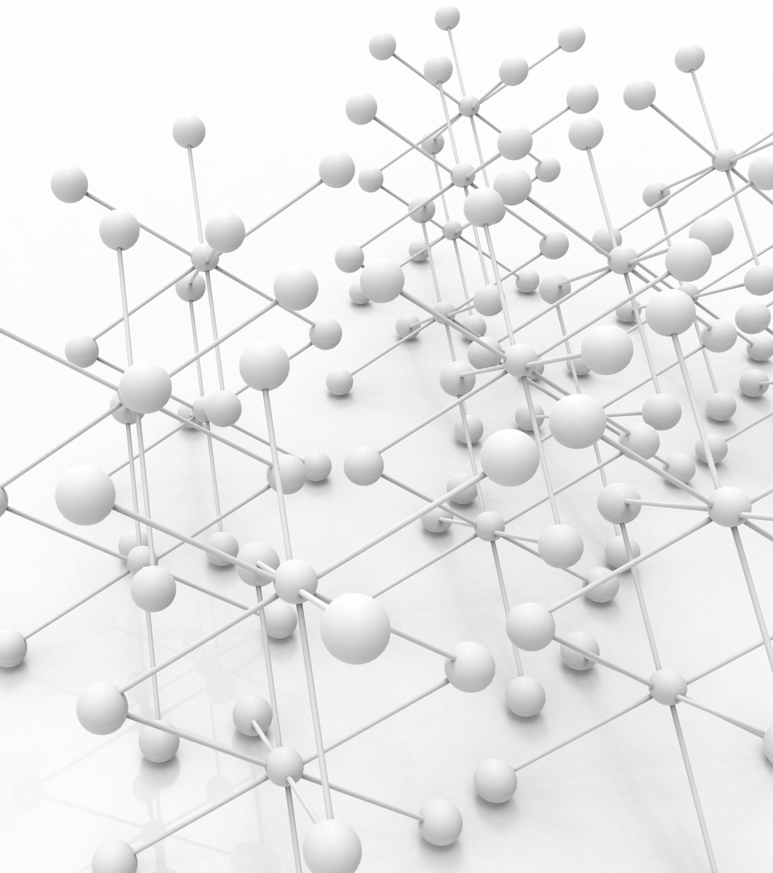
Graph Construction
Methodology: Utilizing NetworkX for directed graph creation, representing entities like authors, papers, and venues.
Nodes and Edges: Authors, papers, venues, and their relationships.

Slide 6
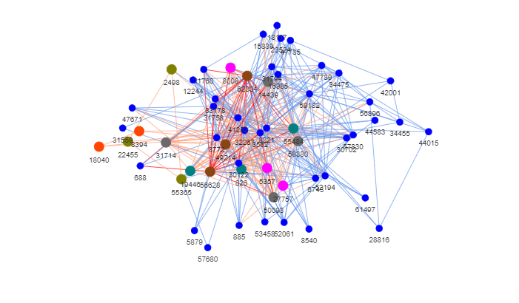
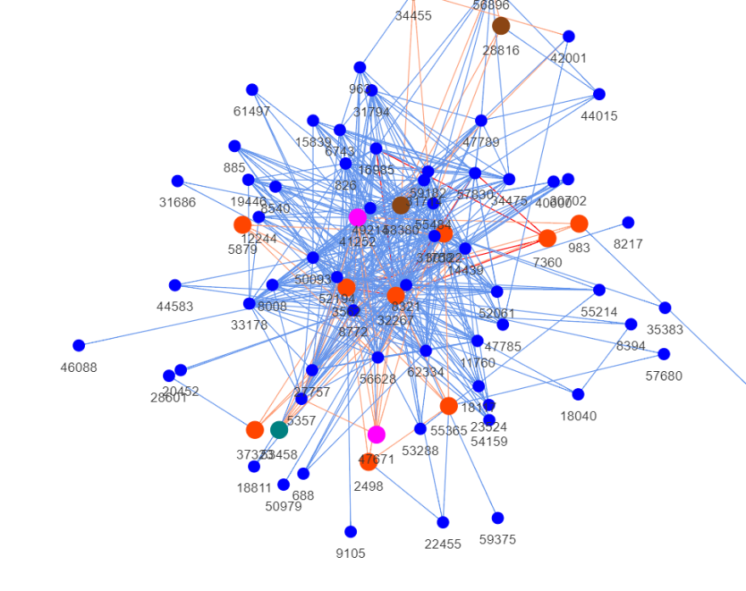
Visualization Using PubMed Dataset
Visualization Using PubMed Dataset
Graphs: Displaying top and bottom 12 node pairs and their neighbors.
Top 12 Bottom 12

Slide 7
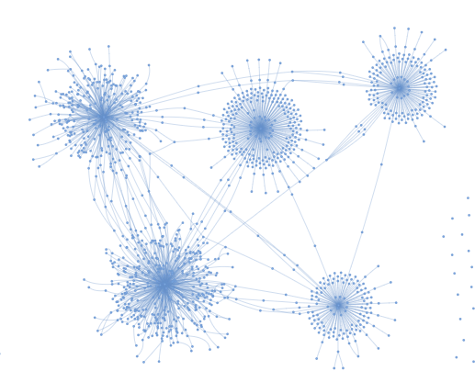
Visualization Using ACM Dataset
Visualization Using ACM Dataset and performing clusters

Slide 8

Querying the Graph
Purpose: Extracting actionable insights from complex networks.
Techniques: Utilizing MongoDB for querying graphs.

Slide 9
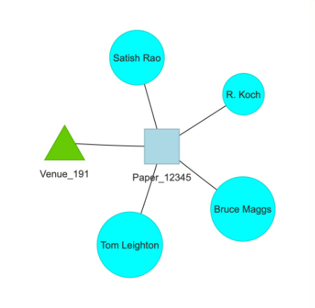
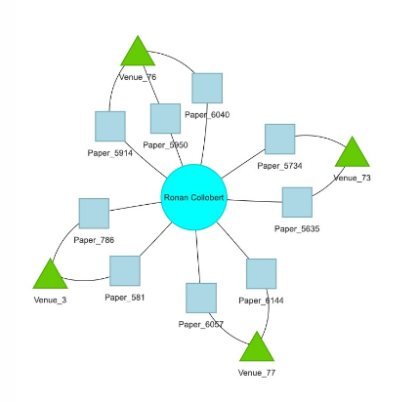
User Interface : Visualization
The visualization outputs for the user input in the web interface.

Slide 10
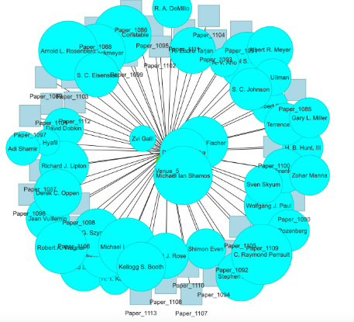
User Interface : Visualization
The visualization outputs for the user input in the web interface.

Slide 11

Advanced Topics
Challenges in handling large datasets and potential technologies

Slide 12

Troubleshooting
Data preparation hurdles
Graph construction challenges
Database integration snags
Visualization pitfalls

Slide 13

Acknowledgments
Acknowledgments to mentors, team members, and the open-source community

Slide 14
Conclusion
Reflections: Insights gained, accomplishments, and future directions.
Key Accomplishments:
Constructing a complex heterogeneous graph
Effective data preprocessing, analysis, and visualization
Integration of advanced machine learning techniques

Slide 15

Apoorva Tangirala’s master project under supervision of Dr.Chunjiang Zhu.
Perrone, Giancarlo, Jose Unpingco, and Haw-minn Lu. "Network visualizations with Pyvis and VisJS." arXiv preprint arXiv:2006.04951 (2020).
Perrone, G., Unpingco, J., & Lu, H. M. (2020). NETWORK VISUALIZATIONS WITH PYVIS AND VISJS. arXiv preprint arXiv:2006.04951.
Perrone, Giancarlo, Jose Unpingco, and Haw-minn Lu. "NETWORK VISUALIZATIONS WITH PYVIS AND VISJS." arXiv preprint arXiv:2006.04951 (2020).
Perrone, G., Unpingco, J. and Lu, H.M., 2020. NETWORK VISUALIZATIONS WITH PYVIS AND VISJS. arXiv preprint arXiv:2006.04951.
Perrone G, Unpingco J, Lu HM. NETWORK VISUALIZATIONS WITH PYVIS AND VISJS. arXiv preprint arXiv:2006.04951. 2020 Jun.
References and citations

