Slide 1
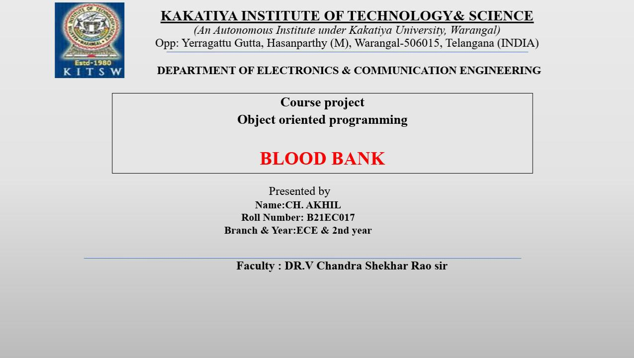

Slide 2
Blood bank
Be the reason for someone’s heartbeat!

Slide 3

Introduction
Blood is essential element of life,we need to donate blood to help peoples.
Here presenting the online blood bank.
This project idealised the blood bank database.
The database of blood bank system project will stores,
the information of people who are willing to donate their blood.

Slide 4
Aims and objectives:
We aim to bridge the gap between blood donors and acceptors.
We’ll displaying the donor details.
Details of those registered with us,to be useful for people who are searching for blood donors.

Slide 5
Software system configuration:
Operating system. : Windows
Application Server. : Apache-Tomcat-7.0.37
Front End. :HTML,JAVA,JSP
Database connectivity : Oracle

Slide 6
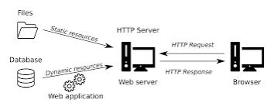

Slide 7
BLOOOD BANK
New login
New login
Donor login
Acceptor login
Taking donor details
Taking donor details
Comparing
Donor and acceptors details
Thank you!
Results!

Slide 8
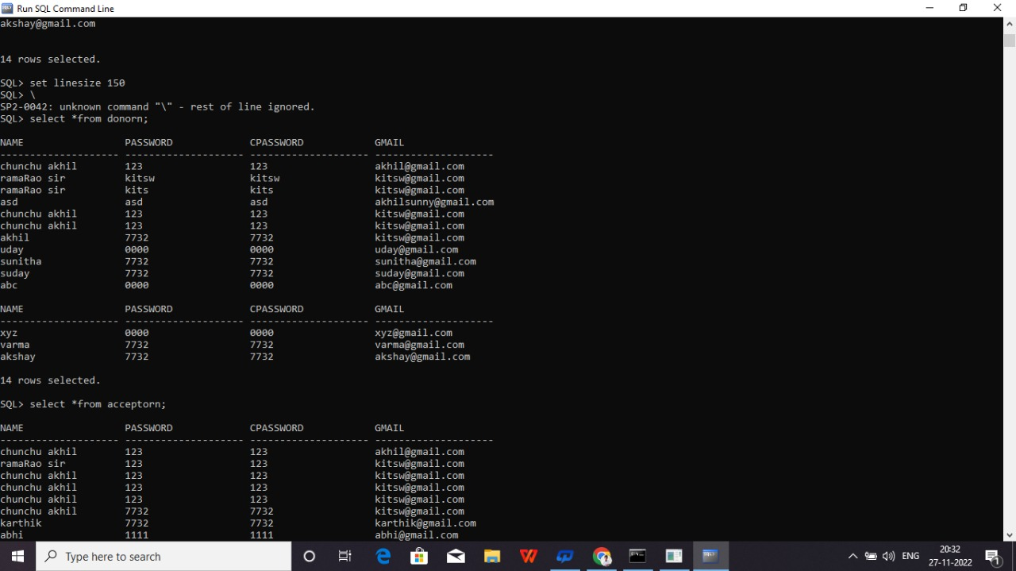
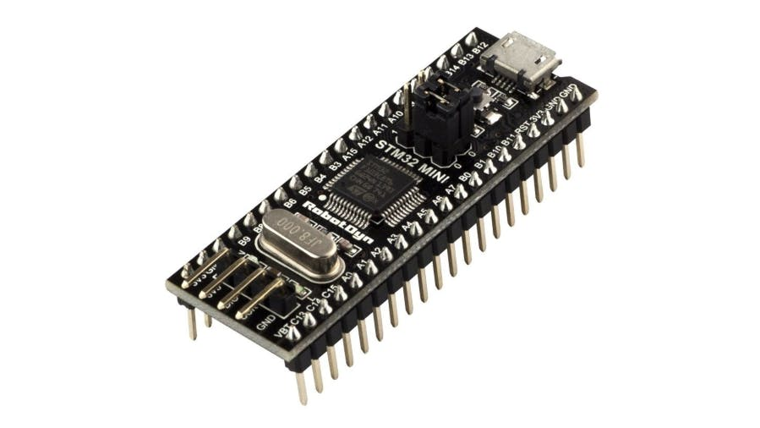
Proposed method and design
This Photo by Unknown Author is licensed under CC BY-SA

Slide 9
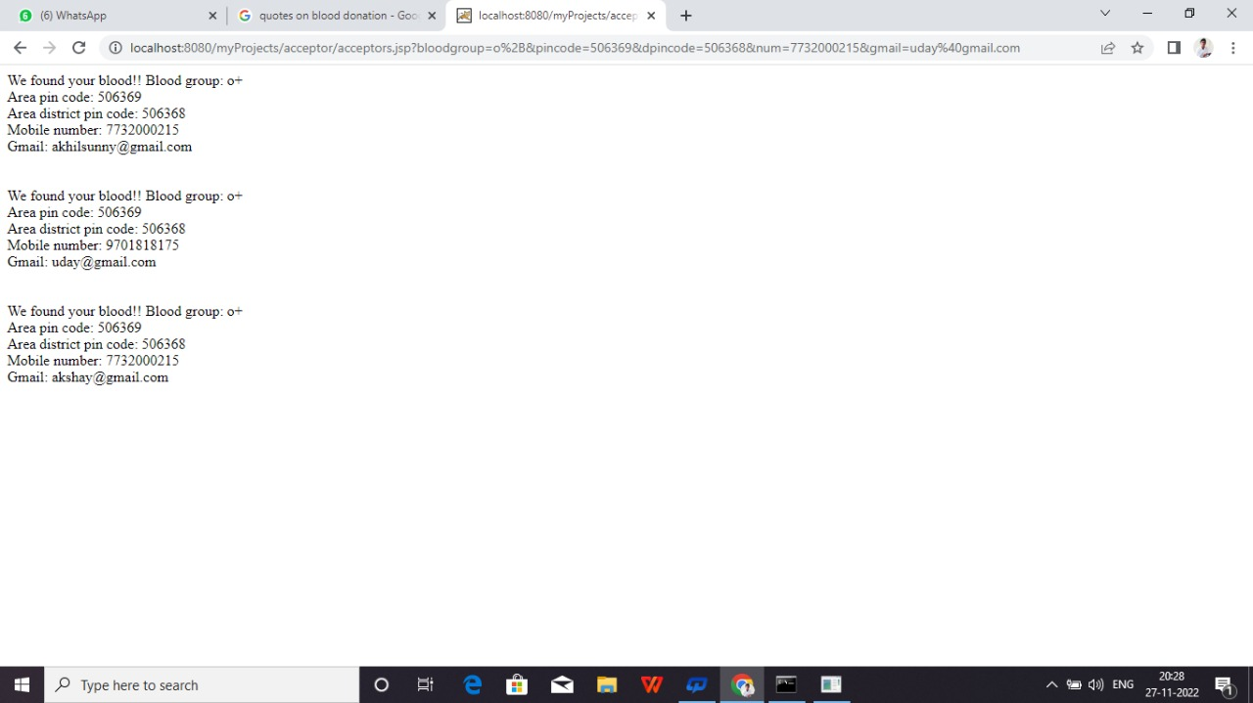

Slide 10


conclusion
By this project a blood acceptor can easily and fastly gets the Donor details.
Without any paperwork and user friendly..

Slide 11
REFERENCES
Faculty co-ordinators:
Dr.V.Chandra Shekar sir ,
Rama Rao sir,
https://www.javatpoint.com
https://www.w3schools.com/js/js_graphics_chartjs.asp
https://www.w3schools.com/
https://youtu.be/HcOc7P5BMi4
https://youtu.be/9zzX2fbkzWU

Slide 12

THANK YOU

