Slide 1

Sleep Optimization App
Presented by:
Akhil Yadati
Sathvika Muthyala
Sai Kiran Nunna

Slide 2
Introduction
Sleep is essential for good health and well-being. Many people struggle to get enough rest, leading to negative impacts on their health.
Our Opt Sleep app aims to improve sleep quality through data-driven insights and actionable recommendations. The app integrates the Google Fit API to provide a seamless experience for users to monitor and optimize their sleep patterns.
Our app also has a Feature called Smart Alarm which recommends the time to the user to set alarm

Slide 3

Main Features
1. Sleep Data Tracking
- Uses Google Fit API to fetch sleep data.
2. Sleep Score Calculation
- Provides personalized sleep scores based on sleep duration and interruptions.
3. Recommendations
- Offers actionable suggestions to improve sleep quality.
4. Smart Alarm
- Recommends optimal alarm times aligned with sleep cycles.

Slide 4
How It Works
1. Sign in using Google.
1
2. Fetch sleep data for the past week using Google Fit API.
2
3. Calculate total sleep time and interruptions.
3
4. Display a sleep score and actionable recommendations.
4
5. Recommends time to the user to set alarm .
5

Slide 5


Technologies Used
1. Kotlin and xml.
2. Google Fit API for sleep data tracking
3. Android Studio for development
4. Material Design for user interface
5. Firebase for authentication and data storage

Slide 6
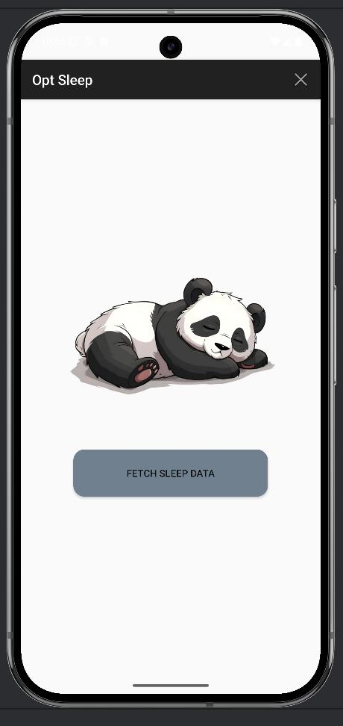
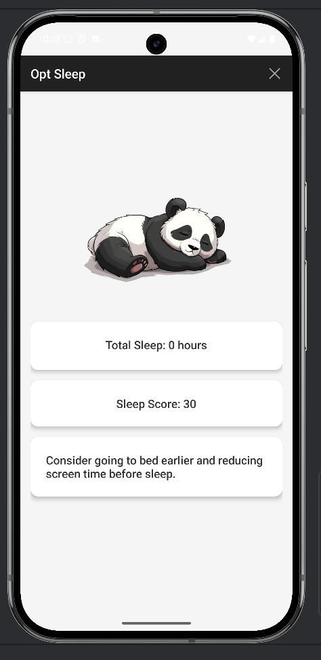
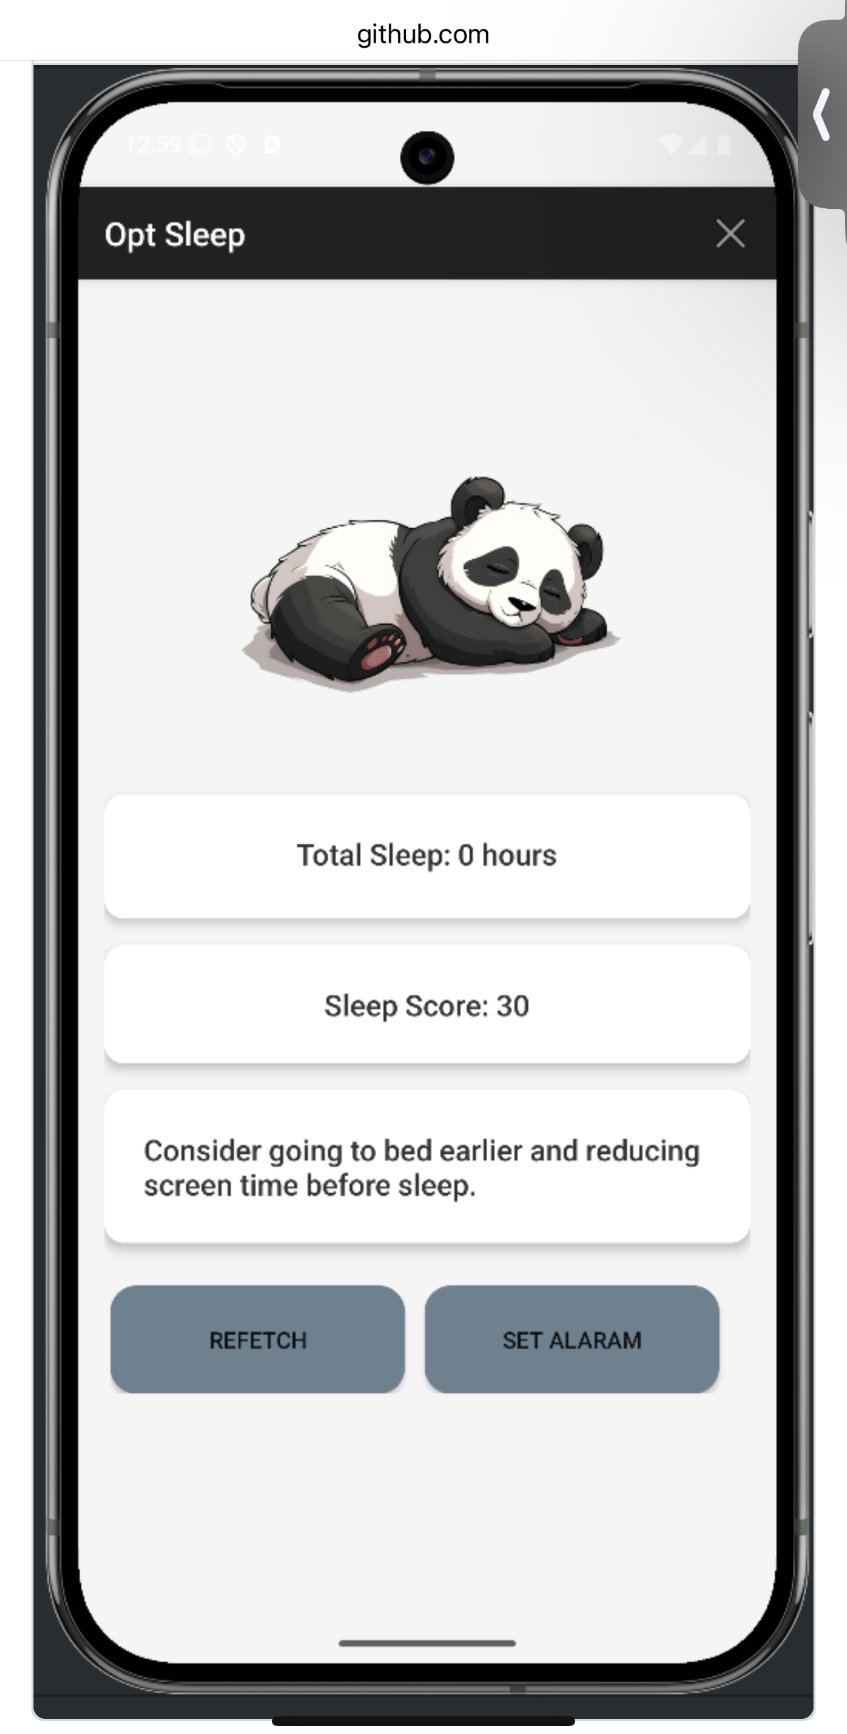
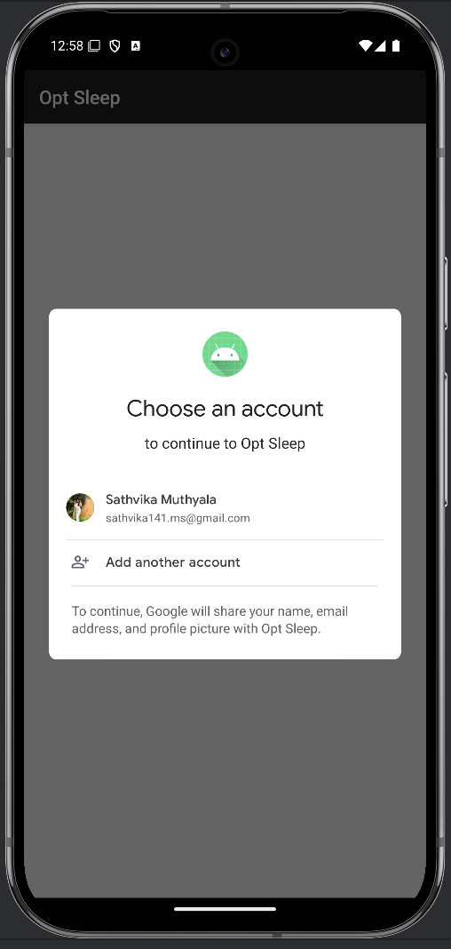
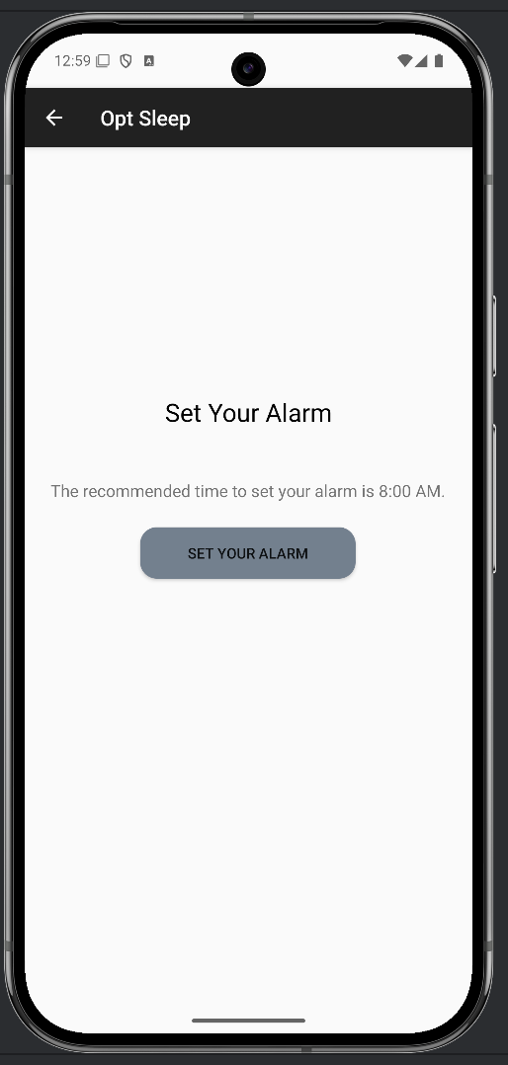
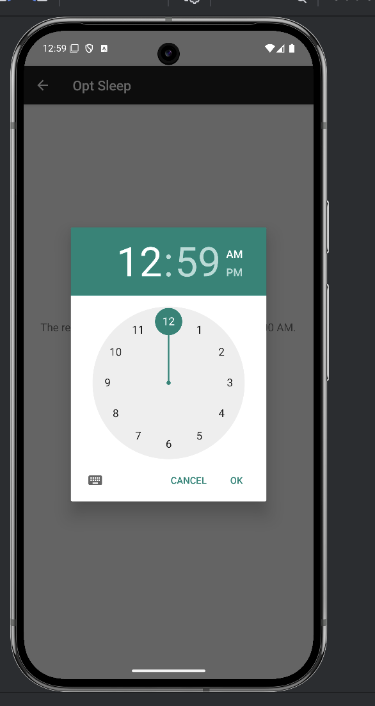
Screens

Slide 7

Achievements
1. Successfully integrated Google Fit API for data retrieval.
2. Fulfilled project requirements including:
- Kotlin development
- Use of Firebase - secure authentication.
3. Met deadlines and ensured robust functionality.

Slide 8

Conclusion
Opt Sleep provides users with a seamless and data-driven experience to improve their sleep quality. By leveraging modern technologies like Google Fit API, Kotlin, and Firebase, the app delivers personalized insights and actionable recommendations.
The project demonstrates a strong understanding of mobile application development and a commitment to improving user health and well-being.

