Slide 1
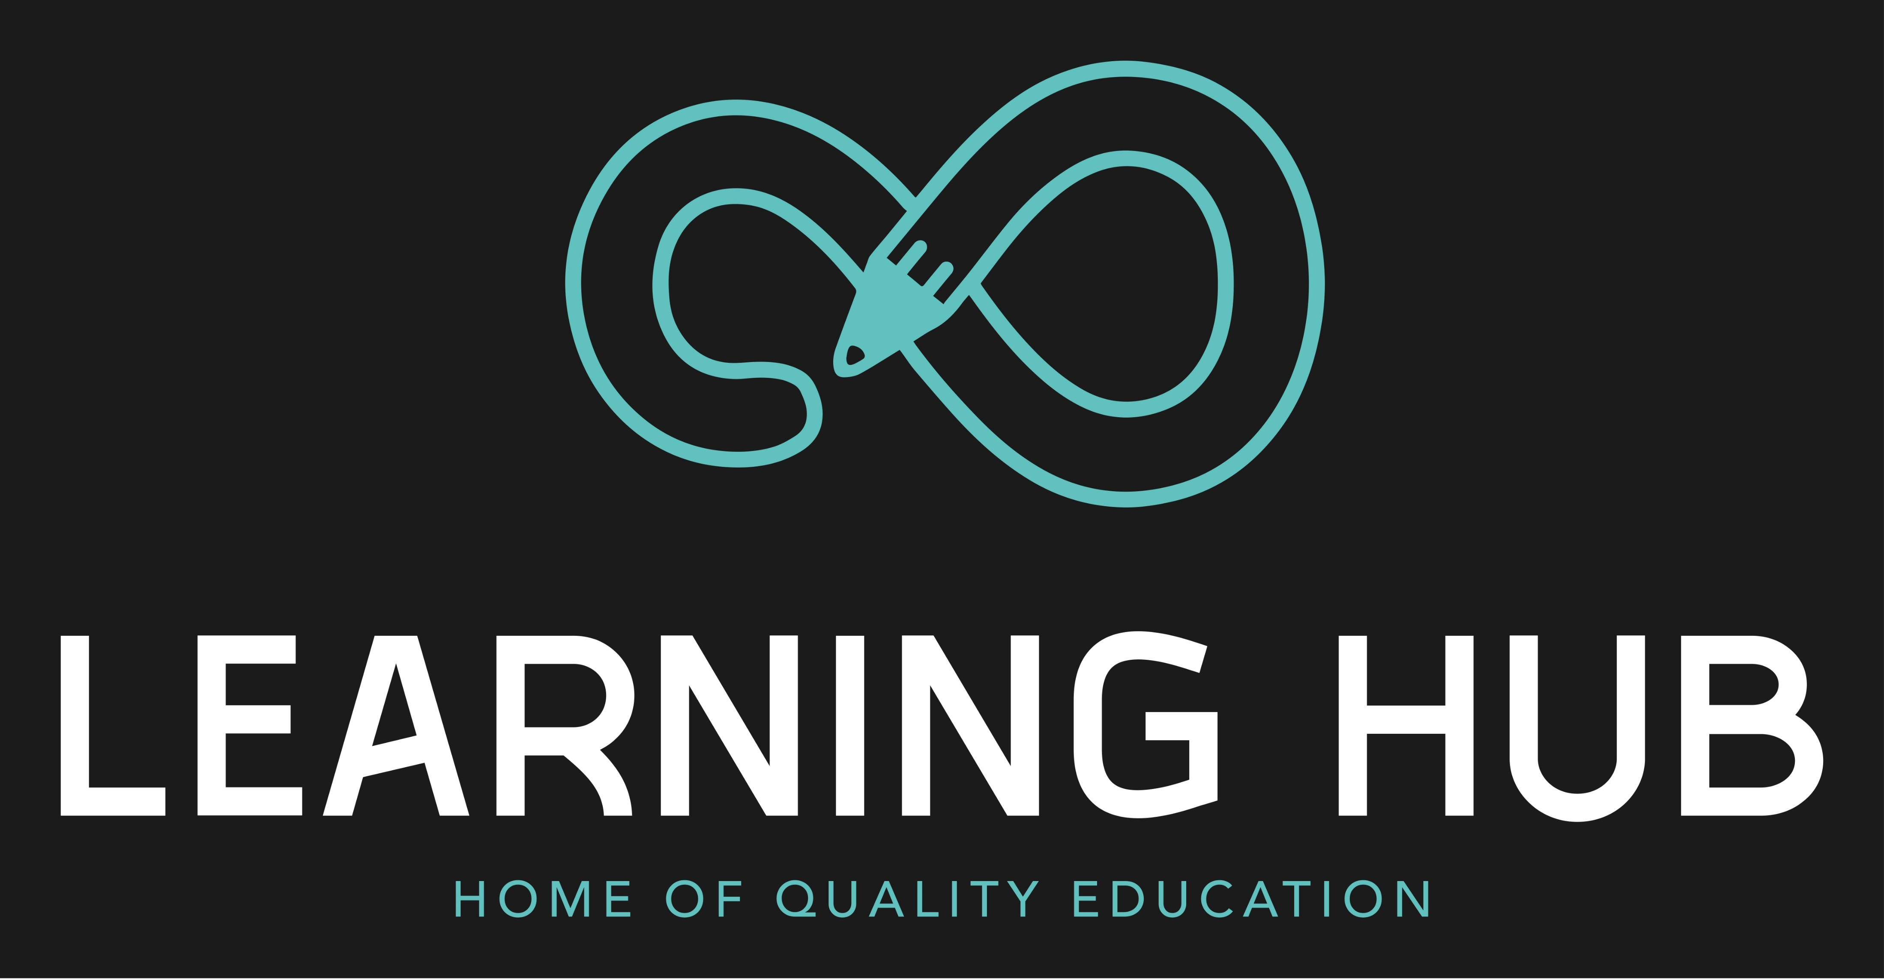

Slide 2

TEAM MEMBERS
A.AKHIL
M.HARSHA VARDHAN

Slide 3

OVERVIEW OF THE PROJECT
Our MERN stack project is about Global Online Learning Platform where every individual can learn easily.
As a global destination for online learning, we empowering individuals with flexible and effective skill development.
As we are the global online teaching platform we had several cources TECHNICAL like EMBEDDED SYSTEMS,PYTHON FULL STACK and JAVA etc.
NON-TECHNICAL like PIANO MUSIC LESSONS AND GUITAR
MUSIC LESSONS etc.

Slide 4
TECHNOLOGIES USED IN OUR PROJECT
HTML: It is a HYPER TEXT MARKUP LANGUAGE it is used to Create a web site and it will structure the webpages.
CSS: It stands for CASCADING STYLE SHEET It's a computer language that's used to structure and lay out web pages. CSS is a cornerstone technology of the World Wide Web, along with JavaScript and HTML.
MongoDB: Used as the database to store various types of information, including user data, course content, assessments, and progress tracking details.

Slide 5
Express.js: Serves as the back-end framework to handle server-side logic, routing, and interactions with the database. It manages the application's business logic, authentication, and authorization.
React: Acts as the front-end framework responsible for the user interface and user experience. React allows for the creation of interactive, dynamic, and responsive web interfaces for learners, instructors, and administrators.
Node.js: The server-side runtime environment that executes JavaScript code. It powers the server and enables running JavaScript on the server, ensuring smooth communication between the client-side and server-side components of the application.

Slide 6
CHALLENGES FACED
As a project creaters we faced the challenges while creating and maintaining the databases and In while doing redux part and routing the web pages.
Creating an user-friendly interface requires careful planning and design iterations. Ensuring a seamless and enjoyable learning experience for users from diverse backgrounds and technical proficiencies can be challenging.

Slide 7
ADVANTAGES OF THE PROJECT
REPEATED ACCESS TO COURSE MATERIALS
PERSONALISED EDUCATION
ONLINE CLASSES ARE MORE FLEXIBLE
ONLINE CLASSES HAVE MORE INTERACTION WITH TRAINERS

Slide 8
DISADVANTAGES OF THE PROJECT
ONLINE LEARNING REQUIRE SELF DISCIPLINE
ONLINE CLASSES ARE PRONE TO TECHNICAL ISSUES
ONLINE CLASSES REQUIRES MORE SCREEN TIME

Slide 9
CONCLUSION
The online learning platforms can have a positive impact on higher education. It can provide students with access to educational resources at any time and at their own pace.

Slide 10


